Slide 1
The Great Depression
Dr. Anjali Dash (MA, Mphil, PhD, Post-Doctorate)
Assistant Professor (Economics)
School of Management, CUTM, BBSR
anjali.dash@cutm.ac.in
Notes:
Section I: Impact of OOPE on Poverty
Section: Cost of hospitalization in Bihar and Tamil Nadu by source
Section: Cost of delivery care by source in Bihar

Slide 2
Causes of the Great Depression
During the 1920s, many Americans believed that the U.S. was a place of unlimited growth, opportunity, and achievement.
Americans were earning more money than ever – national income rose from $61 billion to $87 billion
Many economic analysts and business executives felt that the stock market was the key to prosperity and urged American citizens to invest as much as possible
Consumerism: spending more money than they were saving

Slide 3
Depression foreshadowed
By late 1929, cracks were beginning to show in the U.S. economy…unemployment was on the rise, farmers were losing their land, and stock prices were dropping.
Five key factors:
Unchecked stock speculation
Weak and unregulated banking institutions (Bank failure)
Overproduction of goods
The decline of the farming industry
Unequal distribution of wealth

Slide 4
Cause #1: Republican policies
President Coolidge’s economic policy: “The business of America is business”
Trickle-down economics (from wealthy to middle and lower classes) and a conservative approach to international economics
Benefit big business first, get to the American people eventually
WWI (World war-I) – US lent too much money ($11 billion) to its European allies that were in financial ruins

Slide 5
Cause #1: Speculation and “Buying on Margin”
The practice of speculation-in which a person or organization makes a risky investment in the hope of making a quick, large profit-was widespread in the 1920s.
Many investors speculated on real estate
Purchasing stock on margin: paying a fraction of its worth with a promise to pay the rest once the stock was sold…aka borrowing money to purchase stocks
People overextended themselves to buy cars, homes, and stocks
This works if the stock price goes up, but is disastrous if the stock price falls
Many speculators of the 1920s borrowed 90% of the stock’s value
(If a stock cost $100, you would borrow $90. If the stock price began to fall, you would then have to pay back the money you borrowed-which many speculators didn’t have!)

Slide 6
Cause #2: Stock Market Crash/Banking Industry Collapse
Analysts’ warnings that the bull market (a market in which prices are constantly rising) could not continue indefinitely made some investors nervous.
Oct 28, 1929, investors rushed the stock exchange and sold their stocks at a loss of over $4 billion. On Oct 29, known as “Black Tuesday” orders to sell at any price swamped over the stock market.

Slide 9
Unregulated Banking Institutions
The stock market crash triggered a collapse of the U.S. banking industry, which had grown increasingly unable over the course of the 1920s.
This instability was due in part to banks’ over-extension of credit to stock investors and brokers.
Bank reserves depleted quickly and as the Depression deepened, many banks had no assets, no cash reserves, and no new money coming in.
Hundreds of banks immediately closed their doors after the market crashed, and by 1932 one fourth of the nation’s banks had closed—almost 6,000 banks

Slide 10
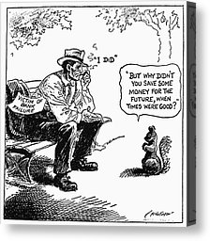

Slide 11
Cause #3: Overproduction
Before 1929, American industrial production seemed to parallel the course of the stock market: it kept going up.
Consumer demand for goods was very high after WWI.
Newly invented machines allowed U.S. factories to produce more goods in less time.
American industrialists believed in unrestricted capitalism and unrestricted growth (facilities expanded, increased production, flooded the market with goods)
By 1929, many companies had more plants than they actually needed, and the market was saturated with goods that few Americans could afford to buy

Slide 12
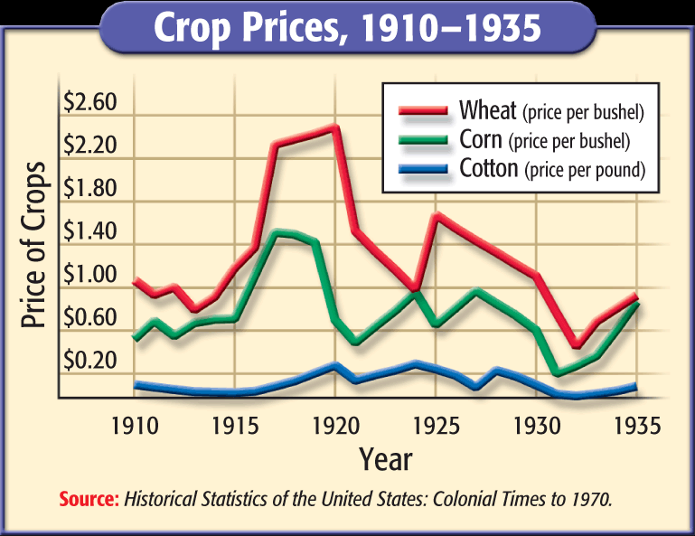

Slide 13
Cause #4: Under-consumption (Toll on Farming Industry)
During the 1920s, farmers borrowed heavily from banks to pay for new, technologically advanced equipment.
As farmers failed to sell their surplus crops, they became unable to repay their bank loans, including their mortgages.
As a result, many farmers defaulted on their loans and some lost their farms due to bank foreclosures
Farmers situations grew worse….Dust Bowl

Slide 14
Cause #5: Unequal Distribution of Wealth
While statistics showed that Americans were more prosperous than ever during the 1920s, most of the country’s wealth remained in the hands of a few people at the top of the economic pyramid.
As the decade went on, the gap grew wider and the distribution of wealth grew increasingly unequal – the prosperity & wealth of the 1920s was not experienced by all.
1929, the Federal Trade Commission reported that 1% of the American population possessed over 59% of the country’s wealth

Slide 15
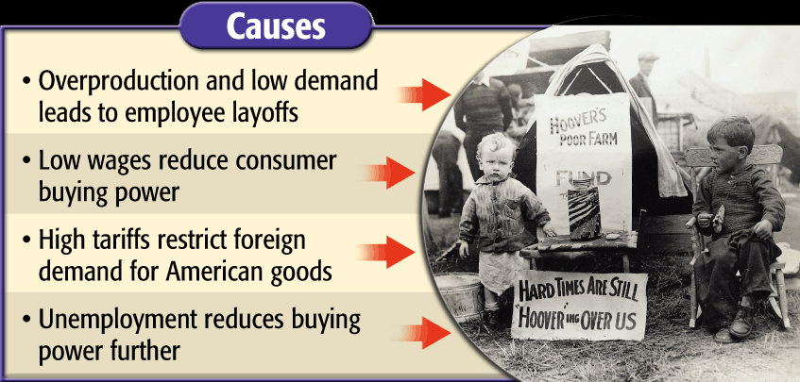
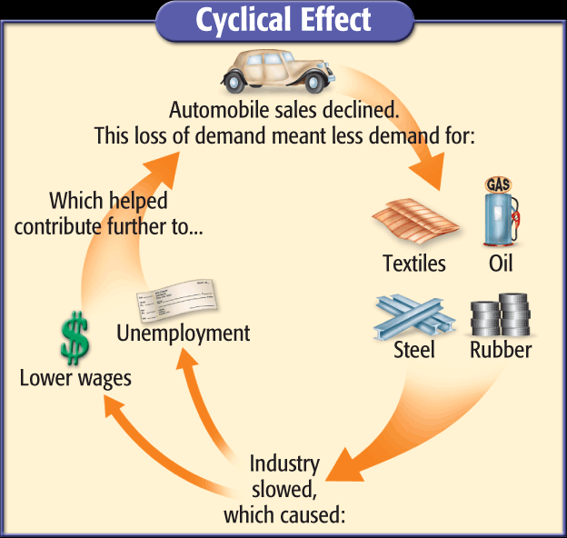
Causes of the Great Depression

Slide 16
The Great Depression in India
The Great Depression in India was a period of economic depression in the Indian subcontinent.
Beginning in 1929 in the United States, the Great Depression soon began to spread to countries around the globe.
A global financial crisis, combined with protectionist policies adopted by the colonial government resulted in a rapid increase in the price of commodities in British India.
During the period 1929–1937, exports and imports in India fell drastically, crippling seaborne international trade in the region; the Indian railway and agricultural sectors were the most affected by the depression.

Slide 17
India at the onset of the Depression
India was one of the foremost suppliers of raw materials during the First World War.
India provided large quantities of iron, steel and other material for the manufacture of arms and armaments.
Manufacturing units were gradually established and for the first time, the British Raj adopted a policy of industrialization.
India acted both as a supplier as well as a sprawling market for finished British goods in order to sustain Britain's wartime economy.
When the war came to an end, the Montagu-Chelmsford reforms were enacted in order to provide certain concessions to Indians in return for their loyalty to the Empire during the war.
In 1923, the British Raj offered government protection to nine industries posing them as a sincere bid to industrialize the economy.
At the onset of the Great Depression, as it had been always, much of India's imports were from the United Kingdom.

Slide 18
Impact of the Great Depression
The price decline from late 1929 to October 1931 was 36 percent compared to 27 percent in the United Kingdom and 26 percent in the United States.
Economic policy of the Raj during the Depression (There was a deficiency of money in many places causing widespread poverty)
International trade (The imports fell by over 47% while the exports fell by over 49% between 1929 and 1932. Between 1928–29 and 1933–34, exports due to seaborne trade decreased by 55.75% to Rs. 1.25 billion while imports decreased by 55.51% to Rs. 2.02 billion).
Impact on the Railways ( the railway revenues decreased exponentially)
Dealing with home charges
The Great Depression had a devastating impact on Indian farmers.

Slide 19
Effects of the Great Depression
The Great Depression had a devastating impact on Indian farmers.
Personal income, tax, revenue, profits and prices dropped, while international trade plunged more than 50%.
Unemployment in USA rose to 25% and few countries it was more than 33%.
Countries around the world depended more on heavy industry.
Farming and rural areas suffered as crops price drop down by 60%.

Slide 20
Results of Great Depression
Nation economy crashed.
Farmer struggle a lots.
Rising price resulting declining of consumers.
Gap between rich and poor widened.
Bank failed
Gross national product decrease
Unemployment rate increased
Hardship, homelessness increased

Slide 58
Thank You

