Slide 1
Rational Expectations and the Efficient Market Hypothesis
Notes:
Lucas won the Nobel for in part these ideas.

Slide 2
Role of Expectations
Expectations are important in every sector and market in the economy
1. Asset demand and the determination of i
2. Risk and term structure of i
3. Asymmetric information and financial structure
4. Financial innovation
5. Bank management
6. Money supply process
7. Federal Reserve
8. Foreign exchange market
9. Demand for money
10. Aggregate demand
11. Aggregate supply and inflation

Slide 3
Theory of Rational Expectations
Expectations will be identical to optimal forecasts using all available information
Even though a rational expectation equals the optimal forecast using all available information, a prediction based on it may not always be perfectly accurate
It takes too much effort to make the expectation the best guess possible
Best guess will not be accurate because predictor is unaware of some relevant information

Slide 4
Formal Statement of the Theory
Notes:
Rational expectation (RE) = expectation that is optimal forecast (best prediction of future) using all available information: i.e., RE ⇒
Xe = X^{of}
2 reasons expectation may not be rational
1. Not best prediction
2. Not using available information
Rational expectation, although optimal prediction, may not be accurate
Rational expectations makes sense because is costly not to have optimal forecast
Implications:
1. Change in way variable moves, way expectations are formed changes
2. Forecast errors on average = 0 and are not predictable
Compare to adaptive expectations
Compare to adaptive expectations, which are merely a function of past observations.

Slide 5
Implications
If there is a change in the way a variable moves, the way in which expectations of the variable are formed will change as well
The forecast errors of expectations will, on average, be zero and cannot be predicted ahead of time
Notes:
Examples of potential non-optimal forecasts
Party food, beer
Setting watch ahead of time.
Arriving at the airport

Slide 6
Efficient Markets— Application of Rational Expectations

Slide 7
Efficient Markets (cont’d)
Notes:
P_{t+1} – P_{t} + C
RET =
P_{t}
P^{e}_{t+1} – P_{t} + C
RET^{e} =
P_{t}
Rational Expectations implies:
P^{e}_{t+1} = P^{of}_{t+1} ⇒ RET^{e} = RET^{of} (1)
Market equilibrium
RET^{e} = RET* (2)
Put (1) and (2) together: Efficient Markets Hypothesis
RET^{of} = RET*
Why the Efficient Markets Hypothesis makes sense
If RET^{of} > RET* ⇒ P_{t} ↑, RET^{of} ↓
If RET^{of} < RET* ⇒ P_{t} ↓, RET^{of} ↑
until RET^{of} = RET*
1. All unexploited profit opportunities eliminated
2. Efficient Market holds even if there are uninformed, irrational participants in market
Even if there are uniformed irrational investors, as long as there are not too many, and they are not all irrational in the same way, or there are enough rational investors there will be an optimal outcome. This is the wisdom of crowds solution.
“Wisdom of crowds”

Slide 8
Efficient Markets
Current prices in a financial market will be set so that the optimal forecast of a security’s return using all available information equals the security’s equilibrium return
In an efficient market, a security’s price fully reflects all available information

Slide 9
Rationale

Slide 10
Forecasting Financial Variables
Stocks
Buy low sell high? Buy on the way up?
Interest Rates
They are really low they must go up?
Do financial variables return to “normal” levels? Are they predictable?
What do you use to forecast?
Sample mean? Value of last observation? Predicting the future.

Slide 11
Case Study
Predicting GM’s Stock Price
Technical Analysis
Fundamental Analysis

Slide 12
A Random Walk

Slide 13
Notes:
Given we know this follows a random walk, the best forecast is the last observation. However if we were able to know the true mean, but somehow didn’t know it was a random walk, then our best forecast would be 0, the true mean. However it

Slide 15
Stationary Autoregressive Process

Slide 20
S&P 500

Slide 21
Evidence in Favor of Market Efficiency
Having performed well in the past does not indicate that an investment advisor or a mutual fund will perform well in the future
If information is already publicly available, a positive announcement does not, on average, cause stock prices to rise
Stock prices follow a random walk
Technical analysis cannot successfully predict changes in stock prices

Slide 22
Evidence Against Market Efficiency
Small-firm effect
January Effect
Market Overreaction
Excessive Volatility
Mean Reversion
New information is not always immediately incorporated into stock prices

Slide 23
Behavioral Finance
Ultimatum Game
Notes:
Run Experiment: Have right side of class write offer of $10 split on paper.
Ultimatum game: You are given 10 dollars to split. You offer a split to an unknown party, and that party can either accept or reject the offer. If the offer is accepted you get the split, if the offer is rejected both people get nothing.
Research shows that societies with the most unequal offers are ones where there is little cooperation outside of the family and/or little market integration. Offers as low as 25%, while some societies demonstrated hyper fair offers >50% of the award. Typical experiments in the US among students find the mean offer around 40%.
Rational Self interest (homo Economicus) suggests the offer should be 1% since a rational player would always accept a positive amount, no matter how small because they would not want to pay something (forgo) to punish the person who made the offer. There has been an enormous amount of work on fairness, and reciprocity in markets, which help to explain why people behave different then the naïve rational model predicts.
This sometimes matters for our models…but has not been completely abandoned.

Slide 24
Behavioral Finance
The lack of short selling (causing over-priced stocks) may be explained by loss aversion
The large trading volume may be explained by investor overconfidence
Stock market bubbles may be explained by overconfidence and social contagion

Slide 26
Evidence on Efficient Markets Hypothesis
Favorable Evidence
1. Investment analysts and mutual funds don’t beat the market
2. Stock prices reflect publicly available information: anticipated announcements don’t affect stock price
3. Stock prices and exchange rates close to random walk
If predictions of ΔP big, R^{of} > R* ⇒ predictions of ΔP small
4. Technical analysis does not outperform market
Unfavorable Evidence
1. Small-firm effect: small firms have abnormally high returns
2. January effect: high returns in January
3. Market overreaction
4. Excessive volatility
5. Mean reversion
6. New information is not always immediately incorporated into stock prices
Overview
Reasonable starting point but not whole story
Notes:
Malkiel JEP 2003
Efficiency means no above average returns without above average risk. There are no $100 on the ground.

Slide 27
Implications for Investing
1. Published reports of financial analysts not very valuable
2. Should be skeptical of hot tips
3. Stock prices may fall on good news
4. Prescription for investor
1. Shouldn’t try to outguess market
2. Therefore, buy and hold
3. Diversify with no-load mutual fund
Evidence on Rational Expectations in Other Markets
1. Bond markets appear efficient
2. Evidence with survey data is mixed
Skepticism about quality of data
3. Following implication is supported: change in way variable moves, way expectations are formed changes

Slide 28
Application Investing in the Stock Market
Recommendations from investment advisors cannot help us outperform the market
A hot tip is probably information already contained in the price of the stock
Stock prices respond to announcements only when the information is new and unexpected
A “buy and hold” strategy is the most sensible strategy for the small investor

Slide 29
Hayek: The Fatal Conceit
"The curious task of economics is to demonstrate to men how little they really know about what they imagine they can design."

Slide 30
Rational Expectations: Implications for Policy

Slide 31
Econometric Policy Critique
Econometric models are used to forecast and to evaluate policy
Lucas critique, based on rational expectations, argues that policy evaluation should not be made with these models
The way in which expectations are formed (the relationship of expectations to past information) changes when the behavior of forecasted variables changes
The public’s expectations about a policy will influence the response to that policy
Notes:
Lucas challenges usefulness of econometric models for policy evaluation
1. Critique follows from RE implication that change in way variable moves, changes way expectations are formed
2. Policy change, changes relationship between expectations and past behavior
3. Estimated relationships in econometric model change
4. Therefore, can’t be used to evaluate change in policy
Example: Evaluate effect on long rate from Fed policy raising short-term i permanently, if in past changes in i quickly reversed
1. Estimated term structure relationship indicates only small change in long rate
2. Once realize short i ↑ permanently, average future short rates ↑ a lot, long rate ↑ a lot
3. Another implication of Lucas analysis: expectations about policy influences response to policy

Slide 32
New Classical Macroeconomic Model
All wages and prices are completely flexible with respect to expected change in the price level
Workers try to keep their real wages from falling when they expect the price level to rise
Anticipated policy has no effect on aggregate output and unemployment
Unanticipated policy does have an effect
Policy ineffectiveness proposition
Notes:
Assumptions:
1. Rational expectations
2. Wages and prices completely flexible, adjust fully to changes in expected price level
Implications:
1. Policy ineffectiveness proposition: anticipated policy has no effect on business cycle
2. Effects of policy are uncertain because depend on expectations
3. No beneficial effect from activist policy: supports nonactivism

Slide 33
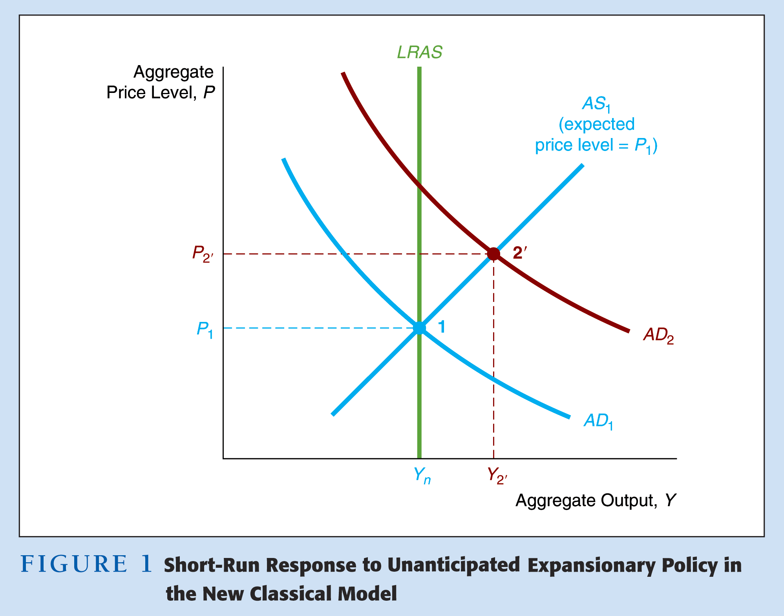

Slide 34
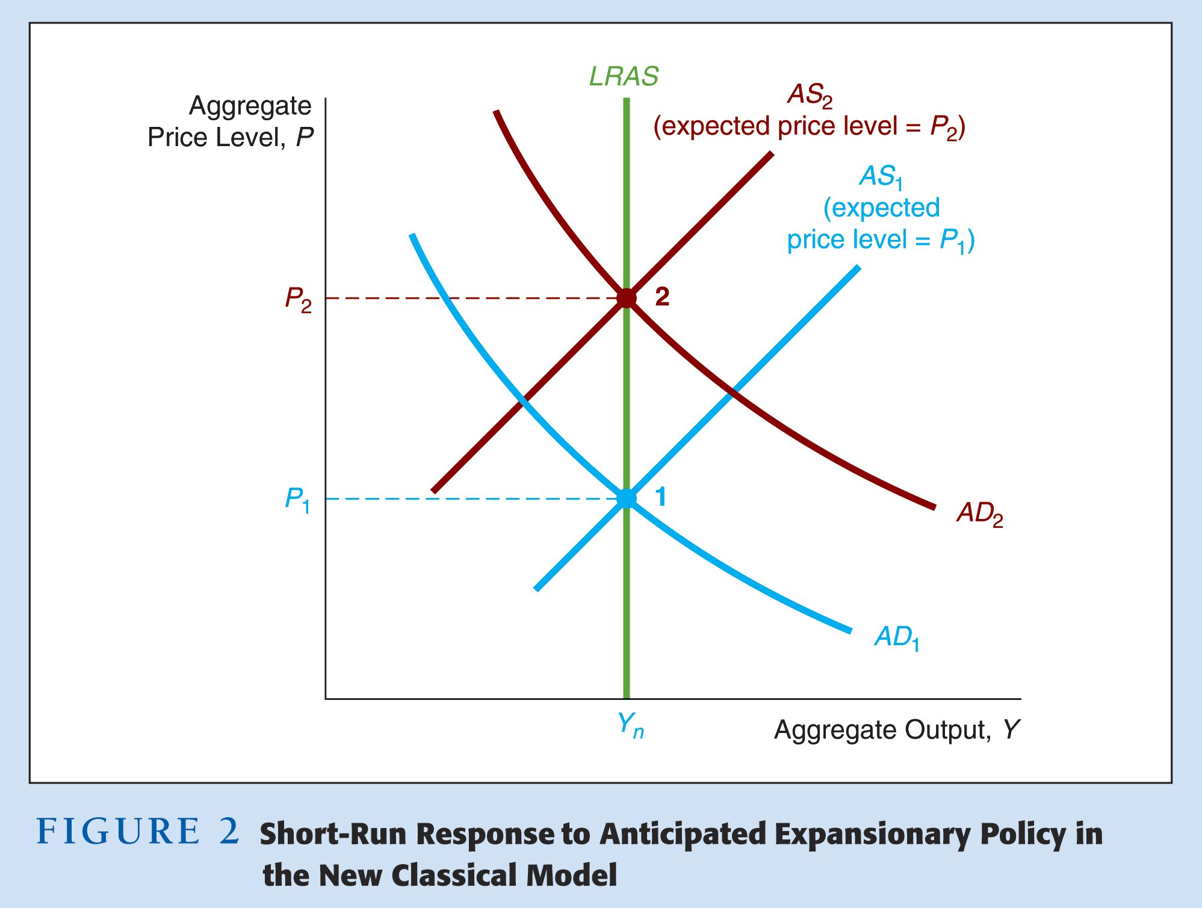

Slide 35
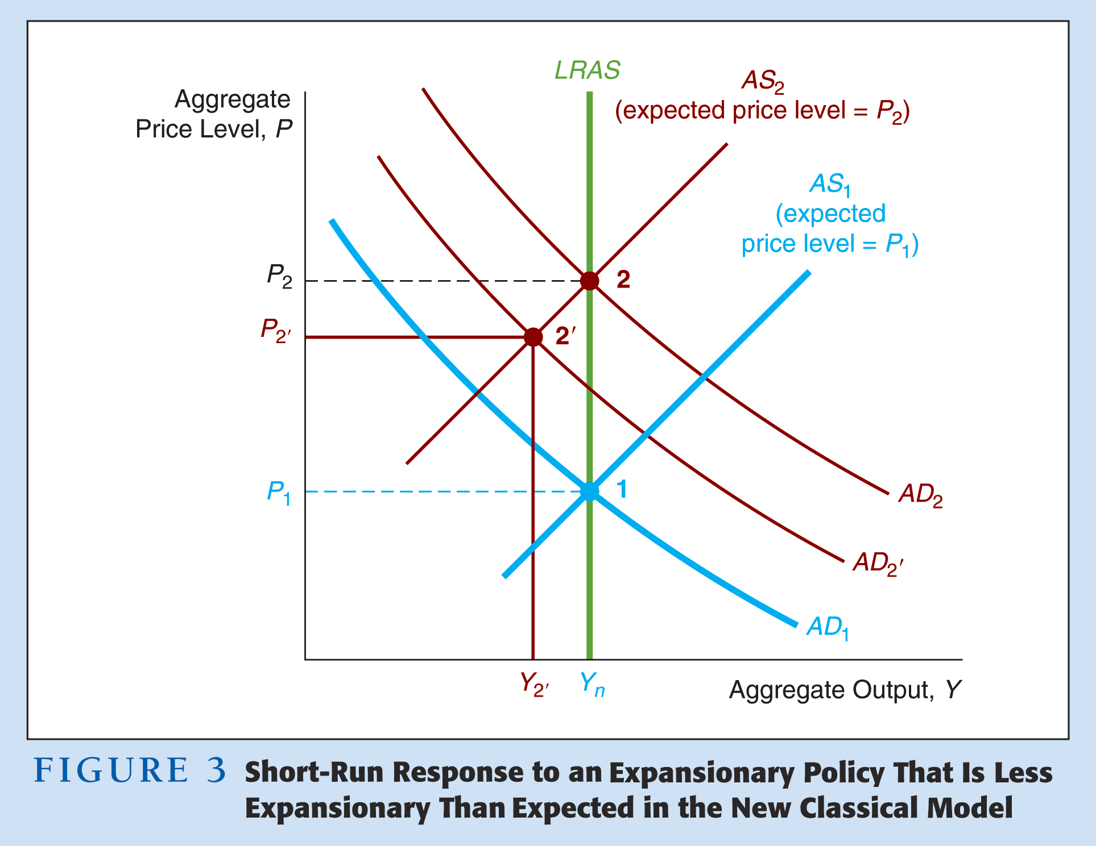

Slide 36
Implications for Policymakers
Distinction between effects of anticipated and unanticipated policy actions
Policymakers must know expectations to know outcome of the policy
Nearly impossible to find out expectations
People will adjust expectations guessing what the policymaker will do
Design policy rules so prices will remain stable

Slide 37
New Keynesian Model
Objection to complete wage and price flexibility
Labor contracts
Reluctance by firms to lower wages
Fixed-price contracts
Menu costs
Model assumes rational expectations but wages and prices are sticky
Notes:
Assumptions:
1. Rational expectations
2. Wages and prices have rigidity: don’t adjust fully to changes in expected price level
Implications:
1. Unanticipated policy has larger effect on Y than anticipated policy
2. Policy ineffectiveness does not hold:
Anticipated policy does affect Y
3. Does not rule out beneficial effect from activist policy
4. However, effects of policy are affected by expectations: designing policy is tough

Slide 38
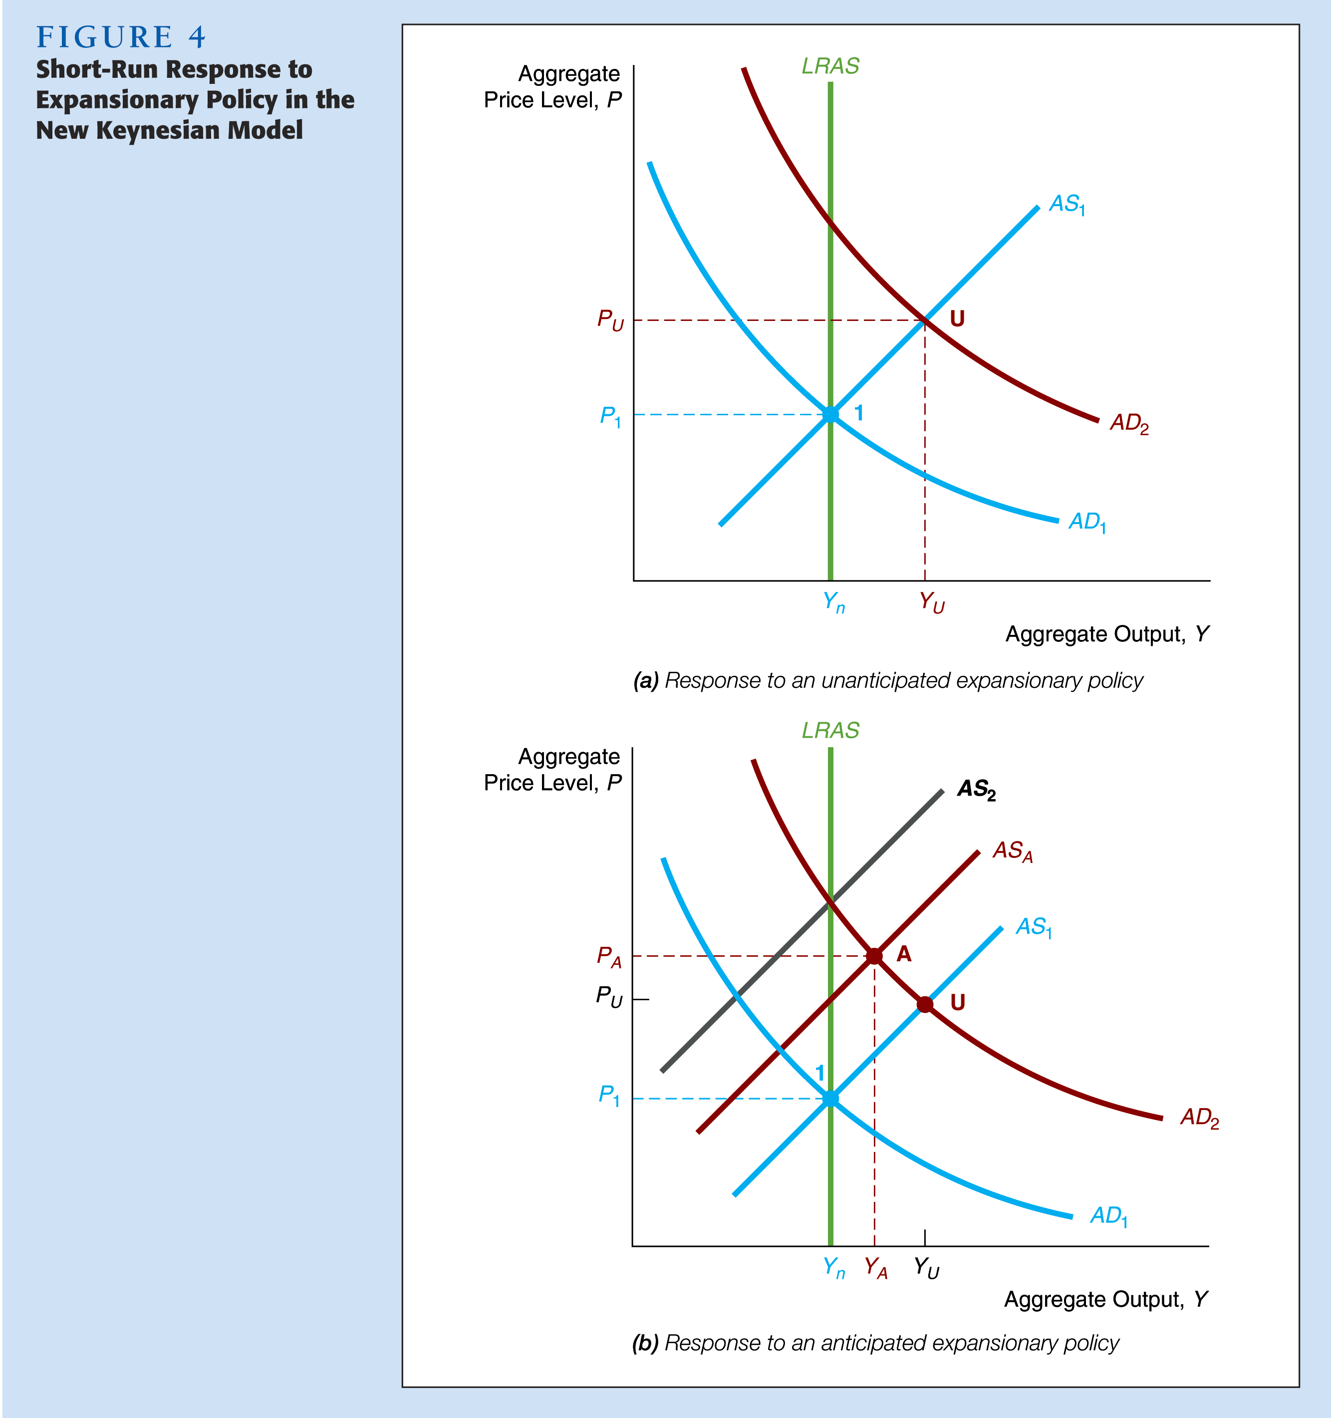

Slide 39
Implications for Policymakers
There may be beneficial effects from activist stabilization policy
Designing the policy is not easy because the effect of anticipated and unanticipated policy is very different
Must understand public’s expectations

Slide 41
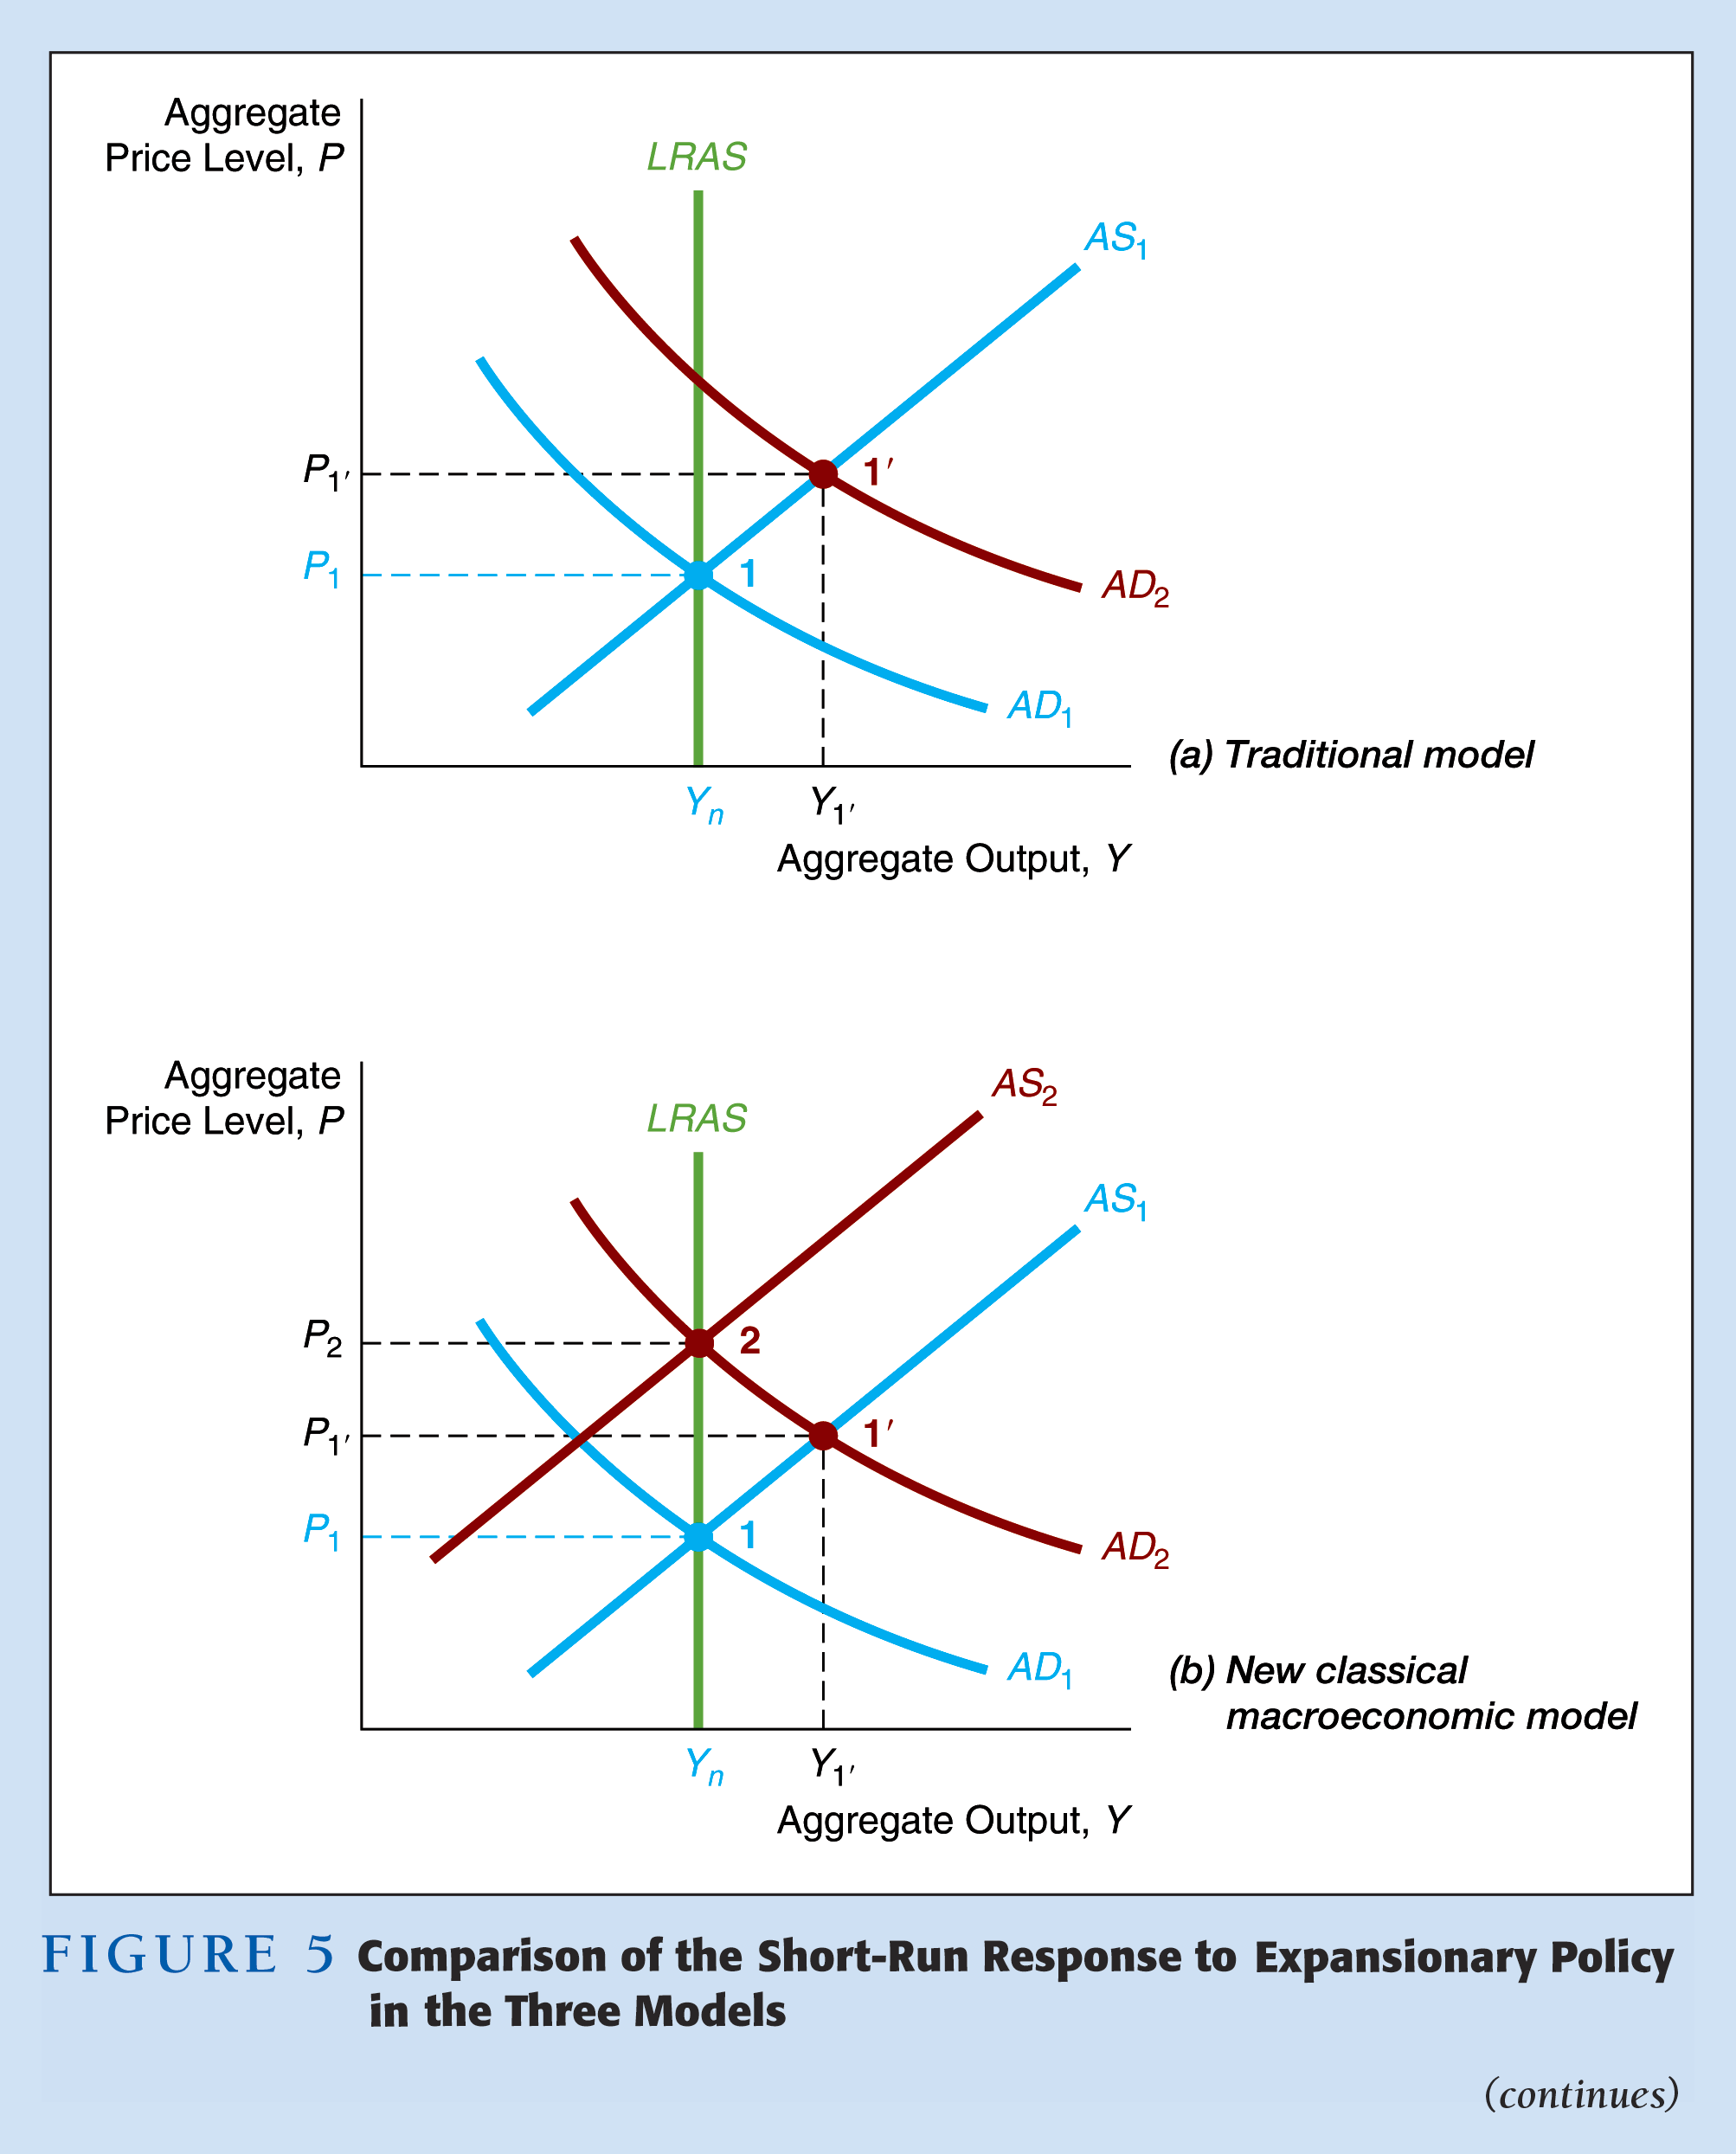

Slide 42
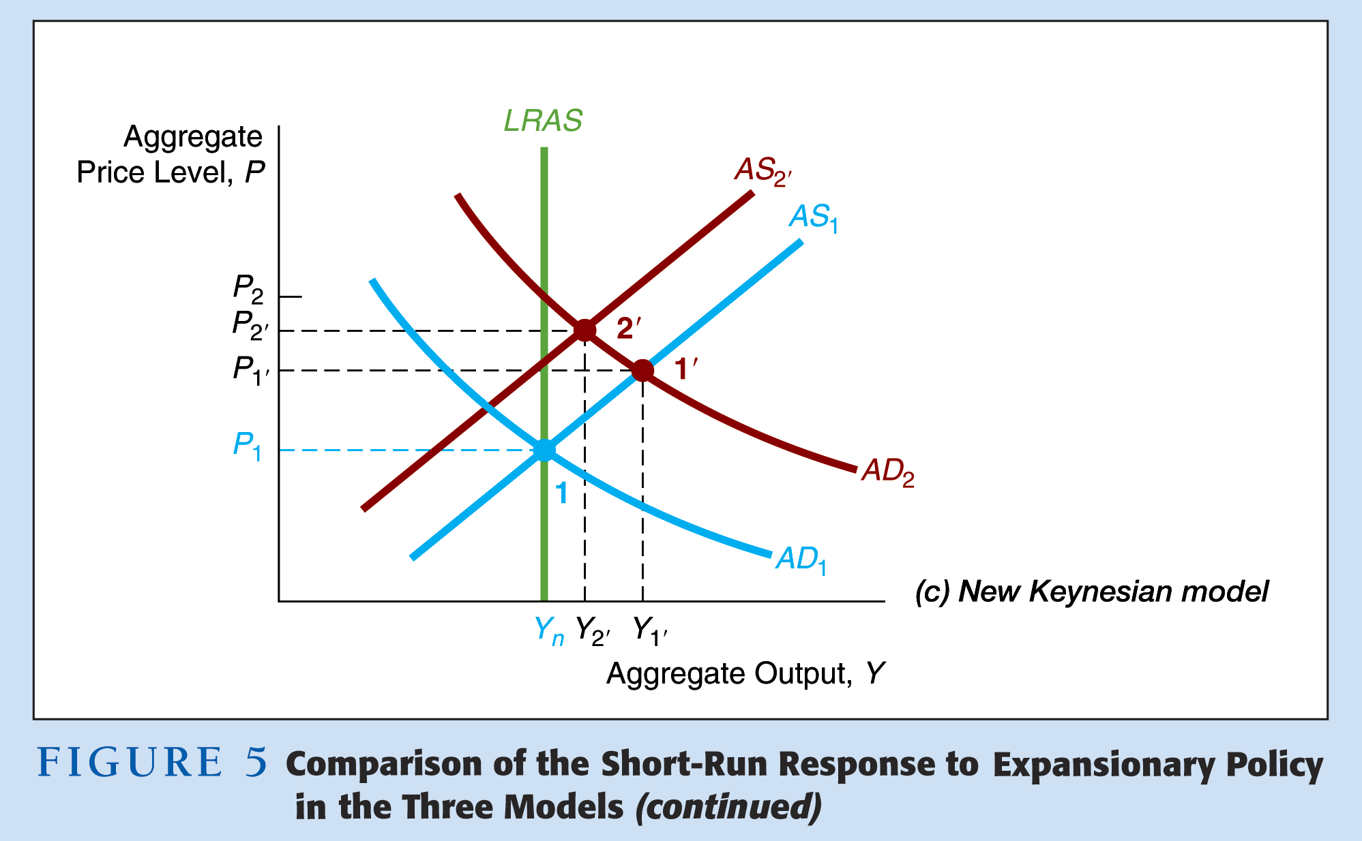

Slide 43
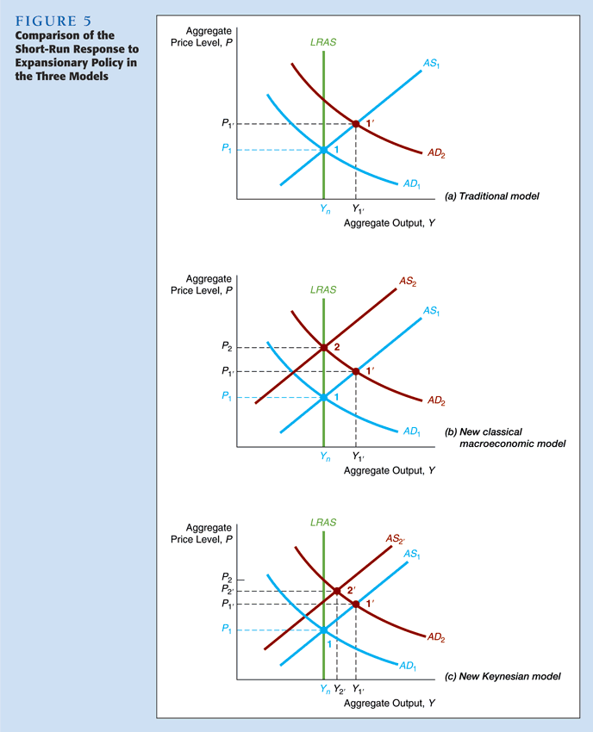

Slide 44
Stabilization Policy
Traditional
It is possible for an activist policy to stabilize output fluctuations
New Classical
Activist stabilization policy aggravates output fluctuations
New Keynesian
Anticipated policy does matter to output fluctuations
More uncertainty about the outcome than Traditional

Slide 45
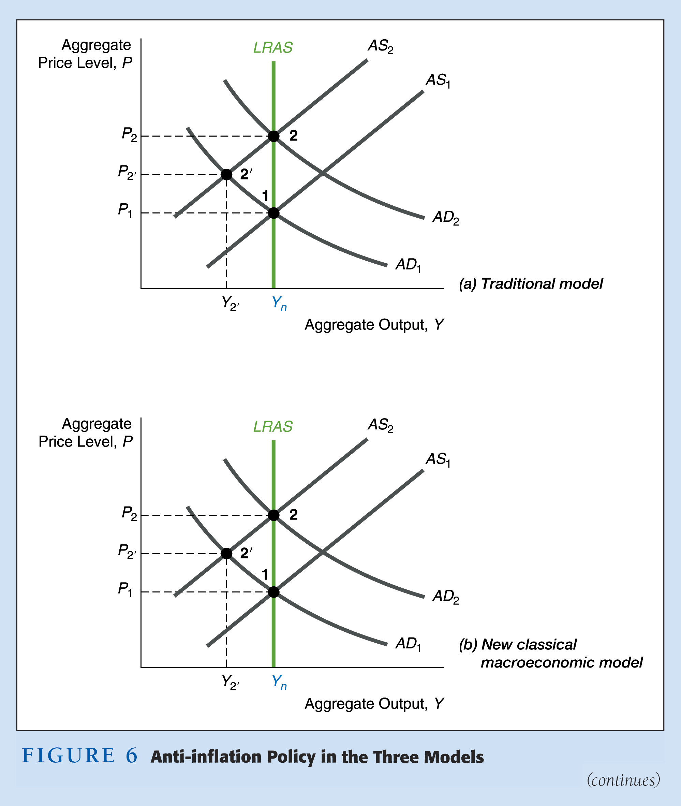

Slide 46
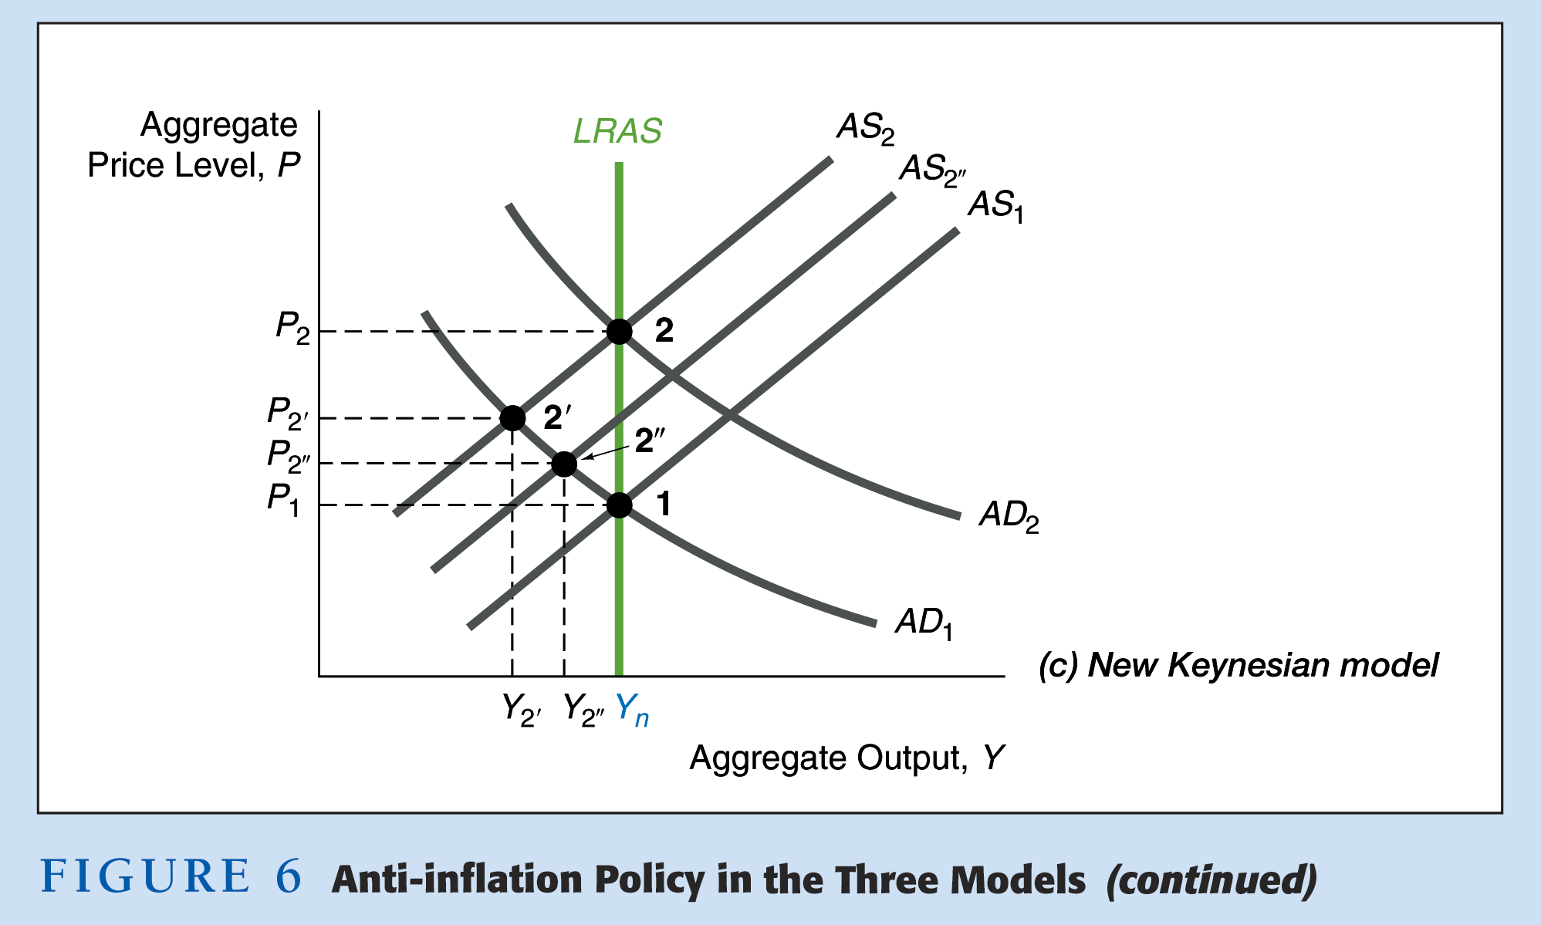

Slide 47
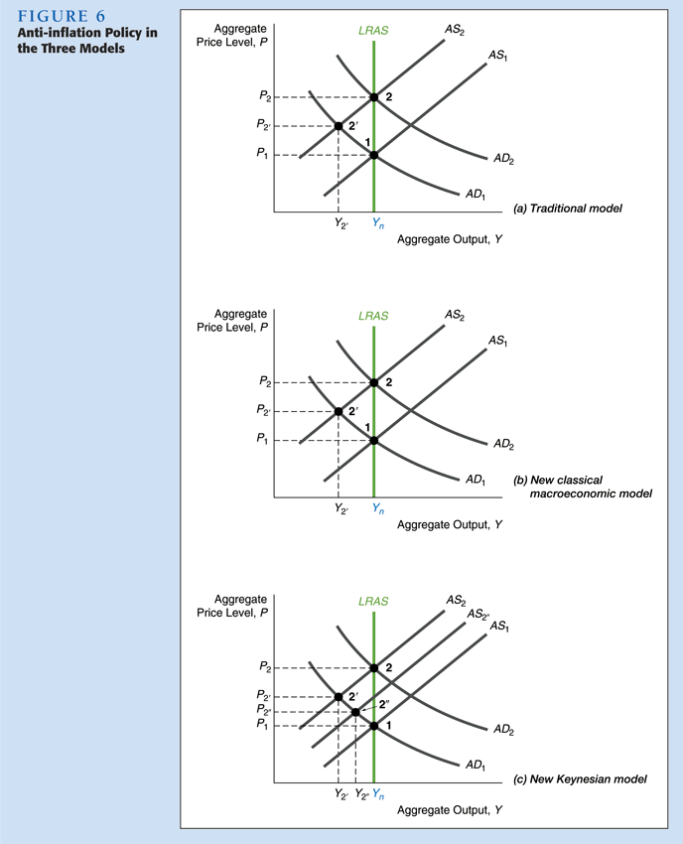

Slide 48
Anti-Inflation Policy in the Three Models
1. Ongoing π, so moving from AD₁ to AD₂, AS₁ to AS₂, point 1 to 2
2. Anti-π policy, AD kept at AD₁
Traditional Model (a)
1. AS to AS₂ whether policy anticipated or not; go to 2', Y ↓, π ↓
New Classical Model (b)
1. Unanticipated: AS to AS₂; go to 2', Y ↓, π ↓
2. Anticipated: AS stays at AS₁; stay at 1, Y unchanged, π ↓ to zero
New Keynesian Model (c)
1. Unanticipated: AS to AS₂; go to 2', Y ↓, π ↓
2. Anticipated: AS to AS_{2''}; go to 2'', Y ↓ by less, π ↓ by more

Slide 49
Credibility and the Reagan Deficits
Reagan deficits may have made 1981–82 recession worse after Fed anti-π policy
Analysis
1. Anti-π policy kept AD at AD₁
2. Fed’s anti-π policy less credible, so AS kept rising to AS₂
3. Go to 2' in panels (b) and (c); Y ↓ by more than if anti-π policy credible
Impact of Rational Expectations Revolution
1. More aware of importance of expectations and credibility
2. Lucas critique has caused most economists to doubt use of conventional econometric models for policy evaluation
3. Since effect of policy depends on expectations, economists less activist
4. Policy effectiveness proposition not widely accepted, most economists take intermediate position that activist policy could be beneficial but is tough to design

Slide 50
Credibility in Fighting Inflation
Public must expect the policy will be implemented
New Classical
Cold turkey
New Keynesian
More gradual approach
Actions speak louder than words
Notes:
1. Ongoing π, so moving from AD₁ to AD₂, AS₁ to AS₂, point 1 to 2
2. Anti-π policy, AD kept at AD₁
Traditional Model (a)
1. AS to AS₂ whether policy anticipated or not; go to 2', Y ↓, π ↓
New Classical Model (b)
1. Unanticipated: AS to AS₂; go to 2', Y ↓, π ↓
2. Anticipated: AS stays at AS₁; stay at 1, Y unchanged, π ↓ to zero
New Keynesian Model (c)
1. Unanticipated: AS to AS₂; go to 2', Y ↓, π ↓
2. Anticipated: AS to AS_{2''}; go to 2'', Y ↓ by less, π ↓ by more

Slide 51
Impact of the Rational Expectations Revolution
Expectations formation will change when the behavior of forecasted variables changes
Effect of a policy depends critically on the public’s expectations about that policy
Empirical evidence on policy ineffectiveness proposition is mixed
Credibility is essential to the success of anti-inflation policies
Less fine-tuning and more stability

