Slide 2
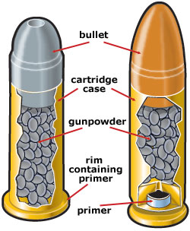
FIRING MECHANISM
It's the mechanical system that transfers mechanical energy to generate heat that causes the chemical reaction that propels bullet or spherical projectiles down the barrel of a firearm.
When you pull the trigger of a gun, a spring mechanism hammers a metal firing pin into the back end of the cartridge, igniting the small explosive charge in the primer.
The primer then ignites the propellant.
As the propellant chemicals burn, they generate lots of gas very quickly. The sudden, high pressure of the gas splits the bullet from the end of the cartridge, forcing it down the gun barrel at extremely high speed.

Slide 3
In ballistics, an action is the functional mechanism of a breech loading firearms, that handles (loads, locks, fires, extracts and ejects) the ammunition cartridge, or the method by which that mechanism works.
In manual loading guns- Bolt action, lever action, pump action, break through action.
In automatic guns- Blow back, blow forward,
The muzzleloader ignition mechanism is referred to as the lock (e.g. match lock, flint lock, cap lock, wheel lock).

Slide 4
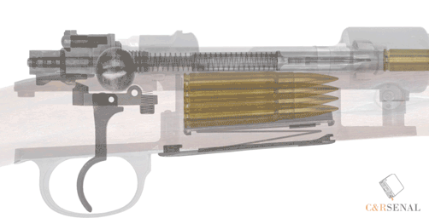
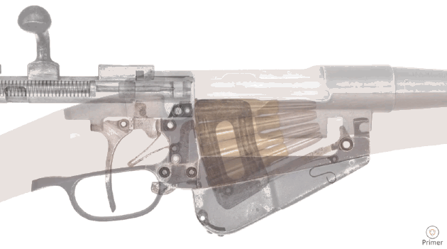
BOLT ACTION
In bolt-action firearms, the opening and closing of the breech is operated by direct manual manipulation of the bolt via a protruding bolt handle.
Most bolt-actions utilize a rotating bolt ("turn-pull") design, where the bolt handle must be rotated upwards for unlocking before the bolt can be pulled back to opening the breech and eject any spent cartridge, and must be rotated back down for locking after the bolt closes the breech.

Slide 5
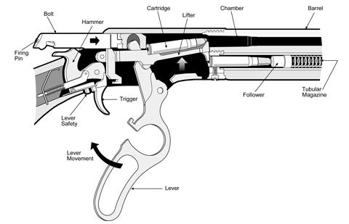
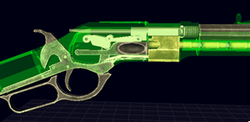
LEVER ACTION
The lever-action firearms use a linked lever to eject and chamber cartridges.

Slide 6
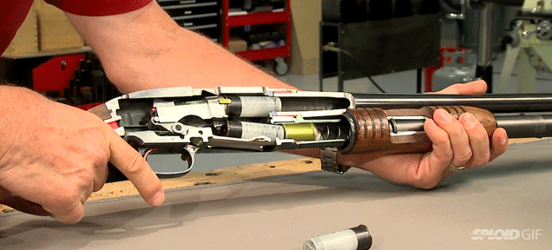
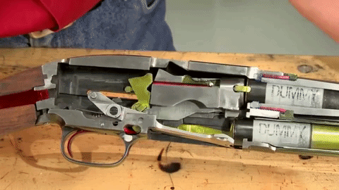
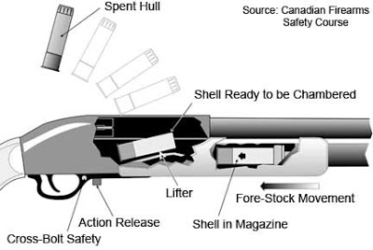
PUMP ACTION
In pump action or slide action firearms, a sliding grip at the fore-end beneath the barrel is manually operated by the user to eject and chamber a new round. Pump actions are predominantly found in shotguns.

Slide 7
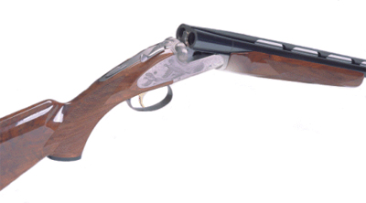
BREAK ACTION
A break action is a type of firearm where the barrel(s) are hinged and can be "broken open" to expose the breech. Multi-barrel break action firearms are usually subdivided into over-and-under or side-by-side configurations for two barrel configurations.

Slide 8
Automatic firearm- Rifling mechanism
The blowback operation is a system in which semi-automatic and fully automatic firearm operate through the energy created by combustion in the chamber and bore acting directly on the bolt face through the cartridge.
The blow-forward operation uses a fixed breech and moving barrel that is forced forward relative to the breech by the friction of the projectile against the bore as well as the breech recoiling away from the barrel.
The recoil operation is a type of locked breech action used in semi-automatic and fully automatic firearms. It also uses energy from the combustion in the chamber acting directly on the bolt through the cartridge head, but in this case the firearm has a reciprocating barrel and breech assembly, combined with a bolt that locks to the breech.
In gas-operation, a portion of high pressure gas from the cartridge being fired is tapped through a hole in the barrel and diverted to operate the action.

