Slide 1
ANIMAL POISONS

Slide 2
Difference between “venomous” & “poisonous” animals.
Venomous animals are capable of producing a poison in a highly developed secretory gland or group of cells and that can deliver their toxin during a biting or stinging act.
Poisonous animals are those whose tissues, either in part or in their entirety, are toxic

Slide 3
The least common but the most serious cause of toxicity.
Animal poison = venom
No statistical data in Libya.
Few researches in Libya.

Slide 4
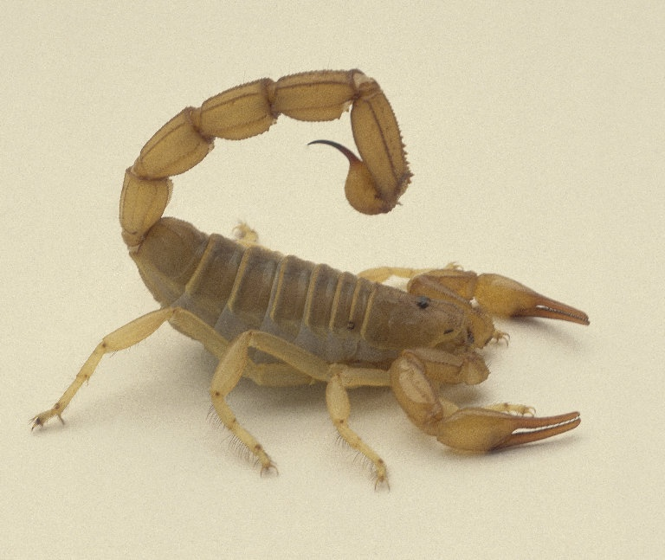
SCORPIONS

Slide 5
Scorpions belong to
  phylum Arthropoda
    class Arachnida
      order scorpionida
          9 living families: Buthidae, Scorpionidae, Diplocentridae, Chaerilidae, Ischnuridae, Bothruridae, Chactidae, Iuridae, and Vaejovidae
In Libya, 9 different species have been recognized; most of them belong to Buthidae family whereas others belong to the family Scorpionidae:

Slide 6
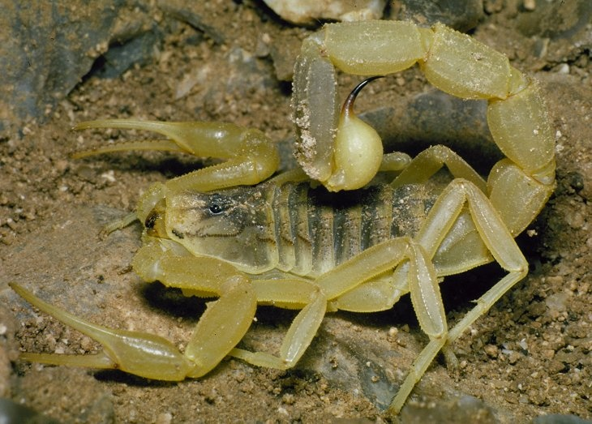
1-Leiurus quinquestriatus: the most abundant and toxic species in Libya and it is restricted to the southern parts e.g. Aujla, jkharra, Gdamas, Elkufra. Not found in costal areas.

Slide 7
2- Androctonus amoreuxi: the second most abundant and toxic species, they are found in the same areas with L. quinquestriatus forming a co-occurrence.

Slide 8
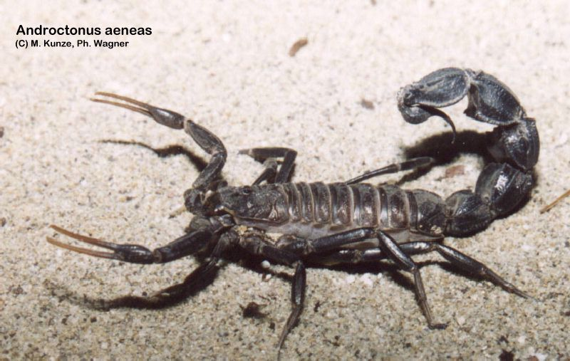
3-Androctonus aeneas (bicolor): widely distributed in low numbers, especially in Aljabal Elgarbi, Wadi Elshati, Zawia, Tripoli, Sirt, Benghazi, ElJabal AlAKHDHAR.

Slide 9
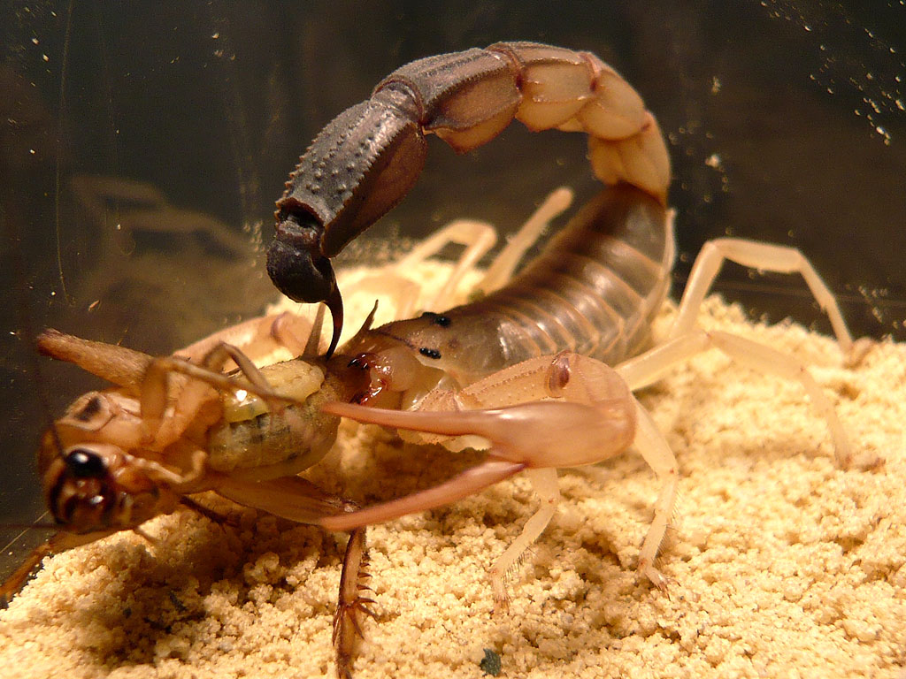
4- Androctonus australis: in costal and southern parts of Libya, but more abundant in Sirt, Algariat, and Shwerif, TRIPOLI, BENGHAZI, ELKUFRA, AUJLA, JALU, WADI ATBAH.

Slide 10
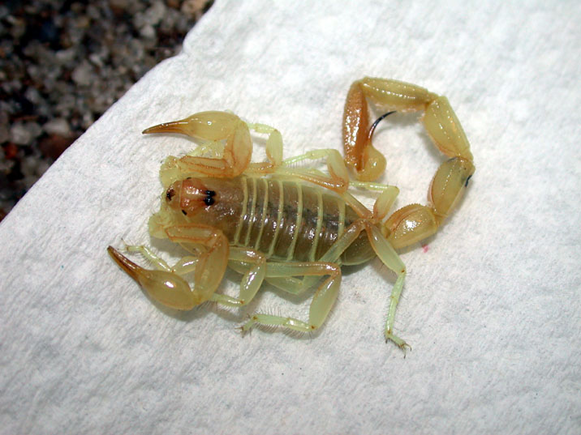
5- Buthacus leptochelys: mainly in Jalow, Aujla, and Jekhirrah.

Slide 11
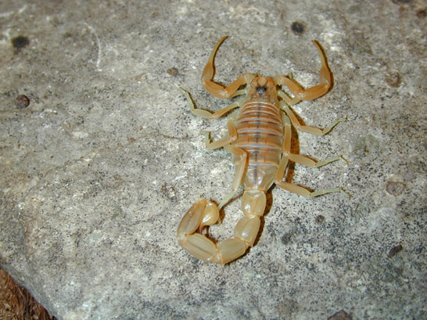
6- Buthus occitanus: in Tajoura, and some other costal regions but not in the southern parts.

Slide 12
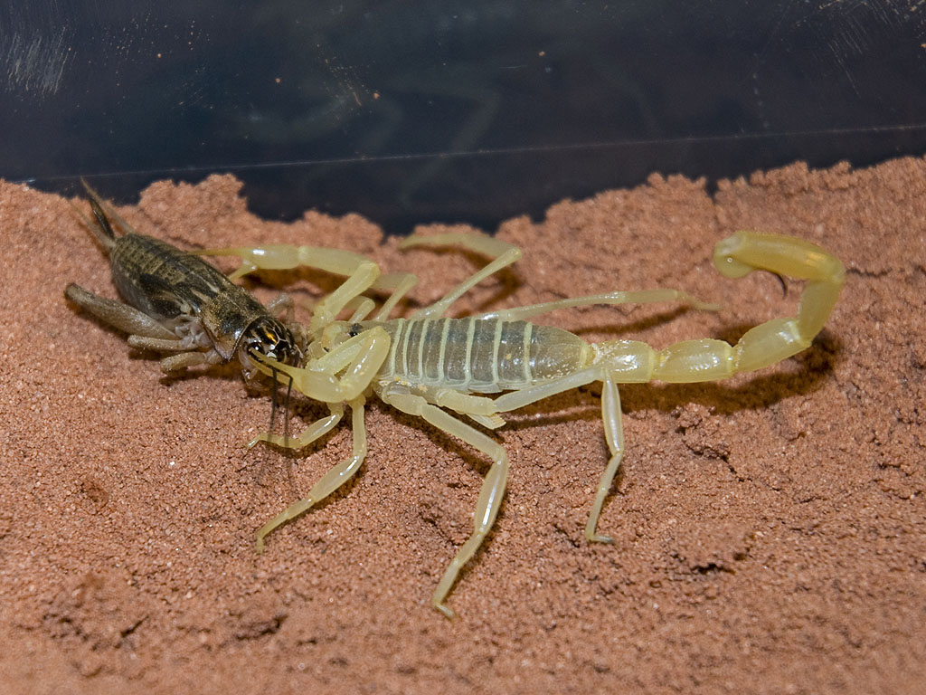
7- Buthacus arenicola: found in same areas with Buthus occitanus but in small numbers.

Slide 13
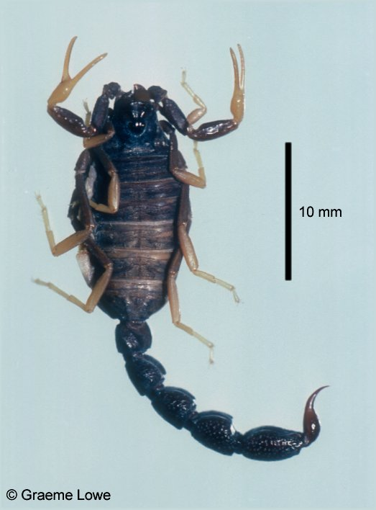
8- Orthochirus innesi: found in restricted areas mainly at Morzug, Marhaba, and Tsawah.

Slide 14
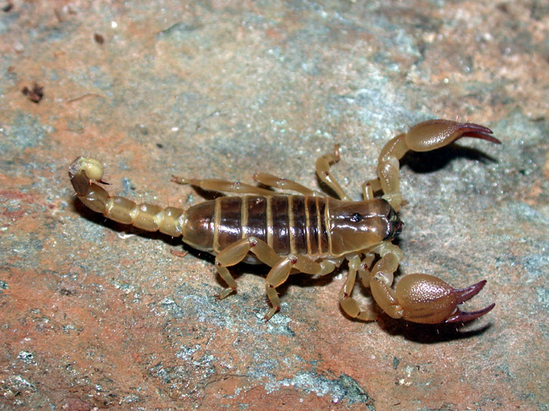
9- Scorpion maurus: the least toxic species and it is restricted to Khums and Msillata.

Slide 15
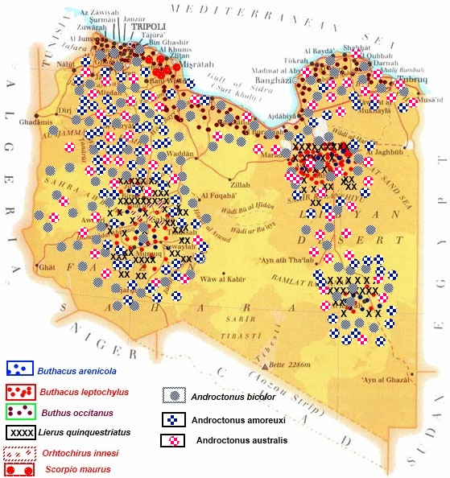
Distribution in some parts in Libya

Slide 16
Pathophysiology
The venom is composed of varying concentrations of:
Neurotoxin
Cardiotoxin
Nephrotoxin
Hemolytic toxin
Phosphodiesterases, tryptophan, phospholipases, hyaluronidases, glycosaminoglycans, histamine, serotonin, and cytokine releasers.

Slide 17
The most potent is the neurotoxin causing cell impairment in nerves, muscles, and the heart by altering ion channel permeability:
The long-chain polypeptide neurotoxin causes stabilization of voltage-dependent sodium channels in the open position, leading to continuous, prolonged, repetitive firing of the somatic, sympathetic, and parasympathetic neurons
The short polypeptide neurotoxin blocks the potassium channels.

Slide 18
Clinical Manifestations
The toxicity, variation, and duration of the symptoms depends on the following factors:
Scorpion species
Scorpion age, size, and nutritional status
Healthiness of the scorpion's stinging apparatus (telson)
Number of stings and quantity of venom injected
Depth of the sting penetration

Slide 19
Composition of the venom
Site of envenomation: Closer proximity of the sting to the head and torso results in quicker venom absorption into the central circulation and a quicker onset of symptoms.
Age of the victim
Health of the victim
Weight of the victim relative to amount of venom
Presence of comorbidities
Treatment effectiveness
Generally, intrathecal and intravenous routes have immediate effects, while subcutaneous and intramuscular routes take effect several minutes to hours later.

Slide 20
Nonlethal scorpion species tend to produce local reactions while lethal scorpion species tend to produce systemic symptoms.
The duration to progress to systemic symptoms ranges from 5 minutes to 4 hours after the sting.
Symptoms generally persist for 10-48 hrs.
Signs last for 24-72 hrs without apparent sequence.

Slide 21
1-Local signs
a) Neurotoxic local effects : sharp burning pain sensation at the sting site, followed by pruritus, erythema, local tissue swelling, and ascending hyperesthesia like an electric current.
Tap test: tapping at the sting site. A positive result is when the paresthesia worsens with the tapping.
b) Cytotoxic local effects : macule or papule appears initially at the sting site within 1st. Hr . Lymphangitis results from the transfer of the venom through the lymphatic vessels.

Slide 22
2- Neurologic signs
Most of the symptoms are due to either the release of catecholamines or acetylcholine:
a) Central nervous system signs
Paresthesia occurs in all 4 limbs.
Venom-induced cerebral thrombosis strokes.
Altered level of consciousness .
Abnormal behavior.
Ataxia

Slide 23
b) Autonomic nervous system signs:
Predominately sympathetic, parasympathetic, or both
Sympathetic signs
Hyperthermia - Tachypnea - Tachycardia - Hypertension - Arrhythmia - Hyperkinetic pulmonary edema
Hyperglycemia- Diaphoresis- Piloerection- Restlessness - Hyperexcitability - convulsions
Parasympathetic signs
Bronchoconstriction - Bradycardia Hypotension – SLUDGE - Rhinorrhea and bronchorrhea - Goose skin
Loss of bowel and bladder control - Priapism - Dysphagia - Miosis - Generalized weakness

Slide 24
c) Somatic signs
  Muscle rigidity in limbs
  Involuntary muscle spasm, twitching, clonus, and contractures
  Alternating episthotonos and opisthotonus
  Increased tendon reflexes
d) Cranial nerve signs
  Rotary eye movement may result in ptosis, nystagmus, and blurred vision.
  Mydriasis
  Tongue fasciculations.
  Dysphagia, dysarthria, stridor
  Excessive salivation and drooling.

Slide 25
3- Nonneurologic systemic signs
a) CVS signs: a pattern of a hyperdynamic phase followed by a hypodynamic phase
Hypertension within 4 minutes after the sting and lasts for few hours
Hypotension - Less commonly occurs secondary to excess Ach or catecholamine depletion
Tachycardia is greater than 130 beats per minute, although bradycardia can be observed.
Cardiovascular collapse occurs secondary to biventricular dysfunction and profuse loss of fluids

Slide 26
b) Respiratory signs
Tachypnea may be present.
Pulmonary edema
Respiratory failure (diaphragm paralysis, alveolar hypoventilation).
c) Allergic signs
Patients may have urticaria, Angioedema, or bronchospasm.
Anaphylaxis is possible.

Slide 27
d) Gastrointestinal signs
Salivation, Dysphagia, Nausea and vomiting, Gastric hyperdistention occurs secondary to vagal stimulation
Acute pancreatitis may lead to hyperglycemia.
e) Genitourinary signs
Decreased renal plasma flow, acute tubular necrosis.
Priapism secondary to cholinergic stimulation.
f) Hematological signs
Platelet aggregation due to catecholamine stimulation.
DIC
g) Metabolic signs
Hyperglycemia: glycogenolysis, pancreatitis, insulin inhibition.
Increased lactic acidosis from hypoxia and increased lactase dehydrogenase activity.
Electrolyte imbalance and dehydration.

Slide 28
GRADES OF SCORPION STING SEVERITY
GRADE | CLINICAL PICTURE
I | Local pain and/or erythema and/or paresthesia at site of envenomation
II | Pain and/or paresthesia remote from the site of the sting and/or tachycardia and mild hypertension in addition to local findings
III | Cranial nerve or somatic skeletal neuromuscular dysfunction: Cranial nerve dysfunction: blurred vision, wandering eye movement, dysphagia, tongue fasciculation, problems with upper airway, slurred speech, and/or ptosis. Somatic skeletal neuromuscular dysfunction: jerking extremity, restlessness, severe involuntary shaking and jerking that may be mistaken for a central seizure disorder.
IV | Any combination of cranial nerve dysfunction, somatic skeletal neuromuscular dysfunction.

Slide 29
TREATMENT
1- General measures:
Ice bags may reduce pain and slow the absorption. This can be effective during the first 2 hours.
Immobilizing the affected part below level of heart may delay venom absorption.
Application of a local anesthetic to the wound decreases paresthesia.
2- Systemic treatment is instituted by:
  giving scorpion antivenom and by
  directing supportive care toward the organ affected by the venom.
  Continuous monitoring of vital signs (pulse oximetry; HR, BP, and RR).

Slide 30
Antivenom:
The quantity of antivenom to be used is determined by
    the clinical severity of patients and by
    their evolution over time.
Decreases the level of circulating unbound venom within an hour.
The timing of antivenom administration is important.
Polyantivenom contains antibodies against equine immunoglobulin fragments against Androctonus australis, Buthus occitanus, Leiurus quinqestriatus.

Slide 31
Hyperdynamic CVS effects:
  administration of an α-blockers is effective in reversing this venom-induced effect. β-blockers alone are not recommended as they may lead to an unopposed α-adrenergic effect.
  Nitrates can be used for hypertension and myocardial ischemia.
Hypodynamic CVS effects:
  monitored fluid infusion
  A diuretic may be used for pulmonary
  Dobutamine seems to have better effects in Pulmonary edema when given with sodium nitroprusside for children.
Insulin administration in scorpion envenomation has helped in preventing multisystem failure.

Slide 32
SNAKES
VENOMOUS SNAKES

Slide 33
Most snakebites are harmless and are delivered by nonvenomous species.
Worldwide, only about 15% of the more than 3000 species of snakes are considered dangerous to humans.
In Libya, no statistics.
The family Viperidae is the largest family of venomous snakes, and members of this family can be found in Africa, Europe, Asia, and the Americas.
The family Elapidae is the next largest family of venomous snakes.

Slide 34
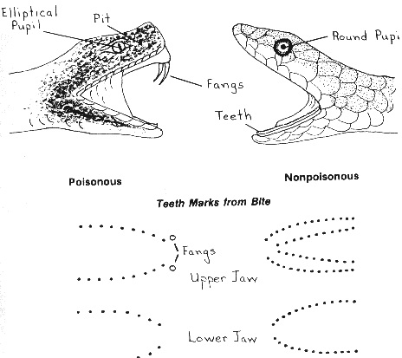

Slide 35
Snake venoms
Venom is produced and stored in paired glands below the eye.
It is discharged from hollow fangs located in the upper jaw.
Fangs are variable in length and size.
Venom dosage per bite depends on:
  The elapsed time since the last bite
  The size of the prey.

Slide 36
Snake venoms
Snake venoms are complex mixtures of 50 or more components.
In human victims, these substances produce local “digestive” effects on tissues as well as hemotoxic, neurotoxic, and other systemic effects.
The relative predominance of digestive, hemotoxoic, or neurotoxic venom components depends on the species of the snake and geographic variables.

Slide 37
Venomous snakes (5 families)
1- Viperidae:
A) Rattlesnakes (Crotalus) (Subfamily Crotalidae)
B) Moccasins (Agkistrodon)
C) Lance-headed vipers (Bothrops) of the Americas
D) Saw-scaled vipers (Echis) of Asia and Africa

Slide 38
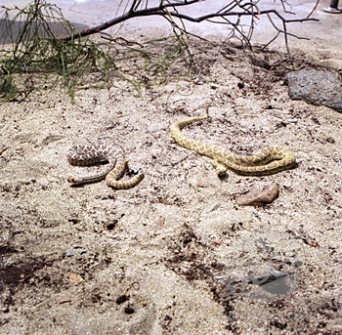
SNAKES FROM LIBYA

Slide 39
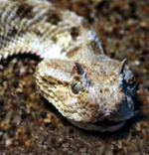
DESERT VIPER

Slide 40
2- Elapidae:
A) Cobras (Naja) of Asia & Africa
B) Mambas of Africa
C) Kraits (Bungarus) of Asia
D) Coral snakes of the Americas

Slide 41
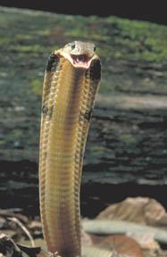
COBRA

Slide 42
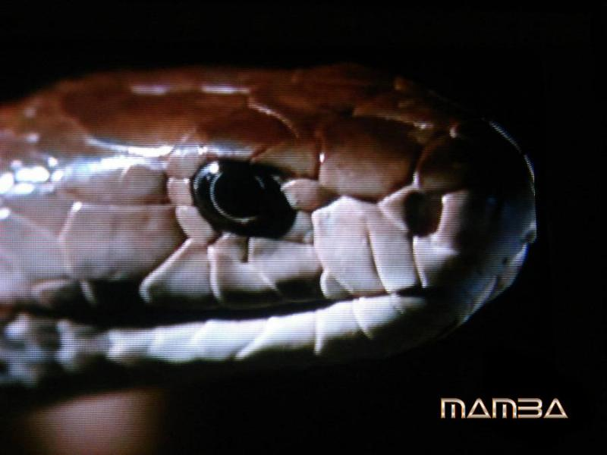
MAMBA

Slide 43
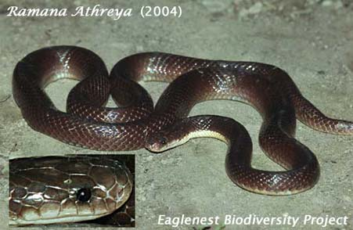
KRAIT

Slide 44
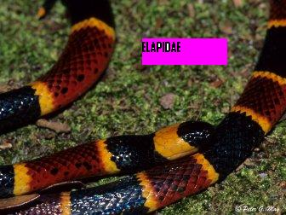
CORAL

Slide 45
Pathophysiology
Venom is mostly water.
Enzymatic proteins in venom impart its destructive properties.
Venoms are different in action according to family:
1- Viperidae : produce hemolytic venoms.
2- Elapidae: produce neurotoxic venom.

Slide 46
Clinical Features
Immediate, local pain, soft tissue swelling (may be progressive),
  Signs of necrosis appear within 48hrs
  The area around fang punctures darkens
  Blistering may follow.
Neurologic findings: may begin early or delayed in onset as long as 24 hours
Respiratory distress or weakness, Cyanosis
Neurologic dysfunction; Altered mental status
Ptosis (may be earliest sign of systemic toxicity
Generalized weakness or paralysis
Cardiovascular collapse

Slide 47
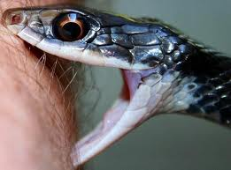

Slide 48
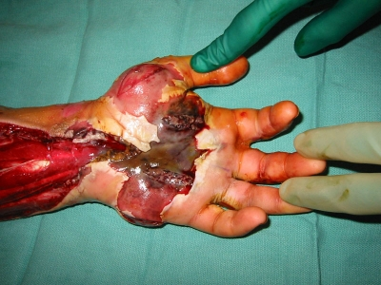

Slide 49
Management
1-Prolonged use of arterial tourniquets is unwise and has caused loss of limb function.
  A completely occlusive tourniquet is reasonable when a victim has been bitten by a highly toxic snake, such as a cobra, and is a short distance from medical care.
An alternative first aid procedure is the Australian pressure immobilization technique. An elastic compress (eg, crepe bandage) is wrapped rapidly around the bitten extremity, beginning distally and progressing proximally to encompass the entire limb. The extremity is splinted and kept at heart level.

Slide 50
2- Incisions are not helpful.
Using a mechanical suction device is unlikely to return any significant amount of venom, and it could increase local tissue damage when necrotizing venom is involved. Suction should, therefore, be avoided.
3- Avoid cooling measures and ice application. They have been associated with increased necrotic complications.

Slide 51
Antivenom is the only proven therapy for significant snakebites, most are polyvalent against venoms of all the important snakes of a region.
It should be started as soon as possible if evidence of systemic envenoming is present.
Administer antivenom according to the manufacturer’s instructions.
Adult and child doses are similar.
Dilute in 500-1000 mL isotonic crystalloid, and begin IV at a slow rate with the physician in immediate attendance, if no reaction, increase rate in order to administer full starting dose in 1-2 h.

Slide 52
polyantivenom may be administered if a patient develops one or more of the following
Systemic envenoming
Evidence of coagulopathy primarily detected by 20 WBCT or visible spontaneous systemic bleeding, bleeding gums, etc., Further laboratory tests for thrombocytopenia, Hb abnormalities, PCV, peripheral smear etc may provide confirmation, but 20 WBCT is paramount.
Evidence of neurotoxicity: ptosis, external ophthalmoplegia, muscle paralysis,
inability to lift the head etc.,
Cardiovascular abnormalities: hypotension, shock, cardiac arrhythmia, abnormal ECG.
Persistent and severe vomiting or abdominal pain.

Slide 53
Local envenomation
Pain at the site of bite, swelling and regional lymph node
Oozing- sero / sanguinous oozing from the site of bite
Discoloration- discoloration at the site of bite
Swelling is seen at the site of the bites on the digits and swelling extends rapidly beyond the site of bite (eg. beyond the wrist or ankle within a few hours of bites on the hands or feet

Slide 54
Dosage of polyantivenom
The recommended dosage level has been based on published research that Russells Viper injects on average 63mg (SD 7) of venom.
One vial of PAV neutralises 6mg of Russells Viper venom.
  To neutralize 63mg of venom, 10 vials are needed.
  Not all victims will require 10 vials as some may be injected with less than 63mg. However, starting with 10 vials ensures that there is sufficient neutralizing power to neutralize the average amount of venom injected and during the next 12 hours to neutralize any remaining free flowing venom.
Warrell et al have shown that test doses for PAV have no predictive value in detecting anaphylactoid or late serum reactions and should not be used.
  These reactions are not IgE mediated but Complement activated.
  They may also pre-sensitise the patient and thereby create greater risk.
For Neurotoxic / Hemotoxic envenomation, 8 to 10 vials of PAV is recommended to be administered as initial dose.
Children receive the same ASV dosage as adults, as snakes inject the same amount of venom into adults and children.

Slide 55
polyantivenom Reactions
Reaction to PAV develop usually within 15 to 30 minutes or within 2 hours. So monitor the case on at 5min. interval for first 30min. and then at 15min. interval for two hours.
Some times, anaphylaxis (Type I) following PAV may develop rapidly and deteriorate into a life-threatening emergency, and hence anticipate and observe for it in every case.
If the correct guidelines are followed, anaphylaxis can be effectively treated.

Slide 56
SPIDERS

Slide 57
There are more than 30,000 species of spiders, most of which are venomous, but they cannot cause serious bites due to delicate mouthparts and short fangs.
Many spiders produce toxic venoms that can cause skin lesions, systemic illnesses, neurotoxicity, and death.
The term "arachnidism" is often used to refer to envenoming spider bites.

Slide 58
There are many families each containing many species but the most important of them in Libya is the family Latrodectus (black widows), examples of these families:
Family Latrodectus (Black widows)
Family Loxosceles: (L. reclusae, L. parrami)
Family Atrax and other funnel-web spiders: Atrax species are large, aggressive spiders. Most notorious is Australian Atrax robustus or Sydney funnel-web spider
Family Pheneutria: P. keyserlingi
Family Lycosa: L. tarantula
The black widow, or hourglass, spider is dangerous because of its potent venom.

Slide 59
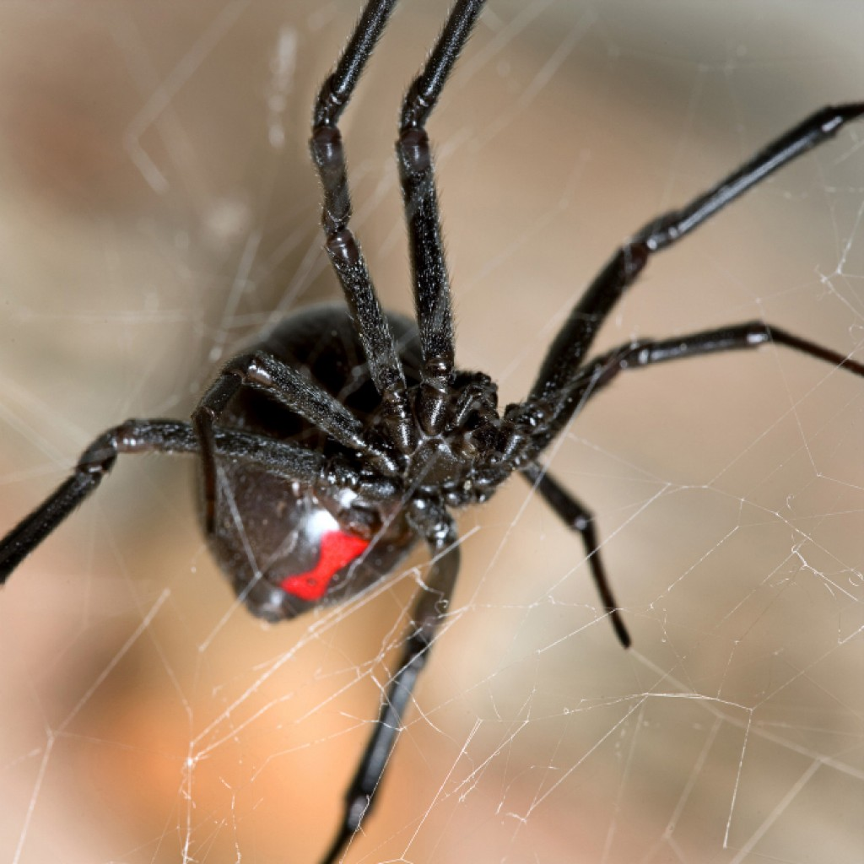
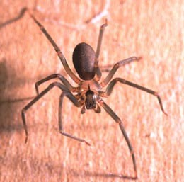
Mediterranean Recluse Spider
BLACK WIDOW

Slide 60
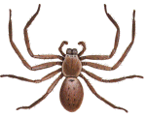
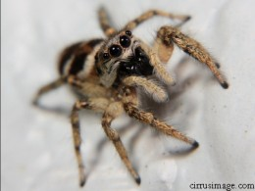
House spiders
Huntsman spider
Jumping spider

Slide 61
MECHANISM OF TOXICITY
Spiders use their hollow fangs to inject their venoms, which contain various protein and polypeptide toxins that are poorly characterized but appear to be designed to induce rapid paralysis of the insect victim and to aid in digestion.

Slide 62
Latrodectus (black widow) spider venom contains α-latrotoxin.
This extremely potent toxin causes opening of nonspecific cation channels, leading to:
    increased influx of calcium
      indiscriminate release of acetylcholine
        excessive stimulation of NMJ

Slide 63
Mediterranean recluse spider
The close cousin of the venomous Brown Recluse Spider in America.
The toxin from this little beauty is hemotoxic.
The initial bite from the Mediterranean recluse spider is usually not felt, and there is no instant pain, which is part of the problem.
Symptoms of a person being bitten include nausea, rashes, vomiting, and fever.
This is followed by muscle aches and joint pain.
In rare cases, internal organs will be damaged as the venom surges through the blood stream and then death.

Slide 64
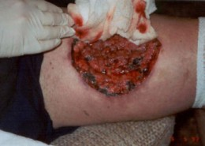
A wound by Mediterranean recluse spider

Slide 65
Clinical Manifestations of Latrodectism
Envenomation can occur in people of any age.
Initially, a severe pain in local muscle groups occurs, which then spreads to regional muscle groups. Severe cramps and contraction of musculature may extend throughout the body. The abdominal pains are frequently most severe, mimicking appendicitis, colic, or food poisoning. Other symptoms include headache, restlessness, anxiety, fatigue, and insomnia.
Signs of latrodectism include: Salivation –Lacrimation – Diaphoresis – Tremors – Tachycardia - Bradycardia – Hypertension - Shock - Coma.

Slide 66
TREATMENT
Pain relievers such as narcotics
Muscle relaxants
Intravenous calcium gluconate. Mechanism of action remains uncertain.

