Slide 1
Aberrations

Slide 21
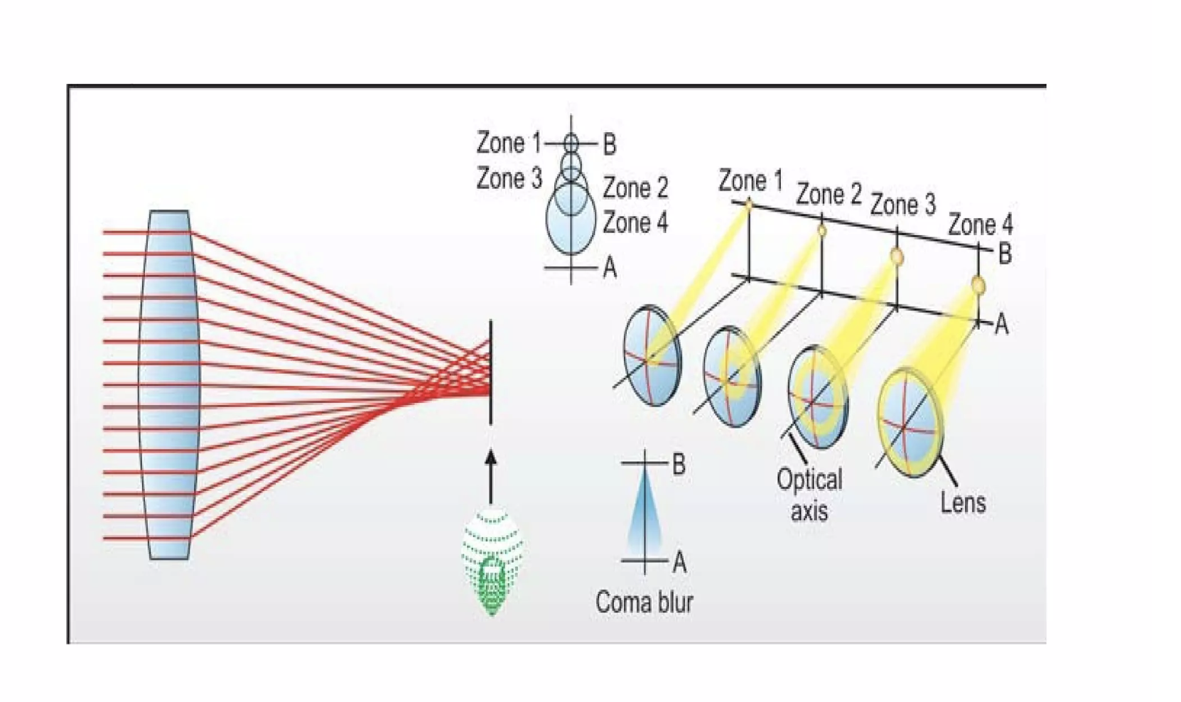

Slide 24
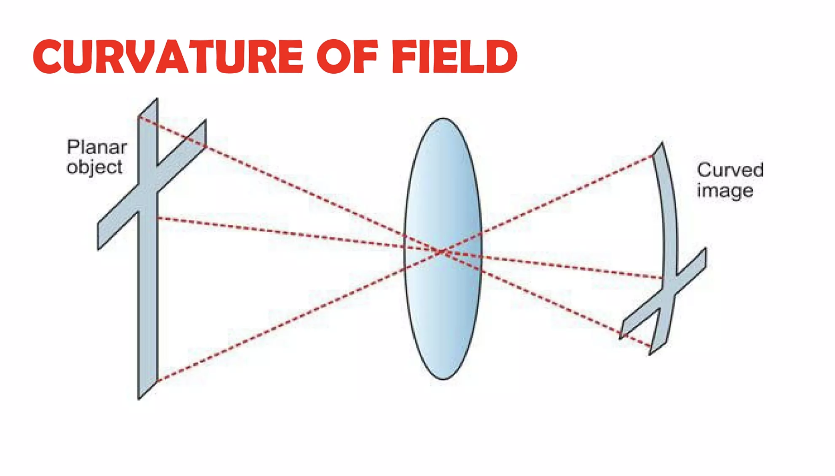

Slide 28
