Slide 1
PRODUCTION TECHNOLOGY OF UNDERUTILIZED VEGETABLE CROPS HVSC 0509 (2+1)
Dr. THRIVENI VANGAPANDU
Assistant Professor (Horticulture)
MSSSoA, CUTM

Slide 2
PRODUCTION TECHNOLOGY OF KALE & COLLARDS
Introduction
Botanical Name: Brassica oleracea var.acephala D.C - Kale
Brassica oleracea var Viridis - Collards
Family: Brassicaceae
Chromosome No.: 2n=18 (n=9)
Mode of pollination: Crosspollinated
Edible parts : Leaves
Among cole crops Kale and collards are rare grown in kitchen gardens of Kashmir
Both kale and collards are used in raw or cooked form like other leafy greens.
Kale is Scottish word derived from coles or caulis , term used by the Greeks & Romans referring to the cabbage group like plants.
Kale & collards differ in appearance but have more resemblance with wild cabbage-Coldwarts than any of its other cultivated forms.
Kale is crowned as queen of greens because it has highest in Vitamin-A(9990 IU/100g) and Vitamin C187mg/100g edible portion) among the all crucifers.
It has good source of lutein and anticarcinogenic compounds-particularly contains indoles-regulate estrogen &inhibits colon cancer.

Slide 3
Origin
Its center of origin is Mediterranean region.
Kale & collards differ in appearance but have more resemblance with wild cabbage-Cold warts- Brassica oleracea var. sylvestris than any of its other cultivated forms.
In the 1600s kale made its way through Europe to the United states.
However its introduced in India during 19th century.

Slide 4
Continued… Types of kales
1.Curly kale :B.O. sub. Laciniata : Kales having finely curled foliage
Its mainly grown for consumption and also one of the earliest form of cole crops.
2.Smooth leafed kale :B.O. Sub. var. plana
3.Thousand headed kale: B. O. Sub. var. millecapidata (Sprouted axillary buds forming loose leafy rosette.
4.Tree kale: B.O. sub var. palmifolia – Tree kales having height upto 2m.
5.Marrow stem kale : B.O. Sub var. medullosa :These kales having long swollen stems.
Chinese kale: Brassica alboglabra
Other types kales are used for fodder, live stock and for ornamental purpose
Collards: B.O. var. viridis : it is an intermediate form of non heading and heading cabbages and resembles to all kales in growth habit with smooth leaf blades than the crinkled leaf blades.
It is also known as tree cabbage/ non headed cabbage and flavour of stem and leaves is milder than the kales

Slide 5
Continued… Types of kales
Karam sag of Kashmir as kale is closely related to Chinese kale because these are freely intercrossed with each other.
Both Chinese kale and karam sag requires different temperature regiems but rossete of leaves at the top & tender leaves are edible portion in the both the crops.
Chinese kales are white and retain their edibility upto bolting stage.
Kale | Collards
B.O.Sub.achephala | B.O.Sub.viridis
Growth habit: open type | Upright growth
Appearance: terminal portion ending with rosette of leaves i.e. non heading intermediate form between heading and non heading cabbages(Transitional type of cabbage) | Terminal portion ending with loose heads of cabbage like mild flavour leaves
Plant is dwarf (20-30cm)- tall (180cm in thousand headed kale) | Intermediate in size (90-100cm)between dwarf &tall kales
The stem tough coarse but nether branched nor markedly thickened | The stem is unbranched, thick and stiff
Leaves are curled, smooth and high variability in size, height, colour and forms of leaves | Leaves are smooth with less variability occurs.
Winter hardy and plants are not killed even in the severe winter | Besides being winter hardy, it can tolerate more heat than kale

Slide 6
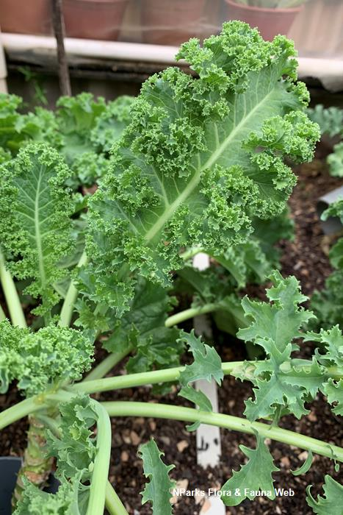
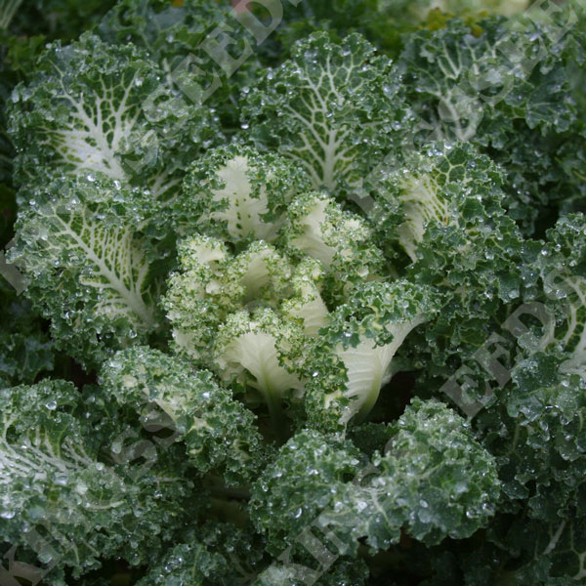
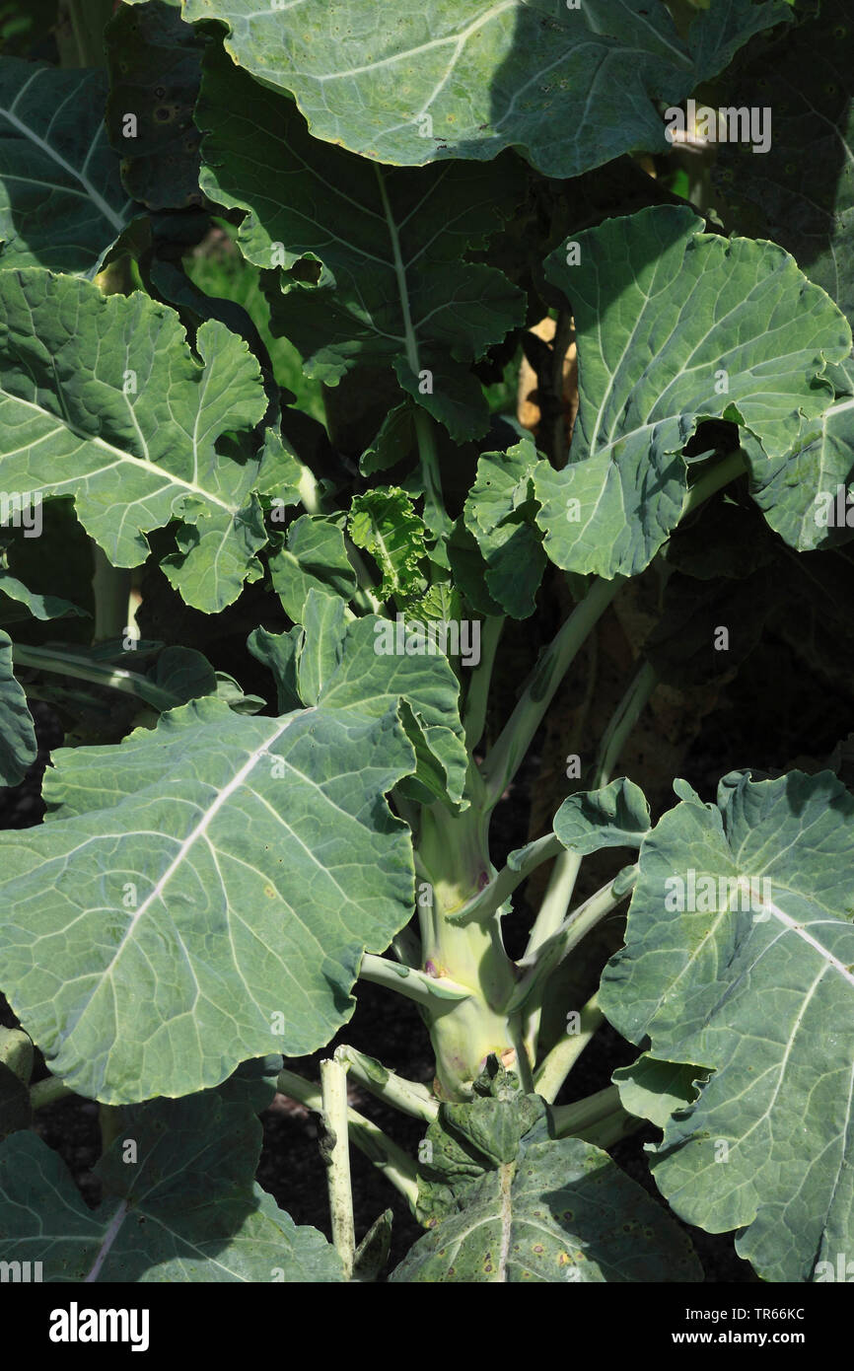
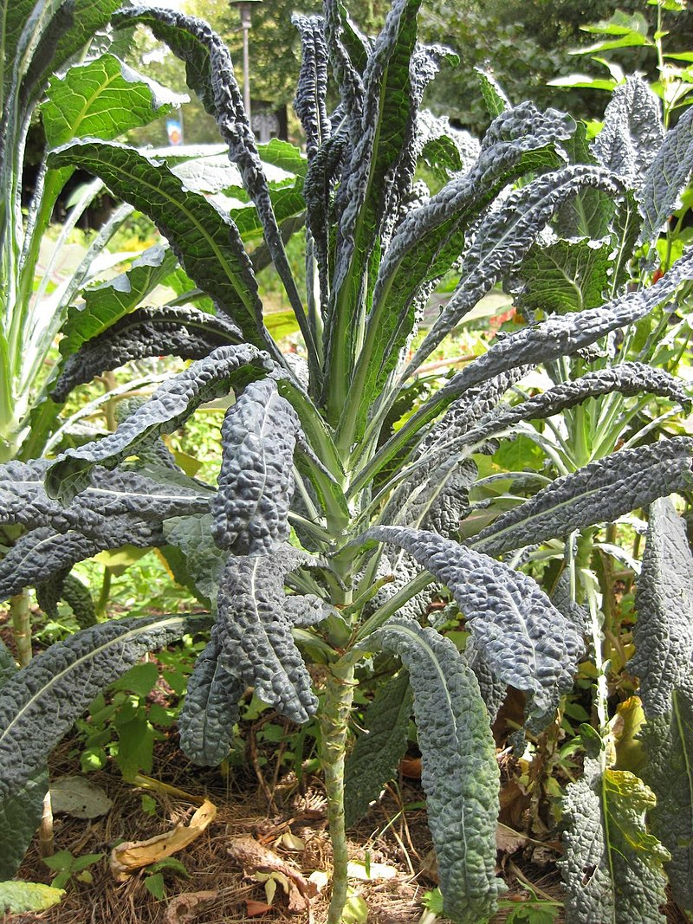
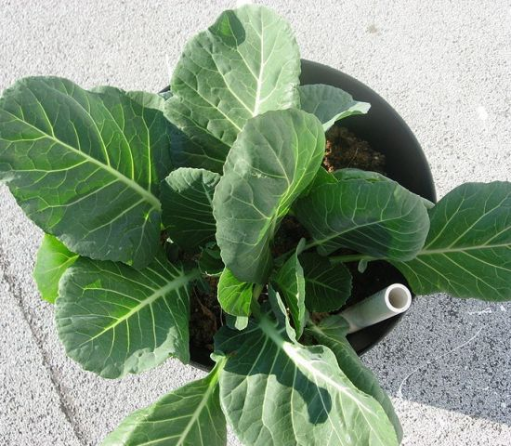
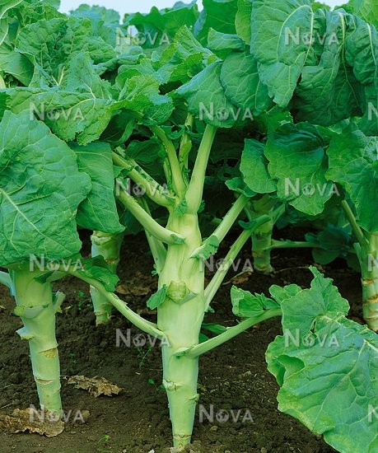
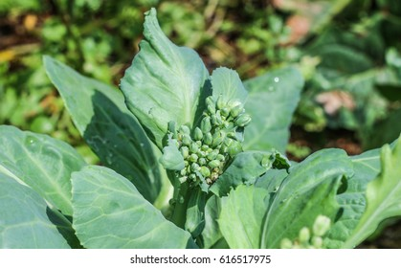
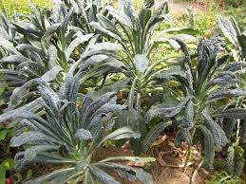
Marrow stem kale
Curly kale: B.O.sub. laciniata
Thousand headed kale: B.O.sub.millecapidata
Brassica alboglabra- Chinese kale
Collards: B.O.var. viridis
Smooth leafed kale
Tree kale

Slide 7
Continued… Types of kales
Branching bush kale: B.o. var fruiticosa also known as cow kale- for its edible foliage & extensively used for animal fodder.
Kale Varieties:
Delaway: it requires 60-65 days to first harvest. Features- good flavour, very attractive in nature producing long green leaves with purple tinge.
Lark’s Tounge: it’s a German kale variety actually called “Lerchenzungen”.
Its take 55 days to mature and very hardy in nature, 2-3ft height, slender, elongated and slightly ruffled leaves.
Red Russian: 55 days to mature having purple vein and deep lobbed leaves. It is tender and sweet even in summer.it can be harvested throughout the season if it is planted in spring.
Red Ursa, Redbore, Starbor, Tall scotch, Dwarf Siberian, Darkibor
Ripbor
Scarlet
Siberian
Toscano/lacinato
Vates Blue Dwarf –it is ready for harvest 30DAP
Collards varieties: Champion, Georgia, Vates, Flash Hybrid

Slide 8
Soil & climate requirements
Soil requirements:
Both the collards and kale can be grown on wide range of soils viz. sandy lams to clay loams.
However soil must be fertile, well drained with good water holding capacity.
The ideal soil reaction pH is between 6-7.5.
Climate requirements:
It is hardiest crop among brassicas capable of with stand temperature as -15ᵒC with better tolerance to high summer temperatures.
These are cool season vegetables and they can be grown in the temperature range of 12-18 ᵒC.
Chinese kale (Brassica alboglabra) requires comparatively high temperature around 18-20 ᵒC.
In this crops frost improves the edible quality of the leaves.
The collards are hardy to low as well as high temperatures than kale.
Rain fall about 30-500mm is best for optimum yield of kale.

Slide 9
Production technology
Mode of propagation : seed
Season of planting:
Summer crop-sowing (march-April)
Early summer-September-October- transplanting(Oct-November)
In hills: August-September
Depth of sowing:1-1.25cm with spacing 45-60cm(between rows) x 45cm(with in rows)
Dwarf varieties: 60 x60cm, 60 x 45cm
Medium varieties: 75 x 60cm, 75 x 45 cm
Tall varieties: 90 x 60cm
Nursery bed size: 1m width with convenient length is made followed by drenching of soil with mixture of fungicide Loyalty 10g+ Pyrimid 700 WP 100g insecticide+ sticker(20ml)/20L of water to minimize pest and diseases, to break dormancy to facilitate uniform germination of seeds.
Seed rate: dwarf varieties: 500-750g/ha Medium: 400-500g/ha and tall varieties: 350-400g/ha.

Slide 10
Manures & fertilizers requirements
Both the crops are heavy feeders.
For average fertile soils 15-20 t/ha FYM- final land preparation
Inorganics Dosage : N-100-150kg/ha
P-50-80kg/ha
K-50-80 kg/ha
Full P₂O₅ ,K₂O and 1/3rd N are mixed and applied as basal dose.
Rest N is applied in two equal splits :30 and 60 DAT as top dressing.
Early stages weeding should be managed.
1 or 2 hand weeding's followed by hoeing effectively controls weed population.
Intercultural operations

Slide 11
Harvesting and yield
Kale harvested in two ways
A) entire plant is cut off at ground level about 40 DAT
B) or the lower leaves are periodically picked.
The inner leaves and buds are left to produce new leaves
The leaves are harvested before they become old /mature, tough and stringy.
In collards all green parts of the plants are edible and may be harvested at any time during growing season after attaining 25-30 cm height.
Yield:
Average yield potential: 150-200q/ha
Post harvest management:
Both kale and collards greens may be stored in dry plastic bags in the refrigerator for up to 3 days.
They may be stored in the freezer in sealed plastic bags for the month.
On commercial scale, collards and kale are stored close to 0ᵒ C with RH of at least 95%. – shelf life held for 10-14 days.

Slide 12
