Slide 1
UNIT - 01 :- SOIL AND PLANT WATER RELATIONS
LECTURE - 03 :- CONCEPT OF OSMOSIS AND DIFFUSION

Slide 2
DIFFUSION
Diffusion is the movement of molecules from a region of higher concentration to a region of lower concentration down the concentration gradient.
Factors that affect the rate of diffusion:
Size of molecules
Size of pores in membrane
Temperature
Pressure
Concentration

Slide 3
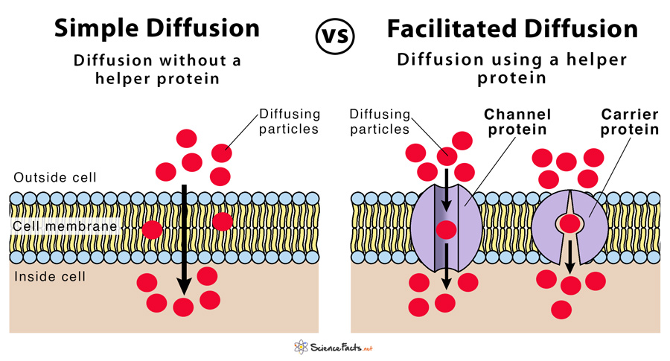
TYPES OF DIFFUSION
Simple diffusion
Facilitated diffusion
Fig; Difference between simple diffusion and facilitated diffusion

Slide 4
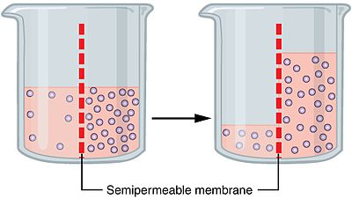
OSMOSIS
Osmosis is a passive process.
It involves the movement of molecules from a region of higher concentration to lower concentration until the concentrations become equal on either side of the membrane.
Fig; Osmosis

Slide 5
OSMOTIC SOLUTION
Types of Osmosis
There are three different types of solutions:
Isotonic Solution
Hypertonic Solution
Hypotonic Solution
Osmosis is of two types:
Endosmosis
Exosmosis

Slide 6
OSMOTIC PRESSURE
Osmotic pressure is the pressure required to stop water from diffusing through a membrane by osmosis.
It is determined by the concentration of the solute. Water diffuses into the area of higher concentration from the area of lower concentration.
When the concentration of the substances in the two areas in contact is different, the substances will diffuse until the concentration is uniform throughout.

Slide 7
THANK YOU

