Slide 1
UNIT - 01 :- SOIL AND PLANT WATER RELATIONS
LECTURE - 04 :-Soil physical properties and water availability in different soils;
Water holding capacity and approaches to improve WHC

Slide 2
SOIL PHYSICAL PROPERTIES
List of physical properties of soil:-
Soil Texture
Soil Structure
Density of Soil
Pore Space
Soil Consistence
Soil Colour.

Slide 3
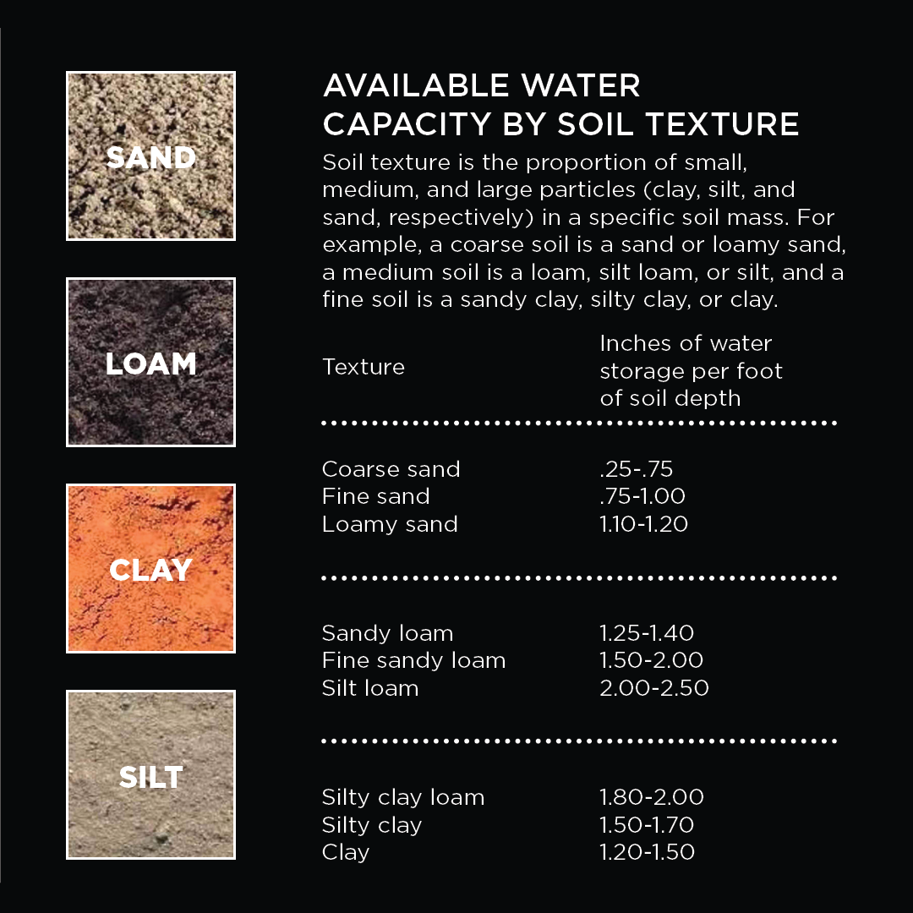
Water availability in different soils
Fig; Available water capacity by soil texture

Slide 4
WATER HOLDING CAPACITY
Water holding capacity is the amount of moisture that is held by the soil available to the plants.
Soils have different levels of water holding capacity largely determined by the texture of the soil.
Soil Texture is the relative amount of sand, silt and clay in the soil.
The soil texture also affects pore space, a portion of the soil not occupied by solid material but filled with air or water.
The larger the soil particle the larger the pore spaces.
Small particles have more spaces but they are smaller in size.

Slide 5
APPROACHES TO IMPROVE WHC
Water-holding capacity is controlled primarily by soil texture and organic matter.
Incorporate compost, manures, or other stable organic materials.
Grow and incorporate a high biomass cover crop.
Add a perennial crop to your rotation.
Add a sod crop to your rotation.
Reduce tillage to provide less disturbance to soil biota and structure.

Slide 6
THANK YOU

