Slide 1
UNIT - 02 :- WATER ABSORPTION AND TRANSLOCATION
LECTURE - 06 :-ROOT STRUCTURE AND FUNCTION;ROOT ARCHITECTURE AND RELEVANCE IN WATER MINING

Slide 2
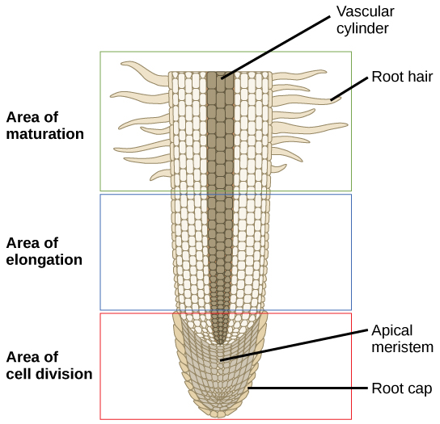
ROOT STRUCTURE
Fig; Structure of root

Slide 3
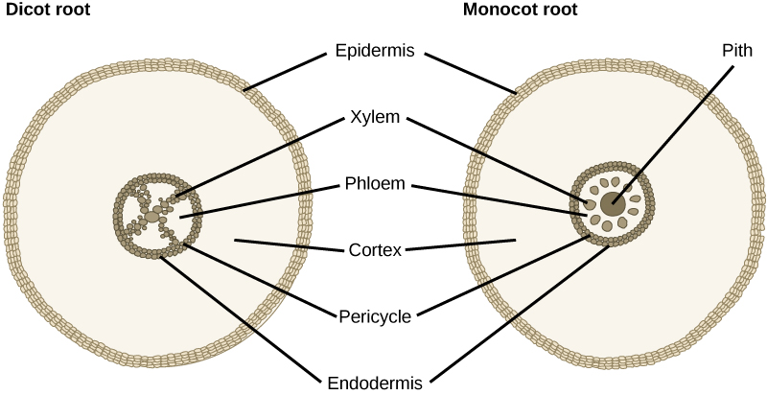
Fig; Root in cross section

Slide 4
FUNCTIONS OF ROOT SYSTEM
Primary functions are anchorage of the plant, absorption of water and dissolved minerals and conduction of these to the stem, and storage of reserve foods.
Ecological Function:- They check soil erosion, provide sustenance and also habitat to various organisms.
Roots help some of the weak stemmed plants to cling and hence climb up a support.

Slide 5
ROOT ARCHITECTURE
Root architecture and root growth are important for exploration of soil for water and nutrients, as the acquisition of these resources drives plant growth.
Root system architecture (RSA) refers to the spatial configuration of the root system or the explicit deployment of root axes
Plants have three types of root systems:
1.) Taproot, with a main taproot that is larger and grows faster than the branch roots.
2.) Fibrous, with all roots about the same size.
3.) Adventitious, roots that form on any plant part other than the roots.

Slide 6
RELEVANCE OF ROOT ARCHITECTURE
Roots are essential for plant productivity and serve a variety of functions, such as water and nutrient uptake, forming symbioses with other microorganisms in the rhizosphere, anchoring the plant to the soil, and acting as storage organs.
RSA and the mechanisms of its development will allow manipulation and exploitation of different root traits to improve plants’ adaptation to changing climates and increase yields for the growing global human population.
Root system architecture has a central role in crop plants’ response to abiotic stresses.

Slide 7
THANK YOU

