Slide 1
UNIT - 02 :- WATER ABSORPTION AND TRANSLOCATION
LECTURE - 07 :-MECHANISM OF WATER ABSORPTION AND TRANSLOCATION

Slide 2
ABSORPTION
The absorption of water is essential for various metabolic activities. Terrestrial plants get their water supply from soil which serve as the sources of water and (minerals).
The way in which water enter into the roots from the soil, particularly to the root xylem is called “Mechanism of water absorption”.

Slide 3
MECHANISM OF ABSORPTION
Active osmotic water absorption
Active absorption
B. Passive absorption
Active non-osmotic water absorption

Slide 4
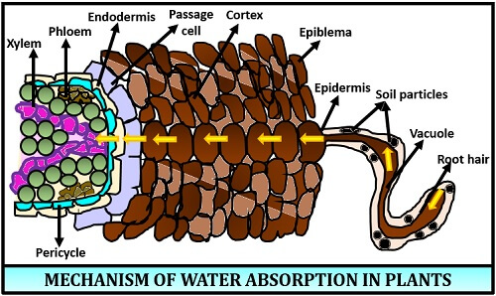
Fig; Mechanism of water absorption in plants

Slide 5
TRANSLOCATION
The movement of material from leaves to other tissues throughout the plants.
Plant produce carbohydrate in their leaves by photosynthesis, but non-photosynthetic parts of the plants also requires carbohydrates.
Occurs in Phloem

Slide 6
MECHANISM OF TRANSLOCATION
Munch Pressure flow hypothesis.
Sugar loaded into phloem.
Increase in solute potential .
Leads to increase in water uptake from xylem.
Builds up hydrostatic pressure .
Unloaded at sink.

Slide 7
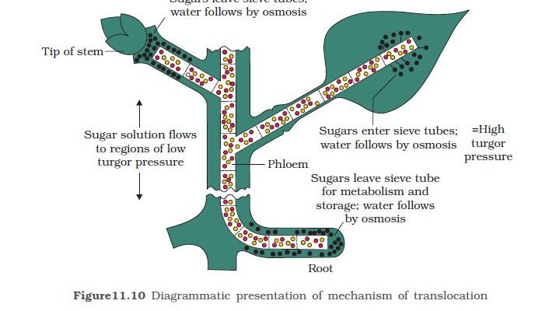
Fig; Mechanism of translocation

Slide 8
THANK YOU

