Slide 1
UNIT 03 - TRANSPIRATION AND EVAPORATIVE COOLING
LECTURE 17 – ANTITRANSPIRANTS AND THEIR RELEVANCE IN AGRICULTURE

Slide 2
INTRODUCTION
Antitranspirants are the compounds or the substances applied to the leaves of the plant for the purpose of reducing water loss without causing a momentous change in the various important processes of the plant .
Conservation of water is of high significant for green agriculture.
Compounds carried out to the surtance of the leaves in flowers to retard transpiration.
These have to additional assist in development of firstrate and productiveness in additionally in the sickness resistance parameter in the plant.

Slide 3
EXAMPLE
It include of the phenylmercury acetate , abscisic acid (ABA) , and aspirin.
Film-forming antitranspirants form a colourless film on the leaf surface that allows diffusion of gases but not of water vapour .
Include silicone oil , waxes .

Slide 4
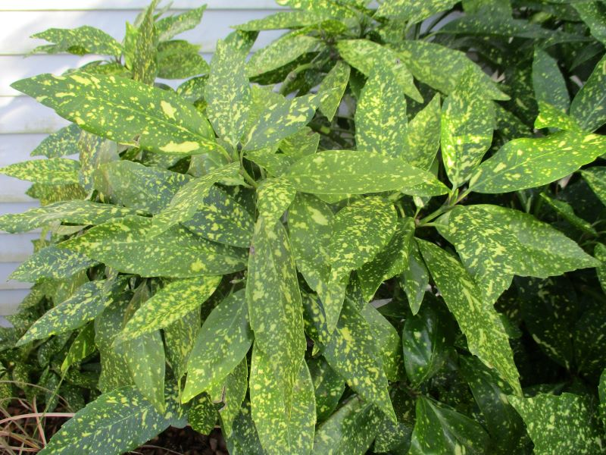
Fig ;- ANTITRANSPIRANTS PLANT

Slide 5
RELEVANCE OF AGRICULTURE
Antitranspirants are compounds applied to the leaves of plant to reduce transpiration.
They are used on Christmas trees, on cut flowers, on newely transplants' shrubs.
And the other applications to preserve and protect plants from drying out too quickly .

Slide 6
THANK YOU

