Slide 1
UNIT - 02 :- WATER ABSORPTION AND TRANSLOCATION
LECTURE - 09 :-MYCORRHIZAL ASSOCIATION AND ITS RELEVANCE IN WATER MINING

Slide 2
INTRODUCTION
The fungus root symbiotic relationship is called mycorrhizae.
All mycorrhizas have intimate contact between hyphae and plant cells in an interface where nutrient exchange occurs
Uptake of nutrient and Mineral nutrient acquisition from soil is considered to be the primary function of mycorrhizas, in addition to it’s roles in ecology, and man economic uses.

Slide 3
TYPES OF MYCORRHIZA
Two types of mycorrhiza occur in Nature;
Endomycorrhiza “vesicular-arbuscular” (common in more than 80 % of terrestrial plant species).
Ectomycorrhiza (specific to conifers and some broadleaved woody species)

Slide 4
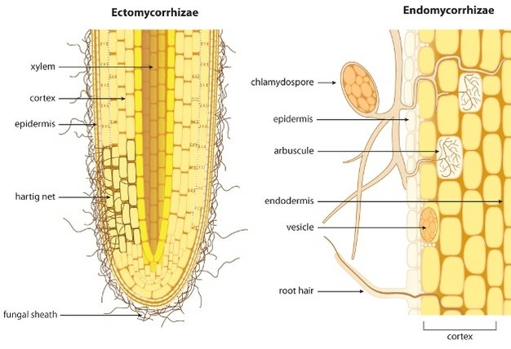
Fig; Ectomycorrhizae and Endomycorrhizae

Slide 5
MYCORRHIZAL RELEVANCE IN WATER MINING
The large surface area of the fungal hyphae is helpful in increasing the absorption of water and minerals from the soil.
In return, they get sugar and nitrogenous compounds from the host plants.
The mycorrhizal association is obligate in some plants. For example, Pinus seeds do not germinate and establish in the absence of mycorrhizal.

Slide 6
THANK YOU

