Slide 1
UNIT - 03 :-Transpiration and Evaporative Cooling
LECTURE - 10 :-Evaporation and transpiration; relevance of transpiration; factors regulating transpiration; Measurement of transpiration

Slide 2
EVAPORATION
The movement of water directly to the air from sources such as the soil and water bodies.
It can be affected by factors including heat, humidity, solar radiation and wind speed. Transpiration: the movement of water from root systems, through a plant, and exit into the air as water vapor.

Slide 3
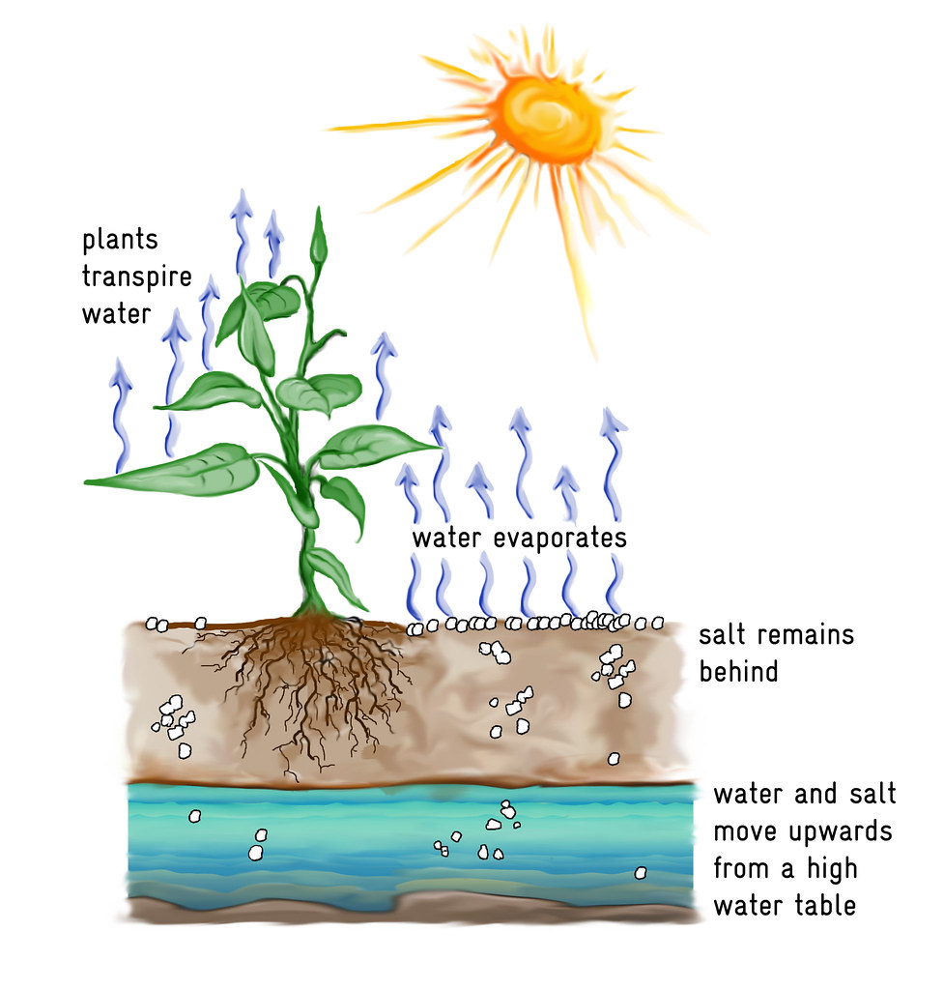
TRANSPIRATION
Transpiration is the process of water movement through a plant and its evaporation from aerial parts especially from leaves but also from stems and flowers.
Fig; Transpiration

Slide 4
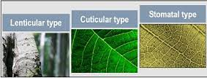
TYPES OF TRANSPIRATION
Stomatal Transpiration
Lenticular Transpiration
Cuticular Transpiration
Fig; Types of Transpiration

Slide 5
FACTORS REGULATING TRANSPIRATION
Cellular Factors
Light
Humidity
Temperature
Atmospheric pressure
Wind speed or velocity

Slide 6
RELEVANCE OF TRANSPIRATION
Transpiration helps in the conduction of water and minerals to different parts of the plants.
Due to the continuous elimination of water from the plant body, there is a balance of water maintained within the plant.
It maintains osmosis and keeps the cells rigid.
A suction force is created by transpiration that helps in the upward movement of water in the plants.

Slide 7
MEASUREMENT OF TRANSPIRATION
The weighing and potometer method is used to measure transpiration.
Bell jar and the cobalt chloride paper are used to prove that the process of transpiration occurs in plants.

Slide 8
THANK YOU

