Slide 1
UNIT -3 TRANSPIRATION AND EVAPORATIVE COOLING
LECTURE 12:- APPROACHES TO MINIMIZE EVAPORATION AND TRANSPIRATION ;CONCEPT OF CCATD AND ITS RELEVANCE

Slide 2
EVAPORATION
Evaporation is the process of during which a liquid changes into a gas .
Water changes to vapour through the absorption of heat.
One of the fundamental component of hydrological cycle.

Slide 3
TRANSPIRATION
Transpiration is the process by which water vapour leaves the living plant body and enters the atmosphere.
It involves continuous flow of water soil in to plant and out through stomata to the atmosphere.
Basically an evaporation process .

Slide 4
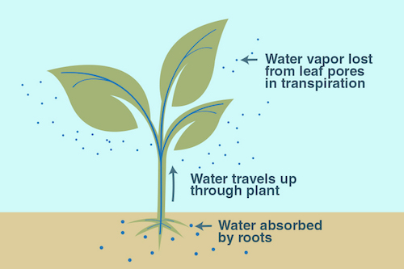
Fig; Transpiration

Slide 5
THANK YOU

