Slide 1
UNIT 03 – TRANSPIRATION AND EVAPORATIVE COOLING
LECTURE 14 – STOMATA – ITS STRUCTURE , FUNCTION AND DISTRIBUTION , MOLECULER MECHANISMS OF STOMATAL OPNING AND CLOSING

Slide 2
STOMATA
Stomata are the tiny opening present on the epidermis of the leves .
We can see stomata under light microscope on stems and other plant parts .they control by the transpiration rate by oprning and closing .
Stomata play an important role in gaseous exchange and photosynthesis .they control by transpiration rate by opening and closing .

Slide 3
Fig : STRUCTURE OF STOMATA

Slide 4
FUNCTION OF STOMATA
Gaseous exchange – stomatal opening and closure help in the gaseous exchange between the plant and surrounding.
It helps in transpiration and removal of excess water in the form of water vapour.
Stomatal closer at night prevent water from escaping through pores.
It maintain the moisture balance according to weather by opening and closing .

Slide 5
MOLECULES OF STOMATAL OPENING AND CLOSING
The molecules of stomatal opening and closing depend on the turgor pressure, caused by the osmotic flow of water in the guard cells.
When the guard cell are turgid ; they expand resulting in the opening of stomata.
Stomata normally open when the light strikes the leaf and close during the night .

Slide 6
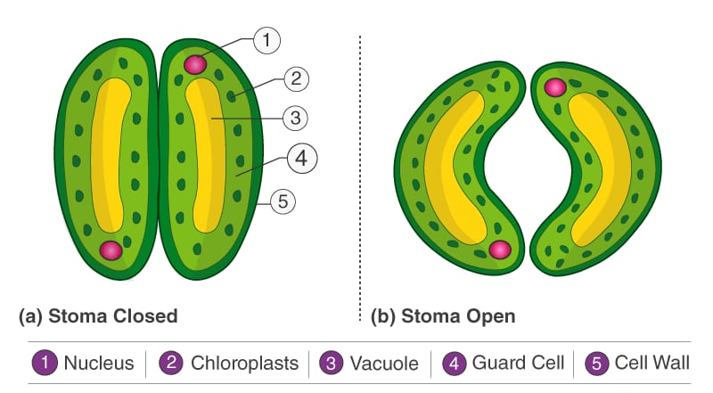
Fig:- OPENING AND CLOSING OF STOMATA

Slide 7
THANK YOU

