Slide 1
UNIT 03- TRANSPIRATION AND EVAPORATION COOLING
LECTURE 16 – GUARD CELLS RESPONSE TO ENVIRONMENTAL SIGNALS; SIGNALLING CASCADE ASSOCIATED WITH STOMATAL OPENING AND CLOSURE

Slide 2
INTRODUCTION
Guard cells play a key role in responding to environment changes .
Guard cells regulate stomatal apertures by integrating environmental signals and endogenous hormone stimuli.
Guard cell have been studies extensively as a model system for dissecting the dynamics and mechanism of environment sensing .

Slide 3
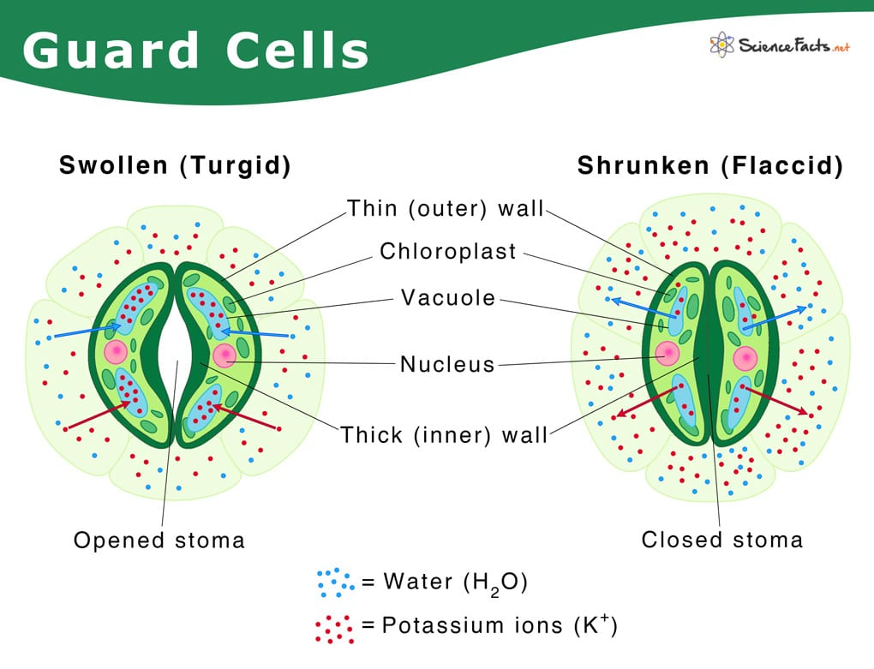
Fig ;- GUARD CELLS

Slide 4
STOMATAL OPENING AND CLOSURE
ABA is the known as the stress hormone that closes the stomata although other phytohormones such as jasmonic acid , brassino steroids, cytokinins are also involved in the stomatal response stress.
As a part of the drought ABA may interact with jasmonic late stomatal closure.
In the addition of the gene that are related to ethylene, cytokinins, changes in pathway including the specific gene.

Slide 5
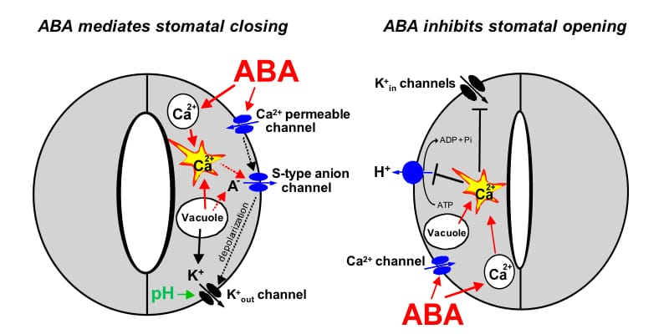
Fig: STOMATAL OPENING AND CLOSURE

Slide 6
THANK YOU

