Slide 1
Course name –
Principles and Practices of Water Management (AGRO 0504)
Course Credit – 2+1
Lecture 1
Topic: Water and its role in plants; Irrigation: Definition and objectives.

Slide 2
Introduction
Sustainable development and efficient management of water is an increasingly complex challenge in India. Increasing population, growing urbanization, and rapid industrialization combined with the need for raising agricultural production generates competing claims for water. There is a growing perception of a sense of an impending water crisis in the country.

Slide 3
importance
The importance of irrigation in the world is well stated by N.D. Gulhati of India:
“Irrigation in many countries including India is an age-old art – as old as civilization – but for the whole world it is a modern science – science of survival”.

Slide 4
After independence, production registered nearly 4.52 times increase from around 50.8 million tons in 1950-51 to about 230 million tons in 2007-08. This has been mainly attributed to three factors viz., high yielding cereals, expansion of area under irrigation and fertilizer use. Irrigation may be considered as the major factor of modern intensive agriculture as it aids in efficient use of costly fertilizers and other inputs besides meeting crop water needs.

Slide 5
On the other hand, improper irrigation causes wastage of large amounts of water, leach mineral nutrients from the root zone into the deeper layers contaminating groundwater, and impairs the productivity of soil, or yield losses may occur if insufficient water applied. Excessive application of water causes water logging and increase high water tables or seepage spots to develop which may be corrected only by the construction of expensive drainage systems. In addition, salts accumulate and an alkali soil may develop.

Slide 6
India, with a population of over a billion is the world’s largest democracy, historically, civilization in India as around the world have largely evolved and developed around water bodies as most human activities, including agriculture and industry depend on water. The water situation in India seems to be going from bad to worse. Not only is there a growing scarcity of water in the country, the agriculturally important states like Punjab, Haryana, Tamilnadu and Rajasthan are facing a steady fall in their ground water levels. While the per capita availability of utilizable water in India in 1951 was 3,450 cubic meters in 1999 it came down to 1,250 cubic meters. This according to the Ministry of Water Resource is expected to decrease to 662 cubic meters per person in 2050.

Slide 7
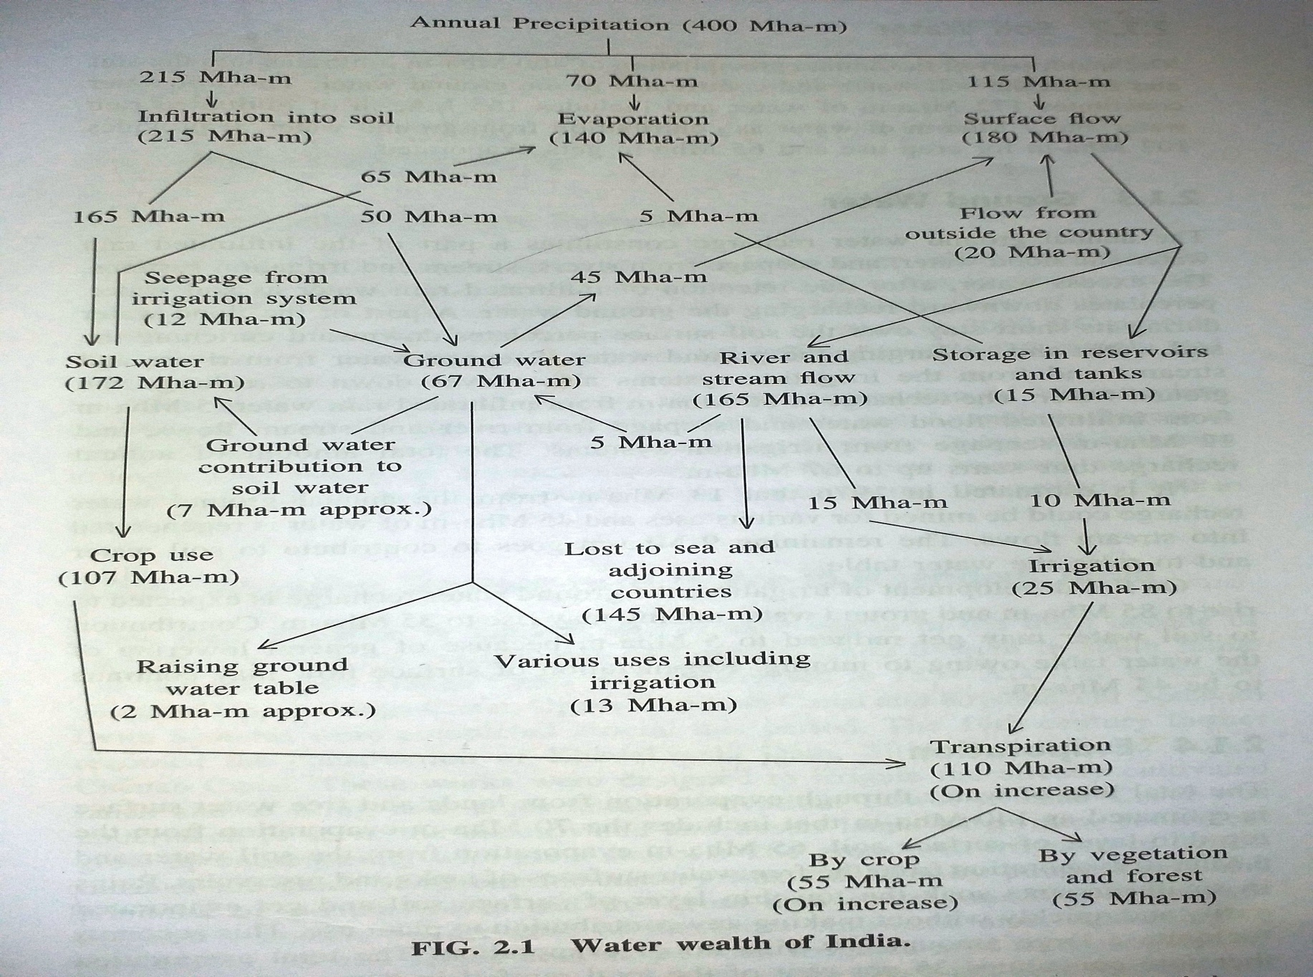

Slide 8
Rain
Evapotranspiration
I
Irrigation channel
I
I
D
I
I
I
D
D
Drainage channel
Seepage
I
I
Percolation
S
Groundwater
inflow
P
Recycling
pump
Tubewell/pump
Groundwater
Outflow
Notes:
5

Slide 9
UNIT - I
Water and its role in plants
To add water to the soil for supplying moisture essential for normal plant growth and development
To provide crop insurance against short duration droughts
To leach or dilute excessive salts in the crop root zone, thereby providing a
favourable environment in the soil profile for absorption of water and nutrients
To soften tillage pans
To cool the soil and atmosphere, thereby making more favourable microenvironment for plant growth

Slide 10
Irrigation – Definition
It is generally defined as “application of water to soil for the purpose of supplying the moisture essential for normal plant growth and development”.
In other words it is the human manipulation of hydrological cycle to improve crop production and quality and to decrease the economic effects of drought. However, a broader and more meaningful definition is that irrigation is the application of water to the soil for the different purposes

Slide 11
Objective
To reach the principles of water management and practices to enhance the water productivity.
a) To increase crop production on sustainable basis where water is
b) Modification of soil & climatic environment
c) To mitigate i.e., lessen the risk of catastrophes caused by drought
d) To increase population of arid and sparsely populated areas
e) National security i.e., self sufficiency in food grain production

