Slide 1
Course name – Principles and Practices of Water Management (AGRO 0504) Course Credit – 2+1
Lecture 10
Topic: Scheduling, depth and methods of irrigation

Slide 2
Scheduling of irrigation
Scientific irrigation scheduling is a technique providing knowledge on correct time and optimum quantity of water application at each irrigation to optimize crop yields with maximum water use efficiency and at the same time ensuring minimum damage to the soil properties.
Meteorological data (temperature, Wind speed, sunshine, relative humidity and rain fall), crop data (growth dates, crop coefficient and root zone) and soil data (soil texture, available soil moisture and initial soil moisture) is used to calculate irrigation water requirements for crops (Allen et al., 1996). In this work, water use for sectors other than agriculture has not been considered in the water balance, because it is mostly a non-consumptive use and generally negligible when compared to agriculture water use.

Slide 3
Criteria for scheduling irrigation
With the advancement of knowledge in the field of soil-plant-atmospheric system several criteria for scheduling irrigations are now available and are being used by investigators and farmers. All the available criteria can be broadly classified into the following three categories:

Slide 4
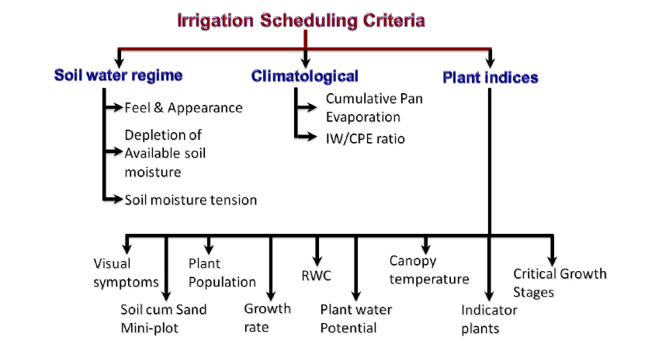

Slide 5
Potential evapotranspiration (PET)
Penmen (1948) introduced the concept of PET and he defined it as “the amount of water transpired in a unit time by short green crop of uniform height, completely covering the ground and never short of water”. He further stated that PET cannot exceed panevaporation under the same weather conditions and is some fraction of pan evaporation.
PET can be estimated by several techniques viz., lysimetric methods, energy balance,
aerodynamic approach, combination of energy balance and empirical formulae etc., and
irrigation’s can be scheduled conveniently based on the knowledge of PET or water use
rates of crops over short time intervals of crop growth.

Slide 6
Lysimeter
By isolating the crop root zone from its environment and controlling the processes that are difficult to measure, the different terms in the soil water balance equation can ben determined with greater accuracy. This is done in lysimeters where the crop grows in isolated tanks filled with either disturbed or undisturbed soil

Slide 7
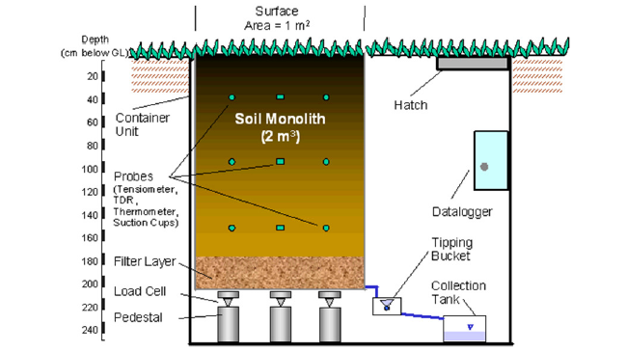
Schematic Lysimeter

Slide 8
Different types of lysimeters vary widely in the accuracy with which changes in soil water are detected. In precision weighing lysimeters, where the water loss is directly measured by the change of mass, evapotranspiration can be obtained with an accuracy of a few hundredths of a millimetre, and small time periods such as an hour can be considered.
In non-weighing lysimeters the evapotranspiration for a given time period is determined by deducting the drainage water, collected at the bottom of the lysimeters, from the total water input.
A requirement of lysimeters is that the vegetation both inside and immediately outside of the lysimeter be perfectly matched (same height and leaf area index).
Lysimeters provide the direct estimates of water balance components viz., E, T, ET, drainage, runoff, effective rainfall etc in a cropped field against which other methods can be tested and calibrated. As lysimeters are difficult and expensive to construct and as their operation and maintenance require special care, their use is limited to specific research purposes.

Slide 9
Cumulative pan evaporation
Earlier investigations have shown that transpiration of a crop is closely related to free water evaporation from an open pan evaporimeter .Thus, the open pan evaporimeter being simple and as they incorporate the effects of all climatic parameters into a single entity i.e., pan evaporation could be used as a guide for scheduling irrigation’s to crops. For example,
Wheat required 75 to 100 mm CPE at Ludhiana
Sugarcane required 75 mm CPE in Maharashtra
Greengram required 180 mm CPE at Ludhiana
Sunflower required 60 mm CPE at Bangalore

Slide 10
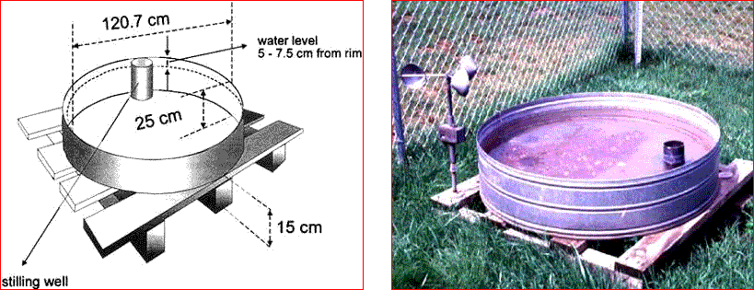
USWB Class A Pan evaporimeter

Slide 11
IW : CPE ratio
Prihar et al. (1974) advocated irrigation scheduling on the basis of ratio between the depth of irrigation water (IW) and cumulative evaporation from U.S.W.B. class A pan evaporimeter minus the precipitation since the previous irrigation (CPE). An IW/CPE ratio of 1.0 indicates irrigating the crop with water equal to that lost in evaporation from the evaporimeter. Few examples of optimal IW/CPE ratios for important crops are given in Table.

Slide 12
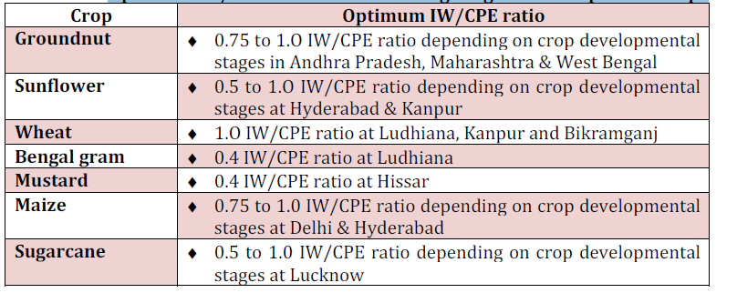
Optimum IW/CPE ratios for scheduling irrigation in important crops

Slide 13
However, the criterion does not take into consideration the critical growth stages for irrigation. It may also not hold well under the following situations.
1. For crops requiring 1-2 irrigations only
2. Determining timing of first and last irrigation
3. Under low temperature/ frost/ salt stresses
Further, the optimum value of CPE for fixed/ variable depth of irrigation has to be worked out for different crops and locations.

Slide 14
METHODS OF IRRIGATION Surface irrigation method refers to the manner or plan of water application by gravity flow to the cultivated land wetting either the entire field (uncontrolled flooding) or part of the field (furrows, basins, border strips).

Slide 15
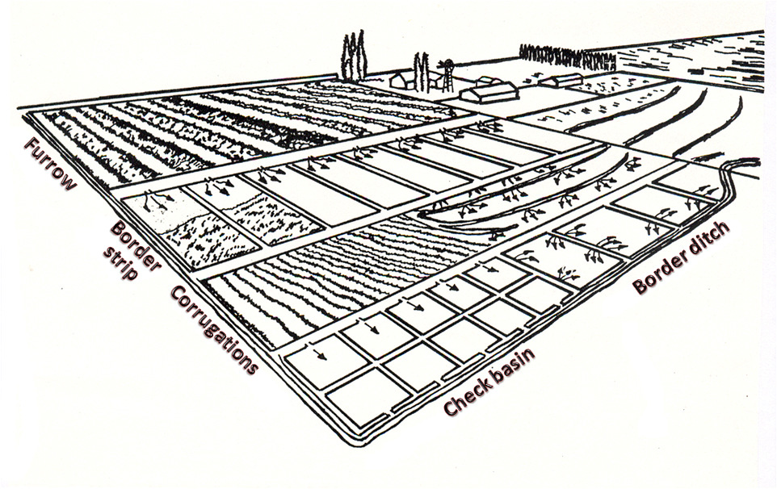

Slide 16
Surface irrigation

Slide 17
Surface Irrigation
Surface irrigation refers to irrigating lands by allowing water to flow over the soil surface from a supply channel at upper reach of the field. Most irrigation method followed in India.
Principles involved are:
Field is divided into plots or strips to uniformly irrigate the soil to a desired depth.
Water is discharged at the highest level of the field allowing water to flow down the gentle slope by gravity.
Water loss by run-off or deep percolation is avoided.
Efficiency of irrigation is kept at a high.
Size of stream should be such as to have an adequate control of water.

Slide 18
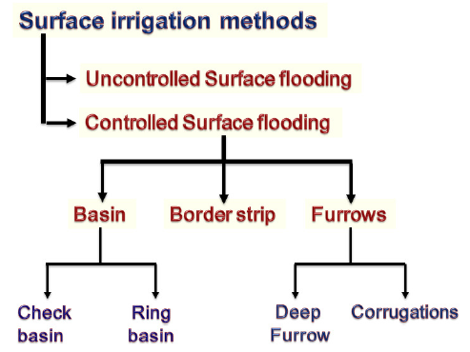

Slide 19
Surface Irrigation
Advantages
Disadvantages
Variable size of streams can be used.
Large flow of water can be easily controlled.
Skilled persons are not required.
Cost of water application is low.
Considerable land is wasted in construction of channels and bunds
Initial construction cost is high.
Causes soil erosion

Slide 20
Methods involving complete flooding

Slide 21
Wild flooding
Wild flooding refers to irrigating fields that are relatively flat and level by allowing water from supply channels to flow over the land surface along the natural slope without much guidance by channels and bunds.
This method is exclusive for low land rice cultivation. Water is allowed from the channel to the entire field.

Slide 22
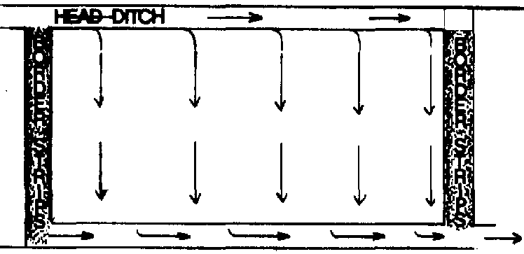
Wild flooding

Slide 23
Wild flooding
Advantages
Disadvantages
Land does not require precise land leveling and grading.
Water application is quite cheap and easy.
Skilled labour is not required.
Flooding is uncontrolled.
Uniform wetting of land cannot be achieved.
Excessive water loss may occur.
Water application efficiency is low.

Slide 24
Border strip irrigation
In this method, field is laid out into long, narrow strips, boundering with small bunds.
Length of the strips ranges from 30 to 300 m and width from 3 to 15 m.
Water from the channel is allowed into each strip at a time.
Method is suitable for close growing crops and medium to heavy textured soils, but not suitable for sandy soil.

Slide 25
Border strip irrigation
Types of border
Straight border
Borders are laid along the general slope of the field.
Grading of the field is done by scraping away the surface soil from one part to other without affecting the soil productivity.
Contour border
Borders are laid across the slope of the field.
It is normally done when slope of the land is very steep with a shallow soil depth and levelling is not feasible.

Slide 26
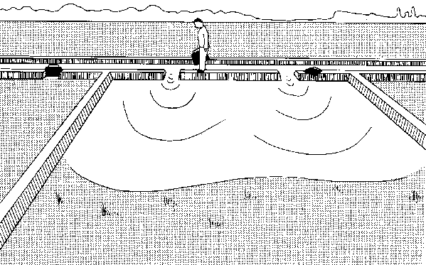
Border strip irrigation

Slide 27
Border strip irrigation
Advantages
Disadvantages
No land is wasted for making channels excepting the supply channel.
Borders can be used for growing crops.
Water application efficiency is high.
Labour requirement is low.
Initial construction cost is high.
Precise levelling is essential.
Enough skill is required in applying water.

Slide 28
Check basin irrigation
In this method, field is divided into small plots surrounded by bunds on all the four sides.
Water from main channel is supplied to the field channels one after the other.
Each field channel supplies water to two rows of check basins and water is applied to one basin after another.
Size of check basins ranges from 4 m × 3 m to 6 m × 5 m depending on the stream size and soil texture. This method is the most common method among surface method of irrigation

Slide 29
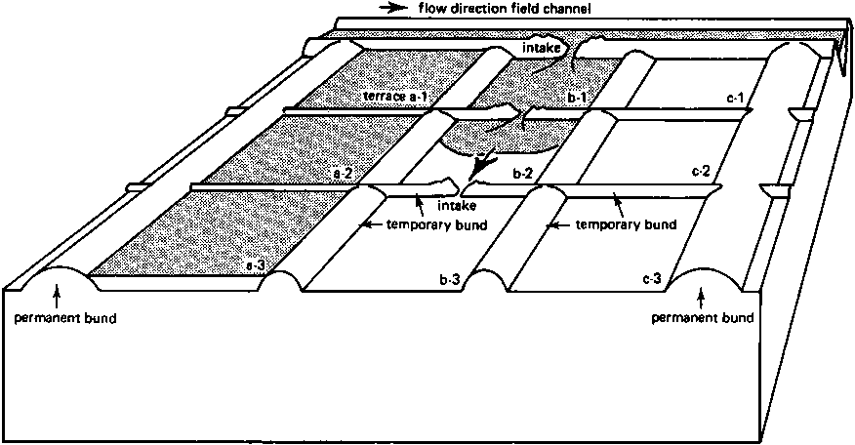
Check basin irrigation

Slide 30
Check basin irrigation
Advantages
Disadvantages
Variable size of streams can be effectively used.
It can be adopted for a wide range of soil.
Water application efficiency is high.
Water logging condition can be easily created for rice crop.
Precise land levelling is essential.
Considerable land is wasted by bunds and channels.
Movement of implements and machinery are often restricted by bunds.
Labour requirement is high.

Slide 31
Contour ditch irrigation
In topography with sloping and rolling where land leveling is not economical, the contour ditch or contour channel irrigation is adopted.
Supply ditches are constructed along with the contours at certain intervals depending on the slope of land.
Water is flooded down the slope from the upper ditch to irrigate the lower land between two adjacent ditches.

Slide 32
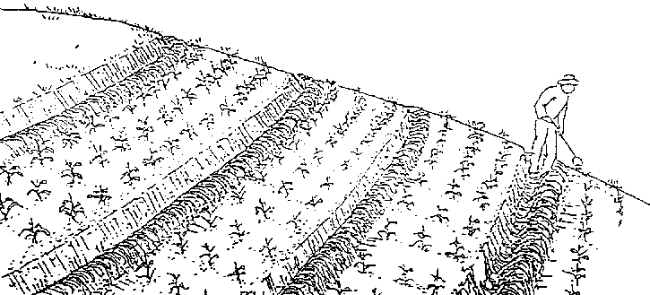
Contour ditch irrigation

Slide 33
Contour ditch irrigation
Advantages
Disadvantages
It does not require precise land levelling.
Cost of land preparation is low.
Chances of soil erosion are low.
Labour cost is high.
Application efficiency is not high.

Slide 34
Methods involving partial flooding

Slide 35
Furrow irrigation
A method of surface irrigation in which water is delivered to the field through shallow ditches between ridges on which plants are grown.
The size and slope of the furrow depends upon the crop grown, equipment’s used and spacing between two crops.
Crops like maize, sorghum, potato, tobacco and sugarcane etc. are suitable for this method of irrigation.

Slide 36
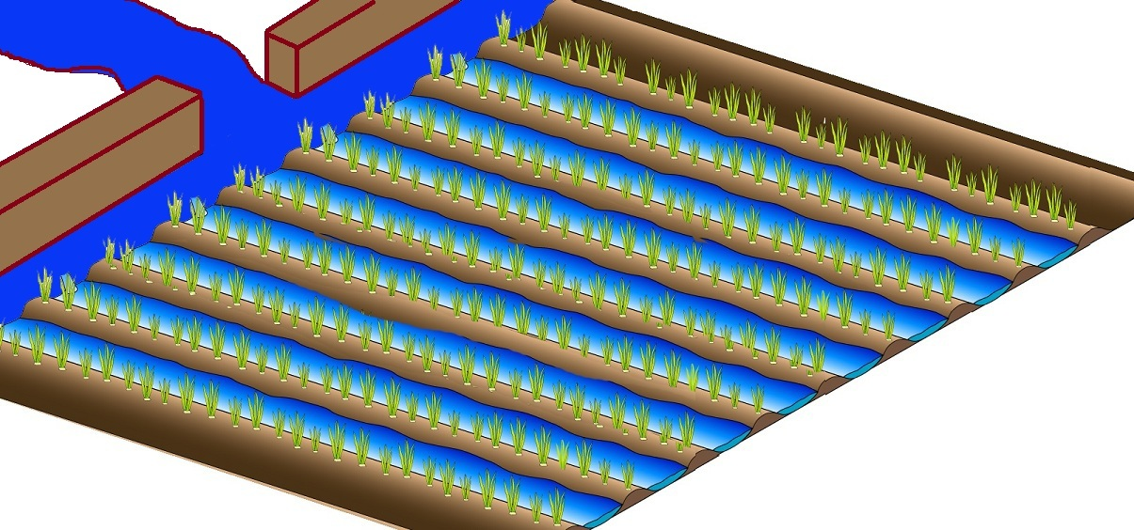
Furrow irrigation

Slide 37
Types of Furrow irrigation
Alternate furrow
Broad bed and furrow
Skip furrow
Straight graded furrow
Straight level furrow
Contour furrow irrigation

Slide 38
Furrow irrigation
Advantages
Disadvantages
Uniform water application
High water application efficiency
Wide range of soil can be irrigated
Variable sizes of stream can be used
More saving of water as compared to flood method of irrigation
No erosion hazard
Land requires precise grading to a uniform slope.
Labour requirement is high for grading land and making furrow.
Un suitable for light soil.

Slide 39
Corrugation
“Corrugation” means miniature furrows that are adopted for irrigating close growing crops.
This method is suitable for fine to moderately coarse soil.
Corrugation is ‘V’ shaped or ‘U’ shaped channels of about 10 cm depth, 40-75 cm apart.
The slope should be just enough not to permit soil erosion.
Corrugation is usually made after the crops shown but before germination of seed with simple implement called corrugator.

Slide 40
Corrugation

Slide 41
Corrugation
Advantages
Disadvantages
To save good amount of water
Small sized streams can be used effectively to prevent crusting of soil.
High water application efficiency
No need of previous land leveling
Not suitable for high rainfall areas
Not suitable where the land is leveled or slope is less than 1%
Not suitable for sandy soil.

Slide 42
Basin irrigation
A basin is usually made for the tree sapling but it may include more than one sapling when they are not spaced very wide.
Basin may be square, circular or rectangular. Water is supplied through laterals and each basin is connected to a lateral with a short and narrow furrow.

Slide 43
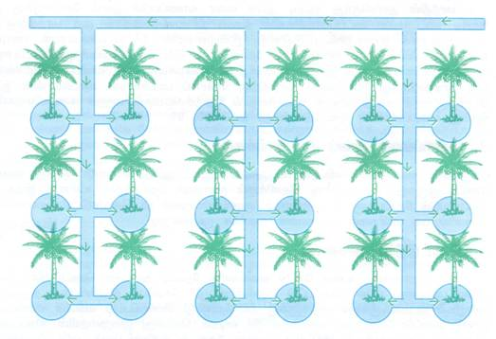
Basin irrigation

Slide 44
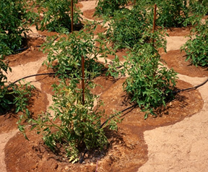
Ring irrigation
In this method, a ring is laid at the periphery of the tree canopy.
The dimension of ring trenches is 30-50 cm wide and 30 cm deep.
This method is adopted in orchards.

Slide 45
Ring and Basin irrigation
Advantages
Disadvantages
Save considerable amount of irrigation water.
Reduce water losses through deep percolation and evaporation.
Water application efficiency is very high.
Control variable size of stream.
Adaptable only in orchard and plantation crop.
Restrict the movements of animals and farm machinery.

Slide 46
Sub - surface irrigation

Slide 47
Sub-surface irrigation
Sub surface irrigation or sub irrigation involves irrigation to crops by applying the water from beneath the soil surface either by constructing trenches or installing underground perforated pipe lines or tile lines.
The principal crops that can be irrigated through this method are potato, sugar beet, vegetable, alfalfa coconut etc.
In India, this method is commonly used in Kashmir for vegetable crops and in Kerala for coconut crop.

Slide 48
Sub-surface irrigation
Conditions to be satisfied for application of Subsurface irrigation:
High water table or a hard impermeable pan should be located bellow the root zone.
High permeable surface soil such as loam or sandy loam is required.
Uniform topographic condition and moderate land slope is required.
Water used for irrigation should not be saline.

Slide 49
Sub-surface irrigation
Advantages
Disadvantages
Water is not lost through deep percolation.
Minimum evaporation losses from the soil surface.
Operation of farm machinery is possible at any time.
Good quality irrigation water is required.
Chance of soil salinity and alkalinity due to upward movement of salts with the water.

Slide 50
Overhead irrigation

Slide 51
Sprinkler irrigation
The method of aerial application of water through pipes fitted with sprinkling units.
The spray is developed by the flow of water under pressure through small orifices and nozzles.
It releases water similar to rainfall through a small diameter (0.5 and 4.0 mm in size) nozzle placed in the pipes.

Slide 52
Sprinkler irrigation
Adaptability:
For almost all crops except rice and jute.
Sandy soil having high infiltration rate.
Steep slopes or uneven topography.
For growing high price crops.
Where water is scarce and costly.

Slide 53
Suitable crops
Sprinkler irrigation is suited for most field crops viz., wheat, lucerne, groundnut, bengal gram, green gram, black gram, potato, leafy vegetables, sunflower, barley, bajra, maize, wheat etc wherein water can be sprayed over the crop canopy

Slide 54
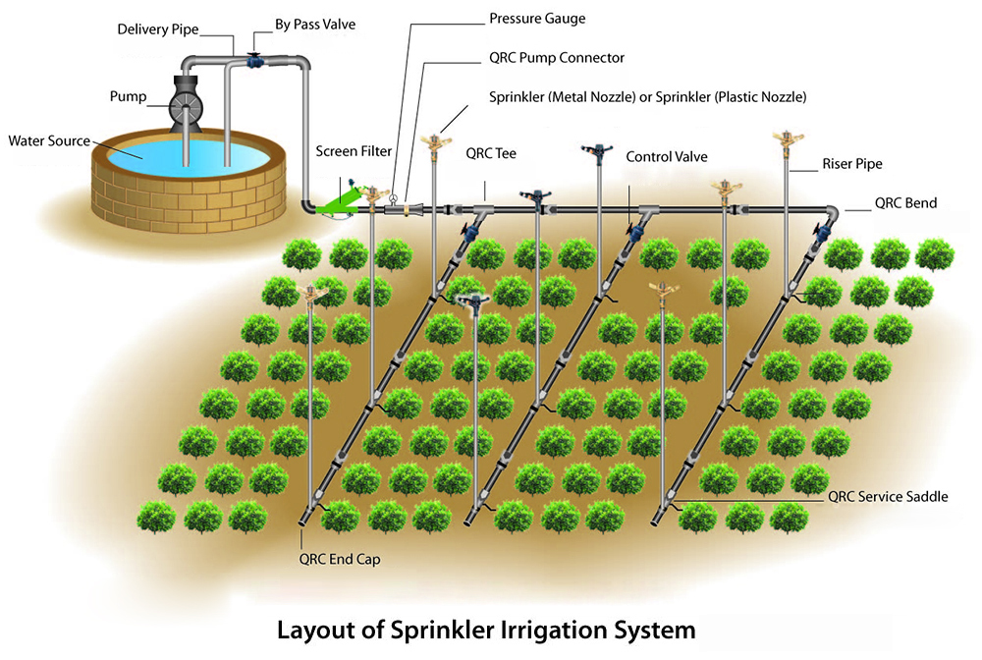
Sprinkler irrigation

Slide 55
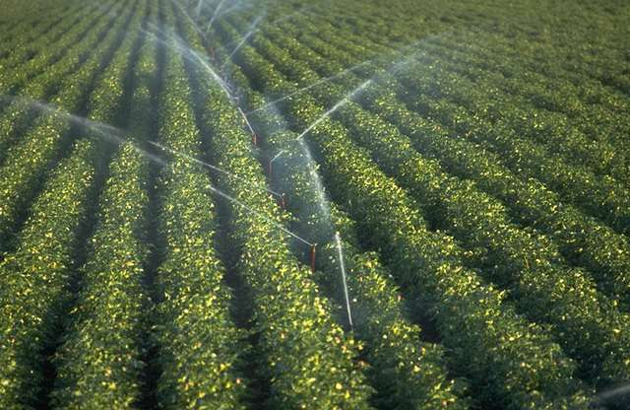
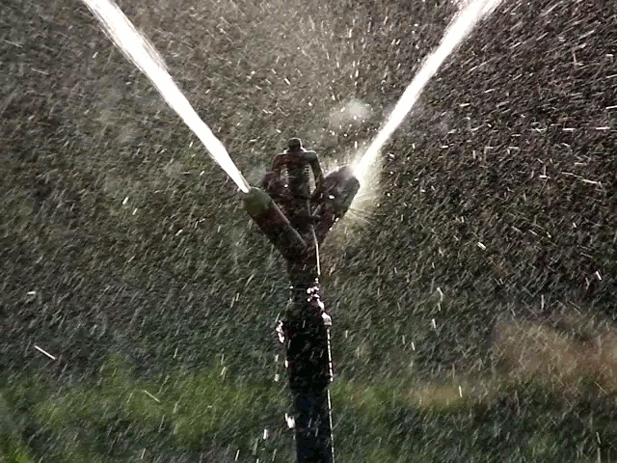
Sprinkler irrigation

Slide 57
Sprinkler irrigation
Advantages
Disadvantages
Water use is economized as losses by deep percolation can be totally avoided.
Land leveling is not necessary.
Water application efficiency is very high.
Application of pesticides, herbicides and fertilizers can be easily made along with irrigation water.
Uniform application of water can be made.
High capital investment is involved in its installation.
Operating cost is high.
Clean water is needed to avoid clogging of nozzle.
Areas with hot winds are not suitable.

Slide 58
Thank You…

