Slide 1
Course name –
Principles and Practices of Water Management (AGRO 0504)
Course Credit – 2+1
Lecture 11
Topic: Micro irrigation systems; deficit irrigation;

Slide 2

Micro irrigation

Slide 3
Drip (or) Trickle irrigation
Drip irrigation is defined as the precise and slow application of water in the form of discrete or continuous or tiny streams or miniature sprays through mechanical devices called emitters at the specific point.
In 1964, Symcha Blasé, an Israeli engineer first developed the irrigation system.
USA has the largest area under drip irrigation.
In India, Maharashtra has the largest area under drip irrigation.

Slide 4
Drip irrigation
Adaptability:
Arid regions
Areas under water scarcity and salt problems.
For various types of crops like grape, apple, strawberry, corn, cotton, sugarcane, tomato, cauliflower, lettuce, cucumber, onion etc.
Efficiency of drip irrigation:
Ex.- Sugarcane under drip irrigation system yields about 1000 t/ha, 35% more than conventional irrigation.

Slide 5
Suitable crops
Drip irrigation, like other irrigation methods, will not fit every agricultural crop, specific site or objective. Presently drip irrigation has the greatest potential in the following crops:

Slide 6
a)Fruit crops – Mango, citrus, grapes, guava, pomegranate, banana, papaya, watermelon, Litchi, Fig, Ber, Amla, Sapota etc
b) Vegetable crops – Tomato, Brinjal, Bhendi, Cabbage, Cauliflower, Capsicum, Chillies gourds etc
c) Plantation crops – Oil palm, Coconut, Arecanut, Cashewnut, Coffee, Tea etc
d) Field crops – Cotton, Sugarcane, Tobacco, Sugarbeet, Castor etc
e) Tuber & Bulb crops – Potato, Cassava, Onion, Sweet potato, Radish, Colocasia etc
f) Spices – Turmeric, Ginger, Cardamom etc
g) Flowers – Roses, Rose, Gerbera, Orchids, Anthurium, Gladiolus, Carnations, Jasmine, Chrysanthemum, Marigold etc.

Slide 7
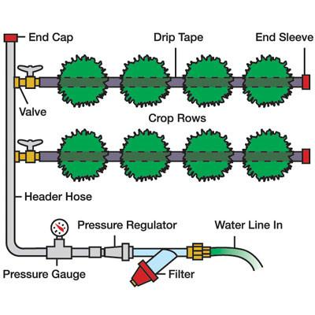
Drip irrigation

Slide 8
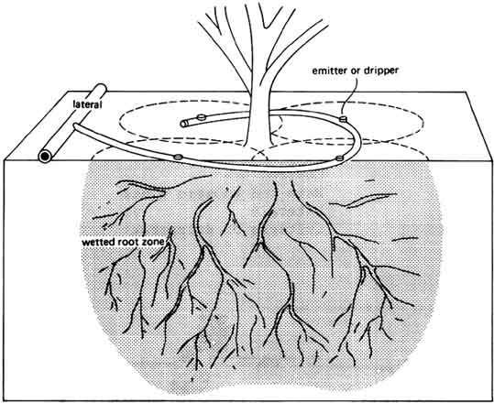
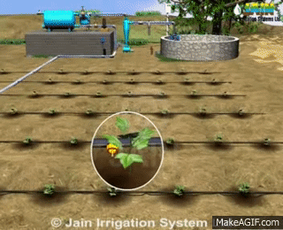
Drip irrigation

Slide 9
Drip irrigation
Types of drip irrigation system:
Surface drip irrigation system
Sub-surface drip irrigation
Continuous- flow Drip irrigation
Fertigation:
Application of irrigation water along with fertilizer in amount and in location at a rate which matches the plant requirement is known as fertigation.

Slide 10
Drip irrigation
Indigenous drip method of irrigation:
This method is cheap, consists of mud pots of 20 liters capacity with pencil size hole made a little above the bottom.
These pots are kept buried neck deep in the basins of fruit trees. The pots are filled with water and covered with lid.
Water slowly trickles from the pot and replenishes the root zone. This method is suitable for young fruit trees and vegetable crops.
By this method, considerable amount of water is saved.

Slide 11
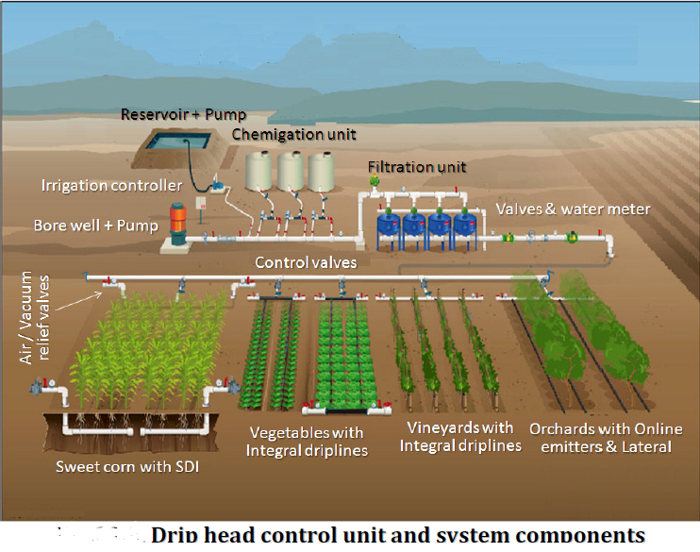

Slide 12
Drip irrigation
Advantages
Disadvantages
Irrigation is possible with low available discharge.
High water application efficiency.
Labour requirement is low.
Improves fertilizer use efficiency.
Weed growth is minimum.
Possibility of using saline water.
Initial capital investment is high.
High skill is required for design, installation and maintenance of the system.
Clogging of emitters may create problem.

Slide 13
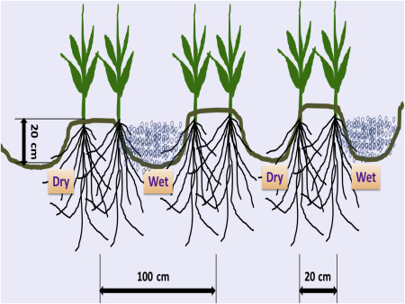
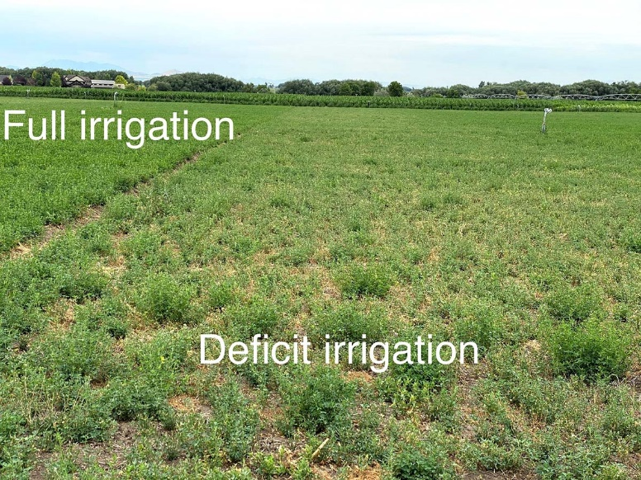
The application of water below the evapotranspiration requirements of the plant is called deficit irrigation.

Slide 14
Yield Response Factor (Ky)

Slide 15
Deficit irrigation is an optimization strategy
Here irrigation is applied during drought-sensitive growth stages of a crop.
Outside these periods, irrigation is limited or even unnecessary if rainfall provides a minimum supply of water.
Water restriction is usually imposed at early vegetative and the late ripening stages.
While this inevitably results in plant stress and consequently in production loss.
Deficit irrigation maximizes irrigation water productivity.

Slide 16
Fully irrigated plants usually have widely opened stomata.
Plants open their stomata for intake of CO₂ but will lose significant quantities of water.
A small narrowing of the stomatal opening can reduce water loss substantially with little effect on photosynthesis rate.
Plants have the capability to increase their WUE in this way, thereby maximizing their chance of surviving a period of drought, potentially without a great reduction in carbon gain and biomass accumulation.
By regulating their stomatal conductance, plants are able to ‘detect’ the degree of soil drying and then respond to it.
A feed-forward mechanism may work through a range of chemical growth regulators such as abscisic acid (ABA), 1-aminocyclopropane-1-carboxylate (ACC), and Cytokinins, which might act as ‘signals’ of the degree of soil drying.

Slide 17
Plant physiological responses to deficit irrigation
Stomata are pores on leaf surfaces through which plants exchange CO₂, water vapour, and other constituents with the surrounding environment.
In general, stomatal conductance depends on stomatal density and size, and more stomata will provide more pores for transpiration.
Under the given conditions,water stress caused by deficit irrigation may result in stomatal closure and thus reduce transpiration rate.
Many researchers have reported that stomatal density responds to various environmental factors and water deficit leads to an increase in stomatal density and a decrease in stomatal size.

Slide 18
Under deficit irrigation, plant hormone abscisic acid is produced in roots and shoot and acting as a signaling chemical to the leaves where it triggers stomatal closure

Slide 19
Crop Cotton

Slide 20
Water-use process regulation by changing the drying and wetting method of plant root zones

Slide 21
Deficit irrigation can be implemented through
Depth of Irrigation
Method of Irrigation

Slide 22
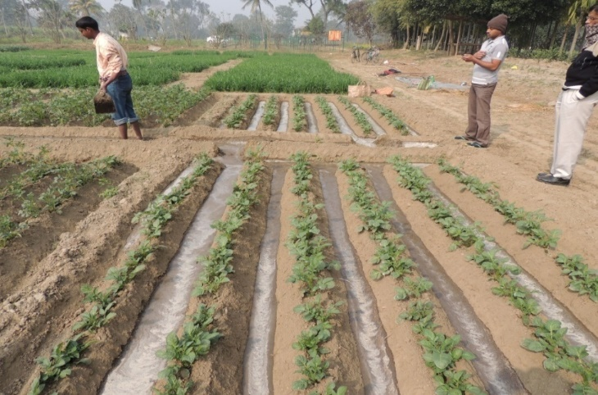
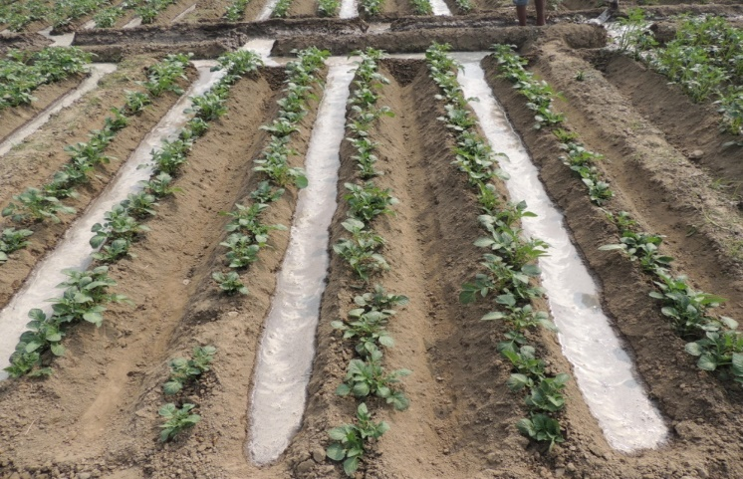
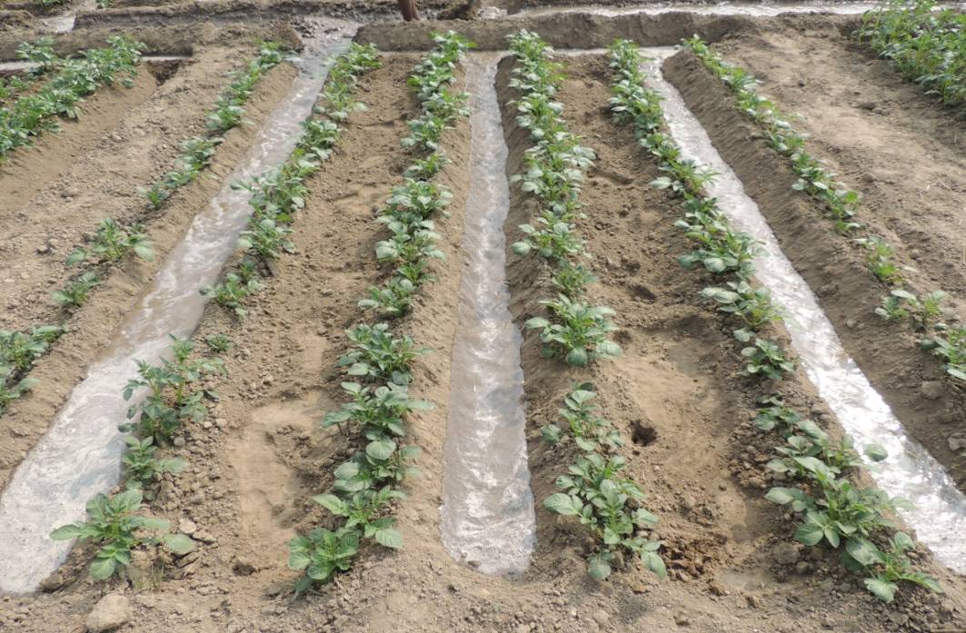
Photographs of irrigation methods
All furrow irrigation
Alternate furrow irrigation
Paired row irrigation

Slide 23
Thank You…

