Slide 1
Course name – Principles and Practices of Water Management (AGRO 0504) Course Credit – 2+1
Lecture 1
Topic: Fertigation.

Slide 2
Fertigation
Fertigation is derived from the word "fertilizer" and “irrigation".
Fertigation system is a method of cultivation in which the provision of a complete fertilizer to crops is given in the form of a solution and delivered to the root zone through a drip irrigation system.

Slide 3
Management of water in controlled environments and polyhouses.
Basic Requirement The basic requirement that are need in fertigation system are:
Green House /ploy House :
needed to control excess moisture,
especially during the rainy season
Roof - must allow sunlight to pass through Type of roofing materials - using transparent plastic
2. Irrigation system :
Using the drip irrigation system.
Function: Flush and distribute or supply water and nutrient rooting zone into each polybeg.
3. Water supply and quality
Must use clean water and quality
Water quality is important to the success of this system Eg: tap water, pool water, river water
pH value and optimum air EC - 6.5 5.5, <1.0 mS / cm
4.Adjust solution tools (pH and EC metre)
Use to determine the pH and EC of fertilizer solution and media are in optimum.
The concentration of fertilizers and media – depend on the plant that we have planted.
EC needs a range of 1.2 mS / cm - 3.8 mS / cm BPSP 2014/2015

Slide 4
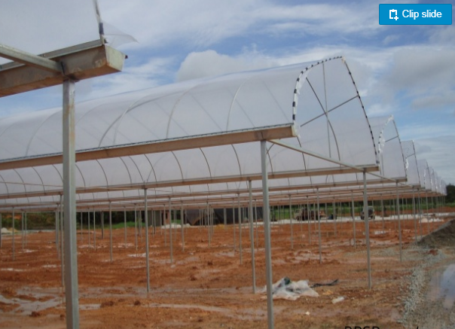

Slide 6
Nutrients

Slide 7
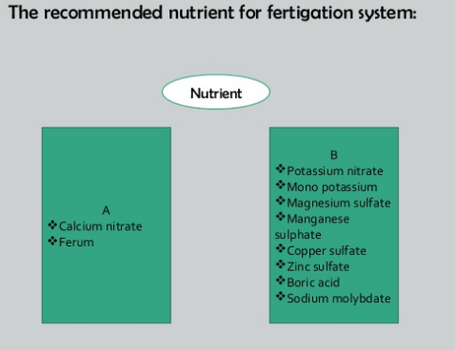

Slide 8
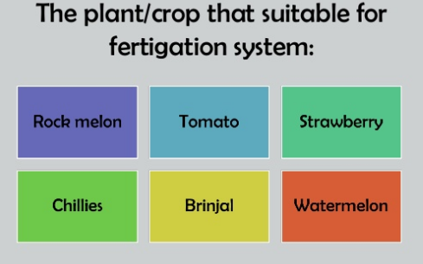

Slide 10
Thank You…

