Slide 1
Course name – Principles and Practices of Water Management (AGRO 0504) Course Credit – 2+1
Lecture 13
Topic- Irrigation efficiency and water use efficiency.
Water management of crop and cropping system.
Quality of irrigation water and management of saline water for irrigation.
Water use efficiency

Slide 2
Water management of the crops and cropping systems; quality of irrigation water and management
of saline water for irrigation; water use efficiency

Slide 3
UNIT IV Water management of the crops and cropping systems
Assured irrigation water facilities provide opportunities for multiple cropping (intercropping, sequential cropping, relay cropping etc). Major sources of irrigation include canal irrigation, tank-fed and well irrigation. Depending on the water availability period, 1,2 seasons or all the year round the number of crops raised per year on a given piece of land is determined. Thus, the cropping intensity in irrigated agriculture ranges from 200 to 400%. Major crops in different agro-climatic zones vary greatly, depending on their adaptability and irrigation water availability. Crops that follow the main crops in sequence also differ from region to region. Major rice, sugarcane and groundnut based cropping systems in Andhra Pradesh are as follows:

Slide 4
1 Rice based cropping systems
The profitable rice based cropping systems followed in different agro-climatic zones
of Andhra Pradesh are as follows:
a) North Coastal zone
Rice – Greengram/Blackgram in irrigated wet lands
Rice – Maize in irrigated uplands
b) Krishna Godavari zone
Rice – Rice
Rice – Maize
Rice – Groundnut
Rice – Greengram/Blackgram
c) Southern zone
Rice – Rice
Rice – Sunflower
Rice – Groundnut
Rice – Finger millet – Groundnut
d) Northern Telangana zone
Rice – Rice
Rice – Groundnut
Rice – Maize
Rice – Sunflower
e) High Altitude Tribal zone
Rice – Vegetables
Rice – Horsegram

Slide 5
2 Sugarcane based cropping systems
The profitable sugarcane based cropping systems followed in different agro-climatic
zones of Andhra Pradesh are as follows:
2.1 Profitable cropping systems
a) North coastal districts
Sugarcane – Sugarcane – Sesame – Paddy
Sugarcane – Sugarcane – Maize – paddy
b) Southern zone
Sugarcane – Sugarcane – Groundnut
c) All zones
Sugarcane – Sugarcane – Paddy
d) Godavari zone
Sugarcane – Sugarcane – Greengram/Blackgram
e) Krishna zone
Sugarcane – Sugarcane – Turmeric
f) Nizamabad zone
Sugarcane – Sugarcane – Sunflower
Soyabean – Sugarcane – Sugarcane

Slide 6
Profitable intercropping systems
a) Western part of Chittoor
Sugarcane + Rajmash
sugarcane + Tomato
sugarcane + Bhendi
b) Nellore
Sugarcane + Watermelon
c) Medak
Sugarcane + Potato
Sugarcane + Bengalgram
d) North-coastal districts
Sugarcane + Blackgram
Sugarcane + Blackgram
Groundnut based cropping systems
The profitable groundnut based cropping systems followed in different agro-climatic
zones of Andhra Pradesh are as follows:
a) North coastal districts
Groundnut + Redgram
Groundnut – Jowar
Groundnut – Vegatables
Groundnut – Rice
Groundnut – Horsegram

Slide 7
b) Krishna Godavari Zone
Groundnut – Bhendi
Groundnut – Chillies
Groundnut – Redgram
c) Southern zone
Sugarcane – Sugarcane – Groundnut
Groundnut – Groundnut
Groundnut – Sunflower / Jowar / Redgram
Groundnut – Castor
d) Scarce Rainfall zone
Groundnut – Fodder Jowar
Groundnut – Vegetables / Watermelon
e) North Telangana zone
Rice – Groundnut
Cotton – Groundnut
Groundnut – Horsegram
Groundnut + Redgram
Groundnut – Jowar / Safflower
f) High Altitude Tribal zone
Groundnut – Minor millets
Groundnut – Niger

Slide 8
Water use efficiency
water use efficiency is a ratio between marketable crop yield and water used by the crop in evapotranspiration.
 Y
WUE (kg/ha-mm)=
 Etc
Where,
WUE = Water use efficiency in kg/ha-mm
Y = Marketable crop yield in kg/ha
ETc = Crop evapotranspiration in mm

Slide 9
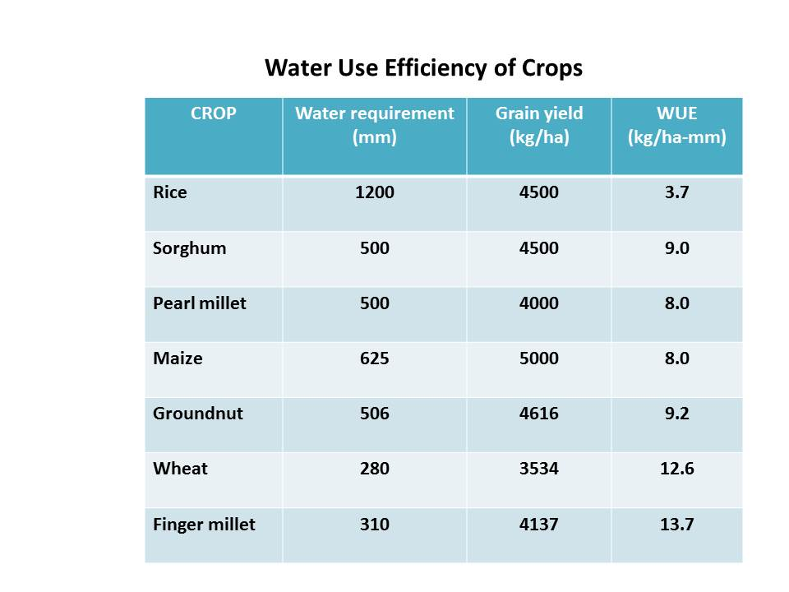
Water Use Efficiency of Crops
CROP | Water requirement (mm) | Grain yield (kg/ha) | WUE (kg/ha-mm)
Rice | 1200 | 4500 | 3.7
Sorghum | 500 | 4500 | 9.0
Pearl millet | 500 | 4000 | 8.0
Maize | 625 | 5000 | 8.0
Groundnut | 506 | 4616 | 9.2
Wheat | 280 | 3534 | 12.6
Finger millet | 310 | 4137 | 13.7

Slide 10
Factors affecting water use efficiency
The factors influencing water use efficiency can be classified as follows:

Slide 11
Irrigation efficiency
indicates how efficiently the available water supply is being used, based on different methods of evaluation. The objective of efficiency concept is to show where improvements can be made, which will result in more efficient irrigation. Various efficiency terms are :
1. Water conveyance efficiency
This term is used to measure the efficiency of water conveyance systems associated with the canal network, water courses and field channels. It is also applicable where the water is conveyed in channels from the well to the individual fields. It is expressed as follows:
Wd
Ec = ---------- x 100
Wf
Where,
Ec = Water conveyance efficiency, per cent
Wd = Water delivered to the irrigated plot (at the field supply channel)
Wf = Water diverted from the source
2. Water application efficiency
After the water reaches the field supply channel, it is important to apply the water as efficiently as possible. A measure of how efficiently this is done is the water application efficiency, expressed as follows :
Ws
Ea = ---------- x 100
Wd
Where,
Ea = Water application efficiency, per cent
Ws = Water stored in the root zone of the crop
Wd = Water diverted to the field (at the supply channel)

Slide 12
3. Water storage efficiency
The water storage efficiency refers how completely the water needed prior to irrigation has been stored in the root zone during irrigation. It is expressed as :
Ws
Es = ---------- x 100
Wn
Where,
Es = Water storage efficiency, per cent
Ws = Water stored in root zone during irrigation
Wn = Water needed in root zone prior to irrigation
4. Water distribution efficiency
Water distribution efficiency indicates the extent to which water is uniformly distributed along the run. It is expressed as :
y
Ed = 100 ﴾1 - -------﴿
d
Where,
Ed = Water distribution efficiency, per cent
d = Average depth of water stored along the run during the irrigation
y = Average numerical deviation from d

Slide 13
5. Water use efficiency
It refers to the amount of marketable end product obtained per unit of water used by the crop.
Total economic yield (kg ha⁻¹)
WUE (kg ha⁻¹ mm⁻¹) = ----------------------------------------------------
Total consumptive use (mm)
(i) Crop water use efficiency: It is the ratio of crop yield (y) to the amount of water depleted by the crop in the process of evapotranspiration (ET).
Y
Crop water use efficiency = -------------
ET
(ii) Field water use efficiency: It is the ratio of crop yield (y) to the total amount of water used in the field (WR)
Y
Field water use efficiency =-----------------
WR
6. Project efficiency
Project efficiency indicates the effective use of the irrigation water source in crop production. It is the percentage of irrigation water that is stored in the soil and is available for consumptive use by crops. When the delivered water is measured at the farm head gate or well, it is called farm irrigation efficiency, when measured in the field, it is designated as field irrigation efficiency, and when measured at the point of diversion from the canal or the main source of supply it may be called project efficiency.
7. Ope rational efficiency
Operational efficiency is the ratio of actual project efficiency compared to the operational efficiency of an ideally designed and managed system using the same irrigation method and facilities. Low operational efficiency indicates management or system design problems, or both.

Slide 14
8. Economic (irrigation) efficiency
Economic efficiency is the ratio of the total production (net or gross profit) attained with the operating irrigation system, compared to the total production expected under ideal conditions. This parameter is a measure of the overall efficiency, because it relates the final output to input.
Significance of irrigation efficiencies
A low value of any of the irrigation efficiencies in general implies that the land, water and the crops are not being managed properly. A low conveyance efficiency implies that much of the water released from the source is lost in transit form source to the field. A low application efficiency means wastage of water in the form of deep percolation or runoff losses. A poor storage efficiency means water has been applied inadequately. A poor distribution efficiency results due to uneven land sur face. There are low patches where water will penetrate more and there are high patches where water cannot reach. A low water use efficiency also results due to over application of water or inability of the crops to utilize the applied water due to poor vegetative growth or adverse chemical properties of root zone soil and water. The net effects of poor irrigation efficiencies are crop loss and wastage of water and nutrients.
Wf
(i) Water conveyance efficiency, Ec = ------------ x 100
Wd

Slide 15
Ws
(ii) Water application efficiency, Ea = -------- x 100
Wd
Ws
(iii) Water storage efficiency, Es = -------------- x 100
Wn
y
iv) Water distribution efficiency, Ed = 100 ﴾1 - ----------﴿
d

Slide 16
Quality of irrigation water and management of saline water for irrigation
Good quality irrigation water is essential to maintain the soil crop productivity
Poor quality water damage both
In india, about 3.58 mha and 5.50 mha are alkali and saline soil receptively
Page 400 dk mujumdar…..

