Slide 1
Course name – Principles and Practices of Water Management (AGRO 0504) Course Credit – 2+1
Lecture 16
Topic: Drainage requirement of crops
Methods of field drainage, their layout and spacing

Slide 2
Drainage requirement in crops
The greatest benefit of drainage relates to aeration. Good drainage facilitates the ready diffusion of oxygen to the root zone and escape of carbon dioxide from the root zone into the atmosphere. Several harmful gases also escape from the root zone into the atmosphere.
The activity of aerobic organisms which influence the availability of nutrients such as nitrogen and sulphur to plants depends on soil aeration and hence, drainage improves aerobic organisms.
Toxicity in acid soils due to excess iron and manganese is decreased by drainage (due to presence of oxygen in the root zone)
Drainage permits roots to grow deeper and spread wider thereby increasing the volume of soil from which nutrients can be extracted.
The removal of excess water helps in drying of the soil quickly and optimum soil temperature permits timeliness of field operations.
The provision of a good drainage system permits the removal of excess salts in the soil or irrigation water and prevents their build up in the upper soil layers.

Slide 3
Water management practices for physical problem of soil
• In light soils shallow depth of water with more frequency should be adopted.
• To increase the infiltration rate of clay type soil, breeding of soil by mixing with coarse textured soil or tank silt at the rate of 50 tones per hectare is advocated.
• Organic wastes like crop residue, farm waste, coir pith, filter cake, etc., at the rate of 20 tones per hectare once in every year can be applied.
• Poorly drained clay soils can be improved by providing tile drains and trenches intermittently.
• To make the soil more permeable and to overcome poor drainage, addition of organic wastes or sandy soil at the rate of 20 tones per ha or 50 tones per ha respectively is advocated.
• Tank silt or heavy soil application is the only way to increase soil depth and water holding capacity. Besides growth shallow rooted crop is advisable.
• The encrustation problem could be alleviated by incorporating organic matter and adding montmorilonite clay containing silt.

Slide 4
Benefits of drainage
a) It provides better soil environment for plant growth by creating favourable soil aeration conditions
b) It improves the soil structure and in turn increases the soil infiltration
c) High infiltration capacity reduces soil erosion.
d) It maintains desirable soil temperature, which accelerates plant growth and bacterial activity
e) It promotes increased leaching of salts and prevents accumulation of salts in the crop root zone

Slide 5
Problems of ill drainage
a) Limitation of aeration.
b) Accumulation of CO2 and toxic substances like H2S, ferrous sulfide etc. in the crop root zones
c) Reduced water uptake due to reduced activity of roots as a result of oxygen stress
d) Reduced nutrient uptake
e) Development of soil salinity and alkalinity

Slide 6
Surface drainage systems
Safe removal and disposal of excess water primarily from land surface or cropped area by a net work of surface drains or constructed channels and through proper land shaping is known as surface drainage. There are four general types of surface drainage systems used in flat areas having a slope of <2% viz.,
Random drain system
(b) Parallel field drain system
(c) Parallel open ditch system
(d) Bedding system

Slide 7
Random drain system:
This system is usually adopted in areas where the ground surface is characterized by a series and depression (undulating land surface) and where small depressions are to be drained off

Slide 8
Parallel field drain system:
The parallel field ditch system is used in places where the surface is uniform and has few noticeable ridges or depressions.

Slide 9
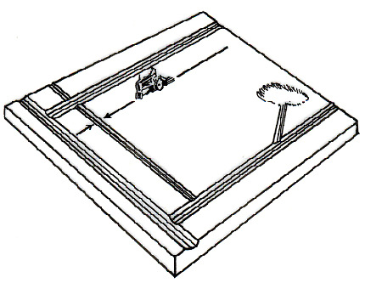
Parallel open ditch system:
The parallel open ditch system is similar to parallel field drain system in all respects except that the drains are replaced by open ditches which are comparatively deeper and have steeper side slopes than the field drains

Slide 10
Bedding system:
This system is usually adopted in fields with very little slope, usually 0.5% or less and slowly permeable soils. It is essentially a tillage operation wherein the land is ploughed into a series of parallel beds separated by dead furrows, which run in the direction of greatest slope lateral drains are located perpendicular to slope

Slide 11
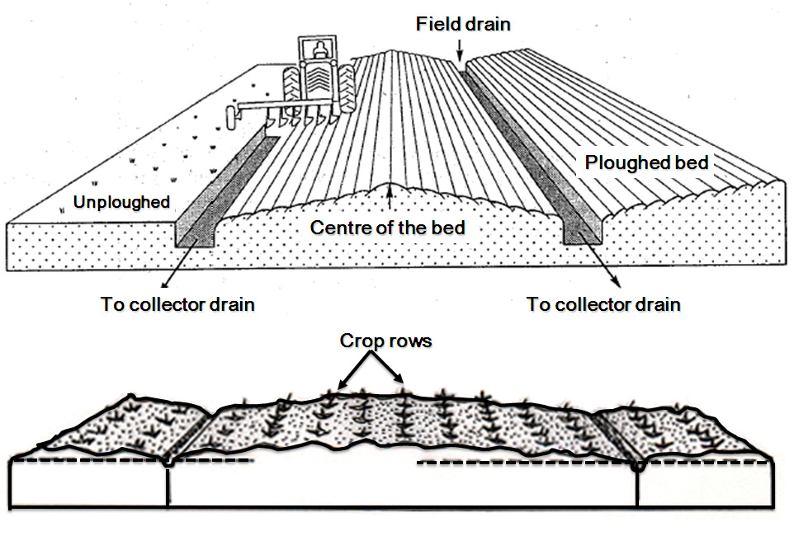

Slide 12
Sub-surface drainage systems:
The removal and safe disposal of excess water that has already entered the soil profile is considered sub-surface drainage. Though several sub-surface systems are available, the most commonly used and effective ones are Tile drainage and Mole drainage systems.
Tile drainage systems
Tile drains removes excess water from the soil through a continuous line of tiles (pipes) laid at specified depth and grade. The pipes are made of either concrete or burnt clay.

Slide 13
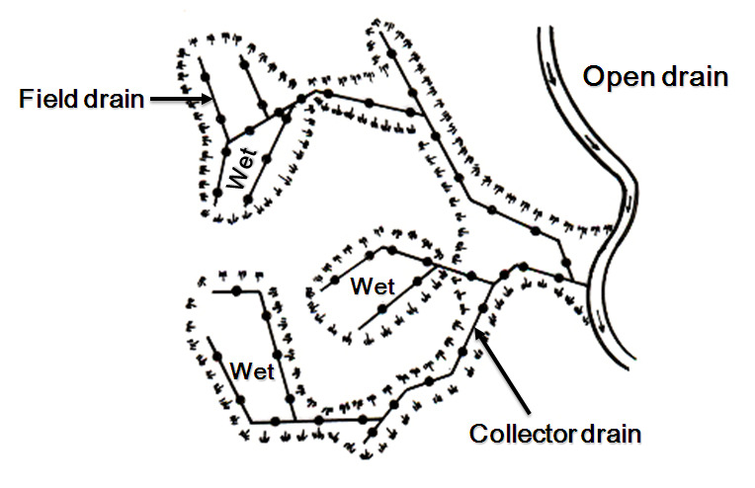
Random system:
The random system is used in areas that have scattered wet areas somewhat isolated from each other. Tile lines are laid more or less at random to drain the wet patches.

Slide 14
Herringbone system:
The system is applicable in places where the main or sub-main is located in a narrow depression i.e., in areas that have a concave surface or a narrow depression with the land sloping to it from both directions. The parallel laterals enter the sub-main from both sides. It is less economical, because considerable double drainage occurs where the laterals and mains join.
Gridiron systems:
The gridiron and parallel systems are similar to that of herringbone system except that the laterals enter the main or sub-main from only one side.

Slide 15
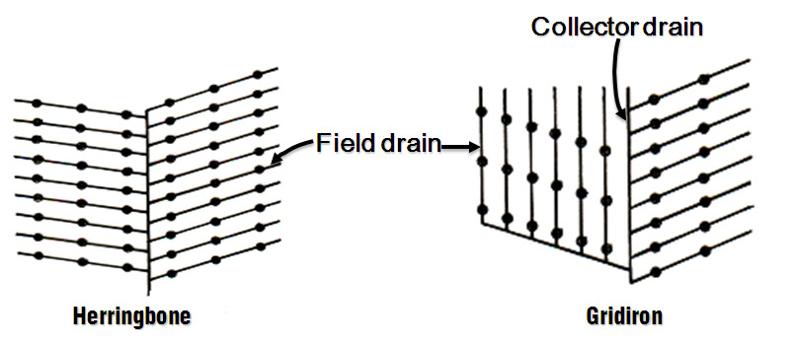

Slide 16
Double main system:
The double main system is a modification of the gridiron system. It may be used where the sub-main is in a broad, flat depression, which frequently is a natural watercourse and sometimes may be wet because of small amounts of seepage water from nearby slopes.
Intercepting system:
This system involves the interception of seepage water that flows over the surface of an impervious sub-soil. The tile line is placed approximately at the impervious layer along which the seepage water travels, so that water will be intercepted and wet condition is relieved. The tile line should be located in such a way that there is at least 60 cm of soil cover over the top of the tile.

Slide 17
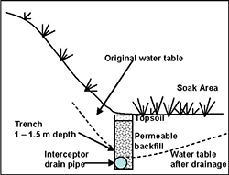

Slide 18
Mole drainage system:
Mole drainage is a semi-permanent method of sub-surface drainage, similar to tile drain in layout and operation. Instead of permanent tiles a continuous circular mole drain (channel) is prepared below the ground surface in the soil profile at desired depth and spacing using a special implement known as mole plough. The depth of the mole drain varies from 4.5 cm to 120 cm depending on the moling equipment and water table. Diameter of the mole varies from 7.5 to 15 cm. The life the mole drain is 10-15 years. It is adapted to a particular type of soil because the soil stability is more important in this type of sub-surface drainage.

Slide 20
Drainage coefficient:
It is defined as the depth of water (cm) to be removed in 24 hours period from the entire drainage area. It ranges from 0.6 to 2.5 cm/day and in extreme cases 10 cm/day.

Slide 21
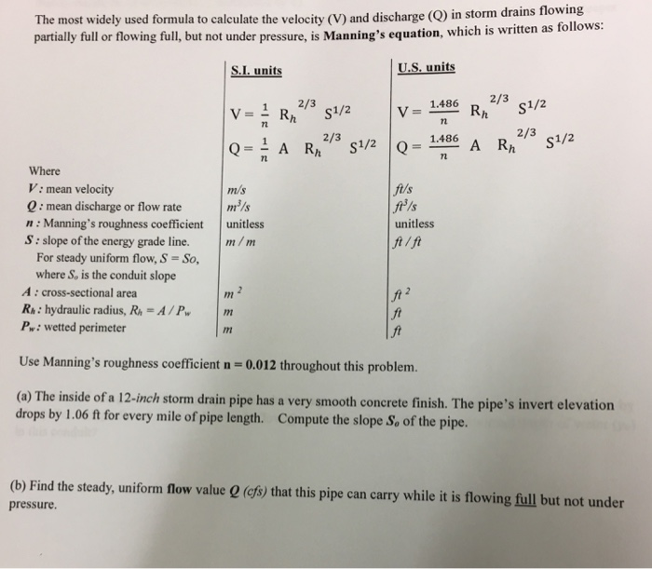

Slide 22
Boi-drainage
Biodrainage may be defined as “pumping of excess soil water using bio-energy through deep-rooted vegetation with high rate of transpiration.”
The biodrainage system consists of fast growing tree species, which absorb water from the capillary fringe located above the ground water table.
The absorbed water is translocated to different parts of plants and finally more than 98% of the absorbed water is transpired into the atmosphere mainly through the stomata.
This combined process of absorption, translocation and transpiration of excess ground water into the atmosphere by the deep rooted vegetation conceptualizes bio-drainage.

Slide 23
Merits of biodrainage over conventional drainage systems
Relatively less costly to raise biodrainage plantations
No maintenance cost from 3rd year onward
No operational cost, as the plants use their bio-energy in draining out the excess ground water into atmosphere.
Increase in worth with age instead of depreciation
No need of any drainage outfall and disposal of drainage effluent
No environmental problem, as the plants drain out filtered fresh water into the atmosphere
In- situ solution of the problem of water logging and salinity
Preventive as well as curative system for waterlogging and salinity

Slide 24
Reclamation
Combined drainage- cum – disposal system
Moderates the temperature of the surrounding by transpiration and a cushion for moderating frost, cold and heat wave impacts
Helps in carbon sequestration and carbon credits
Mitigates the problem of climate change and contributes to increased forest cover
Purifies the atmosphere by absorbing CO2 and releasing O2
Acts as wind break and shelter belts in agroforestry system
Provides higher income to the farmer due to the production of food, fodder, fuel wood and small timber

Slide 25
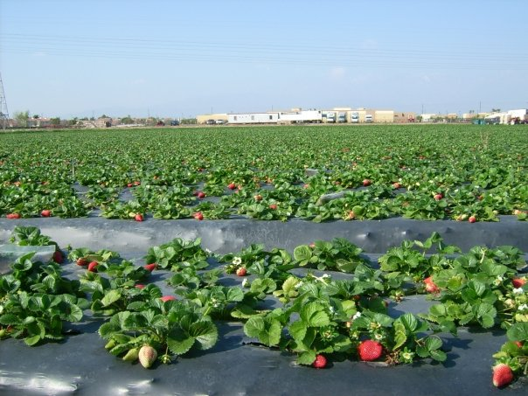
Thank You

