Slide 1
Course name –
Principles and Practices of Water Management (AGRO 0504)
Course Credit – 2+1
Lecture 4
Topic: Field water cycle, water movement in soil and plants.

Slide 2

UNIT II
Soil- Plant- Water Relationships

Slide 3
Water in the Soil-Plant- Atmosphere System
Soil Moisture Plant Uptake Translocation Evapotranspiration
Infiltration Redistribution Withdrawal
Passive absorption Active absorption Aerial absorption

Slide 4
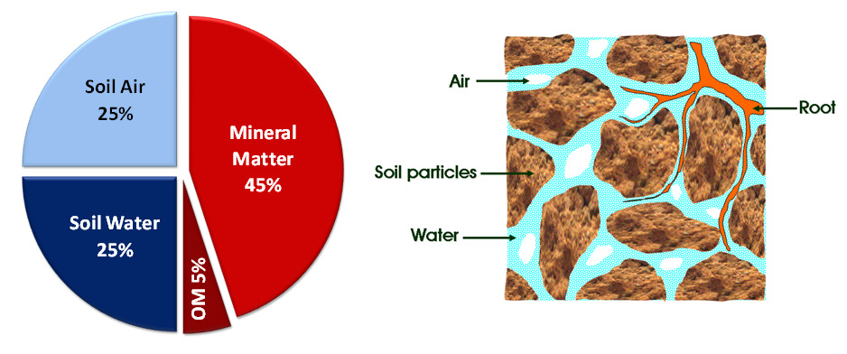
Soil – A three phase disperse system
The soil is a heterogeneous, polyphasic viz., solid, liquid and gaseous and porous system
Volume composition & sectional view of soil

Slide 5
  Soil texture Size grouping in diameter(USDA)
Very Coarse sand 2.0 – 1 mm ISSS
Coarse sand 1.0 – 0.5 mm 2-0.2
medium sand 0.5 – 0.25 mm
Fine sand 0.25 – 0.10 mm 0.2-0.02
Very Fine sand 0.10 – 0.05 mm
Silt 0.05 – 0.002 mm 0.02-0.002
Clay < 0.002 mm <0.002
Size groupings of soil particles

Slide 6
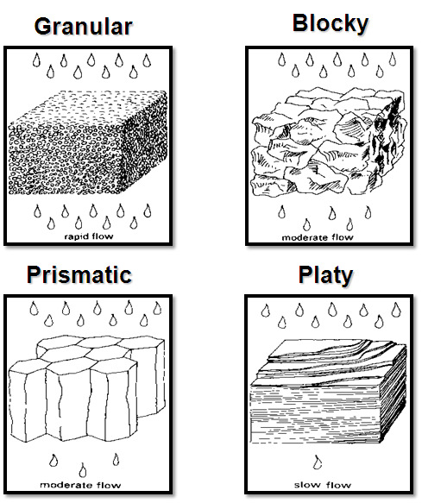
Effect of structural type on permeability for water

Slide 7
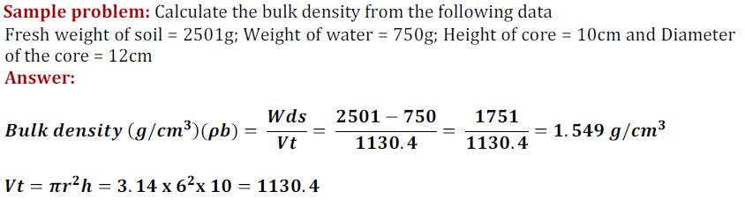
Density of soil solids
Particle density (ρd): It is the ratio of a given mass (or weight) of soil solids to that of its volume. It is usually expressed in terms of g/cm3.
Bulk density (bd): It refers to the ratio of a given mass of an oven dried soil to that of its field volume (i.e., solids + pore spaces).

Slide 8

Pore space Soil total porosity A is an index of pore volume in the soil. It is the space in a givenvolume of soil that is occupied by air and water or not occupied by the soil solids. The total porosity is calculated as follows
Total porosity value generally lies in the range of 30 to 60% for arable soils. Coarse
textured soils tend to be less porous (35 – 50%) than the fine textured soils (40 – 60%),though the mean size of individual pores is greater (>0.06mm in diameter) in the former than in the latter.
Soil moisture tension:
The moisture held in the soil against gravity may be described in terms of moisture tension.

Slide 9
ENERGY MOVING WATER
Kinetic Energy: when water (not soil water) is flowing in a river in rapid and turbulent flows.
Potential Energy: determines the status and movement of soil water (moving very slowly).
Like all substances, soil water move from higher to lower energy level.
Notes:
In physics, the kinetic energy of an object is the energy which it possesses due to its motion. In physics, potential energy is the energy of an object or a system due to the position of the body or the arrangement of the particles of the system. All substances including water tend to move or change from higher to lower energy level. So once we know the energy levels, we can determine the direction of soil water movement. Pure, standing water has a potential of zero.

Slide 10
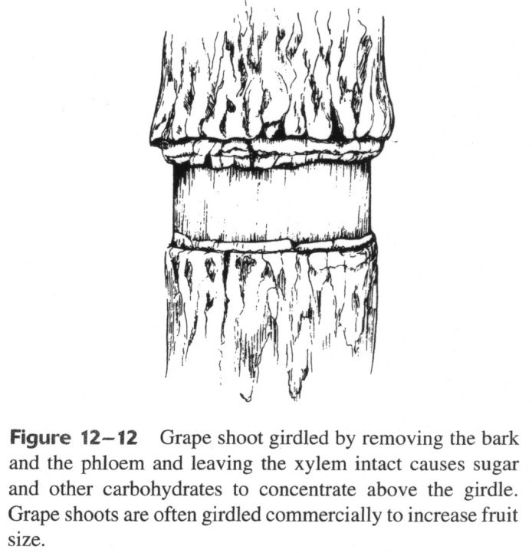
In woody perennials,
when phloem tissue is severed by girdling:
    The tissue above the cut proliferates
    The tissue below the cut is starved
    photosynthates (Fig. 12-12). This can
    severely stunt and even kill a tree
The rate of translocation of sugars in the phloem is, in some instances, more than a thousand times faster than simple diffusion of sugar through water.
The forces that create these high rates of movement are called active transport.

Slide 11
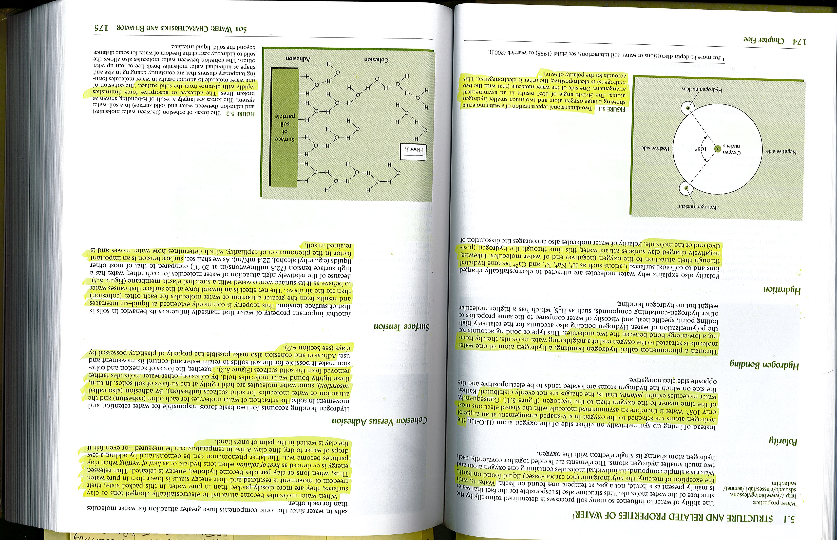
TWO DIMENTIONAL STRUCTURE OF WATER MOLECULE
(The Nature and Properties of Soils, 14th Edition, revised)
Notes:
Two-dimensional representation of a water molecule showing a large oxygen atom and two much smaller hydrogen atoms. The H-O-H angle of 105° results in an asymmetrical (asymmetry is the absence of, or violation of symmetry) arrangement. One side of the water molecule (that with the two hydrogen) is electropositive (measure of an element’s ability to donate electrons and therefore form positive ions); the other is electronegative (tendency of an atom or an functional group to attract electrons) . This accounts for the polarity (a physical alignment of atoms) of water.

Slide 12
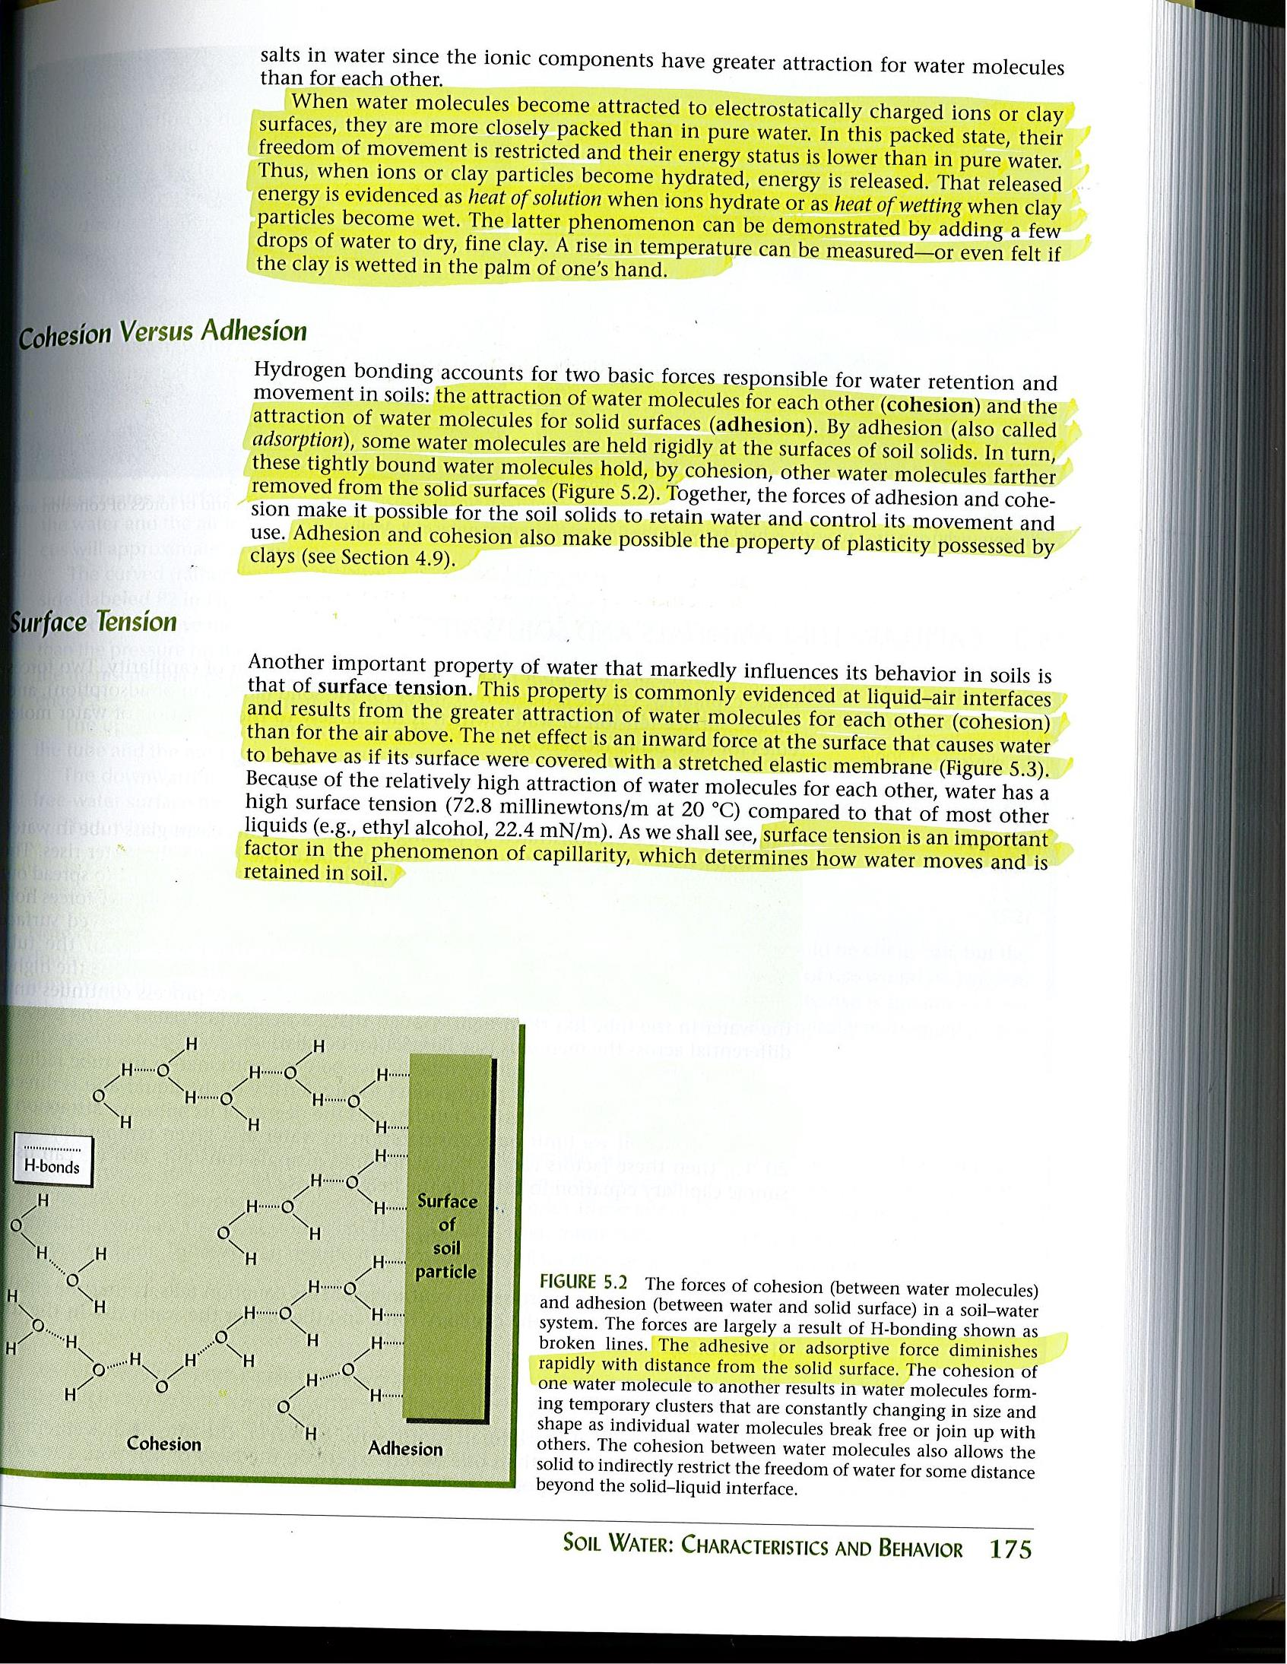
HYDROGEN BONDING
(The Nature and Properties of Soils, 14th Edition, revised)
Notes:
Hydrogen bonding is a result of cohesion and adhesion. These two forces are also responsible how water is retained and move within the soils. Capillarity is also a direct result of these two forces. As one positive charge of a water molecule attracts the negative charge of the other water molecule (oxygen), the other positive charge can get attracted to the CEC sites or anions like orthophosphates; H₂PO₄⁻ and HPO₄²⁻, which are the primary forms of phosphorus taken up by plants. When the soil pH is less than 7.0, H₂PO₄⁻ is the predominate form in the soil. Although less common, certain organic phosphorus forms can also be directly taken up by plants.With its negative charge water molecules can get attracted to the positive charged cations.

Slide 13
pF
In attempting to express the matric potential (or soil moisture tnsion) of soil water in terms of an equivalent hydraulic head (or energy per unit weight), it is understood that this head may be of the order of −100 cm or even −100000 cm of water. To avoid the use of such cumbersomely large numbers, Schofield (1935) suggested the use of pF (by anology with the pH acidity scale), which is defined as the logarithm of the negative pressure (soil water tension or suction) head in cm of water. A tension of 10 cm of water is, thus, equal to a pF of 1. Likewise, a tension head of 1000 cm is equal to a pF of 3, and so forth. Approximate equivalents among expressions of soil water tension are given below in Table

Slide 14
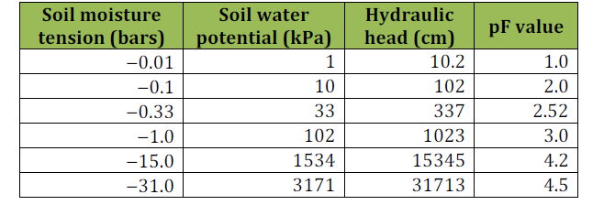
Approximate equivalents among expressions of soil water tension

Slide 15
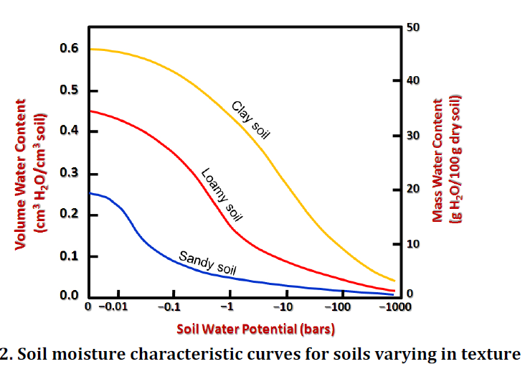

Slide 16
OSMOTIC EFFECT
Notes:
Osmotic potential is the movement of water from low solute concentrations (higher osmotic potential) to high solute concentrations (low osmotic potential). Matric potential is the energy of the water attraction to the soil and its pores (adhesion and cohesion). Plants attract soil water by pulling the water towards roots by exerting a negative force. Plants do that by regulating solutes and salts within the plant cells and intracellular spaces in the roots. Higher is the concentration of salts within the plant cells, greater is the pull of water into the plant. The soil water force moving against plant force is related to the matric and osmotic potential of the soil. As soil water content decreases, matric potential of the soil increases, making it difficult for the plant roots to absorb soil water, due to the increased adhesion force. Soil water moves from higher osmotic potential to lower osmotic potential and plant root cell membrane generally have lower potential than soil solution. However high salt concentration decreases the potential of soil water, thus restricting the soil water absorption by the plant roots.

Slide 17
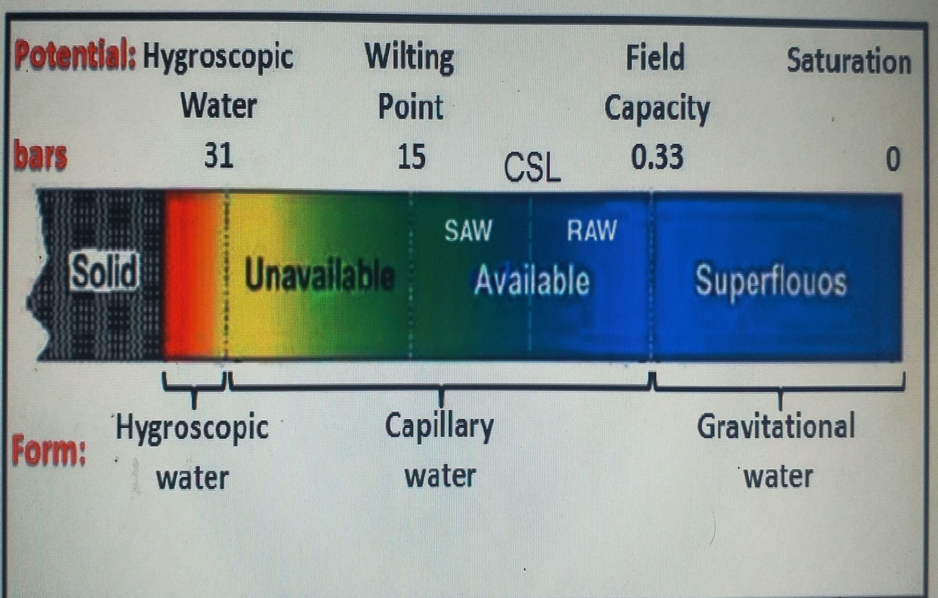
Physical Classification of Water

Slide 18
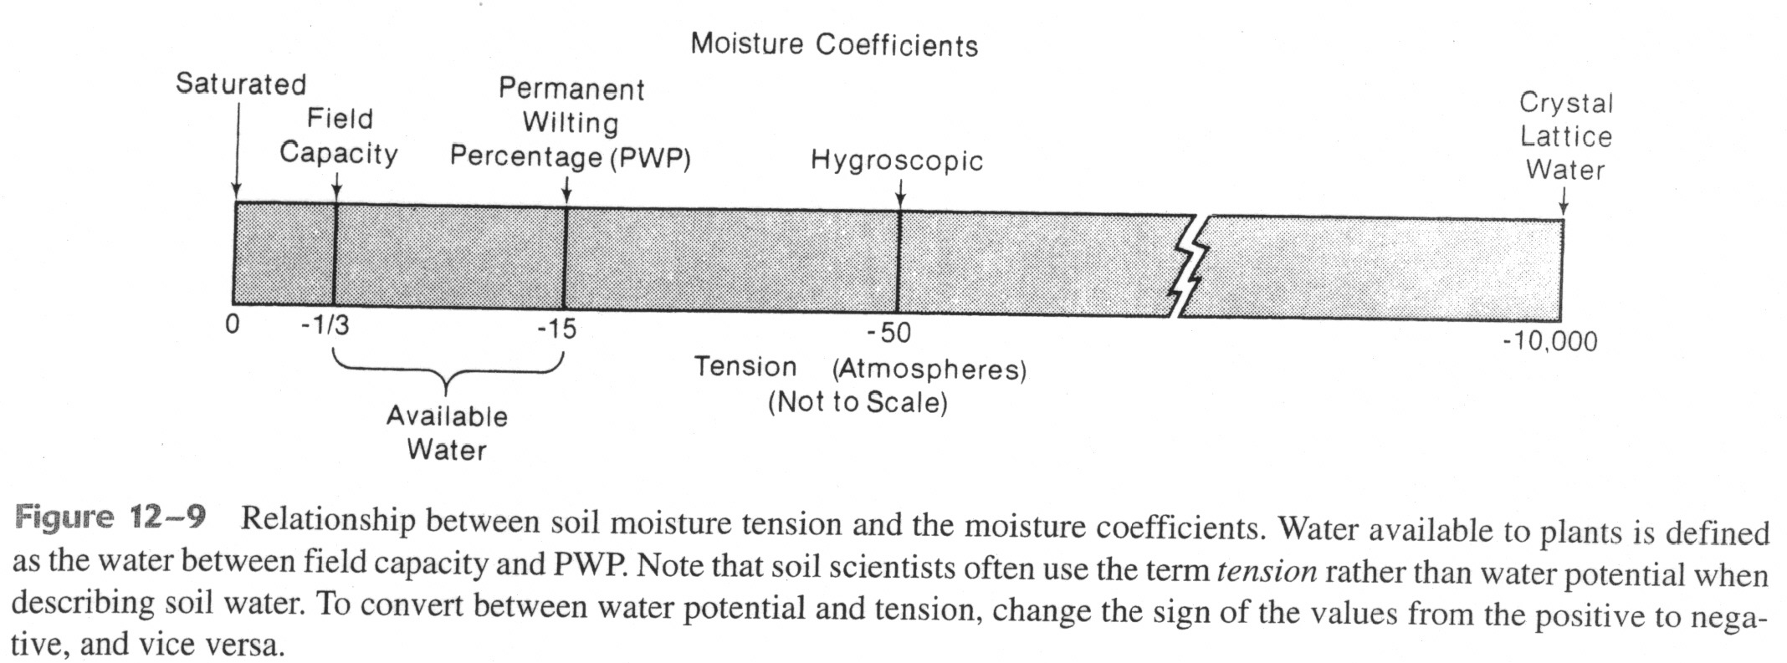
Available water (AW) is defined as the soil moisture between field capacity (FC) and the permanent wilting point (PWP):
AW = FC - PWP
Water between FC and saturation is not considered available because it is lost through drainage.
Water at tensions greater than PWP is held too tightly by the soil for plants to remove.

Slide 19
Soil Water Potential
The SWP potential is defined as the potential energy of water in soil. The SWP is quantified relative to a standard state where water has no solutes, free from external forces except gravity, at a reference pressure, at a reference temperature and at a reference elevation .
The SWP is then defined as the energy state of water in soil with respect to the energy of water at the reference state.
The total SWP ( ψ t ) is determined by a variety of forces acting on the soil water, including gravitational ( ψ g ), matric (capillary and adsorptive, ψ m ), osmotic ( ψ o ) and hydrostatic ( ψ h ).
ψ t = ψ g + ψ m + ψ o + ψ h

Slide 20
Soil-Plant-Atmosphere Continuum
The movement of water from the soil, into the roots, through the xylem and from the leaf into the atmosphere, occurs because of a series of water potential gradients. The system that involves the soil, the plant’s roots, the xylem, the leaf and the atmosphere, is called the soil-plant-atmosphere continuum (SPAC)

Slide 21
Physical Classification of Water
1.Gravitational water
Water held between 0.0 to 0.33 bars (0 to −33 kPa) soil moisture tension, free and in excess of field capacity, which moves rapidly down towards the water table under the influence of gravity is termed as gravitational water
2. Capillary water
As the name suggests capillary water is held in the pores of capillary size i.e., micro pores around the soil particles by adhesion (attraction of water molecules for soil particles), cohesion (attraction between water molecules) and surface tension phenomena.It includes available form of liquid water extracted by growing plants and is held between field capacity (0.33 bars or −33 kPa) and hygroscopic coefficient (31 bars or −3100 kPa)

Slide 22
However, the water within the capillary range is not equally available i.e., it is readily available starting from 0.33 bars up to a certain point often referred to as critical soil moisture level (for most crops it varies between 20 to 50% depletion of available soil moisture) and thereafter up to 15 bars (−1500 kPa) it is slowly available. Further below, when the soil exerts tensions between 15 bars and 31 bars, the water is held very tightly in thin films and is practically not available for plant use. The capillary water moves in any direction but always in the direction of increasing tension and decreasing potential.
3.Hygroscopic water
The water held tightly in thin films of 4 – 5 milli microns thickness on the surface of soil colloidal particles at 31 bars tension (−3100 kPa) and above is termed as hygroscopic water (Fig. 8.1). It is essentially non-liquid and moves primarily in vapour form. Plants cannot absorb such water because, it is held very tenaciously by the soil particles (i.e., > 31 bars). However, some microorganisms may utilize it. Unlike capillary water which evaporates easily at atmospheric temperatures (i.e., it requires very little energy for its removal), hygroscopic water cannot be separated from the soil unless it is heated at 100°C and above for 24 hours.

Slide 23
LEVELS OF SOIL MOISTURE
Saturation:
Almost all of the pores filled with water with no air.
  Generally happens right after heavy rainfall / snow melt or application of flood irrigation.
Field Capacity:
Excessive moisture drained with gravitational force, mostly out of macro-pores.
  Medium and small pores will still be filled with water held due to adhesion and cohesion.
  Depending on the soil type, happens between 1 to 3 days after a heavy rainfall.

Slide 24
LEVELS OF SOIL MOISTURE
Permanent Wilting Point:
Not enough available moisture for normal plant growth.
Continuous unavailability causes plant wilting and ultimately death.
Hygroscopic Moisture Level:
Soil is air dry with no availability of moisture for plants.

Slide 25
PLANT AVAILABLE WATER
Water holding capacity: Amount of soil water held between field capacity and permanent wilting point.
Plant available water: Portion of water holding capacity that can be absorbed by the plants.
  As a general rule, plant available water is considered to be 50 percent of the water holding capacity.

Slide 26
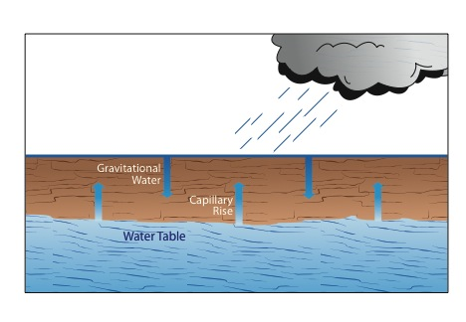
TYPES OF SOIL WATER

Slide 27
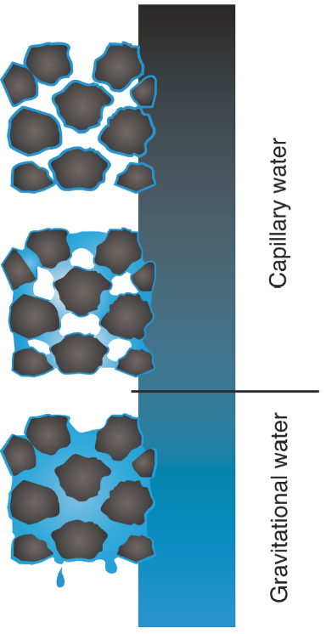
TYPES OF SOIL WATER
Gravitational Water:
  Free water
  Macro-pores
  Moves rapidly under good soil drainage conditions
  Is not available to plants
  Under poor soil drainage conditions, cause plant wilting due to lack of soil oxygen
Courtesy of F. Casey
Notes:
Happens through macro pores and is saturated flow.

Slide 28
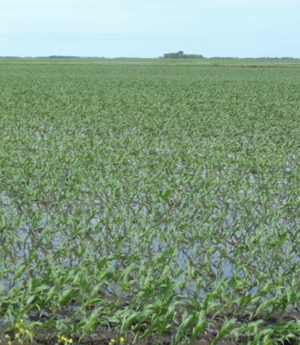
GRAVITATIONAL WATER
Under good soil drainage:
  Leaches excessive salts
  Oxygen
Under poor soil drainage:
  High groundwater levels
  Lack of soil oxygen
  Buildup of excessive salts
How do you improve conditions?
Build aggregates
Rooting channels
Reduce compaction
Use water with crops
Subsurface and Surface drainage

Slide 29
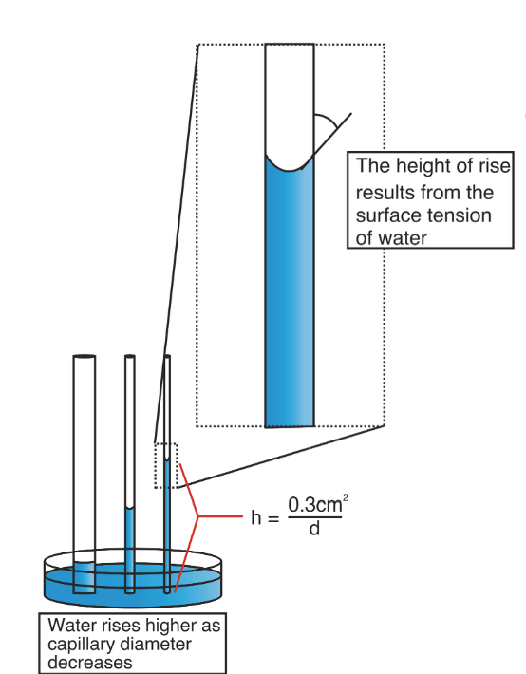
TYPES OF SOIL WATER
Capillary Water:
  Plant available water
  Tension
    Adhesion (attraction to soil)
    Cohesion (attraction to water)
  Evaporation
Courtesy of F. Casey
Notes:
Matric flow is unsaturated flow happens through micro pores and matric forces.

Slide 30
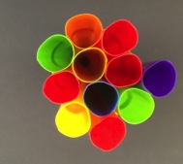

CAPILLARY RISE
Can move to any direction from wet areas (low soil moisture tension) to dry area (high soil moisture tension).

Slide 31
CAPILLARY RISE
Under good soil drainage:
  Movement remains restricted below the rooting zone of most of the crops, due to low groundwater levels
  No buildup of excessive salts
Under poor soil drainage:
  Excessive buildup of salts
  Poor growth environment

Slide 32
SOIL WATER MOVEMENT FACTS
Plant available water is between FC and PWP moisture levels.
Gravitational water is excess water.
Gravitational forces cause the downward movement of soil water under good soil drainage conditions.
Slow or poor movement of gravitational water will cause saturated conditions, high groundwater levels and surface runoff.
Subsurface drainage system will only collect gravitational water.

Slide 33
SOIL WATER MOVEMENT FACTS
Soil water moves quickly through the larger pores, as it is held more tightly in the smaller pores.
Water will not move from the smaller pores to larger pores unless conditions are saturated.
Tortuosity of the soil pores also restricts the soil water movement.
  Water moving along the pore walls versus center will move slowly.
Adhesion and cohesion forces cause the capillary soil water movement/rise.
High groundwater levels combined with soil surface evaporation will maximize capillary rise.
Capillary rise will be maximized for heavier soils.
Preserving top soil moisture will minimize capillary rise.

Slide 34
Water movement in Soil
Water movement in soil occurs in three distinct ways:
1. Saturated flow
2. Un-saturated flow
3. Vapour movement

Slide 35
(i) Saturated flow
This occurs when the soil pores are completely filled with water. This water moves at water potentials larger than – 33 kPa. Saturated flow is water flow caused by gravity’s pull. It begins with infiltration, which is water movement into soil when rain or irrigation water is on the soil surface. When the soil profile is wetted, the movement of more water flowing through the wetted soil is termed percolation.
Hydraulic conductivity can be expressed mathematically as
V = kf
Where, V = Total volume of water moved per unit time f = Water moving force k = Hydraulic conductivity of soil

Slide 36
Hydraulic conductivity:
The hydraulic conductivity of a soil is a measure of the soil's ability to transmit water when submitted to a hydraulic gradient. Hydraulic conductivity is defined by Darcy's law, which, for one-dimensional vertical flow, can be written as follows:
h1- h2
V= K
L
Where, V is Darcy's velocity (or the average velocity of the soil fluid through a geometric cross-sectional area within the soil), h1 and h2 are hydraulic heads, and L is the vertical distance in the soil through which flow takes place. The coefficient of proportionality, K, in the equation is called the hydraulic conductivity.

Slide 37
(ii) Unsaturated Flow
It is flow of water held with water potentials lower than- 1/3 bar. Water will move toward the region of lower potential (towards the greater “pulling” force). In a uniform soil this means that water moves from wetter to drier areas. The water movement may be in any direction .The rate of flow is greater as the water potential gradient (the difference in potential between wet and dry) increases and as the size of water filled pores also increases. The two forces responsible for this movement are the attraction of soil solids for water (adhesion) and capillarity. Under field conditions this movement occurs when the soil macropores (noncapillary) pores with filled with air and the micropores (capillary) pores with water and partly with air.

Slide 38
(iii) Water Vapour Movement
The movement of water vapour from soils takes place in two ways:
Internal movement—the change from the liquid to the vapour state takes place within the soil, that is, in the soil pores
(b) External movement—the phenomenon occurs at the land surface and the resulting vapour is lost to the atmosphere by diffusion and convection.
The movement of water vapour through the diffusion mechanism taken place from one area to other soil area depending on the vapour pressure gradient (moving force).This gradient is simply the difference in vapour pressure of two points a unit distance apart. The greater this difference, the more rapid the diffusion and the greater is the transfer of water vapour during a unit period.

Slide 39
Hysterisis
The moisture content at different tensions during wetting of soil varies from the moisture content at same tensions during drying. This effect is called as hysterisis. This is due to the presence of capillary and non capillary pores. The moisture content is always low during sorption and high during desorption.
Hystersis phenomenon exists in soil minerals as a consequence of shrinking and swelling. Shrinking and swelling affect pore size on a microbasis as well as on the basis of overall bulk density. So, hystersis phenomenon occurs due to factors like shape and size of soil pores and their interconnection with each other pore configuration, nature of soil colloids bulk density of soil and entrapped air. The most important factor affecting hystersis is the entrapment of air in the soil under rewetting condition. This clogs some pores and prevent effective contact between others.

Slide 40
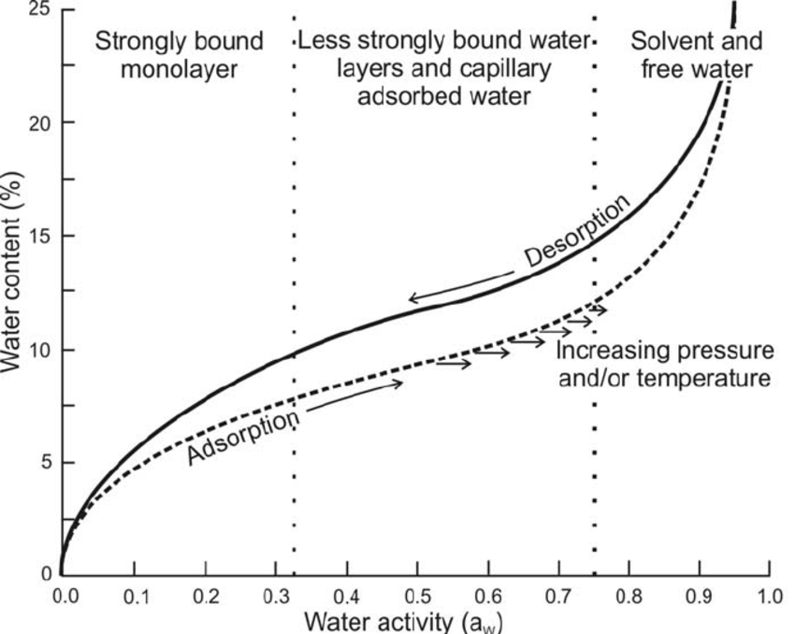

Slide 41
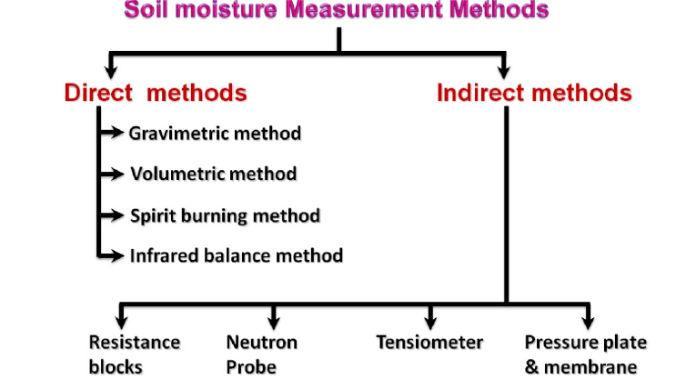
Measurement of Soil Moisture

Slide 42
Direct methods
1 Gravimetric method
The gravimetric method is a direct measurement of soil water content and is therefore the standard method by which all indirect methods are calibrated. The gravimetric water content, also called mass water content, is the ratio of the weight loss in drying to the dry weight of the soil sample. The mass water content can be expressed as mass water percentage by multiplying it with 100 (θm).

Slide 43
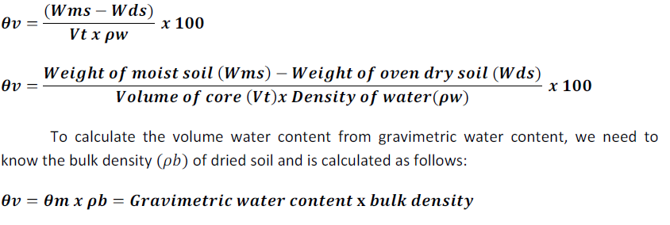
2 Volumetric method
The volumetric water content (θv) is defined as the volume of water present in agiven volume (usually 1 m3) of dry soil. When (θv) multiplied by 100 it gives volume water percentage.

Slide 44
Merits
• Ease of handling
• Low cost
• Minimum technical skill required
• Standard method of soil moisture determination with which other methods are Compared
Demerits
• Time consuming
• Accuracy is subject to weighing and sampling errors
• Destructive soil sampling method
• Laborious

Slide 45
3 Spirit burning method
Soil moisture from the sample is evaporated by adding alcohol and iginiting. Provided the sample is not too large, the result can be obtained in less than 10 minutes. About 1.0 ml of spirit or alcohol per g of soil sample at field capacity and 0.5 ml at permanent wilting point is adequate for evaporating the soil moisture. This method is not recommended for soils with high organic matter content.
4 Infrared moisture balance
It consists of a 250 watt infrared lamp, sensitive torsion balance and autotransformer (Fig. 10.1). All housed in an aluminium cabinet. The radiation emitted by infrared lamp quickly vaporizes the soil moisture. The instrument is directly calibrated in per cent moisture. It gives fairly reliable moisture estimates in about 5 minutes.

Slide 46
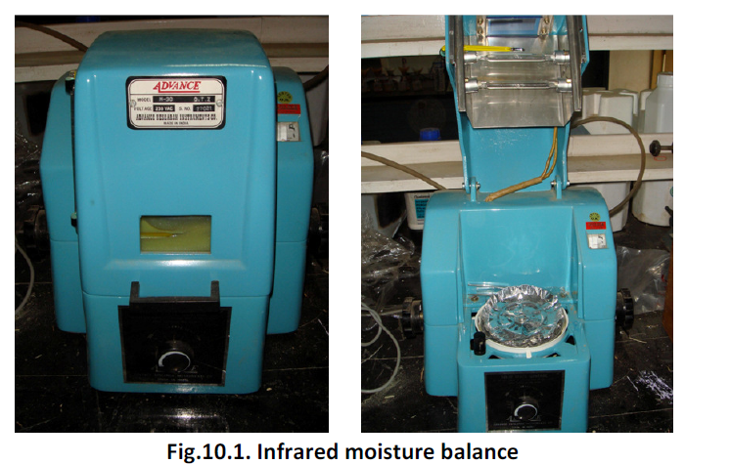

Slide 47
Indirect methods
1 Electrical resistance blocks
Gypsum blocks or electrical resistance blocks, with two electrodes, is placed at a desired soil depth and allowed to equilibrate (Fig. 10.2). Electrical resistance of the block is measured by a meter based on the principal of Whetstone Bridge. Electrical resistance of the soil decreases with increase in water content. Soil water content is obtained with calibration curve, for the same block, of electrical resistance against known soil water content. Resistance blocks read low resistance (400 – 600 ohms) at field capacity and high resistance (50,000 to 75,000 ohms) at wilting point.

Slide 48
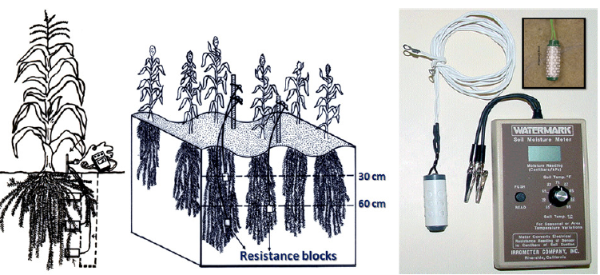

Slide 49
Merits
• Relatively inexpensive
• Easy to install
• Gives quick readings
• Suitable for irrigation scheduling to crops raised in fine textured soils
Demerits
• Not useful in coarse textured soils
• Resistance blocks readings are sensitive to soil salinity, which may affect readings
• Blocks may get damaged over time (2 – 3 years) and require replacement

Slide 50
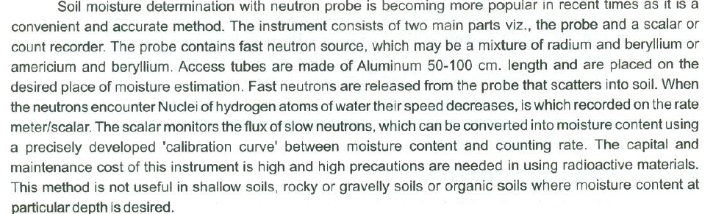
2 Neutron scattering technique

Slide 51
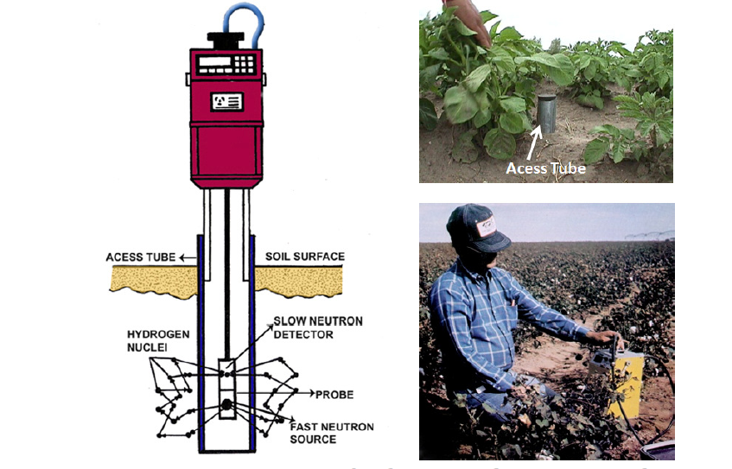

Slide 52
Merits
• Less laborious
• Rapid results
• Non-destructive method after initial installation
• Repeated measurements can be made at the same location and depth
• Independent of temperature and pressure
Demerits
• High initial cost of the equipment
• Probe must be calibrated for each soil & access tube
• Difficult to measure the soil moisture in the top 15 cm soil depth due to escape of neutrons into atmosphere
• Health hazards due to exposure to neutron & gamma radiation

Slide 53
3 Tensiometer
The tensiometer is an instrument designed to provide a continuous indication of the soil’s matric suction (also called soil-moisture tension) in situ . The tensiometer consists of a porous ceramic cup, connected through a tube to a vacuum gauge (or manometer), all parts filled with water. When the cup is placed in the soil where the suction measurement is to be made, the water inside the cup comes into hydraulic contact and tends to equilibrate with soil water through the pores in the ceramic walls.

Slide 54
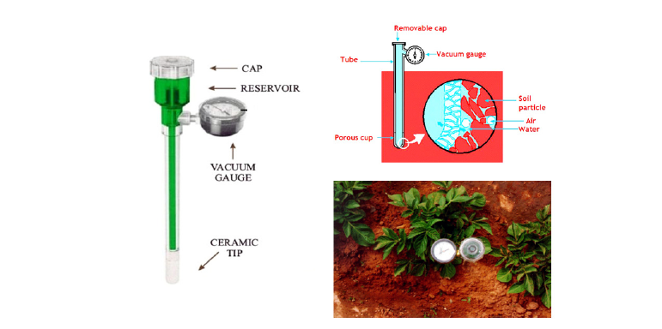

Slide 55
Suction measurements by tensiometry are generally limited to matric suction values below 1 bar or 100 kPa. However in practice, under field conditions the sensitivity of most tensiometers is a maximal tension of about 0.85 bars or 85 kPa.
Merits
• Repeated measurements at the same location
• Nondestructive method
• Suitable for scheduling irrigations to crops raised in coarse textured soils where majority of ASM is between 0 – 0.8 bars or 0 to 80 kPa or centibars and requiring frequent irrigations
Demerits
• Measurements limited to 0.8 bars suction only
• Maximum depth of insertion is about 5 m only
• Water in the tensiometer must be maintained always at a constant height
• Requires few hours for equilibration after initial installation

Slide 56
4.Pressure plate & Pressure membrane apparatus
Laboratory measurements of soil water potential are usually made with pressure membrane and pressure plate apparatus. It consists of ceramic pressure plates or membranes of high air entry values contained in airtight metallic chambers strong enough to withstand high pressure of 15 bars or more .The apparatus enables development of soil moisture characteristic curves over a wide range of matric potential. Moisture content is determined against pressure values varying from −0.1 to −15 bars. The values of moisture content so obtained at a given applied pressure are used to construct soil moisture characteristic curves.

Slide 57
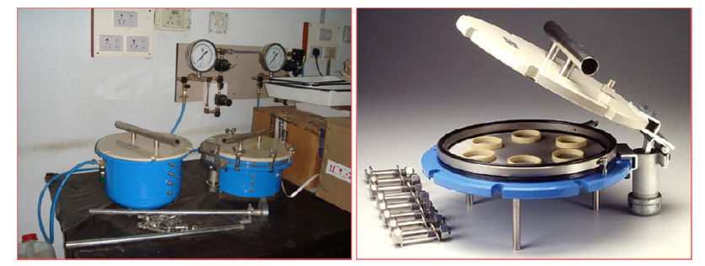

Slide 58
Soil water movement in plants
Water Uptake by plants:
Passive absorption: When water enters into the roots by negative pressure.
Active absorption: When there is a little transpiration, the roots of many plants absorb water by spending energy which is known as active absorption.
Aerial absorption: Some plants are able to absorb water from atmosphere when there is shortage of water in soil. This is known as aerial absorption or negative transpiration.

Slide 59
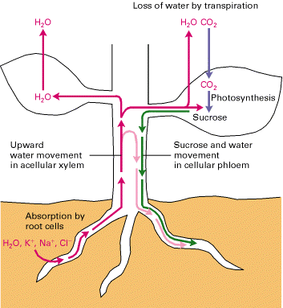
Translocation

Slide 60
Infiltration
Infiltration is the entry of fluid from one medium to another. In irrigation practice it is the term applied to the process of water entry into the soil, generally by downward flow through all or part of the soil surface is termed as infiltration.
Seepage
The lateral movement of water through soil pores or small cracks in the soil profile under unsaturated condition is known as seepage.
Drainage
The frequency and duration of periods when the soil is free from saturation with water. It controls the soil cum water relationship and the supply of nutrients to the plants.
Drainage classified as Very poorly drained, Poorly drained, Imperfect ,Moderately well ,Well ,Somewhat excessive and Excessive

Slide 61
Permeability
It indicates the relative ease with which air and water penetrate or pass through the soil pores. Permeability of soils is generally classified as rapid, moderate and slow.
Deep percolation
Once the water has infiltrated the soil, the water moves downward into the profile. This post- infiltration water movement downward with in the soil profile under the influence of both gravity and hydrostatic pressure is termed as deep percolation.

Slide 62
Thank you

