Slide 1
Course name – Principles and Practices of Water Management (AGRO 0504) Course Credit – 2+1
Lecture 9
Topic: Soil, plant and meteorological factors determining water needs of crops.

Slide 2
UNIT III Soil, plant and meterological factors
Climate influences the distribution of crops over different regions of the world while weather influences crop production and productivity.
Of the weather variables, temperature and rainfall are most important.
Fauna and flora in different climatic zones are dependent on this – tropical, temperate and frigid zones.
Tropical regions get abundant sun’s heat and vegetation is high, low in temperate and very little in frigid.
Xerophytes (arid), mesophytes and hydrophytes (tropics).
Rainfall (Soil moisture), Solar radiation, air temperature, soil temperature, wind humidity, evapotranspiration are common weather factors affecting plant growth

Slide 3
Solar radiation (without which life will not exist)
From germination to harvest and even post-harvest crops are affected by solar radiation.
Biomass production by photosynthetic processes requires light.
All physical process taking place in the soil, plant and environment are dependent in light
Solar radiation controls distribution of temperature and there by distribution of crops in a region.
Visible radiation is very important in photosynthetic mechanism of plants. PAR is essential for production of carbohydrates and ultimately biomass. (0.4 – 0.7µ)
0.4 to 0.5 µ – Blue – violet – Active
0.5 to 0.6 µ – Orange – red – Active
0.5 to 0.6 µ – Green –yellow – low active
0.7 to 0.8 µ Infra-Red Nil to minimum
Photoperiodism – response of plant to day length Short day (Rice, Sunflower, cotton), long day (barley, oat, carrot, cabbage), day neutral (tomato and maize).
Phototropism –– response of plants to light direction. Eg. south quadrant in northern hemisphere receives more light
Photosensitive – season bound varieties depends on quantity of light received

Slide 4
Temperature
Influences distribution of crop plants and vegetation.
Germination, growth and development is highly influenced.
Affects leaf production, expansion and flowering.
Physical and chemical processes with in the plants are governed by air temperature.
Diffusion rates of gases and liquids changes with temperature.
Solubility of different substances is dependent on temperate.
Equilibrium of various systems and components is a function of temperature.
Cardinal temperature (optimum, maximum, minimum)
Concept of growing degree days (GDD) is a function of temperature

Slide 5
Pressure
The response of plants to changes in atmospheric pressure has not received much attention because of the limited influence it has on crops.
Low pressure experienced at high altitudes reduces the solubility of CO2 and O2 in water and in turn on respiration.
Due to low CO2 and O2 experienced in low pressure area the plants show stunted growth.

Slide 6
Wind
Transports heat (sensible/latent) from lower to higher latitudes.
Provides moisture to land necessary for precipitation.
Moderate turbulence promotes consumption of CO2 for photosynthesis. (by removing Boundary layer resistance).
Prevents frost by disrupting a temperature inversion.
Wind dispersal of pollen and seeds is natural and necessary for certain crops.
_{Causes soil erosion.}
Heavy wind damages crops like banana, sugarcane.
Helps in cleaning produce to farmers.
_{Increases evaporation.}
_{Spread of pest and diseases.}

Slide 7
Humidity
Determines the crops grown in a given region.
Affects internal water potential of plants.
Influences physiological phenomena like transpiration.
The water requirement of crop is influenced as it has say on PET.
High humidity can prolong survival of crops under moisture stress but will reduce the yield (No gas exchange).
High RH – expose to saprophytic and parasitic fungi, bacteria and pest (potato blight, sucking pest of crops).

Slide 8
Evaporation
Important process of hydrologic cycle
Decides irrigation water requirement
Modifies microclimate of crop
Important component in heat budget

Slide 9
Transpiration
Dissipation of radiant energy by plants
Translocation of water and minerals in the plant

Slide 10
Evapotranspiration
Irrigation scheduling
To understand the relationship between crop yield and irrigation water

Slide 11
Rainfall
Good solvent gets nourishment in solution form
Plays important role in life processes by gas exchange (1 cm rain over one hectare is 100m3 (1, 00,000 lit) contains 4,339 gms of O_{2 = 3000 lines of pure O2.)}
Regulates the temperature of plants Protects the crop against mechanical disturbances
Quantity and distribution of rainfall decides the vegetation of an area
_{Causes soil erosion}

Slide 12
Effective Rainfall
From the point of view of the crop water requirement Dastane (1974) has defined effective rainfall as “that portion of the total annual or seasonal rainfall which is useful directly and/or indirectly for meeting the crop water needs in crop production at the site where it falls but without pumping”.
ER=Rainfall-(Run-off+deep Perculation of Water)
=1433-900
=533mm

Slide 13
Factors influencing Effective Rainfall
Several factors influence the proportion of effective rainfall in the total rainfall received and these may act singly or collectively and interact with each other. Any factor, which affects infiltration, run-off or evapotranspiration, affects the value of effective rainfall. The following factors have been shown to influence the effective rainfallsignificantly:

Slide 14
a) Rainfall characteristics:
Amount, intensity and distribution of rainfall influence surface runoff and hence its effectiveness. Greater amount of rainfall at high intensities reduce the effective fraction of the rainfall. Similarly, uneven distribution decreases the extent of effective rainfall. In India during kharif season from July to September the rainfall intensity, frequency and amount is high, hence the effectiveness of rainfall is very low. On the other hand, during winter season from November to April, most of the rainfall is effective due to its low intensity, frequency and amount. Other meteorological parameters which increase the ET increase the effectiveness of the rainfall. Higher evaporative demand of the atmosphere encourages greater depletion of moisture in the soil and therefore the proportion of effective rainfall in the total increases.
b) Land characteristics:
The time interval between receipt of rain water and its recession by soaking into soil is known as opportunity time. Water stays longer on flat and leveled land and this has longer opportunity time than on slopping land, leading to higher fraction of effective rain than on undulating lands.
c) Soil characteristics:
Higher infiltration and permeability rates increase effectiveness of rainfall. Fraction of the effective rainfall increases with increasing water holding capacity of the soil. The proportion of effective rainfall is lower in irrigated than the unirrigated areas where there is often greater deficiency of soil moisture.
d) Ground water characteristics:
The amount of effective rainfall is greater when the water table is deep than when it is shallow. Upward capillary movement of water decreases the deficit of moisture and hence the amount of effective rainfall.
e) Management practices:
Any management practice influencing runoff, infiltration, permeability or evapotranspiration also influences the degree of effective rainfall. Bunding, terracing, ploughing, ridging and mulching reduce runoff and increase effective rainfall.
f) Crop characteristics:
Higher crop ET rates create greater depletion of soil moisture. Hence, effective rainfall is directly proportional to the rate of water uptake by the crop. Degree of ground cover, root zone depth and growth stage influences the rate of water uptake. Rainfall which reduces the yield (such as downpours which often cause lodging in cereals when the latter are at the grain formation stage) must be regarded as Ineffective

Slide 15
Drum culture technique
This method was devised by Dastane et.al., (1966) for assessing crop evapotranspiration, percolation, effective and ineffective rainfall of a rice crop simultaneously under the field conditions

Slide 16
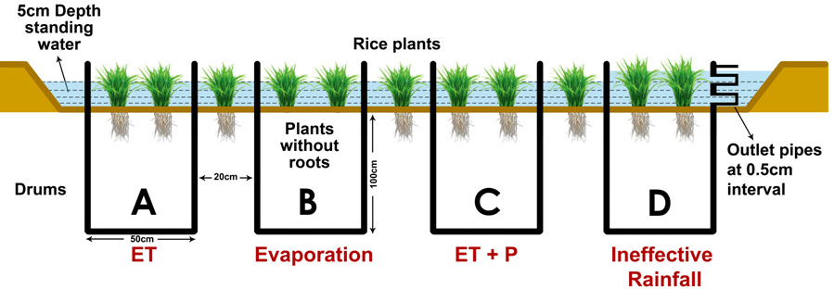

Slide 17
a) Difference in water level in drum A = Daily Evapotranspiration
b) Difference in water level in drum B = Daily Evaporation
c) Difference in water level in drum C = Total daily water needs
d) Difference in water level between drum A and B = Daily Transpiration
e) Difference in water level between drum A and C = Daily Percolation losses
f) Ineffective rainfall = Water collected in receiver tank from outlet pipes of drum D
Effective Rainfall = Total rainfall received – Ineffective rainfall

Slide 18
Determining water Requirement of crops
Water Requirement of crops
Evapotranspiration and Consumptive use
Classification of consumptive use of water by crop
Some terminology on evapotranspiration
Factors affecting evapotranspiration

Slide 19
The equation indicates that the crop water requirement is equal to Kc x ETo, part of which was supplied by the precipitation. When ETa is higher than the water requirement, the irrigation water requirement is considered nil. CROPWAT model which adopts the FAO Penman-Monteith method is used to calculate the reference evapotranspiration (ETo). Relatively accurate and consistent performance of the Penman-Monteith approach in both arid and humid climates has made this method the sole standard method for the definition and computation of the reference evapotranspiration.

