Slide 1
Light – Image formation, Mirrors, Properties

Slide 2
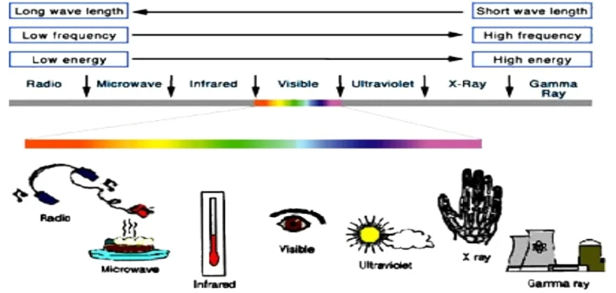
Light
It is a form of Electromagnetic Energy.
Part of Electromagnetic spectrum and is the only part where we can see.

Slide 3
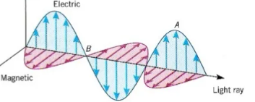
The speed of light C is constant in the vacuum.
Speed of light c=3.0*10⁸ m/s.
Light can be : Reflected, Refracted and Absorbed.
Light is an electromagnetic wave in that it has wave like properties which can be influenced by electric and magnetic fields.

Slide 4
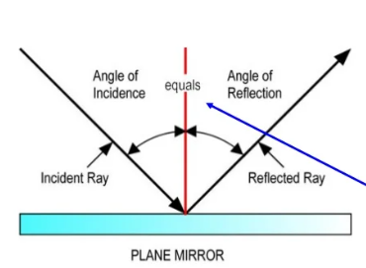
Law of Reflection
It states that angle of incidence (incoming ray) is equal to angle of reflection (outgoing ray)
The law works for Flat, Plane surfaces only.
The angles are measured from perpendicular line to the surface called NORMAL.

Slide 5
Virtual Image
These cannot be projected on screen.
Virtual images are always on the OPPOSITE side of the mirror relative to the Object.

Slide 6
Real Image
Real images are the one which can be projected on to the screen.
For MIRRORS, they always appear on the same side of the mirror as the object.
The characteristics of the image however may be different from the original object.

Slide 7
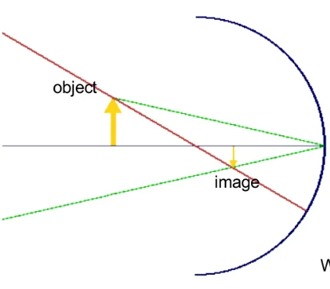
These characteristics are:
Size (reduced, enlarged, same size)
Position ( same side or opposite side)
Orientation ( right side up, inverted)
What if the mirror isn’t flat?

Slide 8
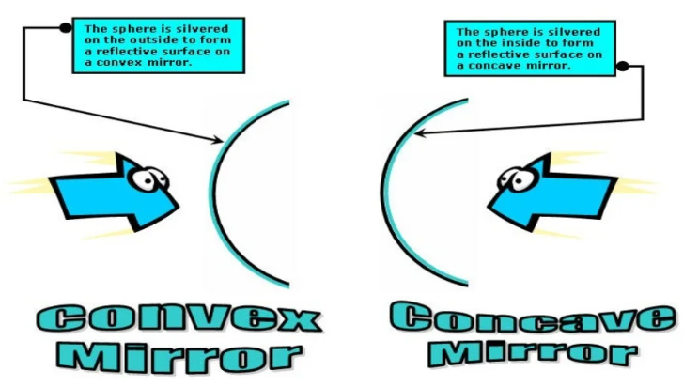
Spherical mirrors- Concave & Convex

Slide 9
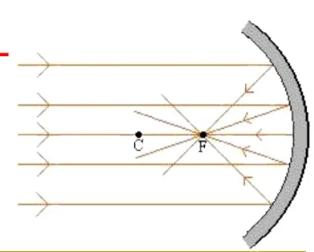
Converging (Concave) Mirror
A converging mirror is one that is spherical in nature by which it can focus all Parallel light rays to a point directly in front of its surface.
Every spherical mirror can do this and is at a fixed point for each mirror.
This point is called as Focal point.
To find this point, one must use
light from Infinity.

Slide 10
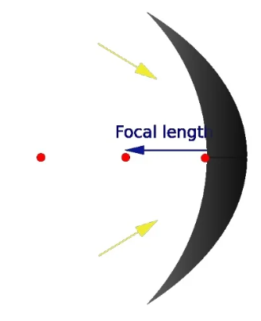
Since the mirror is spherical, technically has a Center of Curvature (C). The focal point happens to be HALF this distance.
f= C/2
C= 2f
A line is drawn through centre of the mirror called Principle axis.

Slide 11
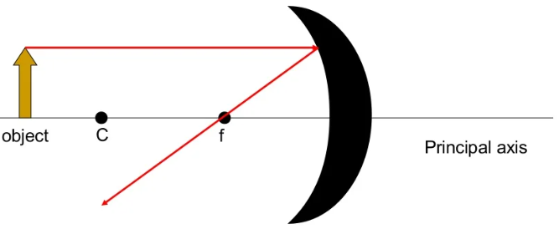
Ray Diagram
A ray diagram is a pictorial representation of how light travels to form an image and can tell the characteristics of the image.

Slide 12
Rule 1:
Draw a ray, starting from the top of the object parallel to the principle axis and then through “f” after reflection.

Slide 13
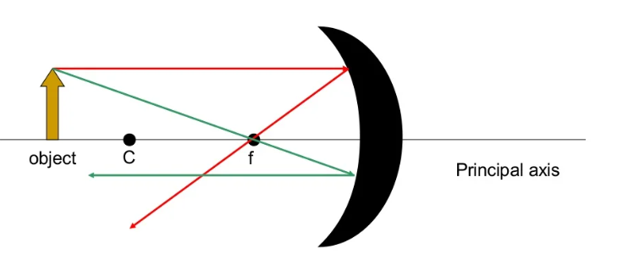
Rule 2:
Draw a ray, starting from the top of the object through the focal point then parallel to the principle axis.

Slide 14
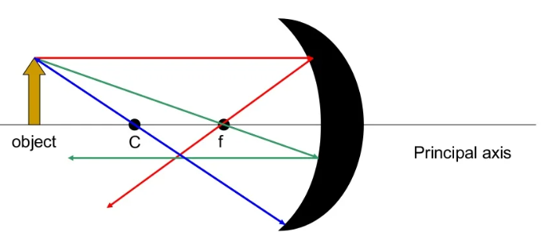
Rule 3:
Draw a ray, starting from the top of the object through C then back upon itself.
What do you notice about three lines? Where do they intersect?
The intersection is the location of the image.

Slide 15
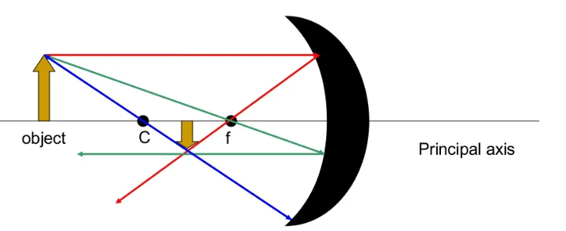
Image Characteristics:
After getting the intersection, draw an arrow down from the principle axis to the point of intersection.

Slide 16
Notify the following characteristics:
Is the image on the same side or opposite side of the mirror as the object?
Is the image enlarged or reduced?
Is the image inverted or right side up?

Slide 17
The Mirror/Lens Equation
Is there any other way to predict the image characteristics besides the ray diagram?
One way is to use the Mirror/ Lens equation to calculate the position of the image.
1/f=1/do+ 1/di

Slide 18
For example:
The focal length of a concave spherical mirror is 10 cm and the object distance is at 25 cm, Calculate the image distance and its characteristics.
1/f= 1/do+1/di

Slide 19
If the image distance is positive, then it is a Real Image.
Real image= Positive image distance
Virtual image= Negative image distance
To know the orientation and size of the image, use the Magnification Equation.
M= -di/do

Slide 20
If we get a positive magnification, the image is upright.
If we get a negative magnification, the image is inverted.
If the magnification value is greater than 1, the image is enlarged.
If the magnification value is less than 1, the image is reduced.
If the magnification value is equal to 1 the image size is equal to object size.

Slide 21
Refraction, Absorption and Reflection
The color of the objects we see in the natural world is a result of the way objects interact with light.
When a light wave strikes an object, it can be absorbed, reflected, or refracted by the object.
All objects have a degree of reflection and absorption.

Slide 22
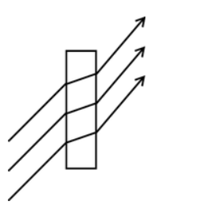
Refraction:
Light goes through the object and bends at an angle.
Example: diamond (greater angle) or water (lesser angle)

Slide 23
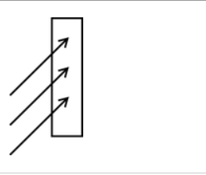
Absorption:
Light stops at the object and does not reflect or refract. Objects appear dark or opaque.
Example: wood.

Slide 24
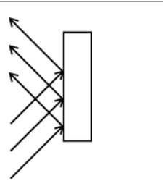
Reflection on a smooth surface:
Light bounces off the surface of a material at an angle equal to the angle of the incoming light wave.
Example: mirrors or glass.

Slide 25
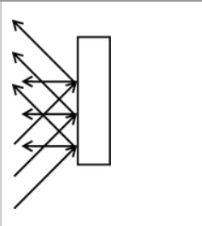
Scatter (Reflection on a rough surface):
Light waves bounce off at many of angles because the surface is uneven.
Example: the earth (that’s why the sky is blue).

