Slide 1
MRI BRAIN
BY
PRATHIBHA MALINI

Slide 2
INDICATIONS
Transient ischaemic attack (TIA), cerebrovascular attack (CVA)
Infection, inflammation, meningitis, encephalitis, HIV, AIDS, TB
Cognitive decline, neurodegenerative disorders, dementia
Demyelinating disease, multiple sclerosis
Loss of consciousness, seizures, epilepsy
Brain tumour, metastases, abscess
Cerebellar lesion, brainstem lesion
Congenital abnormalities
Post-operative follow-up
Vascular pathologies
Headaches
Haemorrhage
Trauma
Ataxia

Slide 3
CONTRA INDICATIONS
Any electrically, magnetically or mechanically activated implant (e.g. cardiac pacemaker, insulin pump biostimulator, neurostimulator, cochlear implant, and hearing aids)
Intracranial aneurysm clips (unless made of titanium)
Pregnancy (risk vs benefit ratio to be assessed)
Ferromagnetic surgical clips or staples
Metallic foreign body in the eye
Metal shrapnel or bullet

Slide 4
PREPARATION
A satisfactory written consent form must be taken from the patient before entering the scanner room
Ask the patient to remove all metal objects including keys, coins, wallet, cards with magnetic strips, jewellery, hearing aid and hairpins
If possible provide a chaperone for claustrophobic patients (e.g. relative or staff )
Contrast injection risk and benefits must be explained to the patient before the scan
Gadolinium should only be given to the patient if GFR is > 30
Offer earplugs or headphones, possibly with music for extra comfort
Explain the procedure to the patient
Instruct the patient to keep still
Note the weight of the patient

Slide 5
POSITION
Head first supine
Position the head in the head coil and immobilize with cushions
Give cushions under the legs for extra comfort
Centre the laser beam localizer over the glabella

Slide 6
Sequences:
T1-weighted sequence: Provides excellent anatomical detail and is useful for evaluating brain structures.
T2-weighted sequence: Shows differences in water content and is helpful in identifying pathology such as edema or tumors.
Fluid-attenuated inversion recovery (FLAIR): Suppresses signals from cerebrospinal fluid (CSF) to enhance the detection of lesions.
Diffusion-weighted imaging (DWI): Measures the random motion of water molecules and is valuable in assessing acute ischemic stroke.
Gradient echo (GRE) sequence: Sensitive to susceptibility changes and useful in detecting hemorrhages or iron deposits.
Magnetic resonance angiography (MRA): Provides detailed images of blood vessels in the brain, aiding in the diagnosis of vascular abnormalities.
Perfusion-weighted imaging (PWI): Measures cerebral blood flow and is employed to assess perfusion abnormalities.

Slide 7
PARA METERS
Field strength: The strength of the magnetic field generated by the MRI scanner, typically 1.5 Tesla or 3 Tesla for brain imaging.
Slice thickness: The thickness of each image slice acquired during the scan, usually ranging from 1 to 5 millimeters.
Matrix size: Determines the resolution of the images and is usually represented as the number of pixels in the x and y directions (e.g., 256x256).
Echo time (TE): The time between the radiofrequency pulse and the peak of the echo signal.
Repetition time (TR): The time between successive radiofrequency pulses.

Slide 8
Flip angle: The angle at which the protons are tipped using radiofrequency pulses.
g. Field of view (FOV): The area of the patient that is imaged, specified as the distance covered in the x and y directions.
h. Number of signal averages: The number of times each slice is acquired and averaged to improve the signal-to-noise ratio.
i. Parallel imaging: A technique that reduces scan time by simultaneously acquiring multiple lines of k-space.

Slide 9
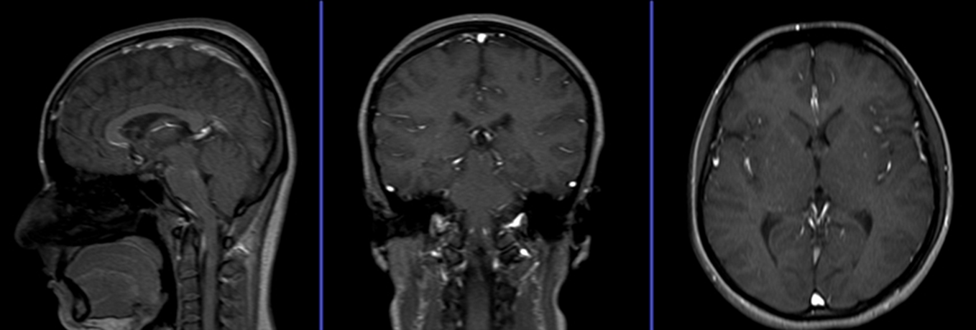
Suggested protocols, parameters and planning
localizer
A three plane localizer must be taken in the beginning to localize and plan the sequences. Localizers are usually less than 25sec. T1 weighted low resolution scans.

Slide 10
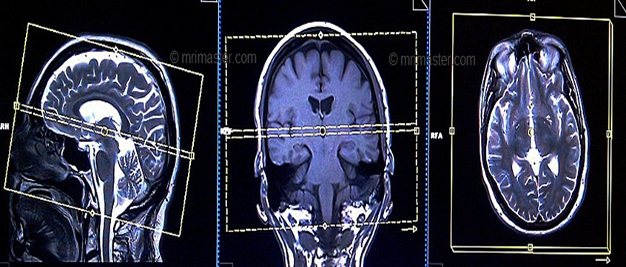
T2 tse axial
Plan the axial slices on the sagittal plane; angle the position block parallel to the genu and splenium of the corpus callosum. Slices must be sufficient to cover the whole brain from the vertex to the line of the foramen magnum. Check the positioning block in the other two planes. An appropriate angle must be given in coronal plane on a tilted head (perpendicular to the line of 3rd ventricle and brain stem).

Slide 11
T2 FLAIR axial
Plan the axial slices on the sagittal plane; angle the position block parallel to the genu and splenium of the corpus callosum. Slices must be sufficient to cover the whole brain from the vertex to the line of the foramen magnum. Check the positioning block in the other two planes. An appropriate angle must be given in coronal plane on a tilted head (perpendicular to the line of 3rd ventricle and brain stem).

Slide 12
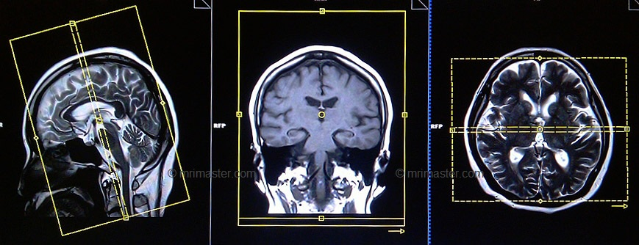
T1 SE coronal
Plan the coronal slices on the sagittal plane; angle the position block perpendicular to the corpus callosum. Check the positioning block in the other two planes. An appropriate angle must be given in the axial plane on a tilted head (perpendicular to mid line of the brain). Slices must be sufficient to cover the whole brain from the frontal sinus to the line of the occipital protuberance.

Slide 13
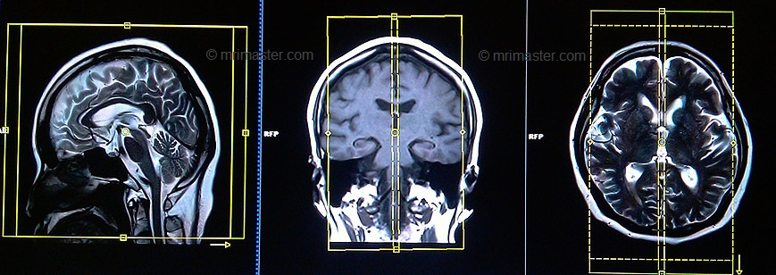
T2 tse sagittal
Plan the sagittal slices on the axial plane; angle the position block parallel to midline of the brain. Check the positioning block in the other two planes. An appropriate angle must be given in the coronal plane on a tilted head (parallel to the line along 3rd ventricle and brain stem). Slices must be sufficient to cover the brain from temporal lobe to temporal lobe.

Slide 14
DWI epi3scan trace axial
Plan the DWI axial slices on the sagittal plane; angle the position block parallel to the line from the glabella to the foramen magnum. This angle will reduce air-bone interface artefacts from the Para nasal sinuses. Slices must be sufficient to cover the whole brain from the vertex to the foramen magnum. Check the positioning block in the other two planes. An appropriate angle must be given in the coronal plane on a tilted head (perpendicular to the line of 3rd ventricle and brain stem).

Slide 15
Indications for contrast enchantement Brain scans
> Tumour, Metastases, Cranial nerve lesion, Indeterminate intracranial lesion, IAC mass
> Cavernous angioma, Amyloid angiopathy, Neurocysticercosis
> Meningitis, Encephalitis, Leptomeningeal spread
> Multiple Sclerosis, AVM, HIV, Infection Abscess
> Leukodystrophies, Delayed development
> Syringomyelia(Syrinx)

Slide 16
THANK YOU

