Slide 1
MR Spectroscopy (MRS) is an exciting application of magnetic resonance to reveal complementary non-invasive information about the biochemical composition of imaged tissue.
This metabolite information is then used to diagnose diseases, monitoring the diseases and assessing response to the treatment.
Even though theoretically MRS can be performed with spins or nuclei of 1H, 13C, 19F, 23Na, 31P, MRS in present clinical use are mainly 1H (Hydrogen) and 31P (Phosphorus) spectroscopy.
With MR spectroscopy, which adds only 10 minutes to a standard MRI exam, the radiologist is able to see the chemical make-up of a tumor. In most cases, the results indicate whether or not the lesion is cancerous without the need for biopsy. - AMERICAN CANCER INSTITUTE.

Slide 2
BASIC PRINCIPLE
MR images are reconstructed from the entire proton signal from the tissue dominated by water and fat proton signals. Protons from other metabolites do not contribute to imaging because of their negligible concentration.
As against MRI, the aim in MRS itself is to detect these small metabolites. Most metabolite signals of clinical interest resonate between resonant frequencies of water and fat.
To be able to detect these small metabolites large signal from water protons need to be suppressed.
How are small metabolites from the tissue detected?
Chemical shift forms the basis of MRS.
This change in precessional frequency of protons because of different chemical environment is chemical shift. So by determining the frequency of protons we can detect their chemical environment, i.e. metabolites in which they are precessing.

Slide 3
MRS requires much more homogeneous field than MRI because the smaller concentrations of metabolites with smaller chemical shift needs to be detected.
Homogeneity required for MRI is about 0.5 ppm while for MRS it is about 0.1 ppm. The process of making the magnetic field homogeneous is called as shimming.
Magnetic field should be homogeneous, of same strength throughout its entire extent for all MR applications.
No frequency encoding gradient in MRS
As in MRI, localization in MRS is done by slice selection and phase encoding gradient.
However, frequency encoding gradient is not used in MRS to preserve optimal homogeneity and chemical shift information.

Slide 4
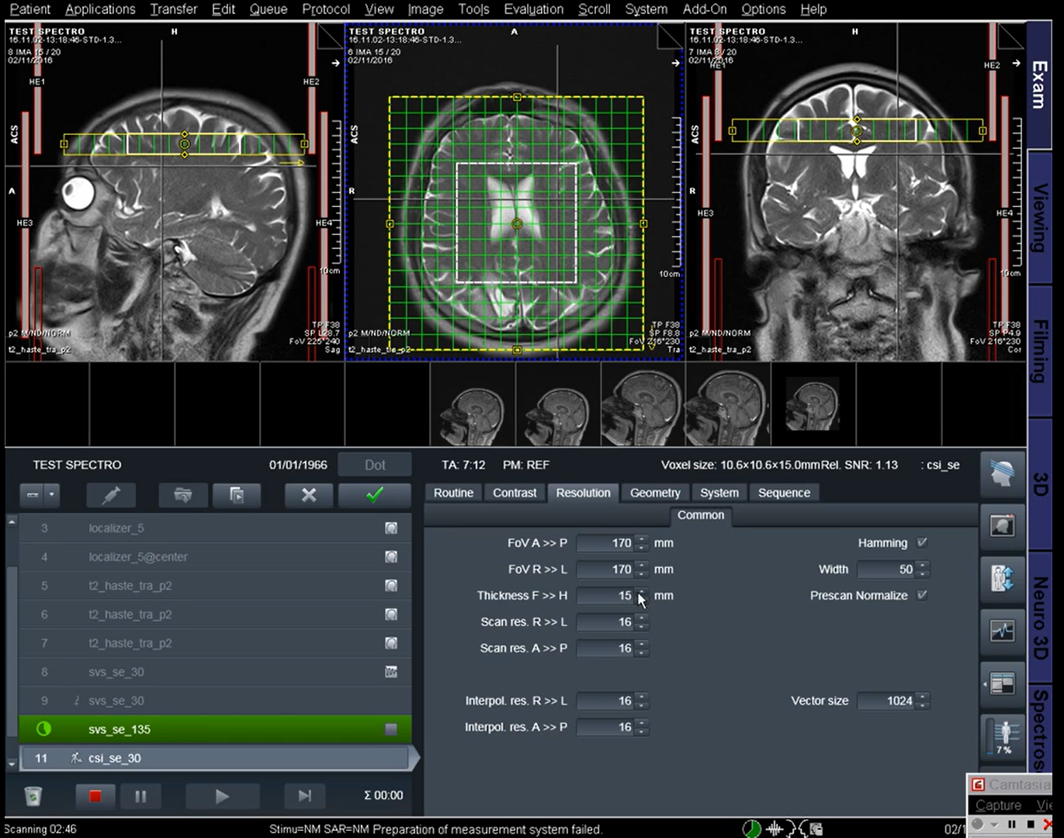
Sequences in MRS.
Localizer
T2 Axial
T2 Sagittal
T2 Coronal.
SVS se 30
SVS se 135
CSI se 30
CSI se 135

Slide 5
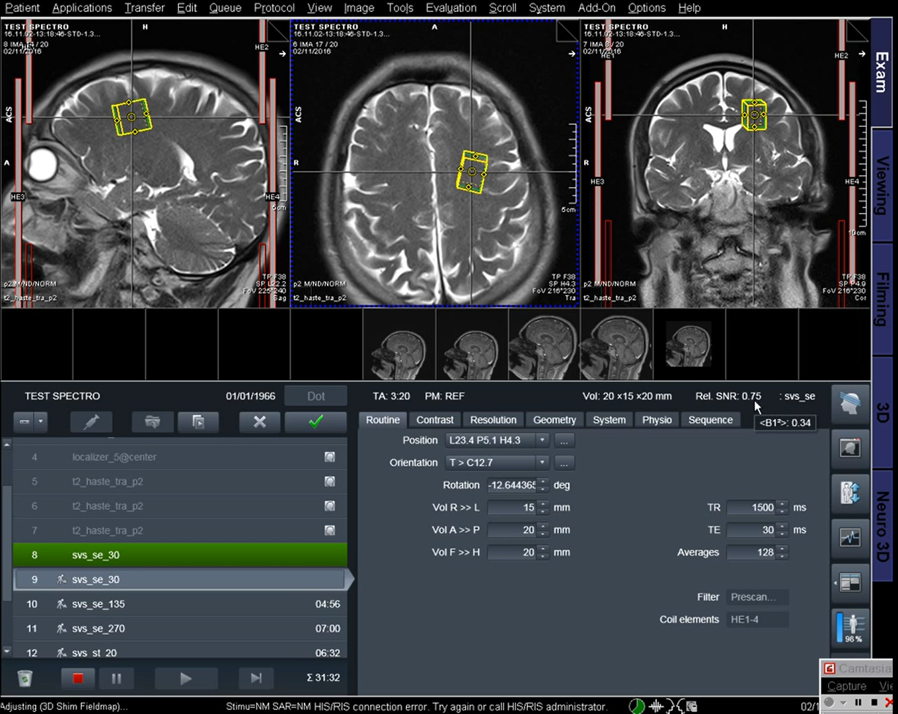
Sequences
MRI - Brain p+c with MRS
Localizer
T2 axial
FLAIR axial
DWI axial
T1 axial
T1 sag
T2 coronal
Perfusion sequence
T1 axial
T1 coronal
T1 sagittal
SVS se 30
CSI se 30
CSI se 135

Slide 6
TECHNIQUES IN MRS
There are 2 types of Techniques in MRS.
Single Voxel Spectroscopy(SVS).
STEAM: Stimulated Echo Acquisition Method
PRESS: Point Resolved Spectroscopy
ISIS: Image Selected In vivo Spectroscopy
Multi Voxel Spectroscopy.
CSI: Chemical Shift Imaging

Slide 7
STEAM: Stimulated Echo Acquisition Method
Volume of interest is excited by three 90 degree pulses in three orthogonal planes.
Since echo is stimulated signals are weak. STEAM is used in short TE (20-30 ms) spectroscopy.
PRESS: Point Resolved Spectroscopy
In PRESS, one 90 degree and two 180 degree pulses are applied along three orthogonal planes.
Signals are strong and PRESS is used for longer TE (135, 270 ms) spectroscopy. PRESS can not be used for shorter TEs.
ISIS: Image Selected in vivo Spectroscopy
Three frequency selective inversion pulses are applied in presence of orthogonal gradients.
Fourth non-selective pulse is used for observation of signal. ISIS is used in 31P spectroscopy.
CSI: Chemical Shift Imaging
CSI is used for multivoxel spectroscopy, where large area is covered divided into multiple voxels.
CSI is also called as Magnetic Resonance Spectroscopic Imaging (MRSI) as it combines features of both imaging and spectroscopy.
Spatial localistion is done by phase encoding in one, two or three directions to get on, two or three dimentional spectroscopy.
Matabolite maps or matabolic ratio maps can be seen overlapped over the images.

Slide 8
Steps in MRS acquisition
Patient positioning
Global shimming
Acquisition of MR images for localization Images are obtained in all three planes (coronal, axial and sagittal) for placement of voxel. MR images already obtained during routine imaging can be used for the localization purpose
Selection of MRS measurement and parameters - TR and TE are important parameters.
Improved SNR is obtained at longer TR.
TEs commonly used are 20-30 ms, 135-145 ms and 270 ms
At longer TEs more than 135 ms peaks of major brain metabolites only like choline, creatine, NAA and lactate are visible.
Peaks from lipid, glutamate, glutamine, GABA, inositols are suppressed at higher TEs.
There is less noise at higher TEs. Shorter TEs are used for metabolites with short T2 such as glutamate, glutamine, inositol.

Slide 9
5. Selection of VOI (volume of interest)
SVS can be used for local or diffuse diseases.
CSI is used in irregularly-shaped large pathology is used and where other side comparison is required
6. Localized shimming
This is optimisation of homogeneity over selected volume of interest.
Good local shim results into narrower metabolite peaks, better spectral resolution and good SNR
7. Water suppression
Water peak is suppressed so that smaller metabolite peaks are visible.
Water peak suppression is done by CHESS (Chemical shift selective spectroscopy) technique

Slide 10
8. MRS data collection — On modern machines in use, SVS usually takes 3-6 minutes and CSI usually takes upto 12 minutes for data acquisition.
9. Data processing and display Acquired data is processed to get spectrum and spectral maps
10. Interpretation
Area under the peak of any metabolite is directly proportional to the number of spins contributing to the peak.
Absolute values for each metabolite may vary with age and population. Interpretation should always base on ratios of metabolites and comparison with normal side

Slide 11
Metabolites of MRS
NAA: N-Acetylaspartate
NAA reduced in: hypoxia, infarction, Alzheimer’s, Herpes encephalitis, hydrocephalus, Alexander’s disease, Epilepsy, Neoplasms, stroke, NPH, Closed head trauma (Diffuse Axonal Injury).
NAA increased in: Canavan’s disease
Cr: Creatine
Cr is increased in hypometabolic states and in trauma.
Cr is reduced in hypermetabolic states, hypoxia, stroke, tumor
Cho: Choline
Cho increased in: Chronic hypoxia, epilespy, Alzheimer’s, gliomas and other tumors, trauma, infarction, hyperosmolar states, diabetes mellitus.
Cho reduced in: hepatic encephalopathy, stroke.
GABA Used for monitoring vigabatrin therapy.

Slide 12
mI: Myoinositol
MI increased in: Alzheimer’s, frotal lobe dementias, diabetes, hyperosmolar states.
MI decreased in: hepatic and hypoxic encephalopathy, stroke, tumor, osmotic pontine myelinolysis, hyponatremia.
Glx: Glutamate (Glu) and Glutamine (Gln)
Glu is excitatory neurotransmitter and GABA is important product of Glu.
Gln has role in detoxification and regulation of neurotransmitter activities. Glx elevated in head injury, hepatic encephalopathy, hypoxia.
Lipids
Not seen in normal brain spectrum Seen in acute destruction of myelin.
Increased in high grade tumors (reflects necrosis), stroke, multiple sclerosis lesions and tuberculomas.
Amino Acids – Alanine is seen in meningioma whereas Valine and leucine are markers of abscess
Glucose Seen next to Cho peak on left side. Increased in diabetes, parenteral feeding, hepatic encephalopathy.

Slide 13
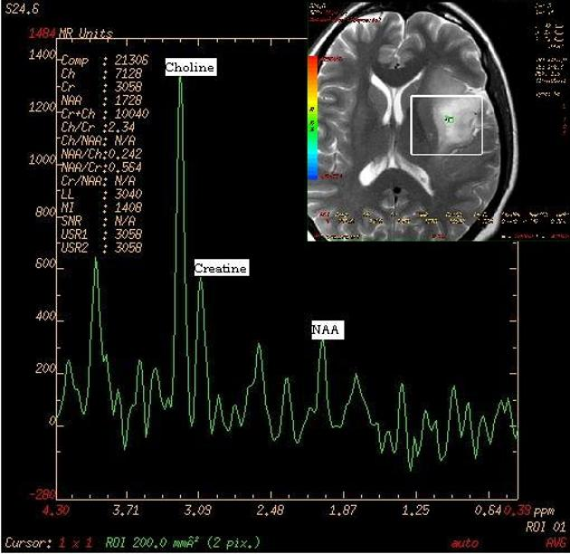
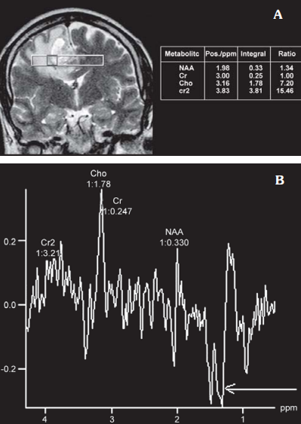
HIGH GRADE TUMOUR
GLIOMA

Slide 14
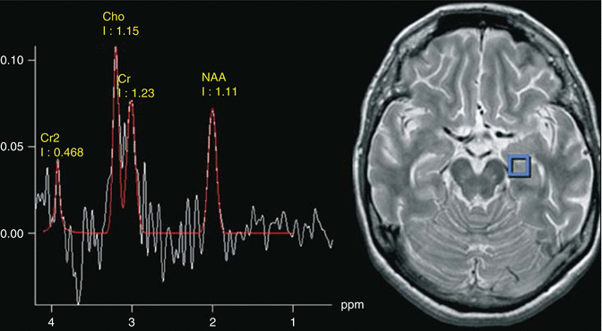
ALZIMERS DISEASE
Reduction of NAA/Cr ratio

Slide 15
Clinical Uses of MRS
Brain Tumor : In tumors there is increase in Cho, lactate and lipid. There is reduction in NAA and Cr.
MRS in tumor evaluation: MRS can differentiate neoplasm from non-neoplastic lesions. MRS also helps to grade gliomas based on metabolite ratios.3
In treatment planning
In Treatment Monitoring : MRS helps to solve very important issue of differentiation of radiation necrosis and gliosis from residual or recurrent neoplasm.
Neonatal Hypoxia : There is decrease in NAA, Cr, MI and increase in Cho, lactate/lipid peaks in neonatal hypoxia. MRS can predict outcome of neonatal hypoxia.
Metabolic Disorders and White Matter Diseases
Elevation of lactate doublet is seen in mitochondrial disorders like MELAS (Mitochondrial Encephalopathy Lactic Acidosis and Stroke)
Canavan can be differentiated easily from Alexander disease by MRS. Canavan shows elevation of NAA peak.

Slide 16
Stroke : NAA and Cr are reduced whereas Cho and lactate are elevated. Extent, severity of ischemia and peripheral penumbra can be defined by CSI.
Closed Head Trauma : In diffuse axonal injury there is decrease in NAA/Cr ratio and absolute concentration of NAA. Outcome correlates with NAA/Cr and NAA values.
Epilepsy : NAA/Cr is reduced in affected lobe. MRS can be used to localise intractable epilepsy.
Multiple Sclerosis : In MS plaques, there is decrease in NAA/Cr and increased Cho/Cr and MI/Cr
Alzheimer’s Dementia : All dementias and aging show reduction in NAA/Cr, NAA and elevation of Cho/Cr ratio. However, Alzheimer’s shows increased MI/Cr and absolute MI concentration.
Hepatic Encephalopathy (HE) : There is reduction in MI and Cho, and elevation of Glx. MRS can detect subclinical HE.

Slide 17
HIV and AIDS : There is steady decline in NAA/Cr in HIV patients. MRS helps to differentiate lymphoma, toxoplasma and PML.
Lymphoma: Elevation of lactate, lipids and choline; reduction of NAA, Cr and MI.
Toxoplasma: Elevation of lipids and lactate and reduction of all other metabolites.
PML: Slight elevation of lactate, lipid, elevation of Cho, MI; reduction of NAA, Cr.
Abscess : Abscess can be difficult to differentiate from neoplasm. The changes in MR spectra in abscess include visualisation of amino acid peaks at 0.9 ppm. These amino acids include valine, leucine and isoleucine. There may be peaks representing acetate, pyruvate, lactate succinate, which are end products arising from microorganisms.

