Slide 1
Prisms
Sony Gunaganti
Department of Optometry

Slide 2
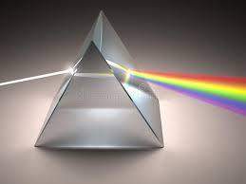
Prisms
Portion of refracting Medium
Bordered by two planes surface which are inclined at a finite angle.
A prism deviates light from its original path without changing its vergence.
Parts :
Two surfaces
Apex
Base

Slide 3
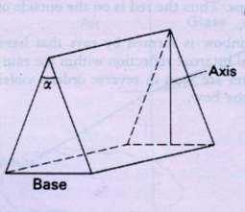
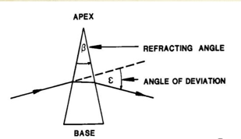
Prism Terminology
Apex
Base
Refracting Angle (Prism Angle)
Angle of Deviation
Refracting power

Slide 4
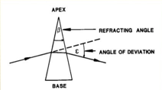
Prism Terminology
Apex
Tip of the prism where the two surfaces meet.
Thinnest portion of the prism.
Base
The bottom of the prism or the side opposite the apical angle
Thickest portion of the prism
Orientation of an ophthalmic prism is described related to the base.

Slide 5
Prism Terminology
Refractive Angle / Apical angle(alpha angle)β
The angle between two surfaces of prism is called as refractive angle / apical angle.
Greater the angle, the more prism will deviate light.

Slide 6
Angle of Deviation
Amount of light deviates from its original path, in degrees((ε)

Slide 7
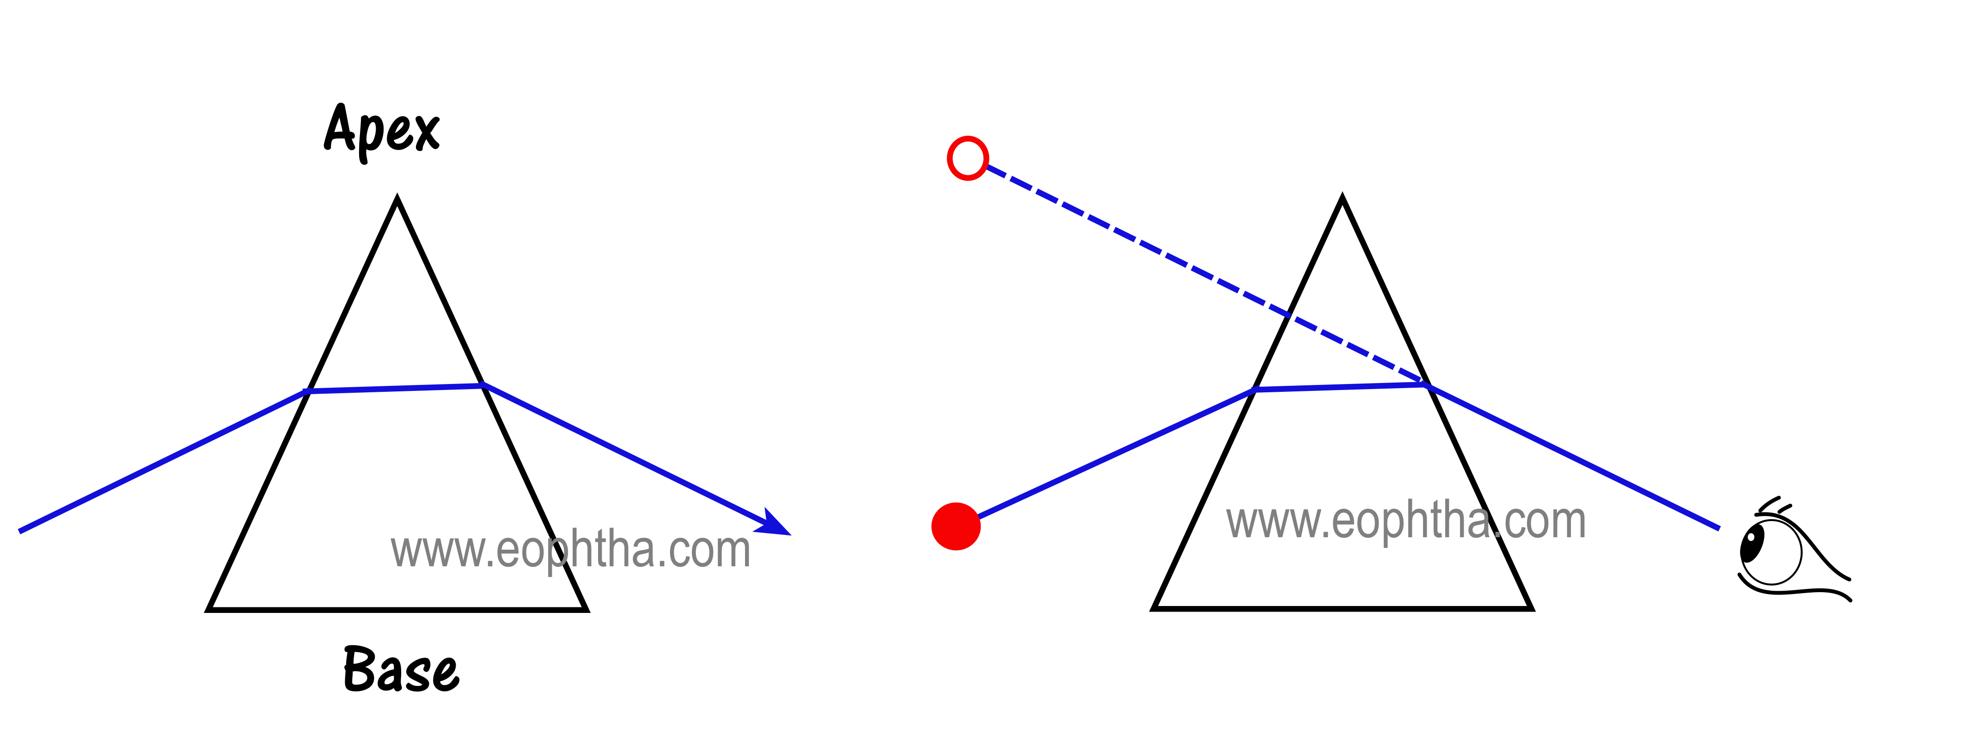
Prism Action
Prism deviates light towards the base of the prism.
Objects appear to move the base of the prism
Eye must make a movement toward apex to maintain fixation of an object.
Eye moves by an amount equal to the angle of deviation.

Slide 9
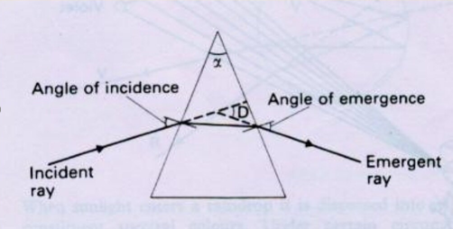
Passage of light through prism
Obeys Snell’s law.
Ray is deviated towards the base of the prism.
Net change in direction of ray- angle of deviation.

Slide 10
Conti…
Angle of deviation
Determined by 3 factors
Refractive index of the material
Refracting angle
Angle of incidence

Slide 11
When light strikes the first surface it is going from a low refractive index material (air) into a higher refractive index material (the prism).
However, it does not change direction because it enters the surface straight on.
Light will continue to travel through the prism without being bent until it reaches the second surface .
This ray of light then strikes the second surface at an angle.
Because the light has not been bent by the first surface, the angle at which it strikes the second surface is equal to the apical angle of the prism ( As this ray of light approaches the second surface of the prism, it is traveling from the denser (high refractive index) medium of the prism to a less dense medium (air) and will be bent away from the normal* to the surface.
Light is always bent toward the base of a prism.

Slide 12
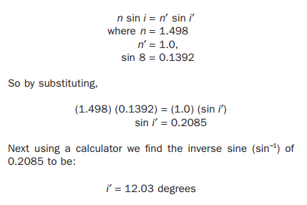
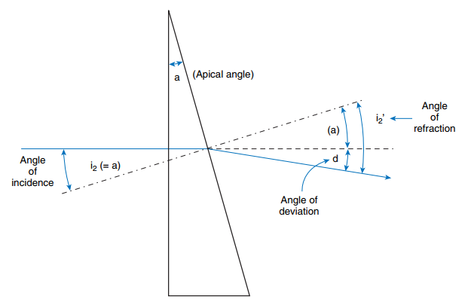
If a prism has an apical angle of 8 degrees and is made from CR-39 plastic with a refractive index of 1.498, how many degrees will the prism deviate the light ray from its original path?

Slide 13
The angle of refraction is the angle at which the light ray leaves the second surface.
To find the angle of deviation (i.e., how many degrees the light is deviated from its original path), subtract the angle of incidence from the angle of refraction.
(angle of deviation) = (angle of refraction) - (angle of incidence)
d = i′ - i = 12.03 - 8.00 = 3.97 degrees
= 4.0 degrees

Slide 14
This means if we begin with:
n sin i2 = n′ sin i2′
We can substitute and get:
n sin a = n′ sin (a + d)
*When angles are small (10 degrees or less), the sine of the angle is the same as the angle measured in radians.
(n) (a) = (n′) (a + d) Because the prism is in air, n′ = 1, and the equation becomes:
(n) (a) = (a + d)
To find d, we can transpose the equation and get: d = (n) (a) - a
or, written another way, d = a(n - 1)

Slide 15
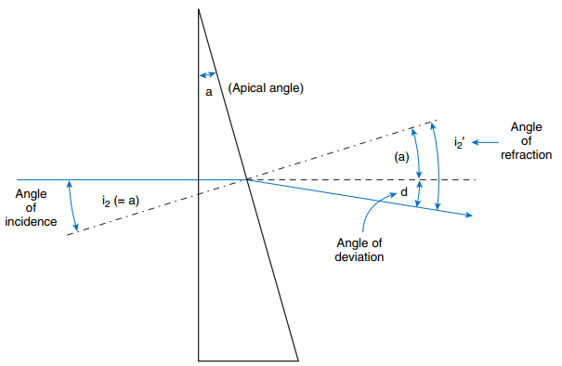
Simplifying for Thin Prisms
The angle of incidence (i2) equals the apical angle of the prism (a), or (i2 = a).
The angle of refraction (i2′) is the sum of the apical angle (a) plus the angle of deviation (d).
(i2′ = a + d)

Slide 16
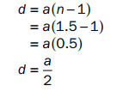
For material with an index of 1.5, the calculation is even easier and reduces to:

Slide 17
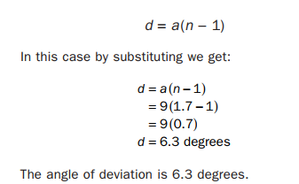
A prism with an index of refraction of 1.70 has an apical angle of 9 degrees. Using the thin prism approximation, what is the angle of deviation?

Slide 18
Finding Apical Angle from Degrees of Deviation d = a(n - 1)
????
a = d /(n-1)

Slide 19
Units of prisms
The power of a prism can be expressed in ..
Prism Diopter
The Centrad

Slide 20
Angle of Minimum Deviation
For any particular prism, the angle of deviation D is least when the angle of incidence equals the angle of emergence.
Refraction is then said to be symmetrical and the angle is called the Angle of minimum deviation.

Slide 21
Prism Diopters
A prism of one prism diopter power produces a linear apparent displacement of 1cm , of an object O situated at 1m.
Denoted by the symbol Δ

Slide 22
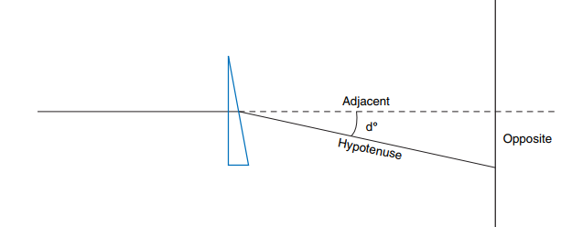
The prism diopter is an angular measure derived by using the tangent of the angle of deviation.
The prism diopter is the unit of angular measure whose tangent is 0.01 or 1/100.
In trigonometry the tangent of an angle is the opposite over the adjacent.

Slide 23
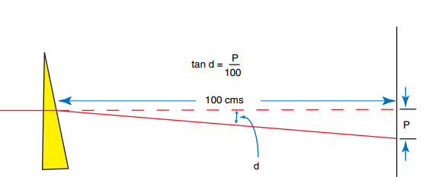

Slide 24
Centrad
It differs from the prism dioptre only in that image displacement is measured along an arc 1m from the prism.
The centrad produces a very slightly greater angle of deviation than the prism dioptre, but the difference is negligible.

Slide 25
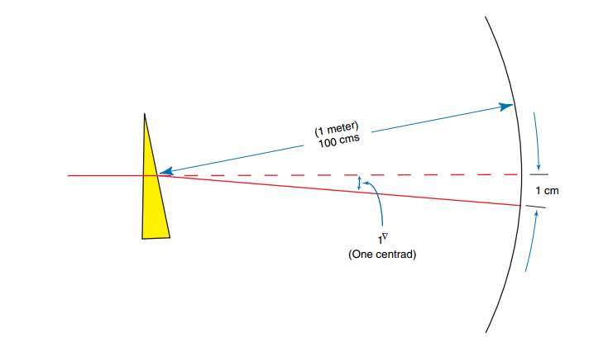
One (1) centrad equals one hundredth part(1/100th) of a radian.
The one hundredth part is measured on the circular arc.
If the radius equals 100 cm, then 1 centrad () is 1 cm measured on the curved arc.

Slide 26
There are two primary positions in which the power of a prism may be specified.
Frontal Position
Prentice position.

Slide 27
Calibration
Prisms made of glass are calibrated in Prentice position. They should be held with the back surface perpendicular to the line of sight.
Plastic prisms and prism bars are calibrated by the angle of minimum deviation. They should be held with a back surface parallel to the face or in the frontal plane position.

Slide 28
Characteristics of prism
A prism has a thickest edge, the base and a thinnest edge, the apex.
A prism displaces the incident rays towards the base of the prism.
A prism displaces the image towards the apex of the prism.

Slide 29
The image formed by the prism is
Erect
Virtual
Displaced towards the apex of the prism.

Slide 30
Prism Orientation
Prism can be oriented in front of the eye using notations
Base-In
Base –Out
Base Up
Base Down
All other base directions require 360 degree notation.

Slide 33
Application
Diagnostic Prisms
Therapeutic Prisms

Slide 34
Diagnostic Prisms
Assessment of squint and heterophoria
Measurement of angle objectively by prism cover test.
Measurement of angle subjectively by Maddox rod
To assess likelihood of diplopia after proposed squint surgery in adults.
Measurement of fusional reserve.
Four dioptre prism test.(microtropia)

Slide 35
Assessment of simulated blindness
If a prism is placed in front of a seeing eye, the eye will move to regain fixation.

Slide 36
Types of prism used in diagnosis
Single unmounted prisms/ loose prisms.
The prisms from the trial lens set
Prism bars
Horizontal
Vertical

Slide 37
Therapeutic prism
Convergence insufficiency
Common therapy for building the fusional reserve of patients with C.I
Base out prisms are using in exercise periods.

Slide 38
To relieve diplopia in certain cases of squint.
Include decompensated heterophorias,small vertical squint and some paralytic squint with diplopia in the primary position.
Prisms are reserved for those patients for whom surgery is not indicated.

Slide 39
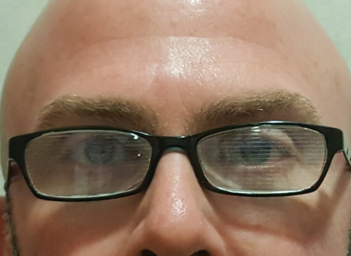
Forms of therapeutic prisms wear
Permanent wear
Temporary wear

Slide 40
Prisms in optical instruments
????....

Slide 41
Types of prisms… ?
Applications of prisms …?

