Slide 1
THEORY OF METAL MACHINING
Overview of Machining Technology
Theory of Chip Formation in Metal Machining
Force Relationships and the Merchant Equation
Power and Energy Relationships in Machining
Cutting Temperature

Slide 2
Material Removal Processes
A family of shaping operations, the common feature of which is removal of material from a starting workpart so the remaining part has the desired shape
Categories:
Machining – material removal by a sharp cutting tool, e.g., turning, milling, drilling
Abrasive processes – material removal by hard, abrasive particles, e.g., grinding
Nontraditional processes - various energy forms other than sharp cutting tool to remove material

Slide 3
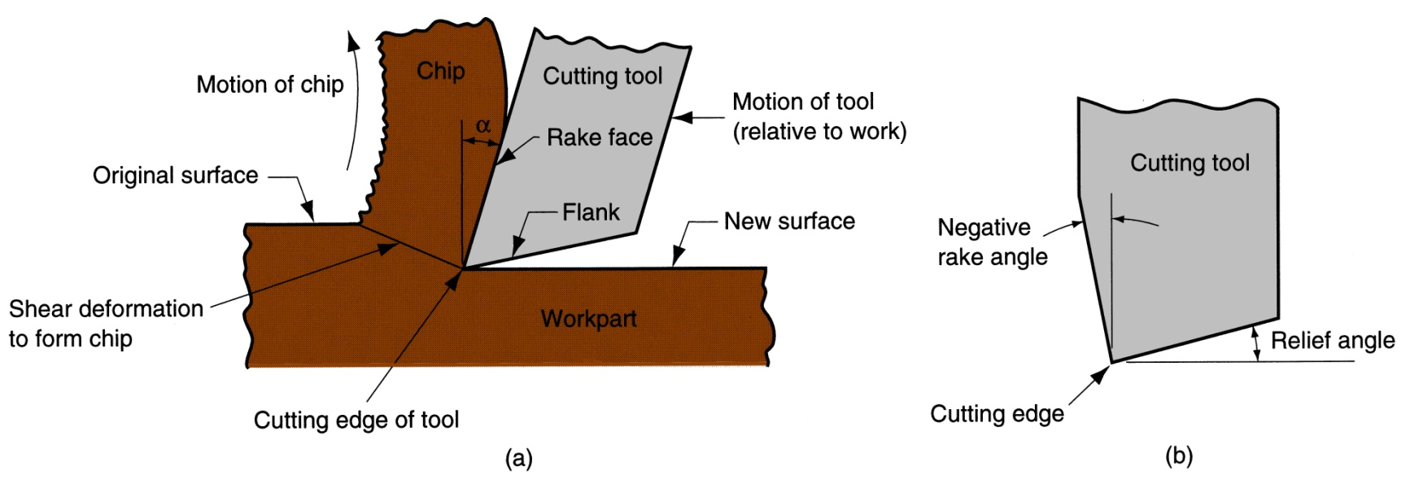
Machining
Cutting action involves shear deformation of work material to form a chip .
As chip is removed, a new surface is exposed
Figure 21.2 ‑ (a) A cross‑sectional view of the machining process, (b) tool with negative rake angle; compare with positive rake angle in (a)

Slide 4
Why Machining is Important
Variety of work materials can be machined
Most frequently applied to metals
Variety of part shapes and special geometry features possible, such as:
Screw threads
Accurate round holes
Very straight edges and surfaces
Good dimensional accuracy and surface finish

Slide 5
Disadvantages with Machining
Wasteful of material
Chips generated in machining are wasted material, at least in the unit operation
Time consuming
A machining operation generally takes more time to shape a given part than alternative shaping processes, such as casting, powder metallurgy, or forming

Slide 6
Machining in the Manufacturing Sequence
Generally performed after other manufacturing processes, such as casting, forging, and bar drawing
Other processes create the general shape of the starting workpart
Machining provides the final shape, dimensions, finish, and special geometric details that other processes cannot create

Slide 7
Machining Operations
Most important machining operations:
Turning
Drilling
Milling
Other machining operations:
Shaping and planing
Broaching
Sawing

Slide 8
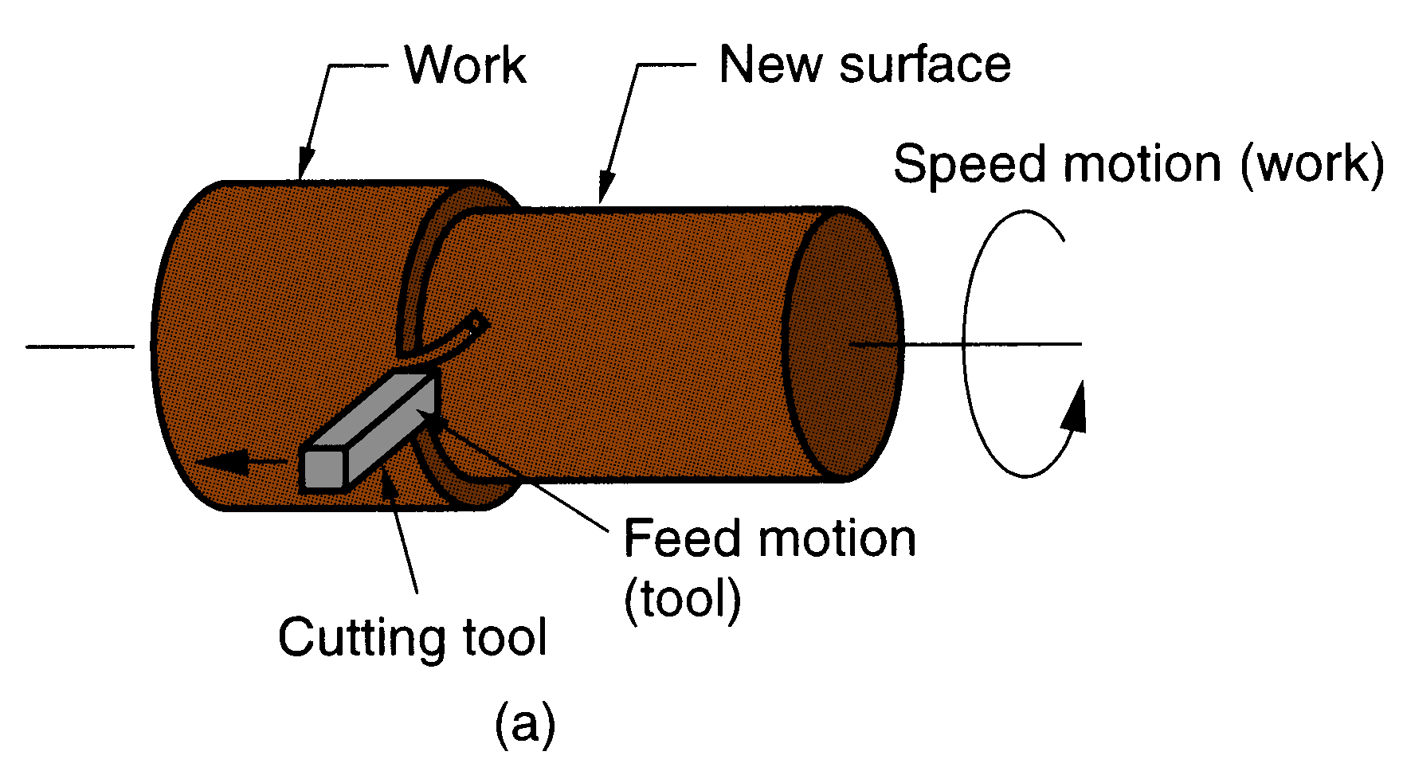
Turning
Single point cutting tool removes material from a rotating workpiece to form a cylindrical shape
Figure 21.3 (a) turning

Slide 9
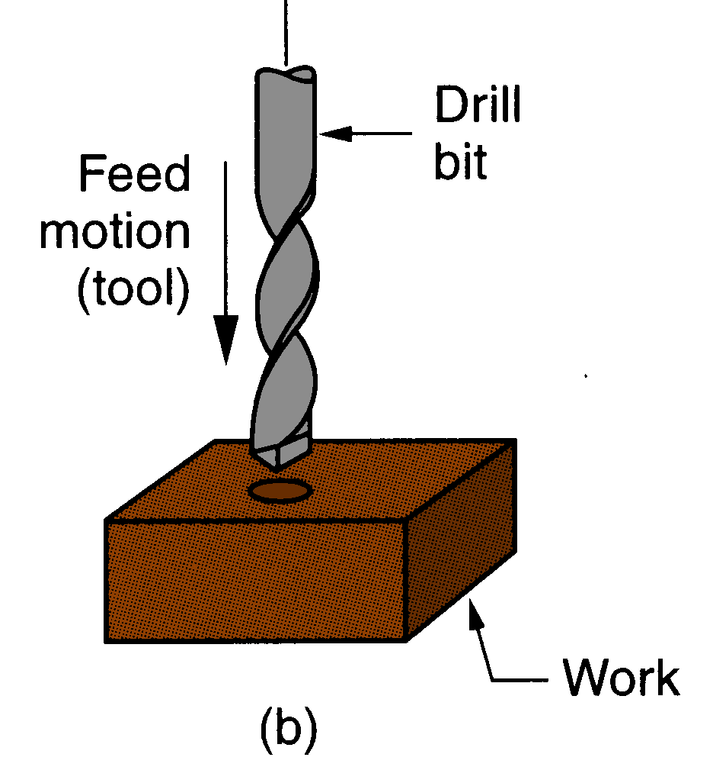
Drilling
Used to create a round hole, usually by means of a rotating tool (drill bit) that has two cutting edges
Figure 21.3 ‑ The three most common types of machining process: (b) drilling

Slide 10
Milling
Rotating multiple-cutting-edge tool is moved slowly relative to work to generate plane or straight surface
Two forms: peripheral milling and face milling
Figure 21.3 ‑ (c) peripheral milling, and (d) face milling

Slide 11
Cutting Tool Classification
Single-Point Tools
One cutting edge
Turning uses single point tools
Point is usually rounded to form a nose radius
Multiple Cutting Edge Tools
More than one cutting edge
Motion relative to work usually achieved by rotating
Drilling and milling use rotating multiple cutting edge tools.

Slide 12
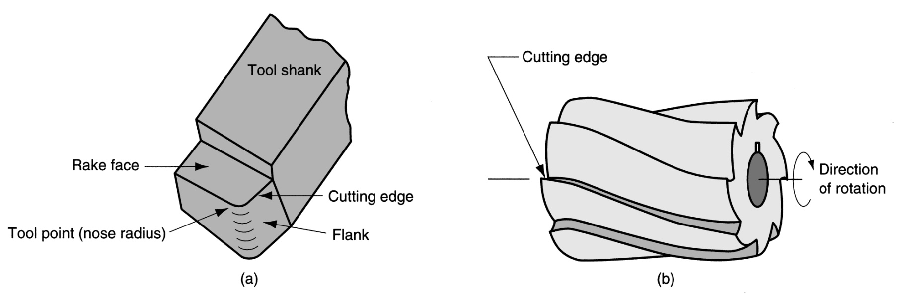
Figure 21.4 ‑ (a) A single‑point tool showing rake face, flank, and tool point; and (b) a helical milling cutter, representative of tools with multiple cutting edges

Slide 13
Cutting Conditions in Machining
The three dimensions of a machining process:
Cutting speed v – primary motion
Feed f – secondary motion
Depth of cut d – penetration of tool below original work surface
For certain operations, material removal rate can be found as
MRR = v f d
where v = cutting speed; f = feed; d = depth of cut

Slide 14
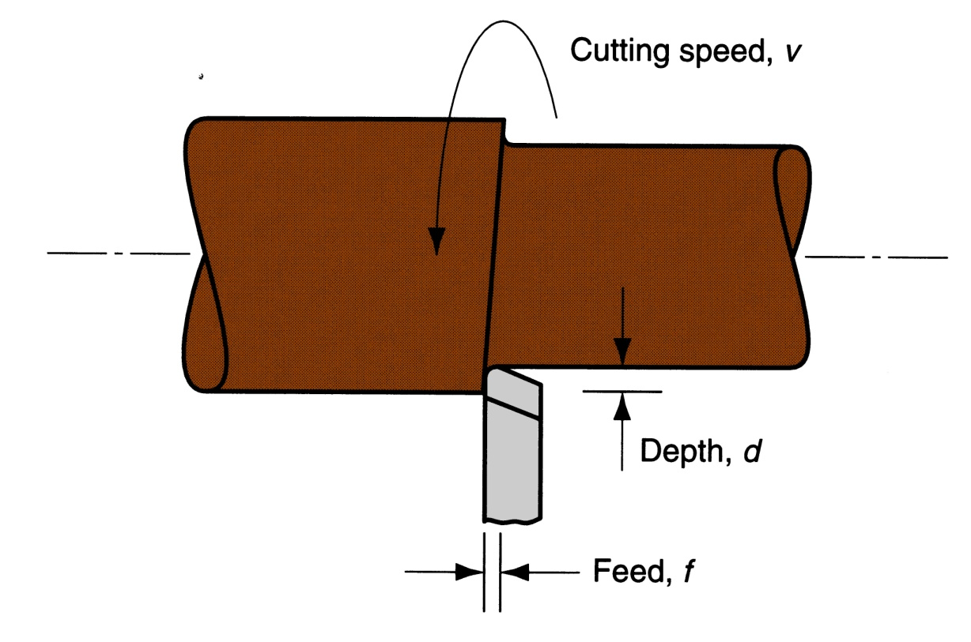
Cutting Conditions for Turning
Figure 21.5 ‑ Cutting speed, feed, and depth of cut for a turning operation

Slide 15
Roughing vs. Finishing in Machining
In production, several roughing cuts are usually taken on the part, followed by one or two finishing cuts
Roughing - removes large amounts of material from the starting workpart
Creates shape close to desired geometry, but leaves some material for finish cutting
High feeds and depths, low speeds
Finishing - completes part geometry
Achieves final dimensions, tolerances, and finish
Low feeds and depths, high cutting speeds

Slide 16
Machine Tools
A power‑driven machine that performs a machining operation, including grinding
Functions in machining:
Holds workpart
Positions tool relative to work
Provides power at speed, feed, and depth that have been set
The term is also applied to machines that perform metal forming operations

Slide 17
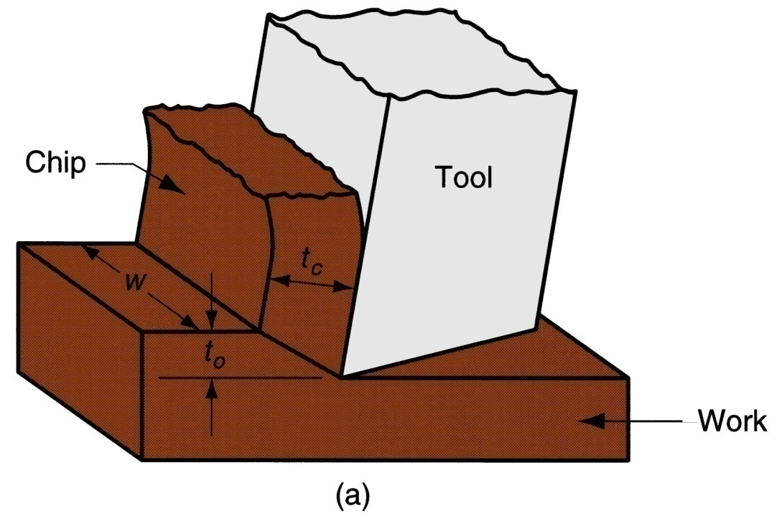
Orthogonal Cutting Model
A simplified 2-D model of machining that describes the mechanics of machining fairly accurately
Figure 21.6 ‑ Orthogonal cutting: (a) as a three‑dimensional process

Slide 18
Chip Thickness Ratio
where r = chip thickness ratio;
t_{o} = thickness of the chip prior to chip formation;
And
t_{c} = chip thickness after separation
Chip thickness after cut is always greater than before, so chip ratio is always less than 1.0

Slide 19
Determining Shear Plane Angle
Based on the geometric parameters of the orthogonal model, the shear plane angle φ can be determined as:
where r = chip ratio, and α = rake angle

Slide 20
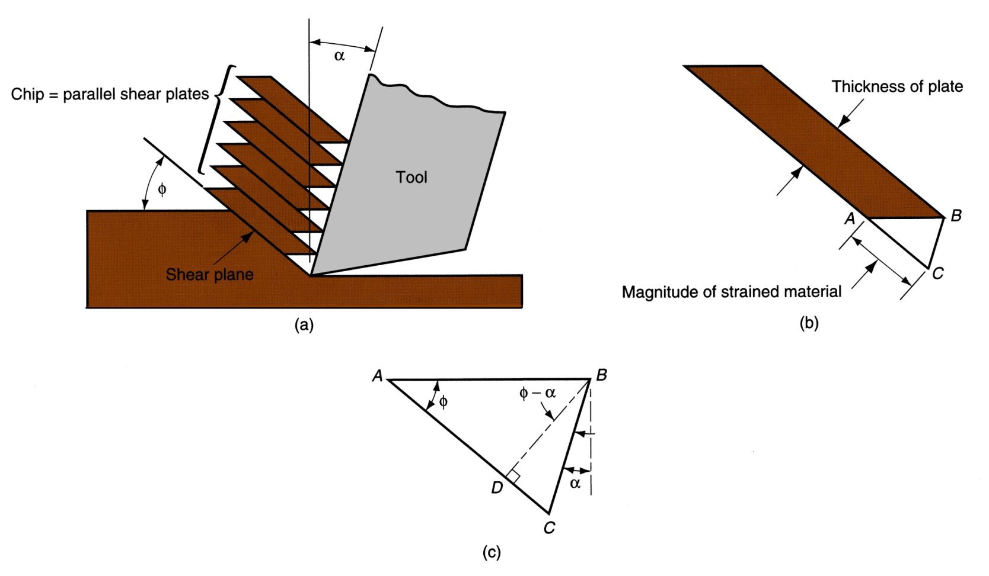
Figure 21.7 ‑ Shear strain during chip formation: (a) chip formation depicted as a series of parallel plates sliding relative to each other, (b) one of the plates isolated to show shear strain, and (c) shear strain triangle used to derive strain equation

Slide 21
Shear Strain
Shear strain in machining can be computed from the following equation, based on the preceding parallel plate model:
γ = tan(φ - α) + cot φ
where γ = shear strain, φ = shear plane angle, and α = rake angle of cutting tool

Slide 22
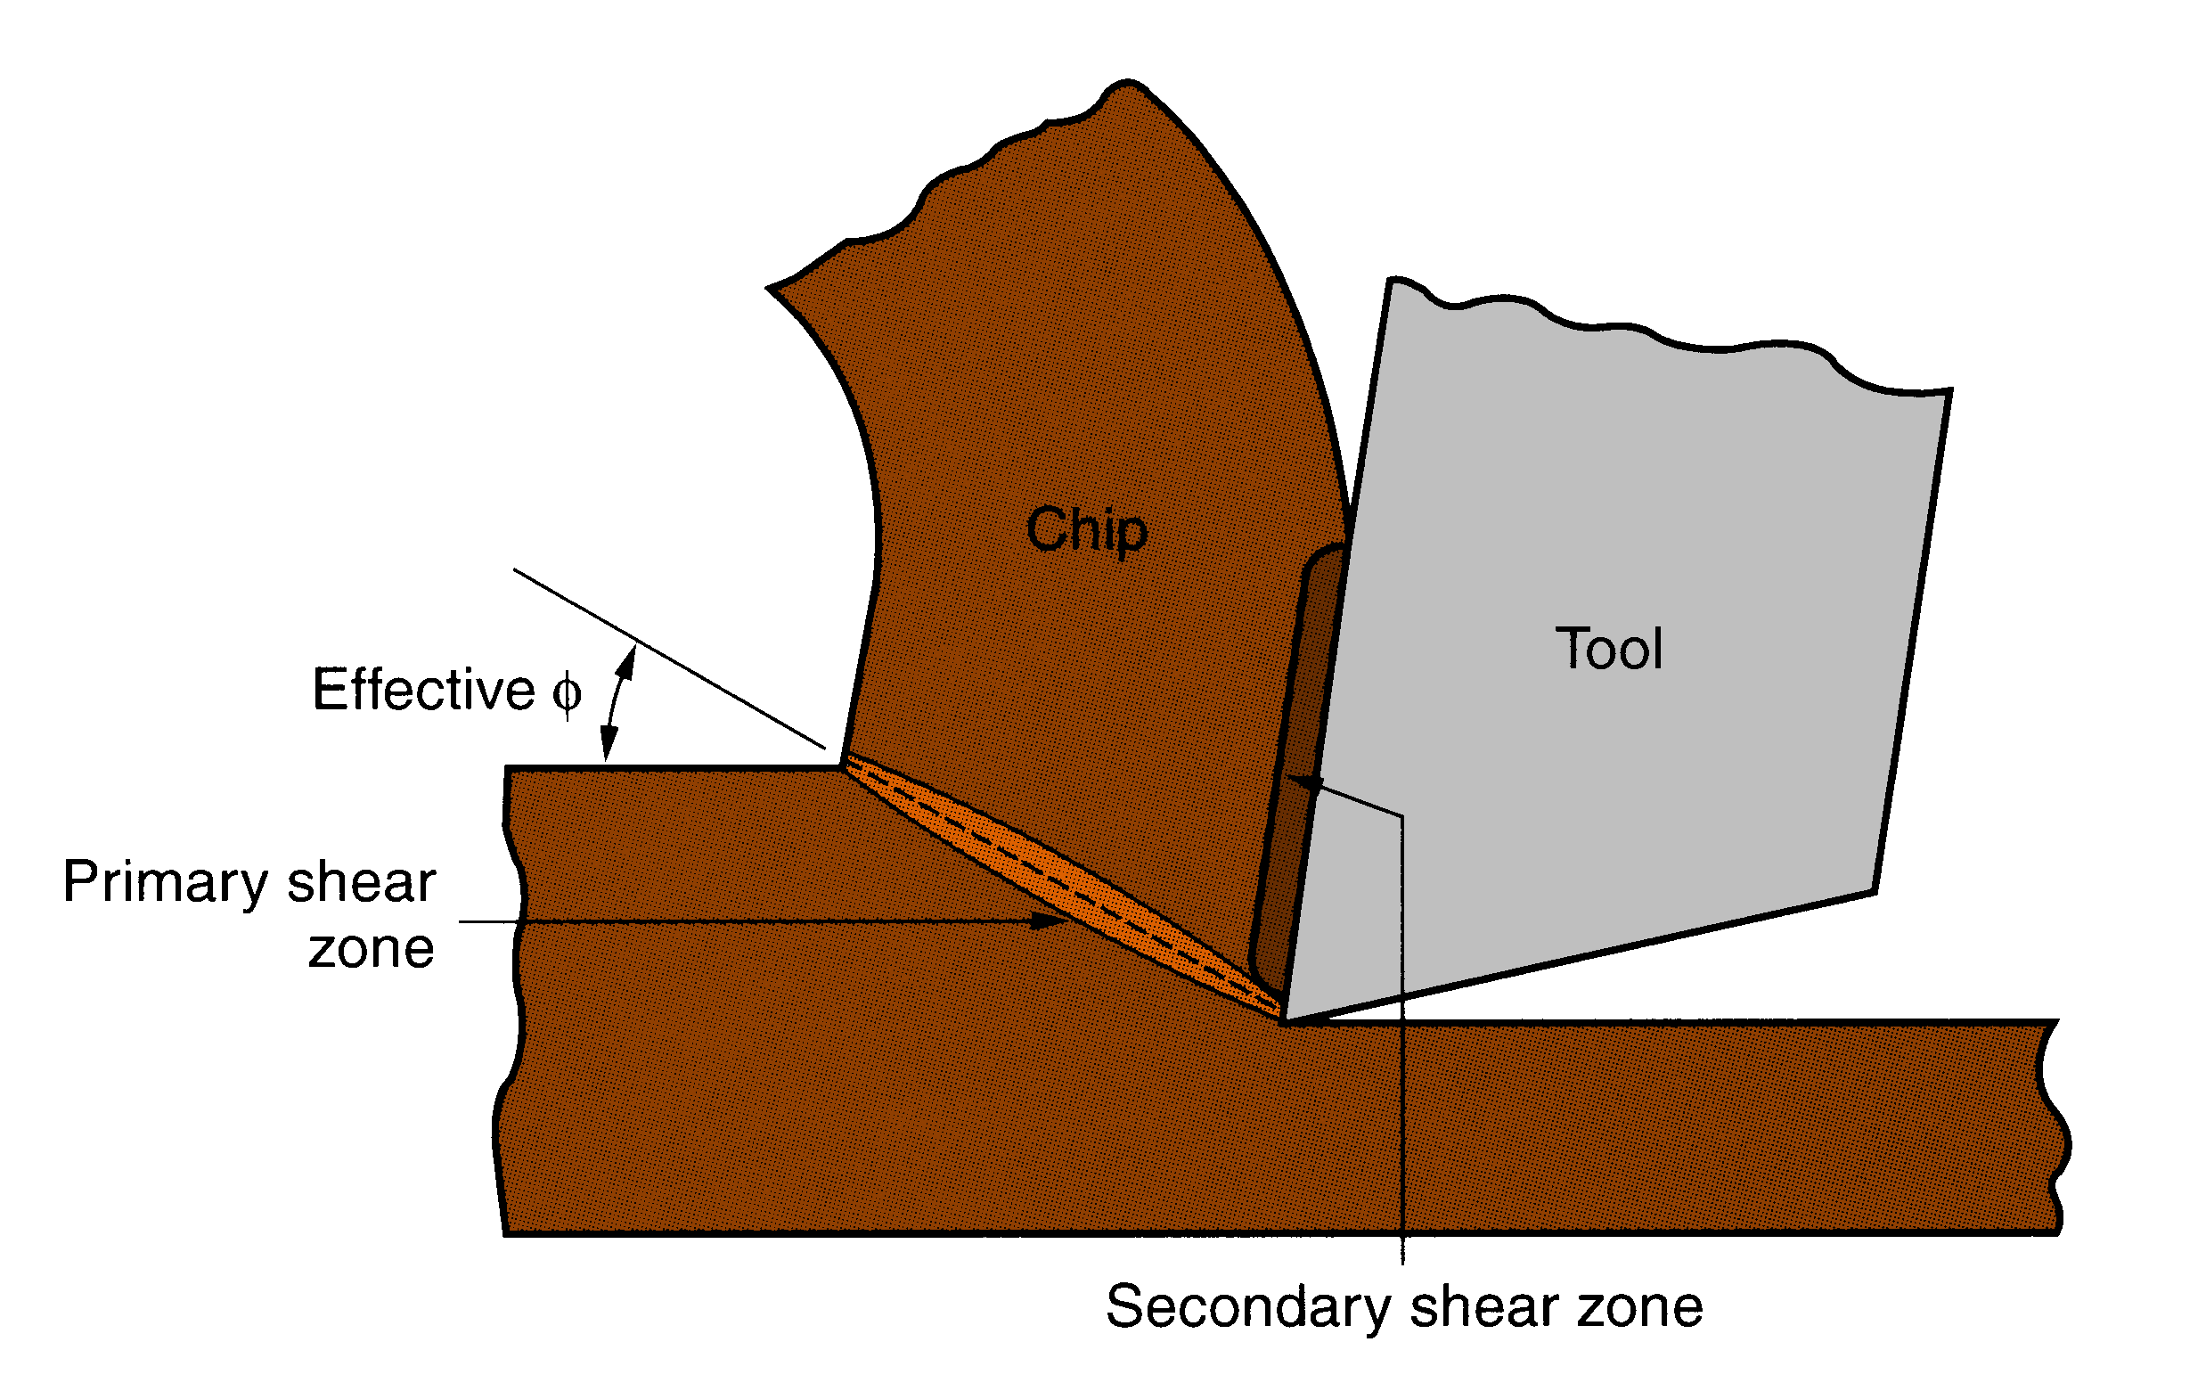
Figure 21.8 ‑ More realistic view of chip formation, showing shear zone rather than shear plane. Also shown is the secondary shear zone resulting from tool‑chip friction

Slide 23
Four Basic Types of Chip in Machining
Discontinuous chip
Continuous chip
Continuous chip with Built-up Edge (BUE)
Serrated chip

Slide 24
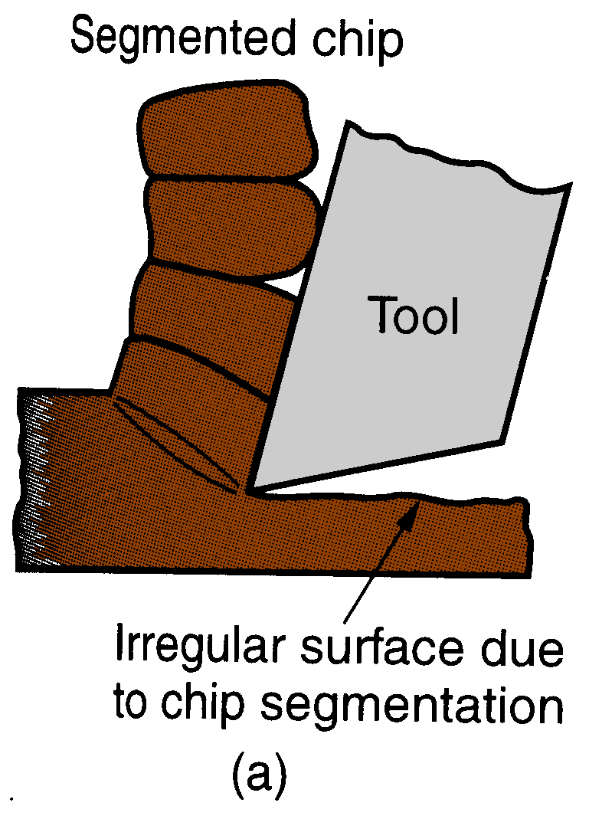
Segmented Chip
Brittle work materials (e.g., cast irons)
Low cutting speeds
Large feed and depth of cut
High tool‑chip friction
Figure 21.9 ‑ Four types of chip formation in metal cutting:
(a) segmented

Slide 25
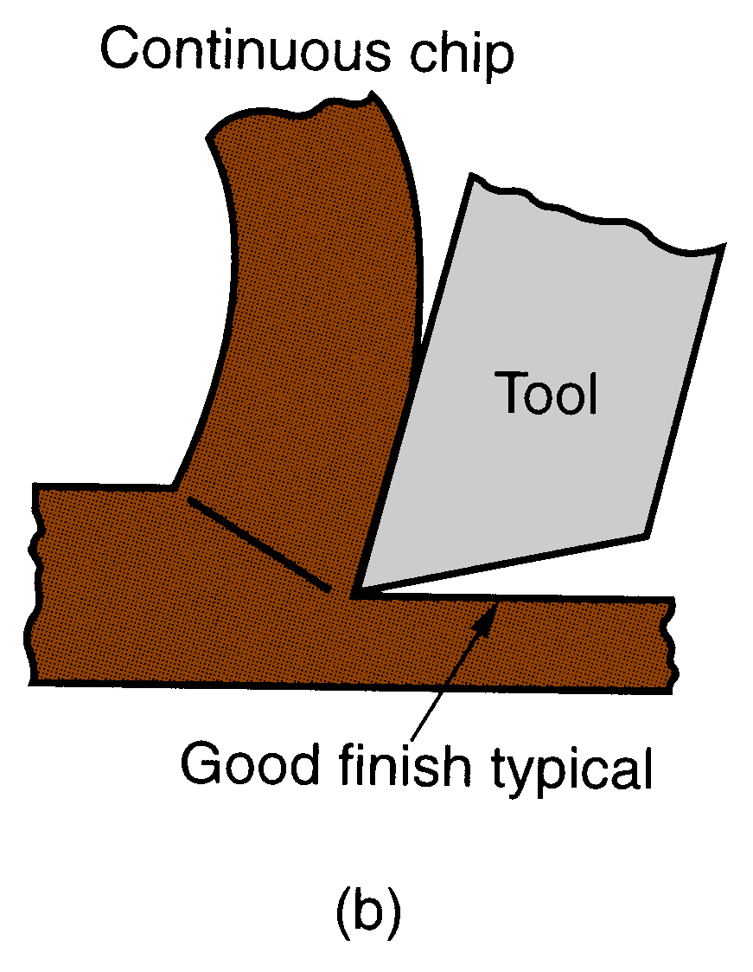
Continuous Chip
Ductile work materials (e.g., low carbon steel)
High cutting speeds
Small feeds and depths
Sharp cutting edge on the tool
Low tool‑chip friction
Figure 21.9 ‑ Four types of chip formation in metal cutting:
(b) continuous

Slide 26
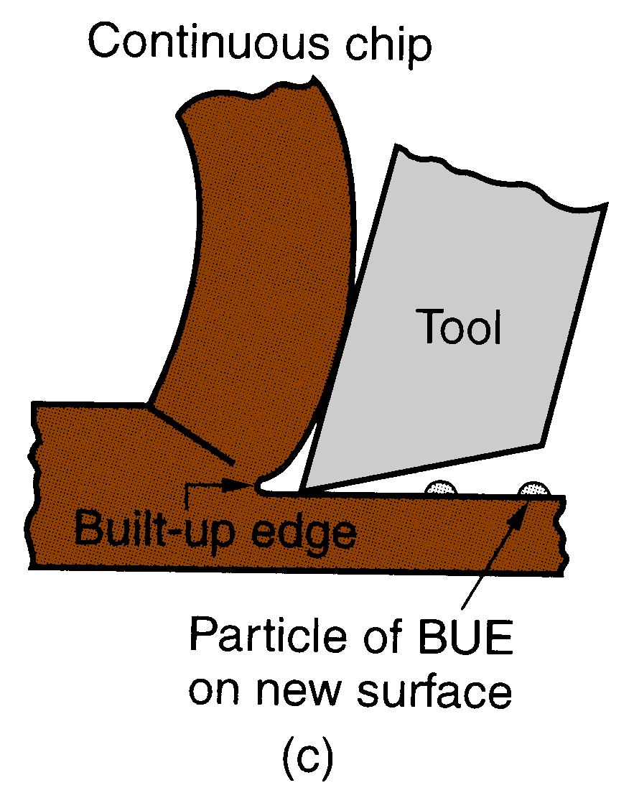
Continuous with BUE
Ductile materials
Low‑to‑medium cutting speeds
Tool-chip friction causes portions of chip to adhere to rake face
BUE formation is cyclical; it forms, then breaks off
Figure 21.9 ‑ Four types of chip formation in metal cutting: (c) continuous with built‑up edge

Slide 27
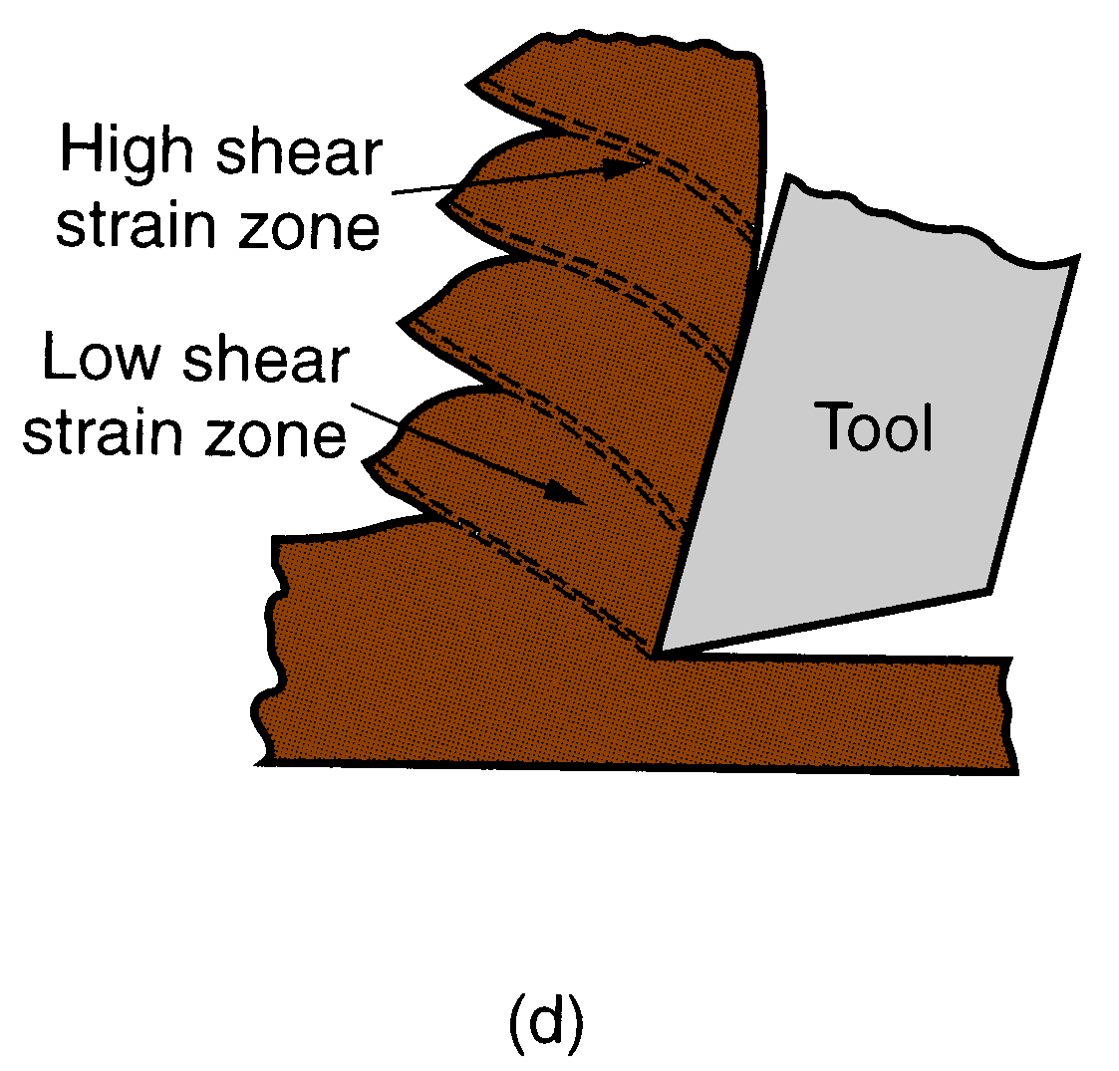
Serrated Chip
Semicontinuous - saw-tooth appearance
Cyclical chip formation of alternating high shear strain then low shear strain
Most closely associated with difficult-to-machine metals at high cutting speeds
Figure 21.9 ‑ Four types of chip formation in metal cutting: (d) serrated

Slide 28
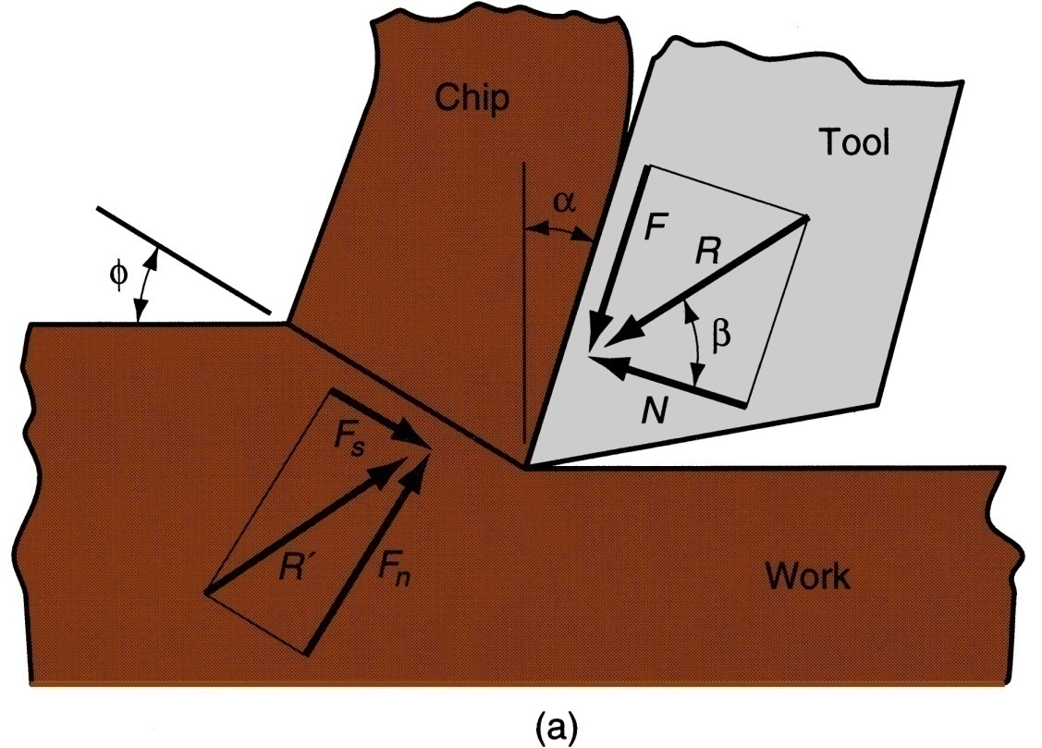
Forces Acting on Chip
Friction force F and Normal force to friction N
Shear force F_{s} and Normal force to shear F_{n}
Figure 21.10 ‑
Forces in metal cutting: (a) forces acting on the chip in orthogonal cutting

Slide 29
Resultant Forces
Vector addition of F and N = resultant R
Vector addition of F_{s} and F_{n} = resultant R'
Forces acting on the chip must be in balance:
R' must be equal in magnitude to R
R’ must be opposite in direction to R
R’ must be collinear with R

Slide 30
Coefficient of Friction
Coefficient of friction between tool and chip:
Friction angle related to coefficient of friction as follows:

Slide 31
Shear Stress
Shear stress acting along the shear plane:
where A_{s} = area of the shear plane
Shear stress = shear strength of work material during cutting

Slide 32
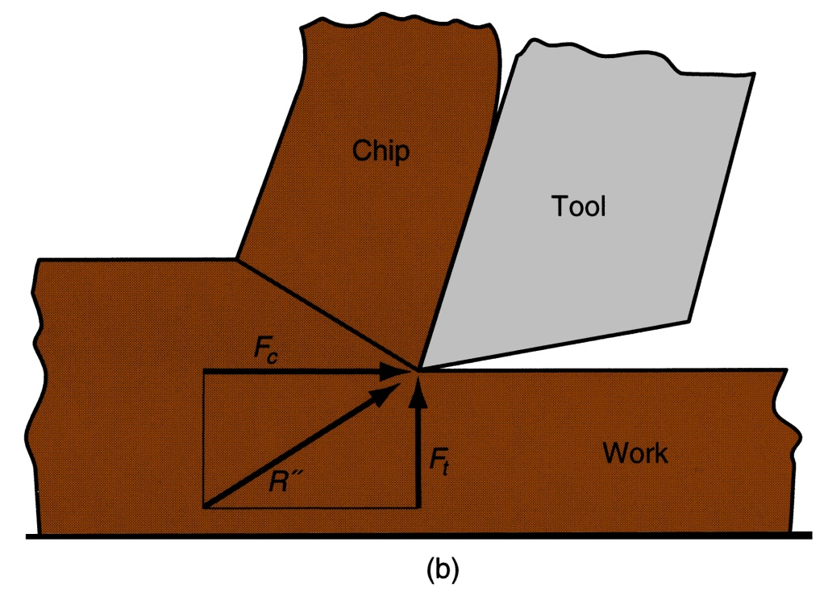
Cutting Force and Thrust Force
Forces F, N, F_{s}, and F_{n} cannot be directly measured
Forces acting on the tool that can be measured:
Cutting force F_{c} and Thrust force F_{t}
Figure 21.10 ‑ Forces in metal cutting: (b) forces acting on the tool that can be measured

Slide 35
Forces in Metal Cutting
Equations can be derived to relate the forces that cannot be measured to the forces that can be measured:
F = F_{c} sinα + F_{t} cosα
N = F_{c} cosα ‑ F_{t} sinα
F_{s} = F_{c} cosφ ‑ F_{t} sinφ
F_{n} = F_{c} sinφ + F_{t} cosφ
Based on these calculated force, shear stress and coefficient of friction can be determined

Slide 36
The Merchant Equation
Of all the possible angles at which shear deformation could occur, the work material will select a shear plane angle φ which minimizes energy, given by
Derived by Eugene Merchant
Based on orthogonal cutting, but validity extends to 3-D machining

Slide 37
What the Merchant Equation Tells Us
To increase shear plane angle
Increase the rake angle
Reduce the friction angle (or coefficient of friction)

Slide 38
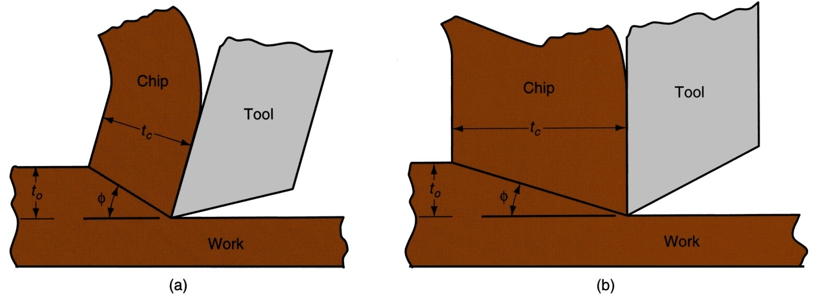
Higher shear plane angle means smaller shear plane which means lower shear force
Result: lower cutting forces, power, temperature, all of which mean easier machining
Figure 21.12 ‑ Effect of shear plane angleφ : (a) higher φ with a resulting lower shear plane area; (b) smaller φ with a corresponding larger shear plane area. Note that the rake angle is larger in (a), which tends to increase shear angle according to the Merchant equation

Slide 41
Power and Energy Relationships
A machining operation requires power
The power to perform machining can be computed from:
P_{c} = F_{c} v
where P_{c} = cutting power; F_{c} = cutting force; and v = cutting speed

Slide 42
Power and Energy Relationships
In U.S. customary units, power is traditional expressed as horsepower (dividing ft‑lb/min by 33,000)
where HP_{c} = cutting horsepower, hp

Slide 43
Power and Energy Relationships
Gross power to operate the machine tool P_{g} or HP_{g} is given by
or
where E = mechanical efficiency of machine tool
Typical E for machine tools = ∼ 90%

Slide 44
Unit Power in Machining
Useful to convert power into power per unit volume rate of metal cut
Called the unit power, P_{u} or unit horsepower, HP_{u}
or
where MRR = material removal rate

Slide 45
Specific Energy in Machining
Unit power is also known as the specific energy U
Units for specific energy are typically N‑m/mm³ or J/mm³ (in‑lb/in³)

Slide 46
Cutting Temperature
Approximately 98% of the energy in machining is converted into heat
This can cause temperatures to be very high at the tool‑chip
The remaining energy (about 2%) is retained as elastic energy in the chip

Slide 47
Cutting Temperature
Several analytical methods to calculate cutting temperature
Method by N. Cook derived from dimensional analysis using experimental data for various work materials
where T = temperature rise at tool‑chip interface; U = specific energy; v = cutting speed; t_{o} = chip thickness before cut; ρC = volumetric specific heat of work material; K = thermal diffusivity of the work material

Slide 48
Cutting Temperature
Experimental methods can be used to measure temperatures in machining
Most frequently used technique is the tool‑chip thermocouple
Using this method, K. Trigger determined the speed‑temperature relationship to be of the form:
T = K v^{m}
where T = measured tool‑chip interface temperature

Slide 49
Metal Cutting theory
Plastically deform a material using a hard tool in order to obtain desired physical shape and properties
Very complex phenomena
Essential for high precision; high performance products

