Slide 1
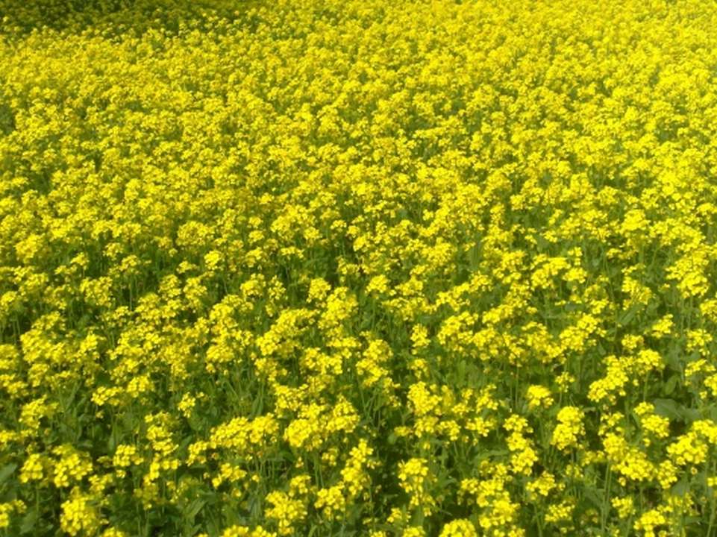
Mustard seed production and hybrid seed production
By
Dr M. Subba Rao,
Professor & Head,
Agricultural College,
Mahanandi

Slide 2
Rai (B. juncea),
Benarasi rai (B.nigra) and
Pahadi rai (B.juncea var rugosa)
belong to mustard and
Cultivated for edible oil.

Slide 3
INTRODUCTION:
Scientiﬁc name : Brassica sps. Family : Brassicaceae
Origin : Europe
Common name : Black mustard Chromosome no. : 18
Local names : Mohari, Tikkya, Rai, Serson

Slide 4
I N T R O D U C T I O N
Rapeseed & mustard are the 3rd most important edible oilseed crops of the world after soybean and oil palm.
Mustard is Brassica juncea, whereas Rapeseed is Brassica campestris.
This crop accounts for nearly one-third of the oil produced in India, making it the country’s key edible oilseed crop.
Seeds are known by different names in different places ; Sarson , Toria or Lahi are generally termed as Rapeseeds while Rai or Raya or Laha is termed as Mustard.
Oil content varies from 37 to 49%.

Slide 5
USES
Its oil & seeds are used in:
~ the preparation of pickles and for flavoring curries and vegetables.
~ human consumption ,.
~ preparation of hair oil and ,medicines ,soaps.
~ in mixture with mineral oils for lubrication.
~ Rapeseed oil is used in the manufacture of greases.
The oil cake is used as a cattle feed, its green stems and leaves are good source of green fodder for cattle.
The leaves of young plants are used as green vegetables.
In tanning industry, mustard oil is used for softening leather.

Slide 6
Importance
The oil extracted from oilseeds forms an important item of our diet.
Extracted oil is used as raw material for manufacturing paints, varnishes, soaps, perfumes, lubricants, etc.
Oil cakes is a by-product obtained after the extraction of oil from oilseeds and is an excellent cattle feed
Oil cakes are also used as fertilizers.
Aids in managing diabetes and cholesterol levels
Nutrients: Dietary ﬁber-59%
Protein-50%
Fat-44%
Calories-23%

Slide 7
RAPESEED OIL
MUSTARD OIL
CANOLA OIL

Slide 8
Canola oil
Canola oil, or canola for short, is a vegetable
oil derive
from rapeseed that is low in erucic acid. There are both edible and industrial forms. It is considered safe for people to eat, and has a relatively low amount
of saturated fat. It is also used as a source
of biodiesel. It lowers the cholesterol .

Slide 9
O R I G I N & H I S T O R Y
The place of origin is not definitely known.
It’s cultivation has been traced to 2000-1500 B.C in India, China and Japan.
According to Prain (1898), Bailey (1922) and others: Rai (B.juncea) originated in China and from there it was introduced in India.
According to Vavilov (1926)the place of origin of Rapeseed
(B. campestris) is eastern Afghanistan and adjoining parts of India & Pakistan.
Singh(1958) considered the B. campestris var. yellow sarson to the oldest of the various rapes & Mustard grown in India.

Slide 11
AREA AND DISTRIBUTION
Rapeseed and mustard are grown in 53 countries of the world.
WORLD :-
Area - 35.44 Million ha ( 2017-18 ) Production - 40.60 Million metric tons ( 2017-18 )
Productivity - 2.09 Metric tons per ha ( 2017-18 )
Major growing countries :- : India, Canada, China, Pakistan, Poland, Bangladesh &
. Sweden , etc.
INDIA :- | Area | - 5.70 Million ha ( 2017-18 )
 | Production | - 6.50 Million metric tons ( 2017-18 )
 | Productivity | - 1 metric tons per ha ( 2017- 18 )
Major growing states of India :- U.P, Rajasthan, M.P, Haryana, Punjab, Assam, Bihar, .
. Gujarat & West Bengal.
U.P alone produces about 20 % of total rapeseed & mustard production in India.
Total oilseed in J&K ( 2014-15 )
Area (000) Ha – 65.95
Production (000 Qtls ) – 583.8 yield ( Qt /ha ) – 8.85

Slide 12
About 35% Area of the total cultivated area of world is in India with 16% of shares in production.
Rajasthan contributes about 49% to the country's total mustard production, followed by Uttar pradesh(11%), Haryana(11%), Madhya pradesh(11%), Gujarat(6%), West Bengal(5%), and other districts(7%)
.

Slide 13
Hybrids Released

Slide 14
Seed treatment
The seed should be treated with 6g bavistin /kg seeds, 2.5g imidacloprid/kg seed and 40g biofertilizers (azotobacter +PSB)/kg seed before sowing to control fungal seed borne disease, insects(cut worm, painted bug, leaf minor) and enhance nutrient use eﬃciency.
An integrated disease management strategy for white-rust affected areas to control leaf and head phases of the rust includes seed treatment with apron 35D@ 6g/kg of seed.

Slide 15
Nucleus and breeder seed production of open pollinated varieties
The procedure of nucleus/breeder seed production varies from crop to crop according to their breeding behavior.
The field should be selected where no Brassica species had been grown for last three years, unless the crop was raised for nucleus seed production of the same variety.
Field should be properly isolated from the other field of any Brassica species.
An isolation distance of 200 m is recommended for production of nucleus and breeder seed of self-incompatible (cross pollinated) crops, including B. rapa var. toria; B. rapa var. brown sarson and E. sativa (taramira) and self compatible (self pollinated) crops, including B. juncea (Indian mustard), B. rapa var yellow sarson and B. carinata (Karan rai).

Slide 16
Nucleus and breeder seed production of open pollinated varieties
Approximately 500 true-to type plants are selected from the basic bulk or multiplication plot for nucleus seed production of self pollinated crops while 2500 or more plants are selected in cross pollinated crops to prevent the narrowing of genetic base of these crops. Five border rows of the same variety (true to type) should be planted around the plot. Selected plants are harvested and threshed separately

Slide 17
Nucleus and breeder seed production of open pollinated varieties
The seed lot from each selected plant should be examined critically for seed characters like shape, colour etc.
Off type seed lots (or plants) are discarded and only the true to type lots (plants) are maintained separately for raising nucleus seed plot.

Slide 18
Nucleus and breeder seed production of open pollinated varieties
Sowing for nucleus seed plot is done from the selected individual nucleus plants in plant to progeny rows. Each progeny row is examined critically at different growth stages for diagnostic characteristics. If any progeny row shows any variation the entire progeny row should be uprooted before flowering.

Slide 19
Nucleus and breeder seed production of open pollinated varieties
In case off-types are found after flowering, the surrounding rows should also be uprooted to avoid contamination.
Single plants (about 500 in self pollinated and about 2500 in cross pollinated crops) are harvested and their seed is kept separately for raising the next cycle of nucleus progeny rows next year.
Remaining seed of progenies should be bulked to be used for production of breeder seed.

Slide 20
Rouguing
The removal of off type plants should be carried out at 3 stages.
First, the off-type plants distinguishable on the basis of morphological characteristics should be removed before
flowering.
Second, the off-type plants, which are identified at flowering, should be removed before pod-formation.
Third, the off-type plants should be removed on the basis of siliqua and seed characteristics and also on the basis of maturity duration.
Disease infected plants should also be removed.
The field should be kept free from all kinds of weeds particularly from Argemone mexicana (Satyanashi) which should be uprooted altogether before it flowers.

Slide 21
Nucleus and breeder seed production of parental lines
Hybrids developed in rapeseed-mustard are based upon Cytoplasmic Genetic Male Sterility system. Parental lines are multiplied in different plots. The seed parent (A line) is maintained by growing the rows of A and B lines in a specific ratio. Normally, 3:1 ratio of seed parent (A line) and maintainer (B line) are followed. The maintainer rows (B line) are harvested first. Later on, the remaining rows of seed (A line) parent are harvested and bulked.
Strict rouging is advised during flowering to rogue out the fertile plants from seed parent.
The seed production of B and R line is similar to any other varietal seed production.

Slide 22
Method of Hybrid Seed Production
Cytoplasmic Genetic Male-Sterility System (CGMS)

Slide 23
The discovery of the cytoplasmic male sterility(CMS) 1st in B.napus later in B.juncea opened up possibilities to develop F1 hybrids in self pollinating crops.
The 1st CMS based hybrid of B.napus, Qinyou No.2 was released in china in 1985.
Gobhi sarson hybrid PGSH 51 was 1st oil seed brassica released in India.
In B.juncea two hybrids DMH-1(cms126-1) and NRCHB-506 (mori CMS) were released.

Slide 24
BY USING CMS SYSTEM WITH RESTORER
Basically the production of the hybrid seed is similar to the multiplication of the CMS line.
It is done by cross pollination of the A-line(male sterile) with the R-line (restorer line).
The F1 hybrid seed production by cross pollination of A-line with the pollen of R-line is self fertile at farmer’s field.
Four beehives per hectare are recommended for harvesting good seed set in male sterile lines.

Slide 25
Gentle shaking of the male rows with stick or rope increases wind pollination.
For high pollen pressure 2-4 border rows of R-line may be grown all around the field.
Otherwise growing A and R-lines in alternating strips of 1.2 to 1.5m each.
Mostly used source of CMS is ogura cytoplasm

Slide 27
Hybrid (A X R) Seed Production
The commercial F1 hybrid seed is produced by growing seed parent (A line) and restorer (R line) in 3: 1 ratio as followed in case of maintenance of seed parent.
The rows of restorer parent (R lines) are harvested first and bulked followed by harvesting of seed parent.
The seed from the seed parent is processed and packed as hybrid seed.
Honeybees play an important role in enhancing the transfer of pollen, hence 3-4-honeybee boxes/ha may be kept to ensure proper pollination and good seed set.

Slide 28
Synchronized flowering of male and female parents
Oilseed brassicas have indeterminate flowering habit.
Early onset of flowering in female parent compared to pollen parent reduces the hybrid seed set.
So sowing should done such that synchronous flowering is achieved.

Slide 29
Pollination

Slide 30
AGRONOMIC PRACTICES For (A X R) seed production

Slide 31
Selection of field
Fertile irrigated field with light to medium textured soil should be selected for hybrid seed production.
Isolation distance of 1500m from other field of same species.
Field should not have rapeseed-mustard crop for at least three previous years.

Slide 32
Seed rate
Quantity of seed required to sow one hectare of seed production plot is
A-line
Female parent
R-line
male parent
X
1875g
875g

Slide 33
Time and method of sowing
The optimum time of sowing is 10th to 31st October
Female to male ratio 3 ; 1
Distance between rows 45 cm
Distance between plants 10cm
A strip of male parent on all sides of seed production blocks helps to augment pollen supply.

Slide 34
Rouging
For quality seed production rouging should be done 2 to 3 times before flowering based on characters of parental lines.
Special care to remove pollen shredders before flower opening in A- line.
Special attention to remove objectionable weed Mexican prickly poppy (Argemone mexicana) which is commonly known as satyanasi in North India.

Slide 36
Seed processing and packaging
After threshing, the seed should be dried either in sunshine or in mechanical seed drier to bring the seed moisture down to 8%.
The temperature of air in seed drier should not exceed 40 °C.
A random sample from the dried seed is taken and analysed for quality characters and oil content before the grading.

Slide 37
Seed testing
After processing, a sample of seed is taken to seed testing laboratory for the examination in respect of seed standards.
The seed purity, germination percentage and moisture content in seed is thoroughly checked in seed testing laboratory.
Breeder seed is considered of high quality because it is used for further seed multiplication chain.

Slide 38
Storage
Seed should be dried to bring the moisture content upto 8% before storage.
Seed should be stored preferably at less than 20 °C and at less than 30% Relative Humidity (RH).
The go-down should be properly fumigated to avoid storage pests.

Slide 39
Foundation and
Certified Seed Production of Varieties

Slide 40
Land Requirements
The land selected should not be cultivated with Rape seed and mustard in the previous season. In addition the field should be well drained and should be free of volunteer plants.
Isolation requirements:
Rape seed and mustard is partially self and cross pollinated crop. The extent of natural cross pollination varies from 30 % to 35 % according to insect activity. For foundation seed 400 m and for certified seed 200 m is recommended from fields of other varieties of same species and fields of the same variety not confirming to varietal purity.

Slide 41
Brief cultural practices
Obtain nucleus/breeder’s/foundation seed from a source approved by a seed certification agency.
First fortnight of October to mid November is the most appropiate time for sowing .
Seed rate is 5 to 8 kg/ ha.
Spacing adopted is 45 cm row to row and plant to plant is 10-15 cm. (45x10-15 cm)

Slide 42
Rouguing
All the off type plants , easily distinguishable plant characteristics , and other species plants must be removed before flowering to ensure pure seed production.
Remaining off types , if any, distinguishable on the basis of siliqua characteristics should be removed before maturity.
Argemone mexicana is the most objectionable weed in Rape and Mustard seed production. The weed should be removed altogether as required.

Slide 43
Field inspection
A minimum of three inspections will be done.
One at the stage of 6-7 pairs of leaves on plants
Second at flowering and
Third at maturity stage prior to harvesting by the Seed Certification Officer.

Slide 44
Field Inspection
A minimum of three inspections are required at various stages plant growth.
1st inspection : at or before flowering to check isolation distance, planting ratio, sowing errors, volunteer plants etc.
2nd inspection : During flowering to check pollen shedders and off type plants.
3rd inspection : At maturity before harvesting to verify removal of pollen parent prior to harvesting of female lines, pod and seed characters

Slide 45
Field standards
Foundation Certified
seed seed
Isolation distance 400 200 m
Off-types 0.10% 0.20%

Slide 46
Harvesting:
It is important to harvest the crop after plants start turning light yellow. At this stage most of the siliqua turns light yellow and the seed inside the siliqua will be light brown. Before storage, dry the seeds to reduce moisture content to eight percent.
Seed yield
The average seed yield varies from 15 to 20 quintals per hectare.

Slide 47
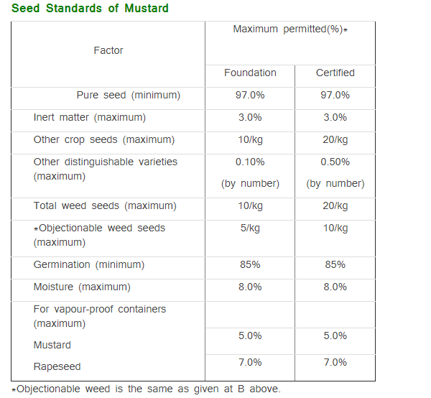

Slide 48
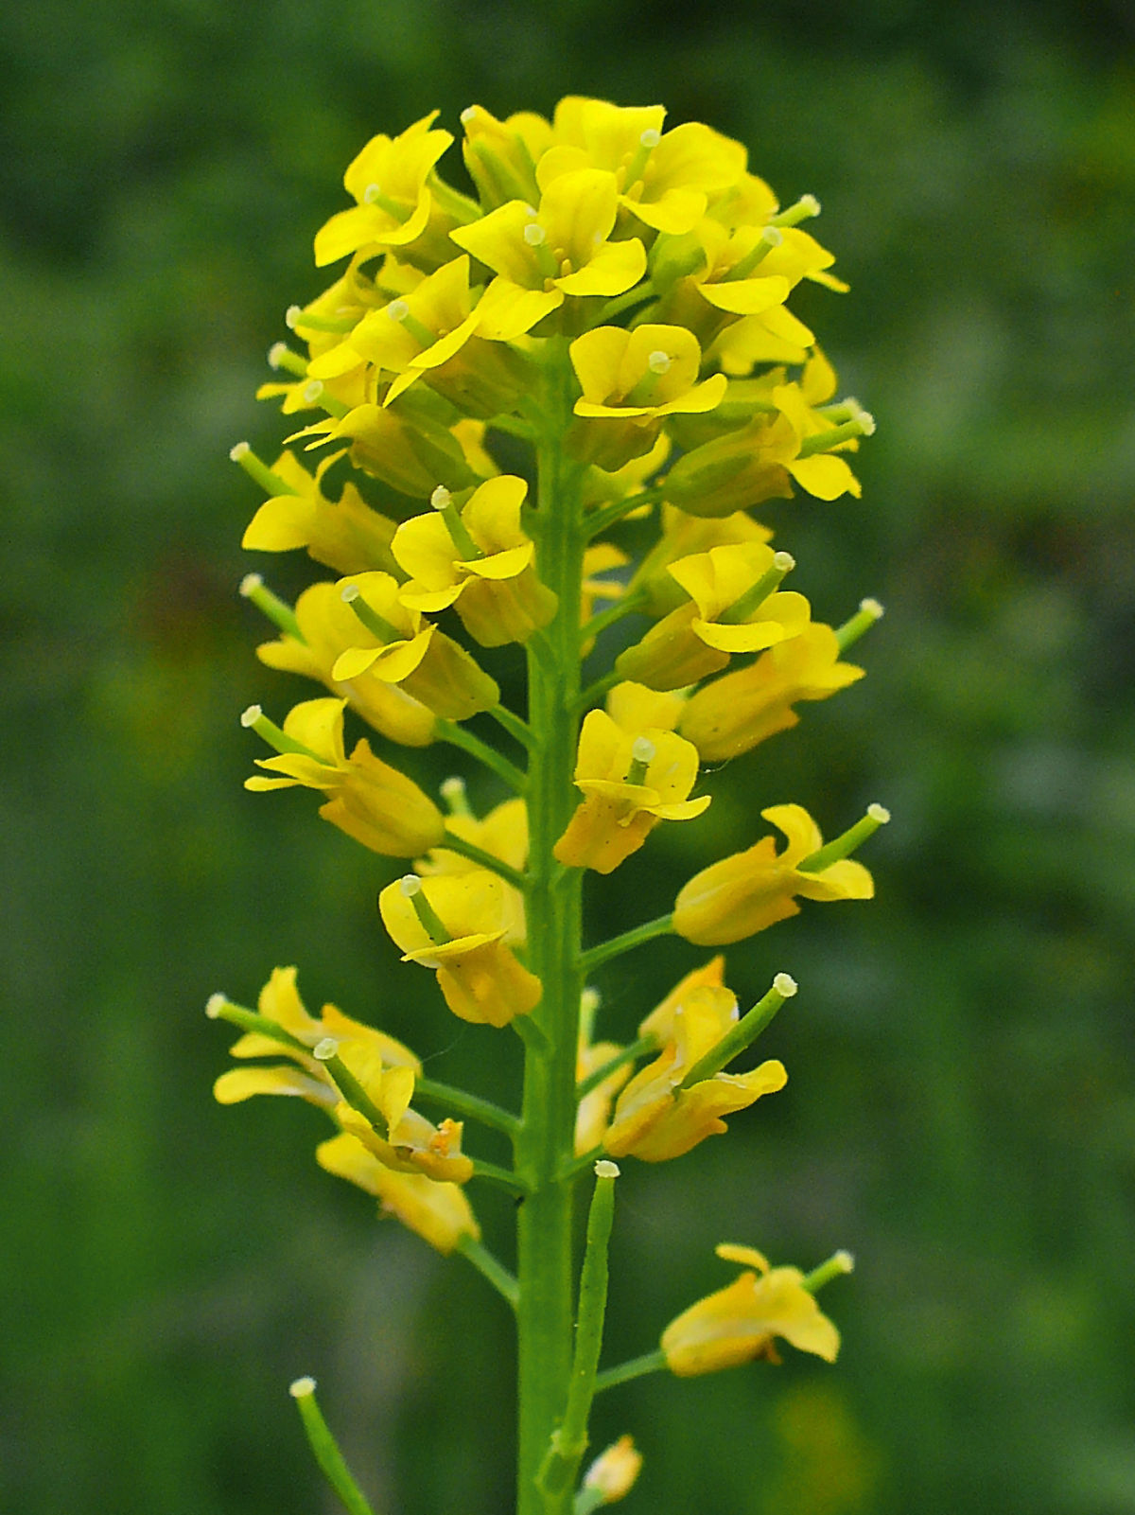
Thank you

