Slide 1
To evaluate populations like RIL, NIL for pest resistance.

Slide 2
Recombinant inbred lines (RILS)
Also called F2-derived lines.
RILs are created by single-seed descent (SSD) from F2 plants through at least five or more (usually 6-8)generations of continued selfing.
At the end of SSD, seeds from each plant are harvested separately to obtain as many RILs as there are individual plants.
SSD is based on selfing; therefore, there is a rapid increases in homozygosity.

Slide 4
RILs are developed by
PEDIGREE METHOD
BACK CROSS
SSD
RECURRENT SELECTION

Slide 5
RIL populations consists of a set of lines each of which contains a different combination of linkage blocks from the original parents.
RILs have been used for mapping a number of useful genes.

Slide 7
RILs offer several advantages:
They can be maintained perpetually.
They are ideal for QTL mapping because they can be evaluated in replicated trials over locations and years, which allows a more reliable phenotyping of the lines.

Slide 8
RILs are mortal population (T/F)

Slide 9
Near-isogenic Lines (NILs)
Near-isogenic lines are identical in their genotype, except for one gene and the DNA regions flanking this gene.
The first strategy used for molecular mapping was based on near iso genic lines (NILs).
Breeders have utilised recurrent backcross to introduce into selected lines traits like disease resistance from a variety of sources.
In a backcross programme, the donor parent (DP)is homozygous for the allele of interest.
The DP is crossed with a recurrent parent (RP), which is homozygous for the wild type or standard allele of this locus.
The resultant F1 individuals are backcrossed to the RP to obtain backcross (BC F1) generation.

Slide 10
In each backcross (BC) generation, BC individuals having the introgressed allele and most similar to the RP in phenotype, are selected and crossed with the RP.
This function implies that an infinite number of backcrosses would be required to ensure complete elimination of all DP-derived genome, except the gene of interest.
However; breeders have used fewer than 10, typically only five or six, backcrosses to generate most of the currently available NILs as outlined .
Thus, the genome of any given NIL, will most likely contain P.P-derived alleles at several of its loci, which accounts for the use of term near-isógenic to describe such lines.

Slide 11
NILs are developed by
PEDIGREE METHOD
BACK CROSS
SSD
RECURRENT SELECTION

Slide 18
Pokkali is resistant to both drought and BPH (T/F).

Slide 19
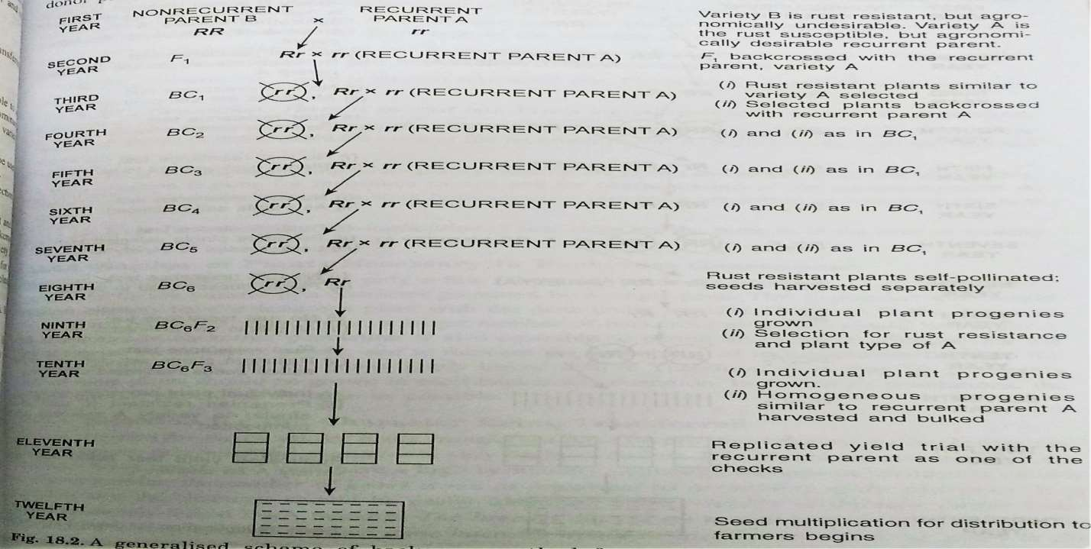

Slide 20
