Slide 1
To study symptoms and data recording techniques for biotic and abiotic stress in plants

Slide 3
7-8 aphid per plant indicates
Immune genotype
Resistant genotype
Tolerant genotype
Susceptible genotype

Slide 5
Response value for MR infection type is
0
0.2
0.4
0.8

Slide 7
LTN is a morphological marker for stem rust of wheat (T/F)

Slide 8
Screening Techniques for Diseases Resistance:

Slide 9
Why artificial inoculation or creation of Artificial epiphytotic ?

Slide 10
1. Artificial inoculation
The artificial inoculation of test genotypes is necessary to obtain a more uniform disease – epidemic than world occur naturally such.
A uniformity facilitates comparison among disease genotypes.
For a successful screening, an adequate amount of inoculum is necessary, since selecting for resistance in the presence of an inadequate amount of disease create an instant artifact.
Among few methods developed, three main procedures of artificial inoculation are generally employed.

Slide 11
1. Spraying the spore suspension on test genotypes –aqueous suspension of the pathogens propagules is sprayed. High pressure spraying is most productive.
2. Injection of spore suspension into the plants surface or into the intercellular air spaces of a leaf with the help of a hypodermic needle.
A single or multineedle pricking may be employed.
3. Immersion of seedlings (Dipping) of test genotypes in a spore suspension before transplanting them into fields.
Since the host tissue become water soaked, they predispose themselves to disease.

Slide 12
Though spore – suspension in sterile water (Inoculum) is often used, successful inoculum of many pathogens can be achieved only if dry spores are employed. Spores are damaged quickly if they became too wet.
Depending upon the convenience and crop materials the procedure may vary from one disease to another and from one crop to another.

Slide 13
Artificial epiphytotics
The manual operation of artificial inoculation can be dispensed with once a sick plot or disease nursery is created.
Artificial creation of such an epiphytotic is necessary because the occurrence of natural disease is subject to chance.
This can be attained by seeding spores in the soil (in case of only soil borne disease caused by facultative parasites) either through growing a highly susceptible genotype in a plot for successive years, or through mixing infected debris in the soil of that plot, prior to sowing the test genotypes.
Maintenance of requisite humidity is essential for high effectiveness.

Slide 14
------------------is planted to create artificial epiphytotic condition.

Slide 15
1. The epiphytotic should be intense developed at both national and international levels. The international wheat rust nursery at Mexico established since 1957 is an outstanding example of such an international collaboration.
2. Frequency of exposure: The test genotypes can be subjected to artificial inoculation or sick plots once or more than area for desired results. Two tests are suggested.

Slide 16
a. Polycyclic test: Exposure that initiates the natural occurrence of diseases with a recurrent infection cycle attacking a crop on the farmers field.
The artificially created sick- nursery is the best form of such polycyclic tests, through repeated artificial inoculations can also achieve the same results.
b. Monocyclic tests: Exposure only once by artificial inoculation, preferably under closed/ controlled condition, such as green houses.

Slide 17
Testing the host plants either by artificial inoculation or under sick nurseries is the beginning of the screening process.
Next comes how to measure the intensity of diseases ??/

Slide 18
2. Measurement of the intensity of disease infection.
There are two methods to assess the disease intensity depending upon the inheritance of the disease.
Qualitative Method: If reflects the response type representing a class but not the magnitudes in monogenic disease control.
Quantitative Method: This quantifies or determines the degree of infection in terms of grades or percentages or indices.

Slide 23
Phenotypic screening methods for diseases caused by bacteria

Slide 24
Bacterial leaf blight (Xanthomonas oryzae pv. Oryzae)
Seedling wilt or kresek
1-3 weeks after transplanting
Green water-soaked layer along the cut portion or
leaf tip of leaves as early symptom
Leaves wilt and roll up and become grayish green to yellow
Entire plant wilt completely

Slide 25
To distinguish kresek symptoms from stem borer damage, squeeze the lower end of infected seedlings between the fingers.
Kresek symptoms should show yellowish bacterial ooze coming out of the cut ends.
Unlike plants infested with stem borer, rice plants with kresek are not easily pulled out from soil.
To distinguish kresek symptoms from stem borer damage, the lower end of the infected seedling can be squeezed between the fingers.
Yellowish bacterial ooze may be seen coming out of the cut ends.
The cut portion can be observed against the light to see the bacterial ooze streaming out from the cut ends into the water.
After 1-2 hours, the water becomes turbid.

Slide 26
LEAF BLIGHT
Water-soaked to yellowish stripes on leaf blades
or starting at leaf tips with a wavy margin
Appearance of bacterial ooze
Severely infected leaves tend to dry quickly
loss in grain yield may be up to 60%.

Slide 29
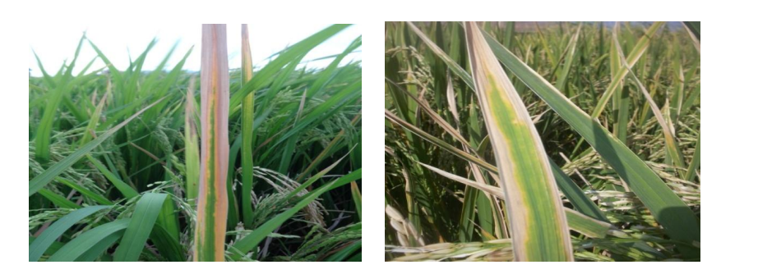

Slide 30
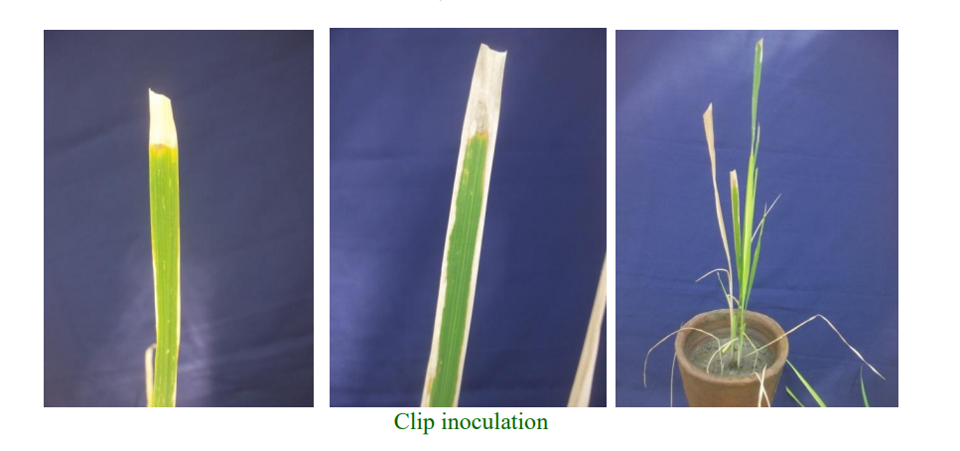

Slide 31
