Slide 1
To study phenotypic screening techniques for sucking pests and chewing pests - traits to be observed at plant and insect level

Slide 2
Materials Required: Inoculums, test material
Learning Objectives:
To get acquainted with different screening techniques

Slide 3
Degree of resistance
Resistance is a relative attribute and is measurable only in relation to susceptibility.
5 groups:-
Immunity:- host-insect relationship in which the insect will not consume the plant under any condition.
High resistance:- the host plant possesses such traits that results in a small level of damage
Low resistance: host suffers less than average damage by an insect
Susceptibility: level of damage is average or more than average
High susceptibility: level of infestation much larger than the average
Tolerance:-at the same level of infestation, produces a higher yield than a susceptible variety

Slide 4
Q. At the same level of infestation , if a variety produces higher yield , then such variety is known as ------------------???

Slide 5
SUCKING PESTS
typically use their sucking and piercing mouthparts to extract plant sap.
It also include the pest plant feeding mites.

Slide 6
Cotton leafhopper
White fly

Slide 7
BPH
Aphid

Slide 8
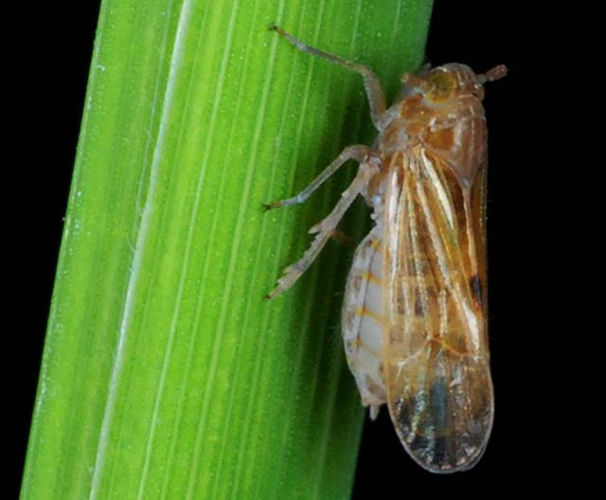
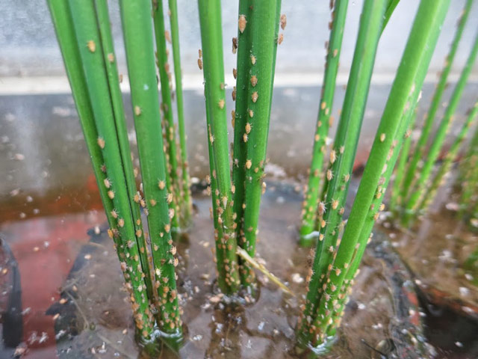

Slide 9
What attracts these pests ?

Slide 10
Influence of Abiotic Factors on Population Dynamics of Sucking Insect Pests in Transgenic Cotton
A field experiment was conducted to investigate the impact of abiotic factors on population dynamics of
sucking insect pests in transgenic cotton cv. RCH-138 Bt viz., aphid (Aphis gossypii Glover), jassid (Amrasca biguttula biguttula Ishida), whitefly (Bemisia tabaci Gennadius), thrips (Thrips tabaci Lindeman) and mealybug (Phenaccocus solenopsis Tinsley) under unprotected condition.
The results of the field study revealed that the sucking pest population was found throughout the year from first fortnight of August to end of January.
Correlation analysis with the weather parameters viz., temperature, relative humidity, wind velocity, sunshine hours and rainfall revealed that maximum temperature showed significant positive effect on all the sucking insect pests.
The minimum temperature showed negative effect on aphid population and non significant effect on whitefly and thrips population. The relative humidity has non-significant effect, whereas precipitation has negative effect on all the sucking pests.

Slide 12
Population dynamics of any pest on crop is highly influenced by weather condition(T/F)

Slide 13
Chewing and biting pests
bite into and chew the leaves, stems, buds, flowers, and even the roots of plants.
Damage caused by these insects includes-
holes in the leaves or stems;
semicircular holes along the edges of the leaves;
discolouration on the surface or the edges of the foliage and flower petal; severed stems and leaves;
and plant wilting.

Slide 14
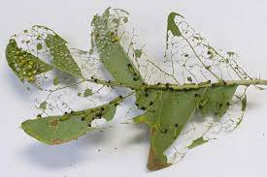
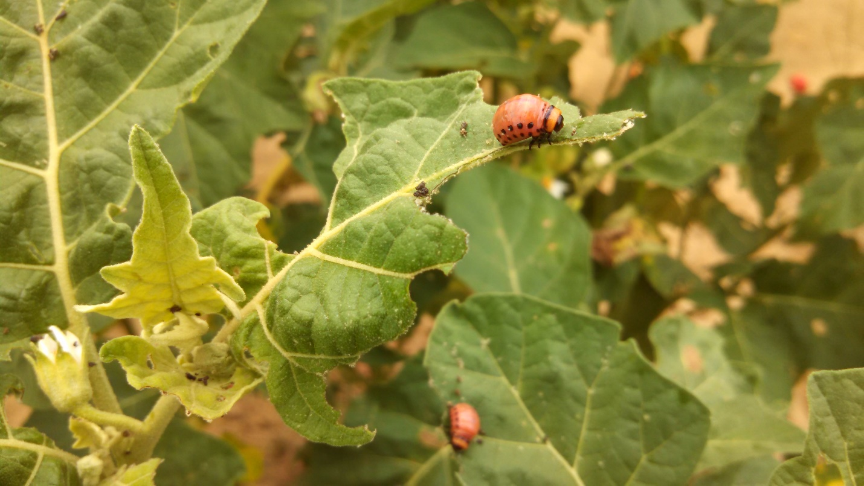
EXAMPLES INCLUDE:
Chewing and biting pests include Helicoverpa and diamondback moth (DBM), caterpillars, beetles, and slugs and snails.

Slide 15
Screening techniques
Equal level of initial infestation of all the plants in a population
To ensure plants scored as resistant are not escapes.
Time consuming
For large population- may not be feasible.
The screening of insect resistance may be done in two conditions
In the field
In the glass house

Slide 16
a. Field Screening:
In breeding programmes- usually in Field
In field much larger number of plants can be screened than in glasshouse.
Moreover, the material is also exposed to other prevalent insect pest of the area.
However, field screening- done in uncontrolled conditions
not possible to ensure uniform initial infestation of all the plants in a population.
As a result- magnitude of experimental error of field tests is much larger than that of laboratory tests.

Slide 17
Field screening is usually done in controlled condition and uniform infestation to plants is easily achieved ( T/F).

Slide 18
How to promote uniform infestation ???

Slide 19
Techniques designed to promote uniform infestation:
1. For air dispersed insect pest-
Simplest technique- planting one row of a known susceptible variety between two rows of the test material.

Slide 20
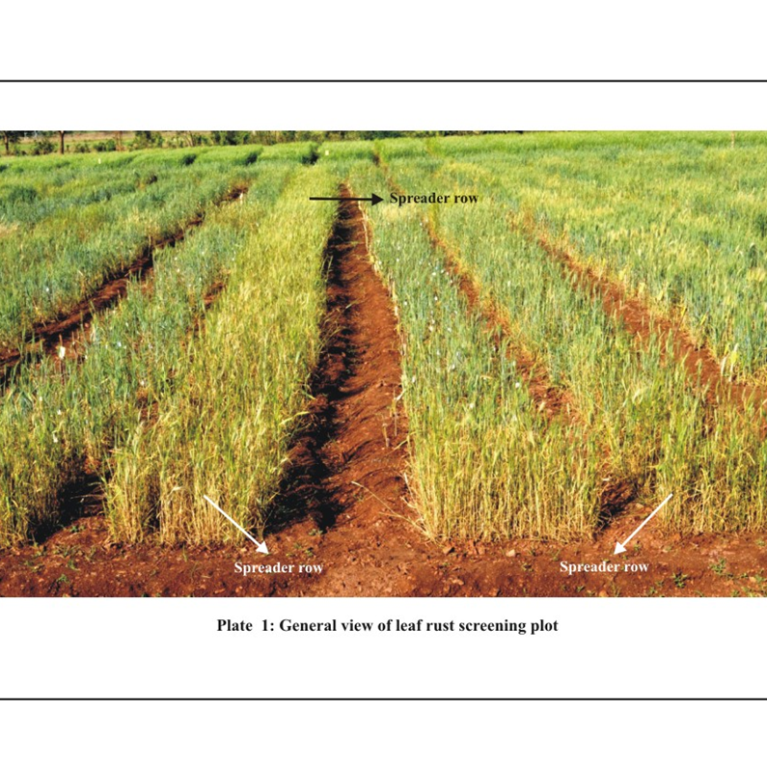

Slide 21
2. Each insect pest is much more prevalent in some area
Screening for resistance- area where it is prevalent
Will ensure heavy natural infestation
3. In case of soil insect pest- in a field that contain a large population of concerned pest.
By regularly planting susceptible varieties in the concerned field.
For screening of oats and clovers for resistance to eelworm.

Slide 22
4. Heavy natural infestation of some insect pest may occur in a particular season.
Eg- rice-stem borer- off season than in main season
Few alternate host available to the female moth for laying the eggs

Slide 23
Screening for rice stem borer should be done in off-season as the many alternate crops are available for laying the eggs by female moth (T/F)

Slide 24
5. An equal no of eggs or larvae may be transferred by hand to each test plant.
Will ensure uniform initial infestation.
Eg. Rice plants are infested with stem borer by transferring egg masses containing about 60 masses.
The number of larvae that hatch are counted and the resistant plants are identified for further testing.

Slide 26
A score value of 9 in case BPH infestation screening indicates
a. Immune genotypes
b. Resistant genotypes
c. Tolerant genotypes
d. Sucesptible genotypes

Slide 27
b. Green house screening:
A much smaller number of plants can be screened.
Results more reliable
Both the environment and the initial level of infestation – can be kept more uniform
Screening for rice stem borer
Larva soon after hatching transferred on plant with the help of soft brush
Extent of damage –recorded
Compared with that on known suscepetible control varieties infested in same manner
Field and glasshouse screening –complementary to each other.

Slide 28
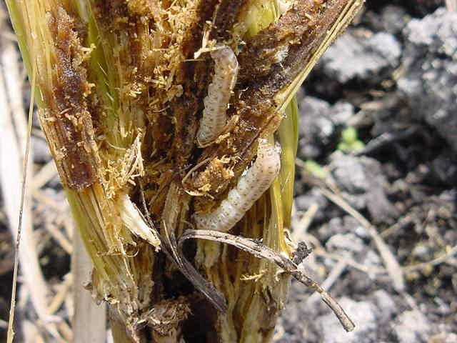

Slide 29
The major advantage of green house screening is both the environment and the initial level of infestation can be kept more uniform (T/F)

Slide 30
Important considerations :
The various criteria used for evaluation of insect resistance are as follows:
Visual evaluation of retarded growth, lodging, cutting and discoloration.
Per cent surviving plants.
Reduction in yield due to infestations.
No. of insect adults or larvae attracted by a genotype.
Effect of feeding of the host tissue on life history factors of the insect.
Effect of feeding on insect on insect growth/weight.

Slide 31
7. no. of egg laid
8. insect survival and reproduction
9. amount of food consumed by each insect
10. amount of food utilized by the insect
11. insect damage and observation of recovery (measures tolerance)
12. Indirect evaluation-root damage from the force required to pull a plant
13. Use of plant leaves or flowers in olfactometers to determine attractance.
14. Correlation of morphological factors with injury.
15. Assay of chemical factors correlated with resistance.

Slide 32
Asparagine's act as a feeding stimulant for
DBM
BPH
RICE STEM BORER
All of the above

Slide 34
High sinigrin attract
Aphids
Mites
Leaf hopper
beetles

Slide 35
In test of insect resistance:
The stage of insect to be used, the growth stage of the plant and the number of individuals per plant must be carefully considered.
Eg- seedlings- Hessian fly and greenbug on wheat
leafhoppers and plant hoppers in rice.

Slide 36
Evaluation of green bugs on wheat
Wheat lines are grown in trays
Subjecting the plant to uniform infestation
Covering the plant with plastic cages for 10-14 days.
Plants destroyed- two weeks- Susceptible, others tolerant (based on damaged leaf area)

Slide 38
Why covering of leaf with plastic bags???

Slide 39
Evaluation in case of insect which produce two generation in one crop season:
European corn borer-
Biological relationship between the host plant and the insect pest, including resistance may differ from one generation to other generation.
.when seedling is used to such insect- seedling resistance is completely correlated to all stages of host plant development.
99 maize inbred-USA, 34 resistant to first brood, only one resistant to second brood.

Slide 41
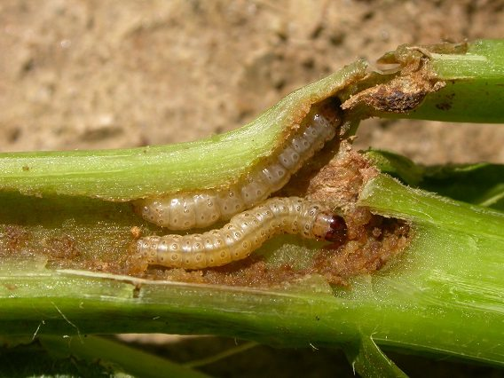
1st brood- attack young plant
2nd brood- developing grains
Governed by different genes
Additive gene action- DIMBOA content-highly distasteful-1st brood
2, 4- dihydroxy-methoxy-2H-1, 4-benzoxazine-3-one.

Slide 42
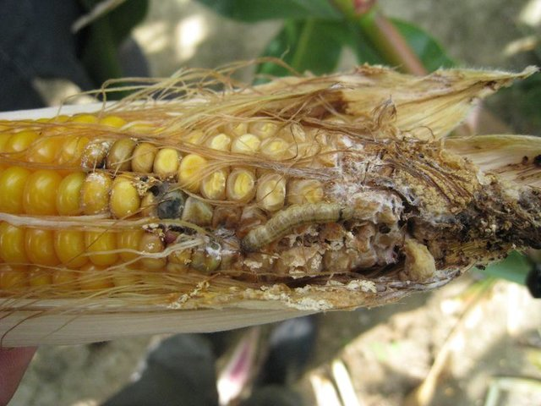

Slide 43
DIMBOA content in corn plant is controlled by
Additive gene action
Dominant gene action
Overdominace gene action
All of the above

Slide 44
Resistance to greenbugs in wheat and barley- High conc. Of benzyl alcohol
High saponin- resistance to spotted alfalfa aphid.

Slide 45
Screening for Jassids in cotton
Hairs of sufficient length and density on the ventral surface of the cotton
Toughness of the leaf vein
High tannin content in leaves

Slide 46
Host crop | Insect pest | Cause of resistance
wheat | Saw fly | Solid stem
barley | Cereal leaf beetle | Hairiness and waxiness of leaves
RICE | BPH | Red pericarp and purple stigma
COTTON | SMOOTH LEAVES | BOLLWORM
COTTON | HAIRINESS ON LEAVES | JASSIDS
RICE | RICE STEM BORER | LIGNIFIED STEM
COTTON | EARLINESS | BOLLWORM

Slide 47
Lignified stem in rice provides resistance against
Rice stem borer
BPH
Mealy bug
Saw fly

