Slide 1
To study different phenotypic screening techniques for nematodes and borers - traits to be observed at plant and insect level

Slide 2
Which one is better Field screening or glass house screening????

Slide 3
Paddy stem borer???

Slide 4
Paddy stemborer:
Scirpophaga incertulas
Symptom of damage:
Presence of brown coloured egg mass near leaf tip
Caterpillar bore into central shoot of paddy seedling and tiller, causes drying of the central shoot known as “dead heart”
Grown up plant whole panicle becomes dried “white ear”
Plants could be easily pulled by hand.

Slide 5
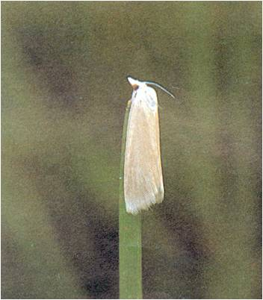


Slide 6
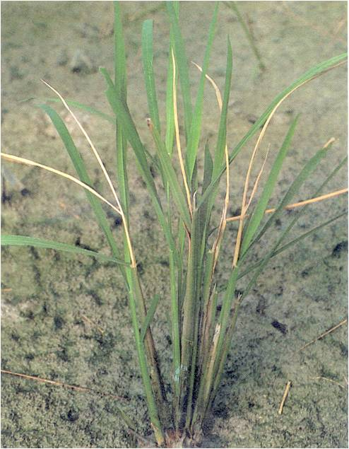
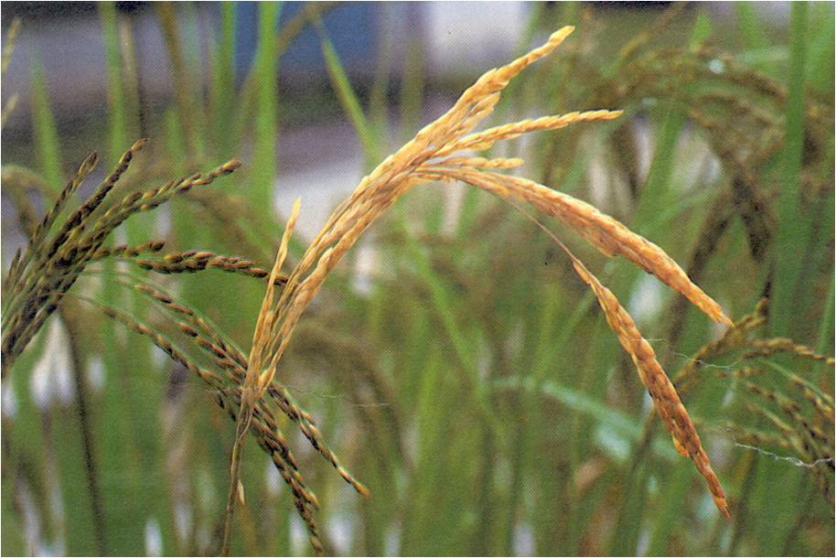

Slide 7
Identification of insect pest:
Egg: are creamy white, flattened, oval and scale like and laid in mass and covered with buff coloured hairs.
Larva: pale yellow with dark brown head
Pupa: White silken cocoon are found inside the stem
Adult:

Slide 8
Female moth: bright yellowish brown fore wings with a black spot possess a tuft of yellow hairs
Male moth: Smaller with pale yellow forewings without black spot
ETL: 25% Dead heart symptoms
ATL (Action Threshold Level): 2 egg masses/m2

Slide 9
Rice stem borer caterpillar bore into central shoot of paddy seedling and tiller, causes drying of the central shoot known as
White ear (T/F)

Slide 10
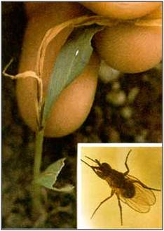
PEST OF MAIZE
Stem fly: Atherigona orientalis

Slide 11
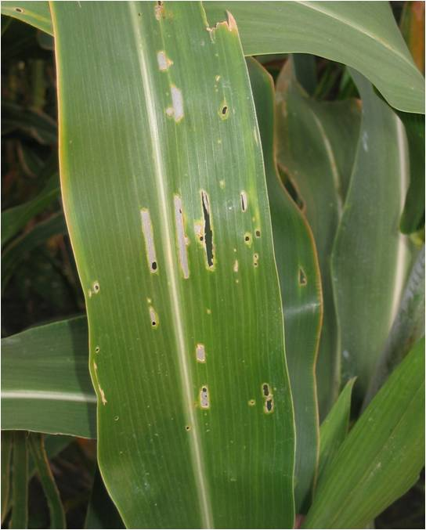
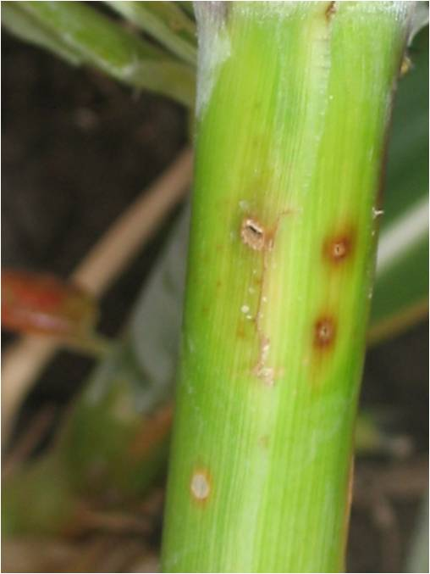
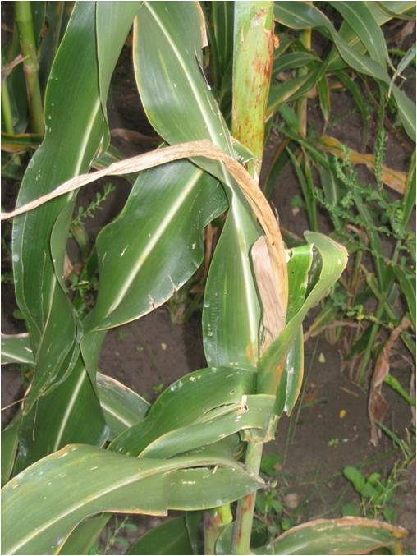
Stem borer: Chilo partellus

Slide 12
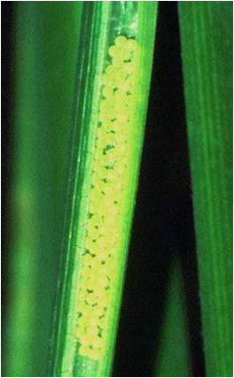
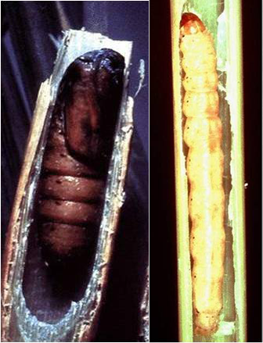
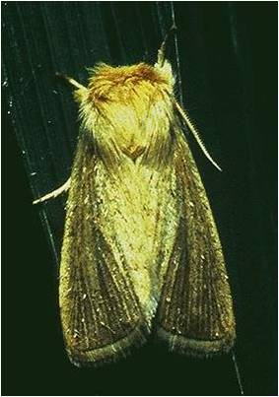
Pink stem borer: Sesamia inferens

Slide 13
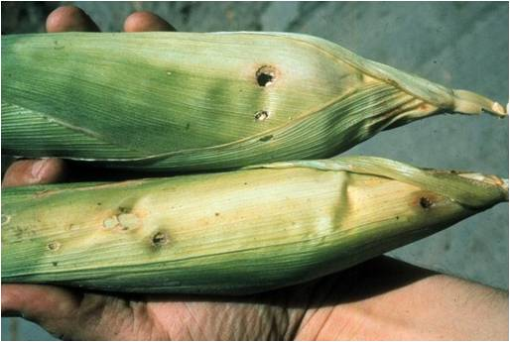
Earhead feeders
Corn worm/Earworm: Helicoverpa armigera

Slide 14
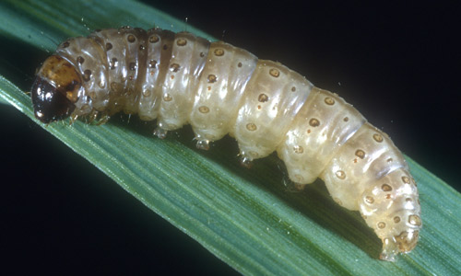
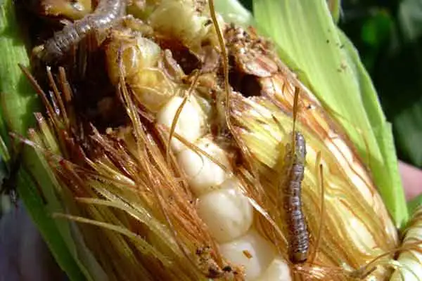
European corn borer scientific name: Ostrinia nubilalis

Slide 15
Scientific name of European corn borer………………………..????

Slide 16
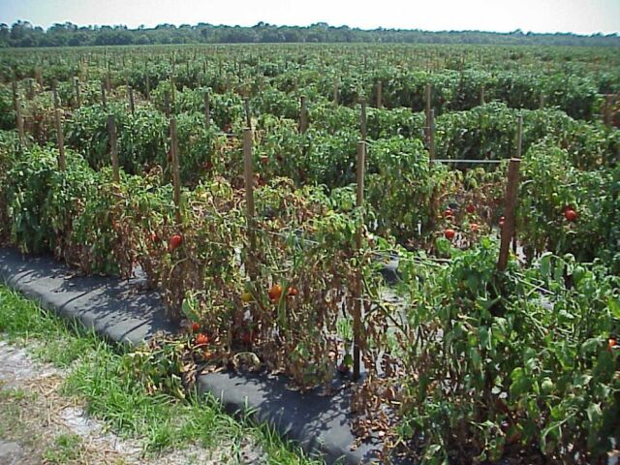
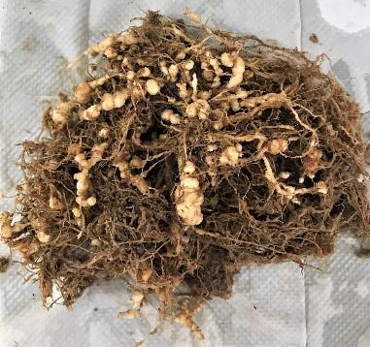
Root knot nematode

Slide 17
Scientific name of root knot nematode------------??????????

Slide 18
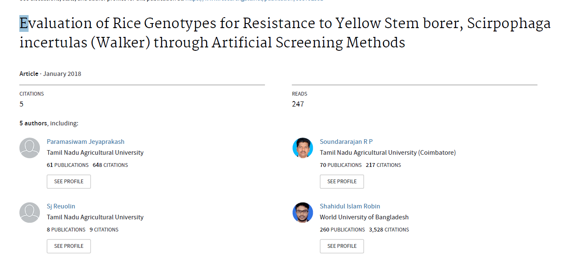

Slide 19
Scirpophaga incertulas- yield loss of 3 to 95 per cent in different areas of damage.
attack rice crop from seedling to grain filling stage
Caterpillars tend to destroy the stems through boring the leaf sheaths at the nodal region, leading to a destructive effect on the terminal shoots are manifested through the damage symptom known as “dead heart.
Artificial screening methodology was adopted for a set of 44 genotypes by two methods, no choice method to assess the damage and choice method to assess the non preference for oviposition and dead heart (DH) damage.
Five replications were maintained for each genotype.
The experimental set up was carried at the Entomology glass house,

Slide 20
Which of the following experimental design can be used for conducting experiment in glass house?
CRD
RBD
LSD
AUGMENTED DESIGN

Slide 21
No Choice method
Freshly collected moths were reared in oviposition cages planted with susceptible variety Taichung Native-1 (TN 1).
The adult moths lay the egg mass at 1/3 away from the leaf tip or at the base of stem.
The egg masses were collected on 4th day and placed in Petri plates lined with moist filter paper.
The freshly emerged larvae were released carefully using camel hair brush on 25-30 day old plants which were trimmed to five tillers per plant for infestation.

Slide 22
The larva at the rate of 2 per tiller (10 per plant) was released at the base of leaf near the auricle region
The seedling was covered with mylar cage to avoid infestation by other pest and disease and escape of released larvae.
The symptom for dead heart was observed after 11-14 days after release of larva.
The stem with dead heart was observed for feeding symptom of larva. The damage scale was calculated by comparing with the susceptible check TN 1.
Five replications were maintained for each genotype.

Slide 23
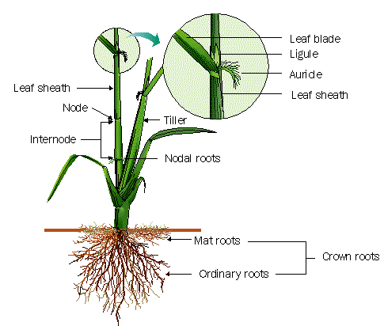

Slide 24
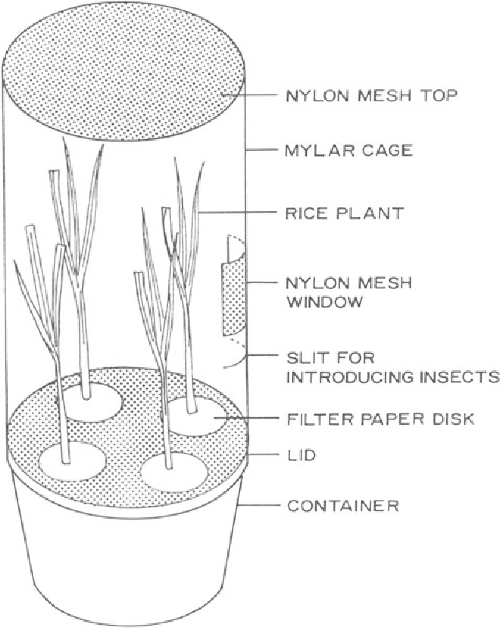
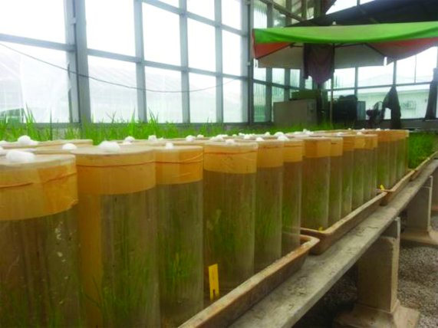

Slide 25
Which of the can be used as susceptible check for screening of rice stem borer?
TKM 6
Damodar
TN1
BPT 5204

Slide 26
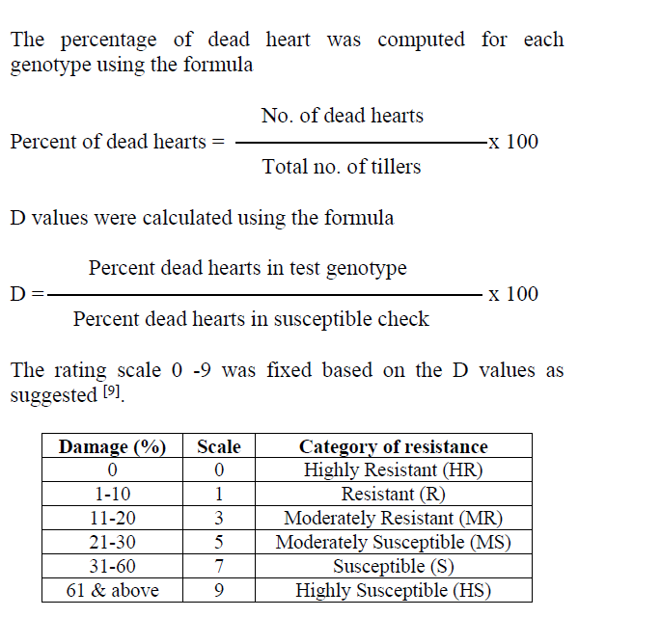
0% | 0
1-20% | 1
21-40% | 3
41-60% | 5
61-80% | 7
81-100% | 9

Slide 27
Results and Discussion
There was a significant difference in the stem borer damage through artificial screening methods among the rice genotypes.
In the no choice method, the percentage of dead heart damage varied from 28.00 to 92.00 in TKM 6 and TN 1 respectively .

Slide 28
A D value of more than 80% shows genotype is
HR
R
MS
HS

Slide 29
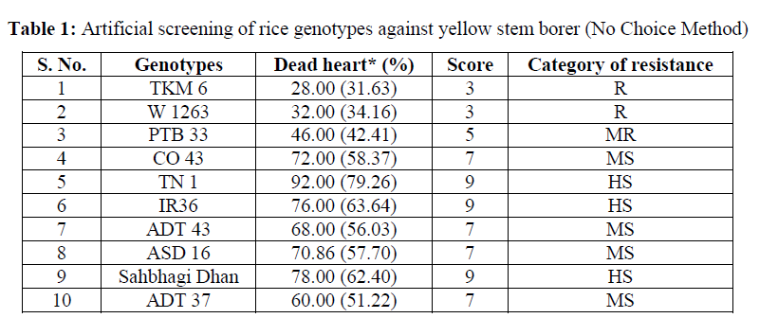

Slide 30
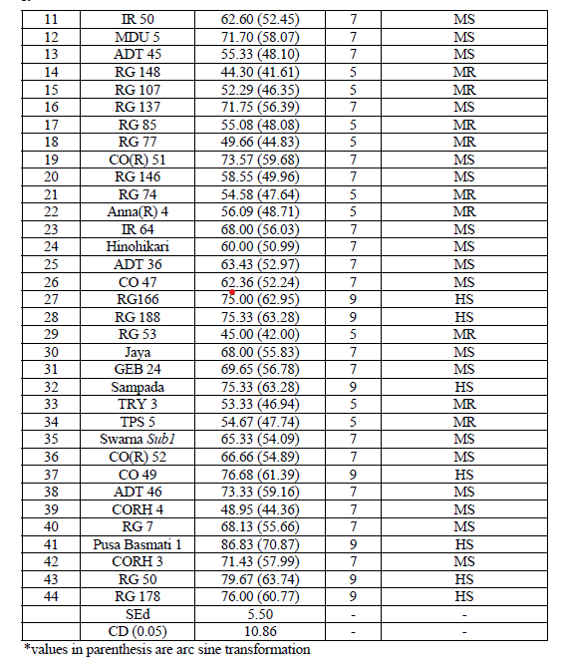

Slide 31
Free choice method
A set of potted plants of different genotypes along with TN 1 plants were placed in a cage of size 2’ x 2’ x 2.5’ to accommodate 12 potted plants.
Fresh adult moths emerged from pupa were released on 35-40 days old seedlings @ one pair per plant and allowed for oviposition.
The moths have free choice to select the genotypes for oviposition.
Two replications were maintained for each genotype.
The number of egg masses on the seedlings was counted.
The first instar larvae were allowed to feed on the tillers till the appearance of dead heart symptom.
The damage symptom was counted on 14 -18 days after oviposition and per cent dead heart damage was worked out.

Slide 32
Ovipositional preference is one among the antixenosis mechanism in host plant resistance.
This may be due to the presence of volatile compounds that emanate from the leaf or other parts of the plant.
In the choice method of artificial screening, oviposition on different genotypes showed significant variation.
The number of egg mass on different germplasm ranged from 1.0 to 4.75 per plant.
Ten genotypes viz., TKM 6, RG 146, RG 74, RG 50, RG 137, CO 47, RG 53, Sampada, TNAU rice hybrid CO 4, CORH 3 recorded with minimum number of egg masses ranged from 1.0 - 1.5/plant.
Moreover, at a high population density (200 moths/20 plants) TKM 6 was the least preferred and Jaya the most preferred. TKM 6 was also reported to have a biochemical resistance factor, oryzanone against Chilo suppressalis that inhibits oviposition and disturbs the insect’s growth and development.
The dead heart count was recorded 14-18 days after release of moths.

Slide 33
In free choice method, moths have free choice to select the plant for oviposition (T/F)

Slide 34
Antixenosis???

Slide 35
Antixenosis/Non-preference/non-acceptane
Host varieties- unattractive or unsuitable for colonization.
Insect variety will not accept a resistant host variety even if there is no alternative source of food.
Various morphological and biochemical features of host plants
landing., settling, feeding., egg laying
Caused by allomones/kairmones

Slide 36
Kairmones provide adaptive advantage to the host (t/f)

Slide 37
The reported resistant varieties viz., TKM 6 and W 1263 recorded 28.0 and 32.0 per cent dead heart respectively in no choice method, whereas 64.33 and 74.18 per cent respectively in the free choice method.
In no choice method of screening, only minimum larva were released whereas in free choice method all emerged larvae from the egg mass were allowed to bore the rice stems.
The pest load is more in the second method and hence the two designated stem borer resistant varieties exhibits more dead heart in the free choice screening method.

Slide 38
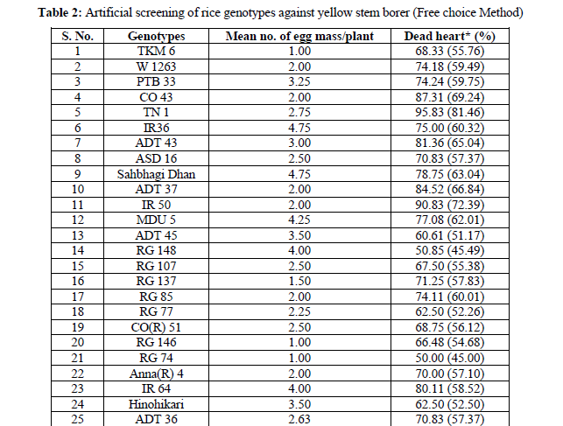

Slide 39
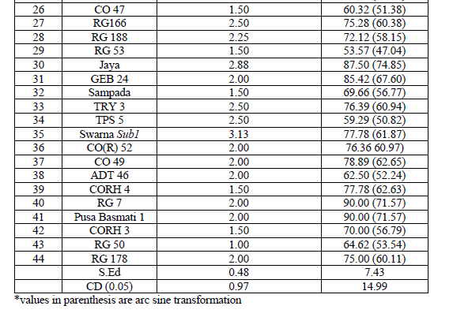

Slide 40
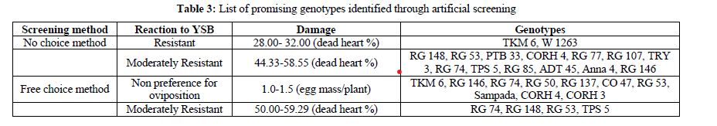

Slide 41
How these resistant genotypes can be used in breeding programme?????

Slide 42
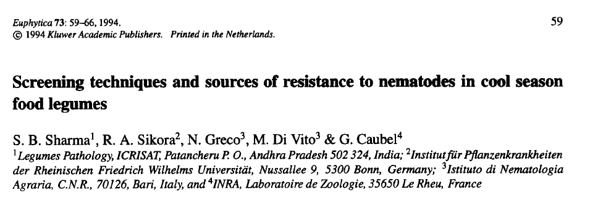

Slide 43
Root-knot nematode infested fields are identified and the population density of the nematode species (M . javanica or M. incognita) is enhanced by growing susceptible cultivars.
Chickpea genotypes are sown in 4 m rows with 10 cm plant-to-plant spacing and 30 cm between the rows .
Two rows of highly susceptible chickpea genotypes (e.g ., ICCC 4 and Dhanush) are sown after every 10 test entries .
Each test entry is replicated at least three times and all the genotypes are evaluated for number of galls or egg masses per plant generally near crop maturity.
Root-knot or egg mass indices of each test genotype are compared with those of the checks .

Slide 44
Name one highly susceptible genotype of chickpea for RKN???

