Slide 1
To study different ways of combating the attack of the pests

Slide 2
Pests can infest crops and reduce yields, reducing overall agricultural production and food security.
To deal with pests, such as mealy bugs or spider mites, most farmers use chemical pesticides which can impact health, pollute water supplies through runoff, and, if pesticides are misused or overused, can actually kill plants.
Finding new methods to get rid of pests without requiring chemical inputs has increasingly become a priority for many farmers.

Slide 3
Control methods
Biological pest control
Trichogramma spp- rice stem borers.
The most promising strains of Trichogramma chilonis and T. japonicus

Slide 4
Cultural control
Mechanical pest control is the use of hands-on techniques as well as simple equipment and devices, that provides a protective barrier between plants and insects.
This is referred to as tillage and is one of the oldest methods of weed control as well as being useful for pest control;
exposes them to the birds and other predators that feed on them.

Slide 5
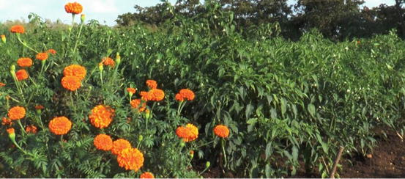
Trap cropping
A trap crop is a crop of a plant that attracts pests, diverting them from nearby crops.
Pests aggregated on the trap crop can be more easily controlled using pesticides or other methods.

Slide 6
A trap crop is a crop of a plant that attracts pests, diverting them from nearby crops (T/F).

Slide 7
Pesticides
Pesticides are applied to crops by agricultural aircraft, tractor-mounted crop sprayers or as seed dressings to control pests.
However, successful control by pesticides is not easy; the right formulation must be chosen, the timing is often critical, the method of application is important, adequate coverage and retention on the crop are necessary.

Slide 8
Resistant Variety
Conventional approaches
MAS
Transgenics

Slide 9
To know the linkage drag which type of selection is done?
Foreground selection
Background selection
Recombinant selection
Negative selection

