Slide 1
To study different breeding strategies for herbicide resistance

Slide 2
Why weeds are important????

Slide 3
Weeds compete with crop plants for water, nutrients, sunlight, and space and also harbor insect and disease pests.
With continuously increasing labour cost, manual weeding has become an expensive field operation for any crop and farmers are increasingly opting for cultivars tolerant to herbicides.
The losses due to weeds are estimated to be 11 billion USD per year, which varied from 13.8% in transplanted rice to 76% in soybean.
Among all biotic stresses, weeds cause the highest potential loss (34%) with insect (18%) and pathogens (16%) being less important.
Initially, hand weeding dominated most weeding practices, but it was gradually replaced (in rural India wage rate for men increased up to 400% from INR 67 in 2004 to INR 276 in 2018.
Mechanical weed control practices are now viewed to be unsatisfactory due to the high-energy requirements and other associated costs, plus the perceived facilitation of soil erosion and compaction.

Slide 4
Estimated losses due to weeds reported highest in
Rice
Maize
Cotton
soyabean

Slide 5
Solution ????

Slide 6
Chemical weed control
Herbicide-tolerant cultivars
Herbicide usage in world has been increased 15-fold after the introduction of transgenic herbicide tolerance cultivars which offer opportunity of controlling weeds through need-based applications of herbicides.
Herbicides have severe morphological and physiological effects on plants such as necrosis, delayed flowering, deformed flower, stunted growth, cupping of Leaves, burning symptoms etc.
An ideal herbicide should have high weed killing potency with low environmental persistence.
Most of the broad-spectrum herbicides lack selectivity, thus limiting their use in some cropping operations but are very useful for complete weed control.
Use of broad-spectrum herbicide is limited because of its sensitivity to crop.

Slide 7
Broad spectrum herbicide act selectively and effectively enabling it for wider application in weed control (T/F).

Slide 8
What is the disadvantage of breeding for herbicide tolerant crops???

Slide 9
The disadvantage accompanied with herbicide tolerant crops is super weeds. Super weeds are the plants which are crop related weeds species on which the resistance genes got transferred by natural outcrossing.

Slide 10
Continuous use of the selective herbicides has led to the development of herbicide resistance in weeds.
Thus, a genotype with herbicide tolerance is required in current perspective.
Breeding for herbicide tolerance is being necessitated by :-
increase in cost of hand weeding
shortage of agricultural labours
decrease in cost of herbicide
increase in the effectiveness of new herbicide molecule
and need of mechanization in intensive agriculture.

Slide 11
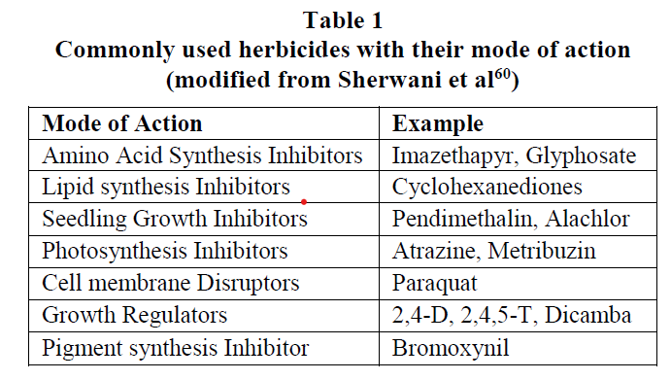

Slide 12
Which of the following is photosynthetic inhibitor?
Glyphosate
Atrazine
Paraquat
2,4-D

Slide 13
ACCase inhibitors: Inhibition of Acetyl coenzyme A carboxylase (ACCase) affects lipid metabolism affecting cell membrane production in the meristems of the grass plant.
2. EPSPS inhibitors: Inhibition of enolpyruvylshikimate 3- phosphate synthase enzyme (EPSPS) creates problem in synthesis of aromatic amino acids (tryptophan, phenylalanine and tyrosine).
3. Synthetic auxins: It mimics plant hormone and thus affects various process cell growth, cell division, cell differentiation, morphogenesis etc.

Slide 14
4. Photosystem-II inhibitors: It creates problem in electron flow from water to NADPH2+ in photosynthesis. As a result, oxidation reactions occur in excess resulting in plant death.
5. Photosystem-I inhibitors: It removes electron from the normal pathway through FeS to Fdx to NADP leading to direct discharge of electrons on oxygen. Production of this extra amount of reactive oxygen species is not tolerated by the cell leading to plant death.

Slide 15
2, 4 D affects
cell division
cell differentiation
Morphogenesis
All of the above

Slide 16
How to develop herbicide resistant crops????

Slide 17
Herbicide tolerant cultivars have been developed in many crops by:-
exploiting already available genetic variability in the germplasm or by creating mutations or by transgenic.
large genetic variation for tolerance to herbicide exists among various crops such as maize, wheat, rice, sunflower, soybean, chickpea, alfalfa etc.
Herbicide tolerance in germplasm or in mutant lines may be due to altered binding site of target enzyme for herbicide, improved herbicide metabolism, sequestration of herbicide molecule and overexpression of target protein.
Herbicide resistant crop via transgenic has also been developed by taking resistant genes from various sources such as bacteria or other plant and incorporating them into crop to make them herbicide resistant.
Transgenic herbicide tolerant crops occupy 47% of total area under transgenic in world.

Slide 18
Source of Herbicide tolerance:
1. Germplasm collections: Conventionally the herbicide tolerance can be found in the crop species itself or its wild and weedy relatives.
Several authors have reported the presence of large amount of genetic variability for several herbicide in the germplasm of different crop plants such as in chickpea, rice, groundnutetc.
2. Artificial random mutagenesis: Herbicides generally target a specific enzyme
and even a small artificial mutation created by random mutagenesis at specific site so that enzyme can be a source of tolerance to herbicide
e.g. EMS mutagenesis in arabidopsis for sulfonylurea and imidazolinone, in soybean for sulfonylurea, in sunflower for imidazolinone etc.
Similarly, mutation by sodium azide has led to development of tolerance to imidazolinone in wheat.

Slide 19
3. Site specific mutagenesis: With advancement of molecular biology and nucleotide sequence data, it has now become easy to target specific domain of an enzyme and create site specific mutation using genome editing tools
e.g. in maize, modified Acetolactate synthase (ALS) enzyme having tolerance to herbicide chlorsulfuron have been developed using CRISPR-Cas9 technology.
4. Transgenic: Several bacterial genes are known to confer tolerance to herbicide.
Transfer of these genes is possible using modern molecular biological tools.
For example, gene for tolerance to herbicides “aroA” has been transferred from S. typhimurium to several crops for tolerance to Glyphosate.

Slide 20
Molecular mechanism of herbicide tolerance
Altered target site: Enzymes generally have domains for binding with several biomolecules. These domains are specific to different substrate or other interacting enzymes.
Herbicides generally target specific domain of target protein, where it acts to disrupt a particular plant process or function (mode of action).
If this target site is somewhat altered (change in amino acids) without affecting its function, the herbicide no longer binds to the site of action and is unable to exert its phytotoxic effect.

Slide 21
2. Enhanced metabolism:
Plants have many mechanisms to degrade or solubilize the toxic compounds, this mechanism can be used by plants to degrade herbicides.
Therefore, a plant having enhanced metabolism of herbicide detoxifying enzymes can easily overcome the toxic effects

Slide 22
3. Compartmentalization or sequestration:
Plants have several inherent mechanisms to exclude the exo- or endogenous toxins such as by encompassing the toxins in vacuole, releasing them with exudates, restricting their movement within plants etc. and thus preventing their harmful effects.
In this case, a herbicide may be inactivated either through binding (sequestration) or removed from metabolically active regions of the cell to inactive regions (compartmentalization) such as cell wall, vacuole etc.

Slide 23
4. Over-expression of the target protein:
Herbicide targets a specific protein and this target enzyme is produced in large quantities by the plant, then the effect of the herbicide becomes insignificant

Slide 24
Conventional approaches to develop herbicide tolerant crops:
Breeding with conventional approaches is cheaper, less regulated and highly adapted.
Apart from this transgenic and gene editing, it can be used as non-conventional breeding approaches which are highly regulated, difficult to release varieties and having less consumer acceptance.
There are various ways by which Herbicide Tolerant / Resistant Crops can be developed.
All these methods have been successfully applied for development of herbicide tolerant crops.
These are:

Slide 25
Screening for natural variation in various germplasm lines of diverse source.
Using available genes in gene pool or genes present in wild relatives.
Use of random mutagenesis for creating variation for tolerance to herbicide.

Slide 26
Germplasm Screening:
Evaluation of germplasm is done by screening them under sprayed condition.
It can be done by growing lines and spraying various doses of herbicide application and evaluating them on various parameters such as :-
average plant stand, yield difference between control and sprayed, leaf damage score on 0-5 scale, floral development.
days to flowering and days to maturity, harvest index, photosynthetic ability, Normalized Difference Vegetation score (NDVI- desiccation evaluation) etc.
The best line selected can be further screened intensively at multi-location in multi-year and later can be used in development of herbicide tolerant cultivar by various breeding methods

Slide 27
NDVI--------------------???

Slide 28
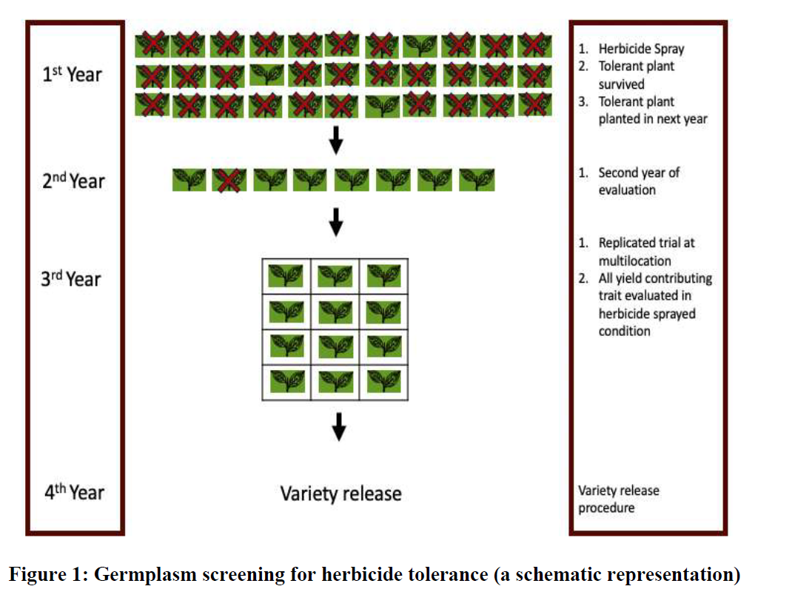

Slide 29
Mutant Screening:
Mutation is a great source of herbicide tolerance in the crops where enough variability for herbicide tolerance is not available in crop germplasm.
Mutation can be generated by physical and chemical mutagenesis which can be effectively utilized in developing herbicide tolerant lines.
Screening for herbicide tolerance in mutants is same as that of germplasm screening.
Lines identified can be directly released as herbicide tolerant cultivars or can be incorporated in breeding programs.

Slide 30
When enough variation is not present, which breeding method is used?
Mutation breeding
Marker assisted selection

Slide 31
Non-conventional approaches for herbicide tolerance:
Herbicide crops can also be produced by novel breeding approaches such as soma clonal variation, site directed mutagenesis, gene targeting, gene editing, transgenic etc.
These approaches are nowadays used commonly to develop herbicide tolerant crops. These approaches can be characterized under following:

Slide 32
1. Somaclonal variation:
Genetic changes occurred during the tissue culture operation have been effectively utilized in development of herbicide tolerance in several cases such as in Brassica napus L.
for tolerance to chlorsulfuron (CS)
for difenzoquat in wheat
for glyphosate in tobacco
for atrazine in soybean etc.

Slide 33
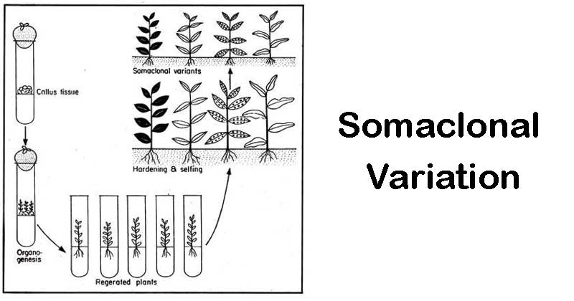

Slide 34
Soma clonal variants for glyphosate has been developed in
WHEAT
SUNFLWER
MUSTARD
TOBACCO

Slide 35
2. Site-directed mutagenesis:
Gene targeted by herbicide can be mutated at herbicide binding site in a way that it does not affect other function of that gene.
Site directed mutagenesis approach by oligo-directed mutagenesis and engineered nucleases can be used for generating herbicide tolerant cultivars.

Slide 36
WHICH OF THE FOLLOWING IS AN EXAMPLE OF ENGINEERED NUCLEASES?
ZFNs
TALENs
CRISPR/Cas9
ALL OF ABOVE

Slide 37
3. Gene editing:
Homologous recombination and replacement of herbicide target domain of target enzyme with mutated version not suited for herbicide binding can be a good approach for herbicide tolerance.

Slide 38
4. Transgenic:
Herbicide tolerance is the most common trait in commercial transgenic crops as 47% (80.7 Mha) of total area under transgenic crop in the world is under transgenic herbicide tolerance (189.8 Mha.
Transgenesis for herbicide tolerance involves the identification of an herbicide resistance gene from a plant or microorganism, its isolation and manipulation for efficient plant expression (if it is of microbial origin) and its subsequent delivery, stable integration and expression in the cells of the target crop plant.
For the most part, genes coding for useful herbicide resistance in crops are isolated from herbicide degrading soil microorganisms.
The most commonly employed techniques in developing herbicide resistant crops via transgenic are the Agrobacterium and the particle bombardment methods respectively.
Herbicide tolerance via genetic transformation can be conferred by one or a combination of these four mechanisms:

Slide 39
1. Introduction of a gene(s) coding for an herbicide detoxifying enzyme(s).
2. Introduction of gene(s) coding for herbicide insensitive form of a normal functioning enzyme or over expression of the genes coding for a herbicide target enzyme such that the normal metabolic functioning is still achieved in the plant even though some of the enzyme is inhibited.
3. Modification of the herbicide target enzyme in such a way that the herbicide molecule does not bind to it.
4. Engineering for active herbicide efflux from plant cells.

Slide 40
Which type of transgenic having maximum area under cultivation?
Roundup ready
Bt-cotton
Bt-brinjal
Golden rice

Slide 41
Detoxification
Transfer of gene whose enzyme product detoxifies the herbicide
Introduced gene produces an enzyme which degrades the herbicide sprayed on the plant.
Introduction of bar gene cloned from bacteria, Streptomyces hygroscopicus, into the plant make them resistant to herbicide based on phosphinothricin.
The bar gene produces an enzyme phosphinothricin acetyl transferase (PAT).
This enzyme degrades ppt into a non-toxic acetylated form.
Plant engineered with bar gene- grow in ppt at level 4-10 times higher than normal field application.

Slide 42
Target modification
Transfer of a gene whose enzyme product becomes insensitive to herbicide.
A mutated gene is introduced and produces modified enzyme in the plant that is not recognized by herbicide.
As a consequence of which it cannot kill the plant.
Eg- mutant aroA gene from bacteria Salmonella typhimurium – used for developing tolerance against glyphosate.
Target site- chloroplast enzyme 5-enol pyruvylshikimic acid 3-phosphate synthase (EPSPS).
Introduction of mutant aroA gene produces modified EPSPS
Not recognized by glyphostate.
Roundup ready- soyabean and cotton.

Slide 43
Target site for glyphosate is
PAT
EPSPS
Ac-CoE
ALL OF THE ABOVE

Slide 44
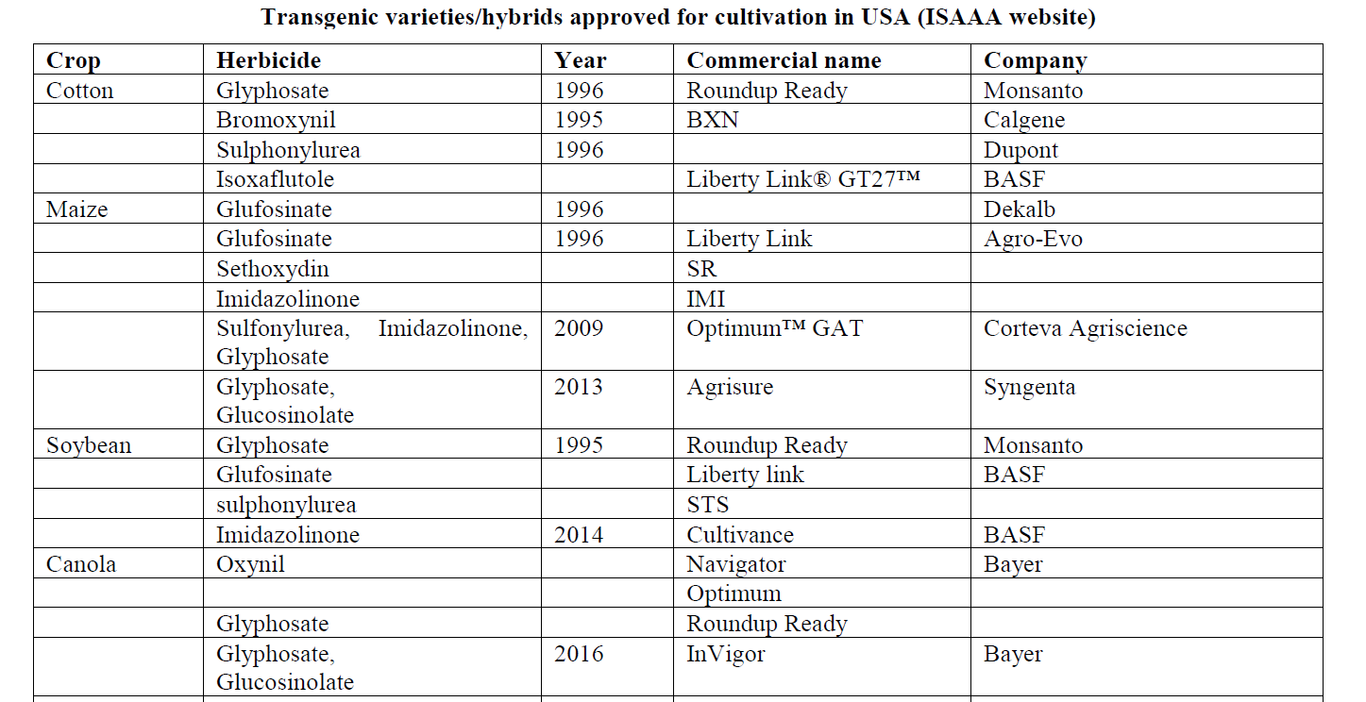

Slide 45
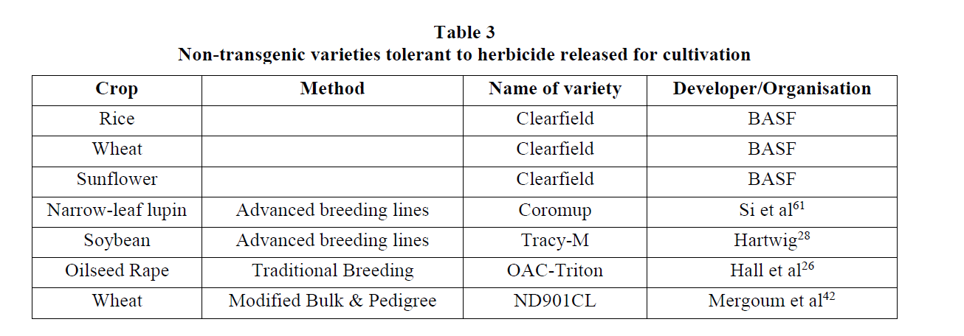

Slide 46
Commercially successful varieties:
Transgenic varieties occupy 40% of total global area under transgenic in USA [International Service for the Acquisition of Agri-biotech Applications (ISAAA), 2019].

Slide 47
Disadvantages of herbicide tolerant crops
1. Mammalian toxicity due to increased usage of herbicide.
2. Ecotoxicity (side effects on soil microorganisms and agricultural flora or fauna).
3. Raising herbicide resistant weeds and volunteers’ crop.
4. Yield performance is affected.
5. Single selection pressure and weed resistance.
6. Shifts in weed species (minor weeds may become major).
7. Gene escape (transfer of transgenic trait into related wild weedy species by pollination).
8. Gene flow and contamination to organic crops.
9. Drift and non-target movement of resistance gene.

Slide 48
Liberty link is resistant to
Glyphosate
Glufosinolate
Atrazine
Sulfonyl urea

Slide 49
Advantages of transgenic herbicide tolerant crops
1. Facilitate low or no tillage.
2. Broader spectrum of weeds controlled.
3. Reduced crop injury.
4. Reduced herbicide carry-over.
5. Use of herbicides that are more environmentally friendly.
6. New mode of action for resistance management.
7. Crop management flexibility and simplicity.

Slide 50
8. Superweeds- A wild plant that has been accidentally pollinated by a genetically modified plant and now contains that plant's abilities to resist herbicides and insects.
Certain invasive grasses and weeds have proven themselves to be resistant to glyphosate, meaning that the herbicide is no longer effective against these plants.
Examples of weeds resistant to Glyphosate are Common Ragweed, Italian Ryegrass etc.

Slide 51
Wild relatives and wild species:
Idea of using wild relatives and species in breeding for herbicide tolerance has come from an unwanted phenomenon of superweeds.
Application of more herbicide in fields has resulted into the selection among the related weed species (crop wild relatives acting as weeds) and subsequently failure of that herbicide against that weeds.
Therefore, wild relatives of cultivated crop species can be screened via same procedures as done for germplasm materials.
Gene-flow is very common among crop wild relatives to crops and among wild relatives.
Once the resistance gene is present in crop volunteers or related weed species, then it is expected that the same weed.
control practices (consistent sprayings with herbicides having the same mode of action) which cause herbicide resistance to occur in naturally tolerant/resistant weed biotypes, will lead to a rapid build-up of HR-weeds and volunteers

