Slide 1
Fresnel Prisms & Risley Prisms

Slide 2
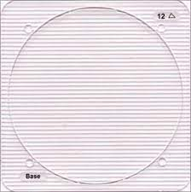
What is a fresnel prism?

Slide 3
A prism’s angle of refraction depends only upon the angle of the surfaces and the index of refraction of the material of which the prism is made.
The angle of refraction is independent of the prism’s thickness.

Slide 4
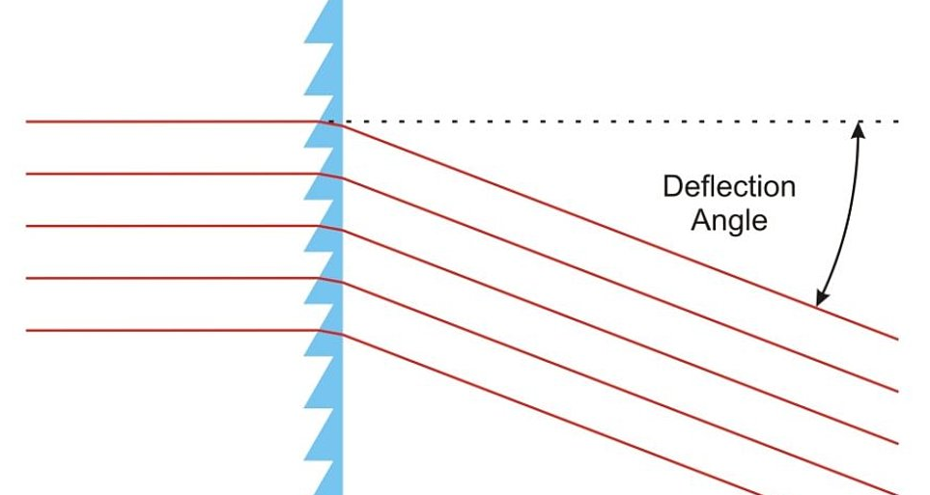
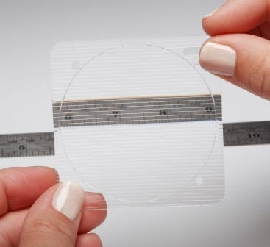

Slide 5
Advantages
It is very thin and extremely lightweight.
It is flexible and can be applied to an existing spectacle lens, making it possible to apply the lens in-house, without an in-house optical laboratory.
it can be cut to any shape with scissors or a razor blade.
They do reduce magnification differences considerably.(But do not completely eliminates it.)

Slide 6
Disadvantages
Cosmetic - Fresnel prisms look different than conventional lenses. They are different enough that they may be noticed by others.
Cleaning - Because Fresnels have a number of small ledges, they are harder to clean than conventional lenses.
Visual performance
High-powered prisms will cause a slight decrease in visual acuity. ( because of chromatic aberration and distortion).
It also cause a slight loss of visual acuity caused by reflections at the prism facets, especially under certain sources of illumination.

Slide 7
Indications
High Amounts of Prism
Because of its thickness advantage, Fresnel prism is especially useful for high amounts of prism.
Use and Reuse
Fresnel prism lenses are easy to apply and remove. They may be used and reused.
This is helpful when determining how a given prism amount will work long term or for use during visual training.

Slide 8
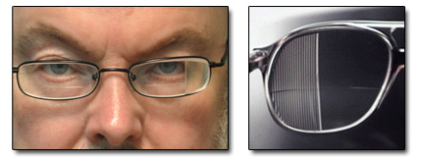
Indications
Sectorial Application
A partially paralyzed extraocular muscle may result in a different amount of prism needed for different directions of gaze. A Fresnel lens can be cut to fit that particular lens area.

Slide 9
Indications
Visual Field Defects
With visual field defects, prism may be applied in one section of the lens with the base direction in the direction of the defect and the edge of the prism close to the central visual area.
This way the eye travels only a short distance before it picks up the image through the prism.
The image appears closer to the center and can be seen without moving the head.
If the defect is a constricted visual field down to 5 to 15 degrees of viewing area,
prism from 20 to 30 prism diopters could be placed base out on the temporal sides
of the lenses and base in on the nasal sides.

Slide 10
Indications

Slide 11
Application of prism – Visual field defect
Procedure :
To measure for correct placement of a prism on one half of the spectacle lens in the case of homonymous hemianopia, the spectacles, properly adjusted, should be on the subject’s face.
The subject looks into the viewing eye of the practitioner.
The eye with the visual field loss nasally is occluded, usually with a cover paddle.
A near point card or other straight edge is brought in from the temporal, non seeing side.
When the subject first reports seeing the card, the location of the card is marked on the lens with a vertical line.

Slide 12
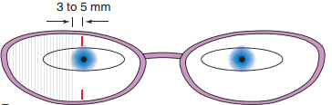
Cont…
The edge of the prism is placed 3 to 5 mm temporalward from this position.

Slide 13
Conti..
Eli Peli’s High-Powered Prism Segment.
Another method of sectorial application of prism for helping the person with homonymous hemianopia places high-powered (30 to 40 Δ) prism in certain segment areas of the lens.
Two prism segment areas, with their base-apex axis in the horizontal position, are placed on the lens prescribed for the eye with the visual field loss.
The upper one is placed above the pupil in alignment with the upper limbus and the lower one below the pupil in alignment with the lower limbus.
Notes:
In the past sectorially applied prism for homonymous hemianopia has been placed on each eye in the blind area. Many practitioners are using only a single sectorially applied prism on the eye with the temporal field defect.

Slide 15
Conti..
These prisms are placed base out and create diplopia in that eye.
Objects seen through the segment areas are shifted from the nonseeing to the seeing part of the visual field.
With adaptation the individual is able to visualize the parts of the objects viewed
through the prism in the areas where they would normally be located, expanding the visual field area by up to 20 degrees.
Such prisms may be constructed as a prism segment within the carrier spectacle lenses.

Slide 16
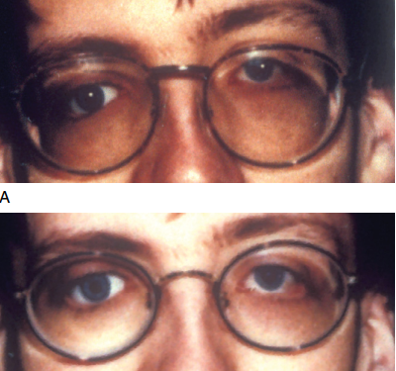
Indication
Cosmetics of Nonseeing Eyes
The use of prism to improve the appearance of a blind or prosthetic eye is discussed. Fresnel prisms can be used in such instances.

Slide 17
Indication
Nystagmus

Slide 18
Indication
Nystagmus is a condition characterized by a constant back and forth movement of the eyes.
Such movement is involuntary and reduces vision. In some cases nystagmus may slow when the person looks to one side or the other.
For example, if the examiner sees that movement slows when the person looks to the right, equal amounts of prism may be applied to both lenses.
The correct base direction would be base left. Because the eyes turn toward the apex, prism base left will keep the head pointed straight while the eyes turn to the right.

Slide 20
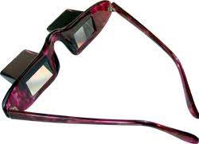

Slide 22
ROTARY PRISMS
Application of obliquely crossed prisms that is used on a regular basis in ophthalmic
practice.
That application is called a rotary or Risley’s prism.
A rotary prism is a combination of two prisms.
These prisms are placed one on top of the other. Initially, their base directions are
exactly identical, but as the prisms are rotated, their bases move by equal extents in
opposite directions.
For example, suppose two prisms of 10Δ each are placed on top of one another base-to-base.
The total prismatic effect is 20Δ
But if they are placed base-to-apex, then their total prismatic effect is zero.

Slide 23
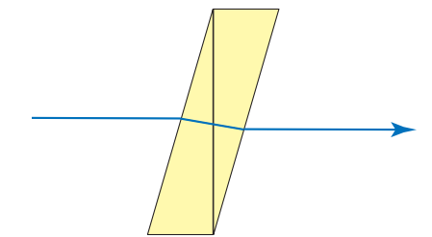

Slide 24
