Slide 1
Reflection & Scattering

Slide 3
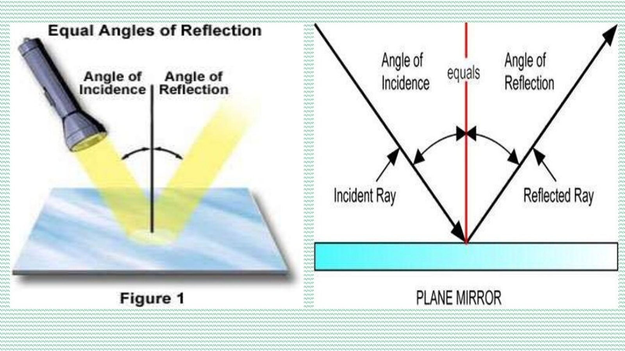

Slide 5
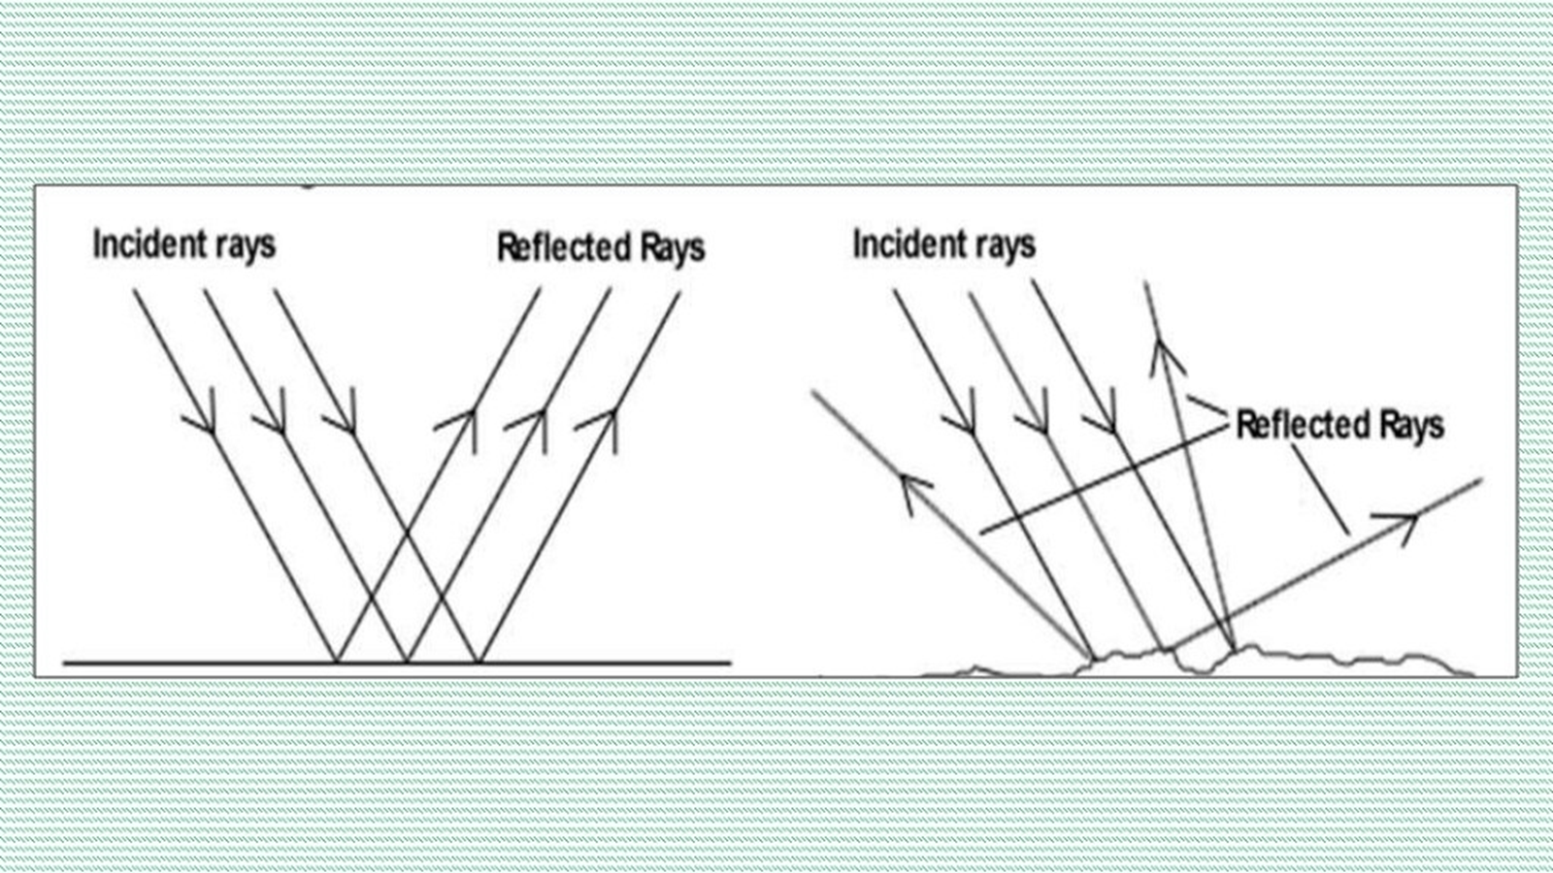

Slide 23
(Tyndall effect)

