Slide 1
Foundations of Human Behaviour: Human behaviour
SESSION 1
Dr. Chitrasena Padhy
Associate Professor
Agricultural Extension

Slide 2
Human Behaviour
Human behaviour refers to the way humans act and interact.
It is based on and influenced by several factors, such as genetic make-up, culture and individual values and attitudes.
Potential and expressed capacity for physical, mental, and social activity during the phases of human life.

Slide 3
Behavior can be defined as the actions or reactions of a person in response to external or internal stimulus situation.
Psychology is a science of activity of people which lead to an understanding of nature of behavior.
Behavior is always the product of two things, one- the nature of individual or organism that behaves and second- the nature of situation in which the individual find himself.

Slide 4
According to Crowder “Behavior is any activity which can be observed, recorded and measured, this includes first what living beings or organisms do- that is their movement in space”.
Psychologists analyze behavior from two point of view- Overt & Covert, the behavior that is visible and what occurs outside of human being is called overt behavior.
Example- playing football and eating something are overt behavior.

Slide 5
The behavior that is not visible and what occurs inside of human being is called covert behavior. Example- thinking.
Psychologist Luine express behavior through an equation as –
B=∫ (P x E) where, B= Behavior, ∫=Function, P=Person, E=Environment.

Slide 6
Behavior is a function of people and environment.
Environment creates stimulus situation, it is human nature to respond stimulus situation.
Human behaviour, the potential and expressed capacity for physical, mental, and social activity during the phases of human life.
Humans show same types of behaviour as other animals. But human behaviour is often more complex because we are more intelligent and aware of ourselves.

Slide 7
Human behavior is an inherently complex subject matter which pertains to the manner and reasons behind people’s actions.
In scientific research, human behavior is a complex interplay of three components: actions, cognition, and emotions.

Slide 8
Actions
An action denotes everything that can be observed, either with bare eyes or measured by physiological sensors.
Think of an action as an initiation or transition from one state to another – at a movie set, the director shouts “action” for the next scene to be filmed.
Behavioral actions can take place on various time scales, ranging from muscular activation to sweat gland activity, food consumption, or sleep.

Slide 9
Cognitions
Cognitions describe thoughts and mental images you carry with you, and they can be both verbal and nonverbal.
“I have to remember to buy groceries,” or “I’d be curious to know what she thinks of me,” can be considered verbal cognitions.
In contrast, imagining how your house will look like after remodeling could be considered a nonverbal cognition.

Slide 10
Cognitions comprise skills and knowledge – knowing how to use tools in a meaningful manner (without hurting yourself), sing karaoke songs or being able to memorize the color of Marty McFly’s jacket in “Back to the Future” (it’s red).

Slide 11
Emotions
Commonly, an emotion is any relatively brief conscious experience characterized by intense mental activity, and a feeling that is not characterized as resulting from either reasoning or knowledge.
This usually exists on a scale, from positive (pleasurable) to negative (unpleasant).

Slide 12
Other aspects of physiology that are indicative of emotional processing – such as increased heart rate or respiration rate caused by increased arousal – are usually hidden to the eye.
action = emotion (joy) + cognition

Slide 13
Actions, cognitions and emotions do not run independently of each other – their proper interaction enables you to perceive the world around you, listen to your inner wishes and respond appropriately to people in your surroundings.
However, it is hard to tell what exactly is cause and effect – turning your head (action) and seeing a familiar face might cause a sudden burst of joy (emotion) accompanied by an internal realization (cognition):

Slide 14
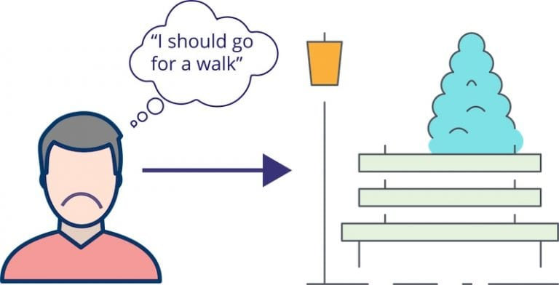
The sequence of cause and effect might be reversed: Because you’re sad (emotion) and ruminating on relationship issues (cognition), you decide to go for a walk to clear your head (action).
emotion (sadness) + cognition (“I should go for a walk“) = action

Slide 15
Our brains help us interpret the environment, recognize everyone and everything, learn new knowledge, and ironically, we really don’t know how much of our brains work.
However, modern neuroscience and neuropsychology have made significant strides in explaining the impact our minds have on our daily tasks.
This is why Psychology feels intriguing and thought-provoking to many

Slide 16
The term ‘psychology‘ has been derived from the Greek word ‘psyche’ translating as ‘breath, spirit, soul’ and ‘logia’ that corresponds to ‘study of’.
Human behaviour includes everything we do.
Anything we say(Verbal behaviour).
Our facial expressions
Body gestures

Slide 17
Human behavior refers to the range of behaviors exhibited by humans and which are influenced by culture, attitudes, emotions, values, ethics, authority, rapport, hypnosis, persuasion, coercion and/or genetics.
The behavior of people falls within a range with some behavior being common, some unusual, some acceptable, and some outside acceptable limits

Slide 18
What factors can affect behaviour?
Physical factors - age, health, illness, pain, influence of a substance or medication
personal and emotional factors - personality, beliefs, expectations, emotions, mental health
life experiences - family, culture, friends, life events
what the person needs and wants.

Slide 19
Behaviour is also affected by the context, including:
what is happening at the time
the environment - heat, light, noise, privacy
the response of other people, which is affected by their own physical factors, personal and emotional factors, life experiences, wants and needs.

Slide 20
THANK YOU

