Slide 1
Biological bases of human behaviour – Nervous system, brain, endocrine system and genes
SESSION 3
Dr. Chitrasena Padhy
Associate Professor
Agricultural Extension

Slide 2
The brain is the most complex part of the human body.
It is the center of consciousness and also controls all voluntary and involuntary movement and bodily functions.
It communicates with each part of the body through the nervous system, a network of channels that carry electrochemical signals.

Slide 3
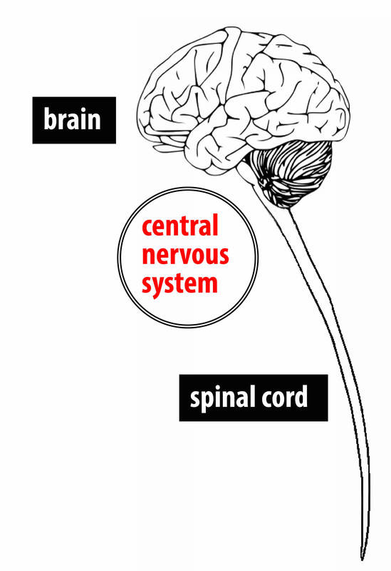
It is through the nervous system that we experience pleasure and pain, feel emotions, learn and use language, and plan goals, just to name a few examples

Slide 4
The Central Nervous System, or CNS for short, is made up of the brain and spinal cord (see Figure 1).
The CNS is the portion of the nervous system that is encased in bone (the brain is protected by the skull and the spinal cord is protected by the spinal column).
It is referred to as “central” because it is the brain and spinal cord that are primarily responsible for processing sensory information—touching a hot stove or seeing a rainbow, for example

Slide 5
Sending signals to the peripheral nervous system for action.
It communicates largely by sending electrical signals through individual nerve cells that make up the fundamental building blocks of the nervous system, called neurons.
There are approximately 86 billion neurons in the human brain and each has many contacts with other neurons, called synapses (Herculano-Houzel, 2009).

Slide 6
If we were able to magnify a view of individual neurons we would see that they are cells made from distinct parts (see Figure ).
The three main components of a neuron are the dendrites, the soma, and the axon.
Neurons communicate with one another by receiving information through the dendrites, which act as an antenna.

Slide 7
When the dendrites channel this information to the soma, or cell body, it builds up as an electro-chemical signal.
This electrical part of the signal, called an action potential shoots down the axon, a long tail that leads away from the soma and toward the next neuron.
When people talk about “nerves” in the nervous system, it typically refers to bundles of axons that form long neural wires along which electrical signals can travel.
Cell-to-cell communication is helped by the fact that the axon is covered by a myelin sheath—a layer of fatty cells that allow the signal to travel very rapidly from neuron to neuron (Kandel, Schwartz & Jessell, 2000)

Slide 8
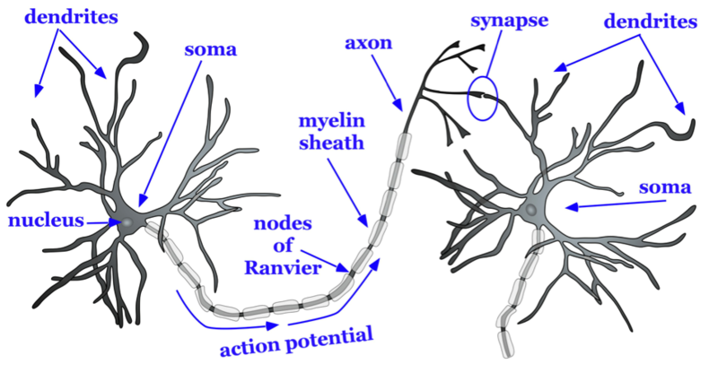
Parts of Neuron

Slide 9
Neurons
Neuron is the basic unit of our nervous system.
Neurons are specialised cells, which possess the unique property of converting various forms of stimuli into electrical impulses.
They are also specialised for reception, conduction and transmission of information in the form of electrochemical signals.
They receive information from sense organs or from other adjacent neurons, carry them to the central nervous system (brain and spinal cord), and bring motor information from the central nervous system to the motor organs (muscles and glands).

Slide 10
The neuron, or nerve cell, sends and receives signals that affect many aspects of behavior

Slide 11
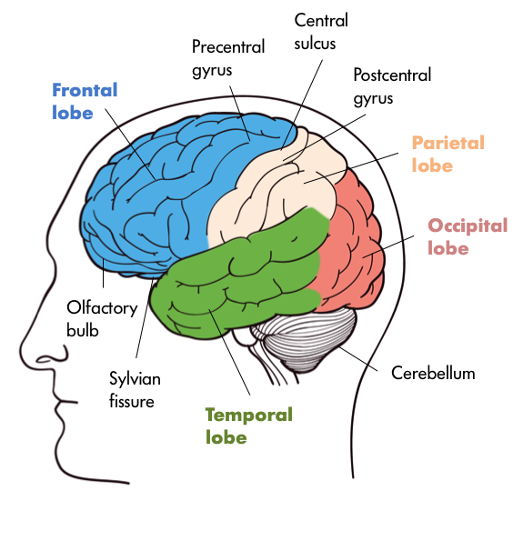

Slide 12
Neural communication is the information system that helps connect our biological process to our psychological process as an information highway.
Nerve cells are at the very basis of this communication.
Each neuron consists of a cell body with extended branches. These branches are called dendrites, and they receive information to then carry it back to the cell body.

Slide 13
The central nervous system (CNS) consists of the brain and the spinal cord. Our brains have two primary functions, which are to control behavior and to regulate the body’s physiological processes.
However, the brain cannot do this alone as it needs to receive information from the body’s sense receptors, which it achieves through communication with the spinal cord.

Slide 14
The CNS is named ‘central’ because aside from occupying the central position of the body, the CNS is also the most important part of the nervous system for maintaining and producing behavior.
The central nervous system (CNS) is comprised of the brain and spinal cord. The three broad functions of the CNS are to take in sensory information, process information, and send out motor signals.
The CNS receives sensory information from the nervous system and controls the body's responses. The central nervous system plays a primary role in receiving information from various areas of the body and then coordinating this activity to produce the body's responses.

Slide 15
The Brain
The brain controls many of the body's functions including sensation, thought, movement, awareness, and memory.
The surface of the brain is known as the cerebral cortex.
The surface of the cortex appears bumpy thanks to the grooves and folds of the tissue. Each groove is known as a sulcus, while each bump is known as a gyrus.

Slide 16
The largest part of the brain is the cerebrum. It is responsible for functions such as memory, speech, voluntary behaviors, and thought
The cerebrum is divided into two hemispheres, the right hemisphere and the left hemisphere.
The right hemisphere controls movements on the body's left side, while the left hemisphere controls movements on the body's right side

Slide 17
Each hemisphere of the brain is then divided into four interconnected lobes
Frontal lobes are associated with higher cognition, voluntary movements, and language.
Occipital lobes are associated with visual processes.
Parietal lobes are associated with processing sensory information.
Temporal lobes are associated with hearing and interpreting sounds as well as the formation of memories.

Slide 18
The cell body (or soma) is the bulbous end of a neuron, containing the cell nucleus. The soma makes use of nutrients to supply energy for neuronal activity.
Axons are organelles that carry information away from the cell body. Axons may be as small as several microns or as long as several meters in giraffes and whales. The axons main job is to send a signal to the dendrites of another neuron, but some say that they may also receive signals in certain situations. Each neuron has only one axon, but the axon may have branches with what are called terminal buttons at its end.
Dendrites are organelles that sense the neurotransmitter secreted by the axon of another neuron. Most neurons have more than one dendrite. Dendrites and axons do not directly touch each other; there is a gap, called a synapse.

Slide 19
The Transmission of the Signal
The transmission of the signal is basically the same in all cells, the signal is sent across the synapse by the axon and the dendrite of the next cell picks up the signal.
Synapse
The synapse is a gap between two cells. Synapse are one way junctions between neurons and other cells. The neurotransmitter is emitted from the axon of one cell and usually goes to the dendrite of the next cell. Sometimes the signal goes to the soma or the axon of the next cell instead of the dendrite

Slide 20
The soma or cell body is the main body of the nerve cell.
It contains the nucleus of the cell as well as other structures common to living cells of all types (Figure 3.1).
The genetic material of the neuron is stored inside the nucleus and it becomes actively engaged during cell reproduction and protein synthesis.
The soma also contains most of the cytoplasm (cellfluid) of the neuron. Dendrites are the branchlike specialised structures emanating from the soma. They are the receiving ends of a neuron

Slide 21
All human (and animal) behavior is a product of biological structures and processes, highly organized on multiple interconnected levels. Understanding these biological precursors of behavior can lead to treatments for psychological disorders, such as drugs that influence neurotransmitter function.
The nervous system is highly specialized and hierarchical in its structure, but neuroplasticity gives the brain some flexibility to adapt its structure and function.
Though interconnected with and regulated by the nervous system, the endocrine system produces effects on behavior in a distinct way: endocrine glands secrete hormones into the bloodstream, allowing hormones to reach and interact directly with target organs.

Slide 22
Biopsychological researchers use a variety of imaging technologies to view the structure and function of the brain, along with specialized research strategies that allow them to learn more about the brain’s organization and the origin of psychological traits.
While many behaviors are learned as a result of experience within a particular environment, the very capacity to learn such behaviors has a genetic basis, and such capacities only persist because they contribute to the fitness of organisms.
Since the late nineteenth century, psychologists have investigated consciousness, including the awareness of one’s self and environment, the ways consciousness can be altered, and the various levels and states of consciousness.

Slide 23
Sleep cycles through multiple stages that vary in levels of neural activity, muscle control, biological functions, and dreaming; sleep disorders cause disruptions to these processes.
Psychoactive drugs, including depressants, narcotics, stimulants, and hallucinogens, affect brain chemistry to alter the perceptions and behavior of users; some psychoactive drugs are used medicinally and/or recreationally, and some have a high potential for abuse.

Slide 24
BIOLOGICAL BASES FOR BEHAVIOR KEY TERMS
Neurons: The basic functional units of the nervous system; cells which contain specialized structures to communicate signals.
Soma/cell body: The part of a neuron that contains its nucleus and other standard cellular structures.
Dendrites: The multiple thin, treelike fibers that branch off from a neuron’s soma and contain receptors to accept incoming signals from other neurons.

Slide 25
Axon: A long, tubular structure in a neuron that transmits action potentials.
Myelin sheath: A fatty substance that coats an axon, insulating it and enhancing its ability to transmit action potentials.
Terminal buttons: The branching structures at the ends of axons that release neurotransmitters.

Slide 26
Synapse: The small gap between the axon of a presynaptic neuron and the dendrites of a postsynaptic neuron.
Action potential: The electrical impulse sent along an axon when the dendrites of a neuron are sufficiently excited.
Neurotransmitter: A specialized chemical messenger which sends signals between neurons.
Excitatory: Describes a neurotransmitter that causes a postsynaptic neuron to propagate more action potentials

Slide 27
Inhibitory: Describes a neurotransmitter that causes a postsynaptic neuron to propagate fewer action potentials.
Acetylcholine: A neurotransmitter involved in learning, memory, and muscle contraction.
Dopamine: A neurotransmitter involved in mood, movement, attention, and learning.
Serotonin: A neurotransmitter that regulates sleep, mood, appetite, and body temperature.

Slide 28
Gamma amino butyric acid (GABA): The primary inhibitory neurotransmitter in the nervous system.
Norepinephrine: A neurotransmitter important in controlling alertness, wakefulness, mood, and attention.
Glutamate: The main excitatory neurotransmitter in the central nervous system; important for learning and memory.
Agonists: Drugs that mimic a particular neurotransmitter, activating the same receptors that it does.

Slide 29
Antagonists: Drugs that block a particular neurotransmitter from activating its receptors.
Re-uptake inhibitors: Drugs that prevent a neurotransmitter from being reabsorbed by presynaptic axons, causing greater activation of postsynaptic receptors.
Selective serotonin re-uptake inhibitors (SSRIs): Drugs that prevent the reabsorption of serotonin, leading to greater activation of serotonin receptors.

Slide 30
The nervous system is the body's main communication system; it gathers, synthesizes, and uses data from the environment.
The most basic unit of the nervous system is the neuron, which serves as both a sensor and communicator of internal and external stimuli.
The nervous system can be broken down into two major parts—the central nervous system and the peripheral nervous system.

Slide 31
The central nervous system, the main data center of the body, includes the brain and spinal cord.
The peripheral nervous system includes all of the neurons that sense and communicate data to the central nervous system.
The peripheral nervous system can be further divided into the autonomic system, which regulates involuntary actions, and the somatic system, which controls voluntary actions.

Slide 32
THANK YOU

