Slide 1
Livestock & Poultry Management
ASAP2101(2-1-0)
Session: 1
Role of livestock in the national economy

Slide 2
Livestock and Poultry
Live-stock: Property which is live
Broad sense – all animals and birds producing useful items for man
Narrow sense – all the mammal farm animals
Livestock- Cattle, Buffalo, Sheep, Goat, Swine, Horse, Camel, Mithun and Yak
Poultry – Broilers and Layers (Chicken), Quails, Ducks, Goose, Turkey and Emu

Slide 3
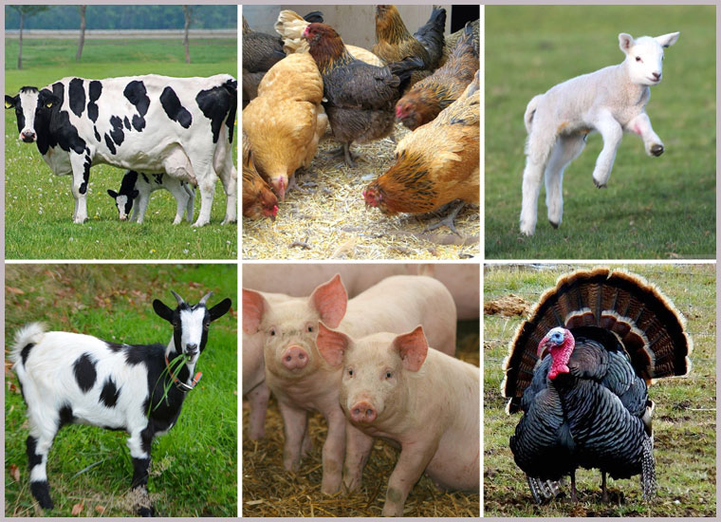

Slide 4
India’s livestock sector is one of the largest in the world.
Livestock sector plays an important role in Indian economy and also, in the social development of rural households.
The livestock sector plays a critical role in agricultural economics, in the rural economy, particularly by providing employment to marginalized small farmers and agricultural workers.
It also provides employment and an income and livelihood for landless workers and an additional source of income for families through the employment of women.

Slide 5
The livestock sector played a vital role in the development of India.
Livestock sector contributes 4.11% Gross domestic product (GDP) and 25.6% of total Agriculture GDP.
There was an increased growth of Livestock share in the agricultural sector GDP over the past decade due to the growing demand for livestock products driven by income and population growth and urbanization.

Slide 6
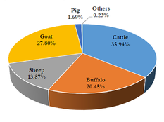
20th Livestock census
35.94%-Cattle, 27.80%-Goat, 20.45%- Buffaloes, 13.87%- Sheep, 1.69%- Pigs, Mithun, Yaks, Horses, Ponies, Mules, Donkeys and Camels taken together contribute 0.23% of the total livestock

Slide 14
Contribution of livestock/ livestock sector in Indian economy
Animal Origin Food
Animal by-product
Animal dung, urine and other waste materials
Socio economic security and women empowerment
Employment generation
Use of animal for agricultural activities
Livestock serve as an asset

Slide 15
Challenges faced by Livestock sector
Improving the productivity of farm animals is one of the major challenges.
The frequent outbreaks of diseases like Foot and Mouth Diseases, Black Quarter etc. continue to affect livestock health and lowers productivity.
The indigenous or native stock has a poor performance relative to highly selected commercial lines but they have the ability to survive in challenging environments

Slide 16
Promotion of indigenous high yielding cattle that are known for maintaining performance at higher ambient temperature is the need of time.
Limited artificial insemination services owing to a deficiency in quality germplasm, infrastructure and technical manpower coupled with poor conception rate following artificial insemination have been the major impediments.
Access to markets is critical to speed up commercialization of livestock production. Lack of access to markets may act as a disincentive to farmers to adopt improved technologies and quality inputs.

Slide 17
More than 50% of the marketable surplus is still handled by the unorganized sector
Meat and poultry products accounted for 83 percent of total export earnings
Except for poultry products and to some extent for milk, markets for livestock and livestock products are underdeveloped, irregular, uncertain and lack transparency.
Further, these are often dominated by informal market intermediaries who exploit the producers.
The scope of Bulls usage for draft purpose might decrease due to mechanization (Tractors). However, they can be used for transportation of feed and fodder by small marginal or landless farmers.

Slide 18
Future Prospects
Besides, providing great potential and outstanding contribution to the agricultural sector over the past years, the livestock sector is performing well in the manner of production, value addition and export of different livestock products.
Livestock helps in women empowerment and provides livelihood to many marginal farmers.
Both the national economy as well as the socio economic growth of rural India is backed by the livestock sector.

Slide 19
So, in general we can clearly mention that the role of livestock is immortal and immense in today’s scenario and in the coming future.
It is going to pump up the socio- economic status of the rural families and hence secure the national food and economic security.
Livestock is already catering the various employment opportunities and the day is not far when livestock will be an essential asset for every agricultural farmer.

Slide 20
Thank you
Thank you

