Slide 1
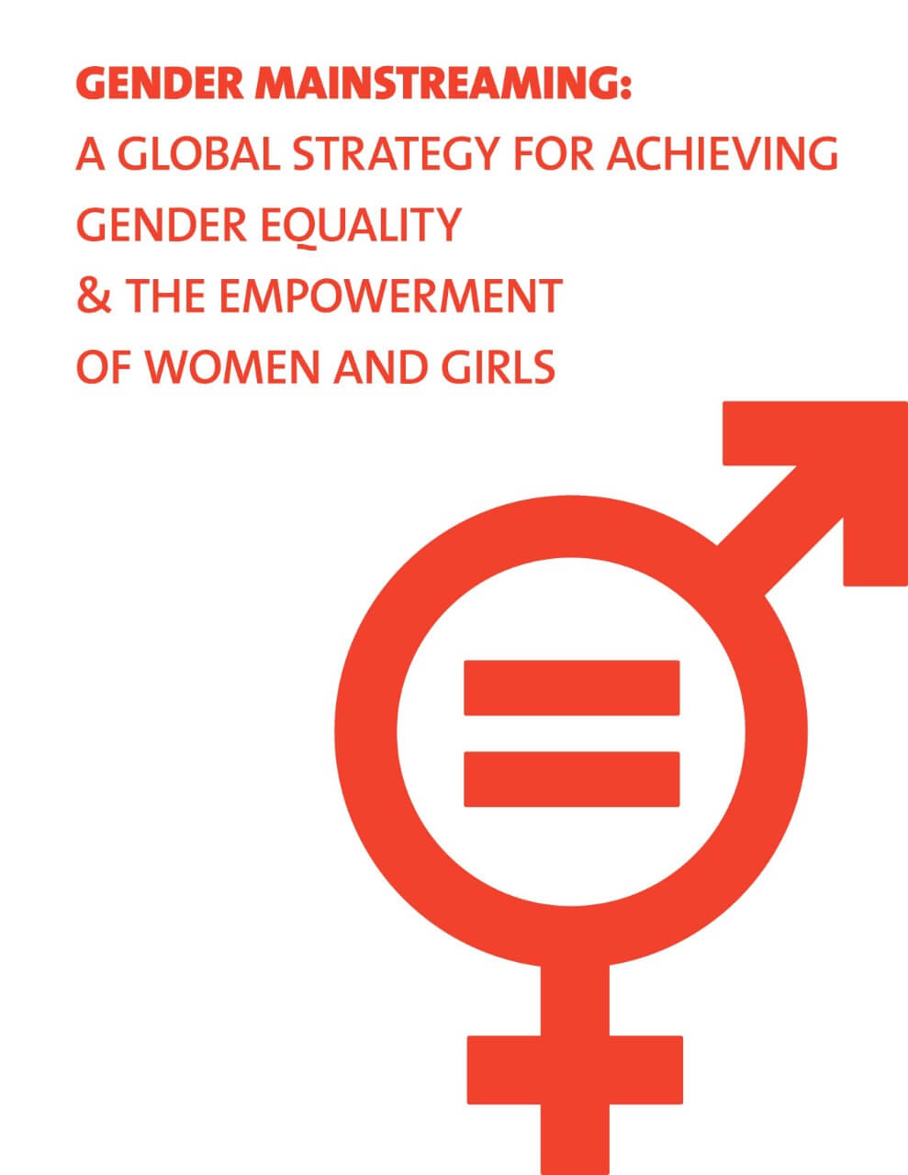
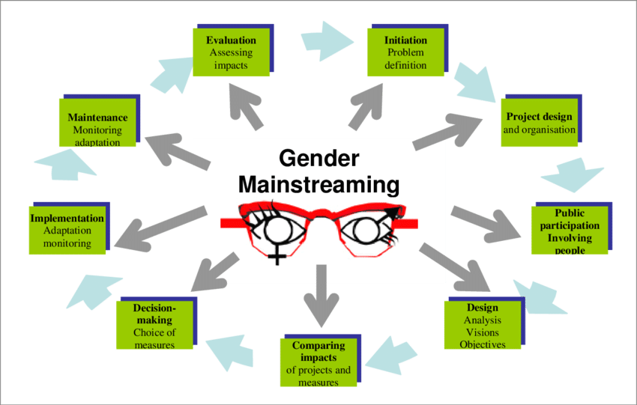

Slide 2
Gender Mainstreaming: an approach to policy-making that takes into account both women's and men's interests and concerns.
1985 Nairobi World Conference on Women, concept first introduced
1995 Fourth United Nations World Conference on Women in Beijing, adopted as a tool to promote gender equality at all levels.
1998, the Council of Europe defined
“The (re)organisation, improvement, development and evaluation of policy processes, so that a gender equality perspective is incorporated in all policies at all levels and at all stages, by the actors normally involved in policy-making”.

Slide 3
such as gender and health, nutrition, gender in agricultural value chains, gender and climate change adaptation, gender and globalization& liberalization for mainstreaming gender concerns into the national programmes and policies;

Slide 4
Good nutrition is crucial to overcoming gender barriers.
We apply a gender lens to all of our programs, projects and partnerships to ensure women and girls can be empowered advocates for their own health and nutrition.

Slide 5
Women and Girls are hit hardest by malnutrition.
Access to good nutrition is a basic human right and a fundamental component of human dignity. Yet women and girls are twice as likely to suffer from malnutrition as men and boys, due to a combination of biological, social and cultural reasons.
Women and Girls are empowered to claim their rights, it leads to improved health and nutrition for themselves and a better quality of life for their families and communities.
Gender equality will not be possible as long as women and girls suffer from malnutrition at a much higher rate than men and boys.

Slide 6
Grounded in the United Nation’s Sustainable Development Goals, Global Nutrition Targets 2025, and global efforts to promote gender equality:
Providing capacity building and organization-wide gender equality training for staff
Enhancing technical advice and quality assurance in gender analysis to inform the design, implementation, monitoring, and evaluation of gender-sensitive and responsive programs
Reporting on gender-sensitive outcomes to track their progress and to serve as a model for other nutrition programs
Reviewing progress on an annual basis to guide how Nutrition International will continue to strengthen capacity to promote gender equality and to set the groundwork for the next stages of gender mainstreaming

Slide 7
Gender mainstreaming approach considers differences between men and women to ensure fair results.
Supporting deeper consideration of gender equality into all aspects of our programs
Strengthening capacity to promote gender equality and women’s empowerment
Designing and delivering gender-sensitive nutrition programming at scale
Delivering on gender-sensitive outcomes
Measuring and tracking knowledge, attitudes and practices related to gender equality
Tracking equitable participation in training and capacity building
Analysing gender as part of continuous learning
Filling gender data gaps
Encouraging equitable participation
Advocating for the importance of improving children’s, adolescent girls’ and women’s nutrition to advance gender equality

Slide 10
conceptual framework around CC and gender (Kristjanson et al., 2017)
include four main components;
climate signal,
vulnerability context
adaptation arena
wellbeing outcomes.

Slide 11
Example of conceptualized link between Food security and nutrition and gender (Jost et al., 2014 in CEPAL et al., 2018)
a) Analyze gender differences in vulnerability and existing adaptation and mitigation strategies;
b) Obtain data disaggregated by sex of access to productive resources, work, use of time, and group membership;
c) Analyze the suitability of existing institutions and policies to address the impacts of CC on gender;
d) Use all the information collected, about the gender disparity, to inform the gender sensitive interventions in agriculture and CC.

Slide 12
Gender-Climate Change- Food Security and nutrition
Reducing gender gap in agriculture has a great potential to increase yields and reduce food insecurity and malnutrition (FAO 2011b; UNDP, 2012).
The three main challenges;
(1) improving food and nutrition security of poor women, men, girls and boys,
(2) reducing gender and social inequalities,
(3) favoring sustainable development (Beuchelt and Badstue, 2013).
as CC produces extreme events such as drought, floods, land degradation, the risks to food security and agricultural productivity increase (IICA, 2018; Sida, 2015). Thus, there is a need to foster men and women adaptive capacity.

