Slide 1
Water Productivity and Water Use Efficiency
Lecture 18: WUE and its relevance in water productivity
Transpiration efficiency, a measure of intrinsic WUE
Approaches to measure WUE.

Slide 2
Introduction
The term "water use efficiency" originates in the economic concept of productivity. Productivity measures the amount of any given resource that must be expended to produce one unit of any good or service. In a similar manner, water use efficiency measures the quantity of water taken up by the crop during its crop life to produce a unit quantity of the output i.e., crop yield.
The lower the water resource input requirement per unit of crop yield produced, the higher the water use efficiency.

Slide 3
Crop water use efficiency:
Crop water use efficiency is a ratio between marketable crop yield and water used by the crop in evapotranspiration.
WUE (kg/ha.mm) = Y/ETc
where,
WUE = Water use efficiency in kg/ha.mm
Y = Marketable crop yield in kg/ha
ETc = Crop evapotranspiration in mm
Field water use efficiency:
Field water use efficiency is a ratio between marketable crop yield and field water supply which includes water used by the plant in metabolic activities, ET and deep percolation losses.
FWUE = Y/WR
where,
FWUE = Field water use efficiency in kg/ha-mm
Y = Crop yield in kg/ha
WR = Water used in metabolic activities, ET and deep percolation losses in mm

Slide 4
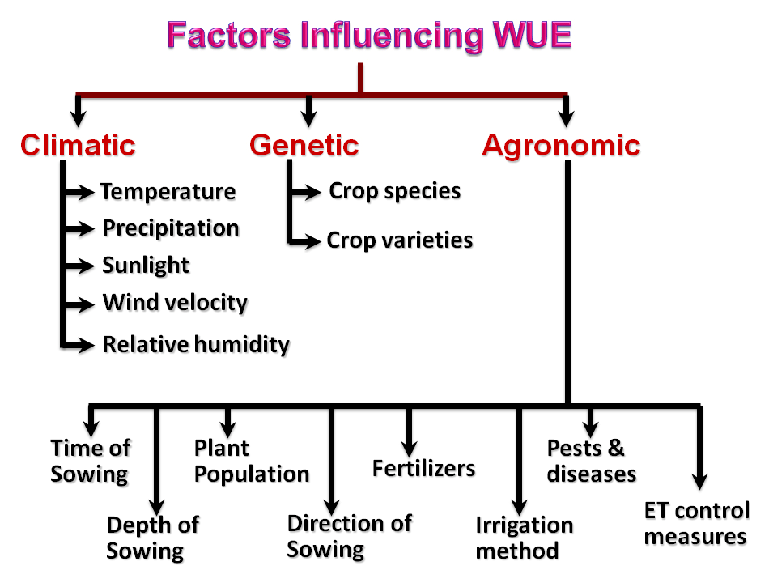
Factors affecting water use efficiency:

Slide 5
OBJECTIVES
Improving design for more efficient
operation and management
Better harmonization and regulation
with irrigation system
Higher focus on capacity building to
sustain WUE results
More accurate measurement and
recording of water services
IMPROVEMENT OF:
water resources management
the service to irrigated agriculture
the cost-effectiveness of infrastructure management

Slide 6
Transpiration efficiency
At a plant level, the transpiration efficiency (TE), an important component of WUE, is defined as TE = biomass/water transpired.
At the leaf level, TE is defined as the intrinsic WUE; that is, the ratio of instantaneous CO₂ assimilation (A) to transpiration (T) = A/T.
TE shows an inverse relationship with the VPD

Slide 7
The accurate gravimetric measurements of TE using a lysimetric approach
The TE ratio is actually quite complex, as it depends on both genetic and environmental components [TE = k_{d}/(e*_{a} − e)_{d}], (where the term in parentheses reflects the vapour-pressure deficit (VPD) and k_{d} is a coefficient that reflects the CO₂ concentration in the stomatal chamber)
Passioura equation (Passioura, 1977)
In which TE is one of the components (Yield = WU × TE × HI; where WU is the water used for transpiration and HI is the harvest index),

Slide 8
THANK YOU

