Slide 1
Water Productivity and Water Use Efficiency
Lecture 19: Stomatal and mesophyll regulation on WUE;
Passioura’s yield model emphasizing WUE.

Slide 2
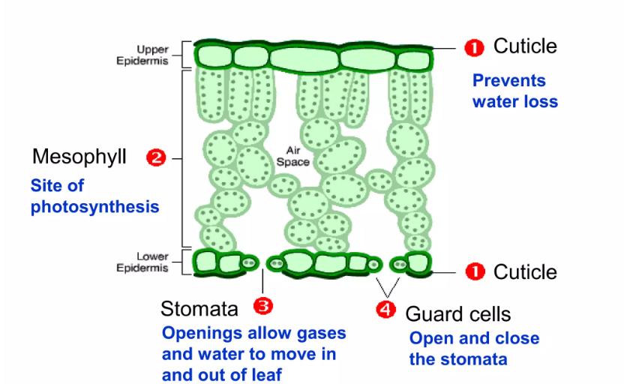
Leaf structure

Slide 3
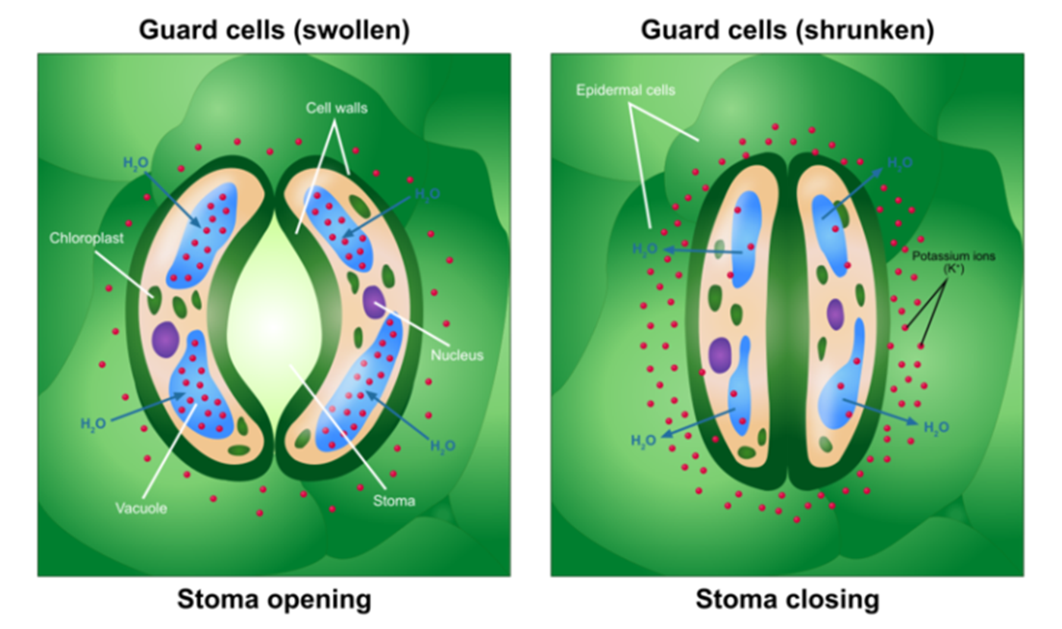
Guard cell properties and their relationship with stomatal control
• Thickness of cell wall varies in the ventral(0.5μm) and thicker dorsal part of the guard cells.
• Contains chloroplast and can perform light reaction. (not dark reaction for the lack of key enzymes)
• Structurally isolated from epidermal cells for the lack of plasmodesmata (water and ions transmit only through cellular pathway, thus helps to build up water gradient)
• Little volume, little amount of water absorption or loss controls stomatal aperture

Slide 4
The balance between stomatal and mesophyll conductance has been reported to directly influence intrinsic water-use efficiency (WUE_{i}), but it is unclear whether variations in stomatal and mesophyll limitations (l_{sc} and l_{m}, respectively) affect WUE_{i} during soil drought and rewatering.
Limitations (l_{sc}, l_{m} and biochemical limitation, l_{b}) and WUE_{i} were measured in Manchurian ash and Mongolian oak saplings exposed to two levels of water stress (moderate and severe) and rewatering in this study.
The primary limiting factors for photosynthesis among l_{sc}, l_{m}, and l_{b} and their correlations with WUE_{i} were assessed.

Slide 5
Both l_{sc} and l_{m} increased with water stress, while l_{b} decreased, and during recovery, l_{sc} and l_{m} decreased, while l_{b} increased.
Photosynthesis limitations directly influenced WUE_{i}, with WUE_{i} being larger after rewatering than during water stress, increasing as biochemical capacity weakened at the expense of diffusional limitations (l_{sc} and l_{m}).
Stomatal closure was more limiting to net photosynthesis in Mongolian oak than in Manchurian ash during the drought and recovery treatments.

Slide 6
Mechanism for stomatal closing
Uptake of Ca+2 into the cytosol
Depolarize the membranes
Anion channel opened and Cl- and malate released from the vacuole.
K+ channel opened and K+ released from vacuole and subsequently into subsidiary cells.

Slide 7
Passioura’s yield model emphasizing WUE.
The importance of water use efficiency (WUE) in influencing grain yield underwater limited conditions can be explained by the following model give by passioura.
Grain Yield = TX * TE * HI
Where T = Total transpiration by the crop canopy
TE = Transpiration Efficiency or WUE
HI = Harvest Index (Economic Fraction of Dry matter)
This relationship provides an analytical tool to select the genotype with high levels of T and TE.

Slide 8
THANK YOU

