Slide 1
Moisture Stress and Plant Growth
Lecture 20: Physiology of water stress in plants;
Effect of moisture stress at molecular, cellular, organ and plant level.

Slide 2
OVERVIEW
What is mineral nutrition?
The study of the uptake, transport, and utilization of mineral nutrients by plants.
What is water stress?
A condition in which plants do not have enough water to meet their metabolic needs.
What is the physiology of water stress?
The study of how plants respond to water stress at the molecular, cellular, organ, and plant levels.

Slide 3
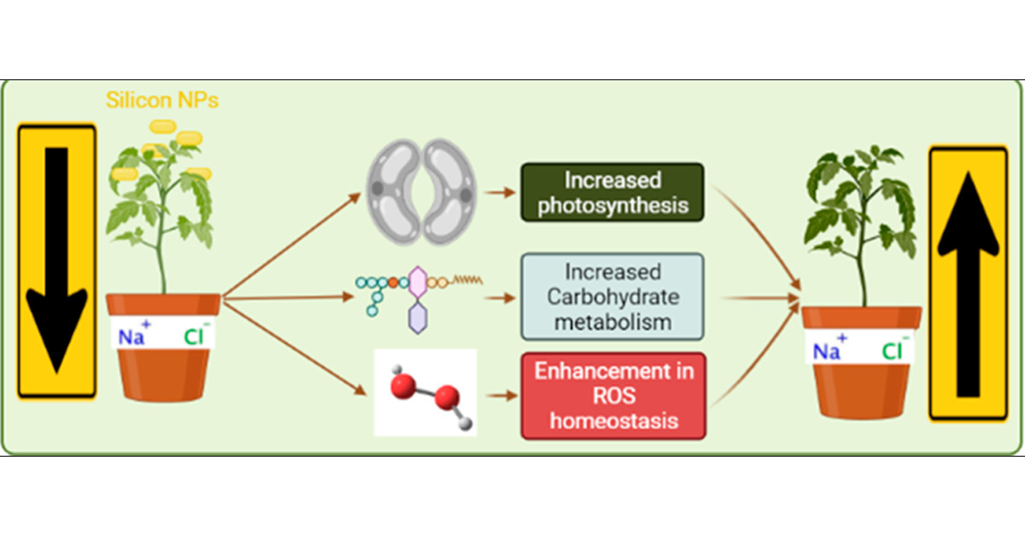
Water Stress at the Molecular Level
Water stress triggers a range of molecular responses in plants.
Aquaporins, which are specialized water transport proteins, play a key role in regulating water movement across cellular membranes.
Under water stress conditions, plants produce stress-responsive proteins such as dehydrins and late embryogenesis abundant (LEA) proteins, which help maintain cellular water potential and protect cellular structures.

Slide 4
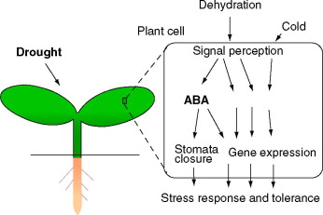
Water Stress at the Cellular Level
Water stress significantly affects cellular processes in plants.
Stomatal closure is a crucial response for water conservation during stress.
The hormone abscisic acid (ABA) plays a key role in inducing stomatal closure in response to water stress.
ABA triggers signaling pathways that regulate ion channels and transporters, ultimately reducing water loss through transpiration.

Slide 5
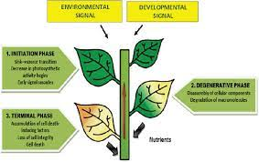
Water Stress at the Organ Level
Water stress impacts various plant organs.
Roots, responsible for water uptake, are particularly affected by water stress.
Under stress conditions, plants may undergo root modifications such as increased root length, root hair density, and the development of aerenchyma, which enable them to adapt to limited water availability.
Leaves also experience significant changes, including reduced photosynthesis, leaf rolling, and wilting, as a result of water stress.

Slide 6
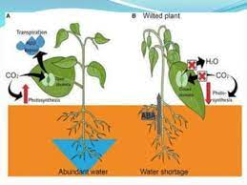
Water Stress at the Plant Level
Water stress has far-reaching effects on overall plant growth and development.
Plants exhibit reduced growth rates and altered morphological features under water stress conditions.
Flowering, fruit development, and seed production can be compromised due to water stress.
Severe and prolonged water stress can lead to premature senescence and even plant death.

Slide 7
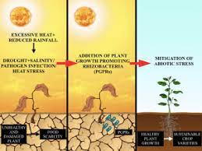
Mitigation Strategies
Several strategies can help mitigate the negative effects of water stress on plant physiology.
Implementing efficient irrigation techniques, such as drip irrigation or precision farming, can optimize water use efficiency.
Application of plant growth regulators can enhance stress tolerance in plants.
Breeding programs focused on developing drought-tolerant crop varieties can contribute to combating the challenges posed by water stress

Slide 8
Conclusion
Water stress exerts significant physiological impacts on plants at the molecular, cellular, organ, and plant levels.
Understanding the complex responses of plants to water stress is crucial for developing effective strategies to mitigate its negative effects.
By implementing appropriate mitigation techniques and promoting research in this field, we can enhance crop productivity and promote sustainable agricultural practices in water-limited environments.

Slide 9
THANK YOU

