Slide 1
Moisture Stress and Plant Growth
Lecture 22: Drought indices and drought tolerance strategies.
Drought tolerance traits.

Slide 2
Drought
A prolonged period of abnormally low rainfall, leading to a shortage of water.

Slide 3
DROUGHT INDICES
Standardized Precipitation Index (SPI)
Palmer Drought Severity Index (PDSI)
Surface Water Supply Index (SWSI)
Moisture Adequacy Index (MAI)
Crop Water Stress Index (CWSI)

Slide 4
Standardized Precipitation Index (SPI)
SPI, based on probability of precipitation for any time scale, is calculated as : X -Xm , SPI = -----------
Where X = Precipitation for the station
Xm = Mean precipitation =Standardized deviation
SPI Drought Classes
Less than -2.00 Extreme drought
-1.50 to -1.99 Severe drought
-1.00 to -1.49 Moderate drought
-0.99 to -0.00 Mild drought
Merits :
Can be computed for different time scales Can provide early warning of drought
Can help assess drought severity Is less complex than PDSI.
Demerits:
Groundwater, stream flow, and reservoir storage reflect longer-term precipitation anomalies. So, SPI is calculated for 3, 6, 12, 24, and 48 month time scales

Slide 5
Palmer Drought Severity Index (PDSI)
PDSI, popular in the US, uses data on precipitation, temperature and local available water content (AWC) of soil, and calculates the difference between Climatically Appropriate For Existing Conditions (CAFEC) rainfall and actual rainfall as a drought indicator.
PDSI generally varies between -4.0 (extreme drought) and +4.0 (adequate moisture condition).
Drought categories are: Index value Class for drought
1.00 to –1.99 Mild drought
- 2.00 to –2.99 Moderate drought - 3.00 to - 3.99 Severe drought
< - 4.00 Extreme drought
Merit: It can well be used for spatio-temporal (belonging to both space and time) variability of drought.
Demerit :The index values did not often match the situation in some countries.

Slide 6
Surface Water Supply Index (SWSI) Designed for river basins with a component of mountain snow input. Integrates reservoir storage, stream flow and snow and rain into a single index. where a, b, c, and d are weights for snow, rain, stream flow and reservoir storage, respectively; while (a+b+c+d) = 1, and Pi = probability (%). Calculated at monthly time step.
Moisture Adequacy Index (MAI) MAI used for quantification of agricultural drought, which is defined as : MAI = AE/PE ▪ where AE is actual evaporation, and PE potential evapo-transpiration (in %) during different phonological stages of a crop. ▪ MAI is obtained from weekly water balance. Drought impact is related to moisture availability at certain crop growth stages..

Slide 7
Crop Water Stress Index (CWSI)
CWSI values are a daily integration of plant- available soil water, evaporative demand and plant phenological stage susceptibility, and is defined for the growing season as: Harvest CWSI=  (1-(T/Tp) SUS Planting T is the computed actual transpiration (mm/day), Tp is potential transpiration (mm/day), SUS is seasonally dependent weighting factor for grain yield susceptibility.
Merits : The estimates using dynamic simulation models are reasonably good.
Demerits: This model needs calibration for each crop and region and hence has a limitation for use.

Slide 8
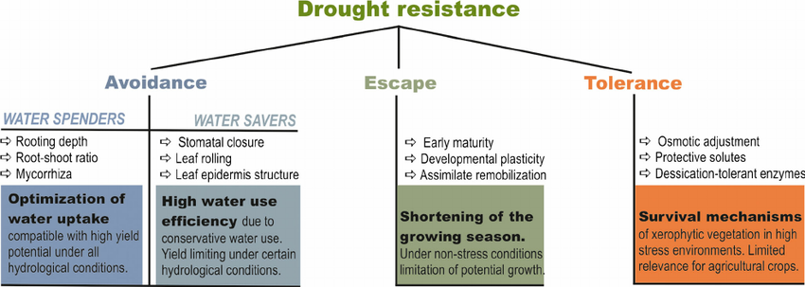

Slide 9
Drought tolerance traits
Germination rate (GR)
Germination energy (GE)
Drought index
Leaf wilting
Water use efficiency
Canopy wilt
Fibrous roots
Yield under water deficit

Slide 10
THANK YOU

