Slide 1
Nutrient Elements and Their Importance
Lecture 23: Role of mineral nutrients in plant’s metabolism;
Essential elements and their classification;
Beneficial elements.

Slide 2
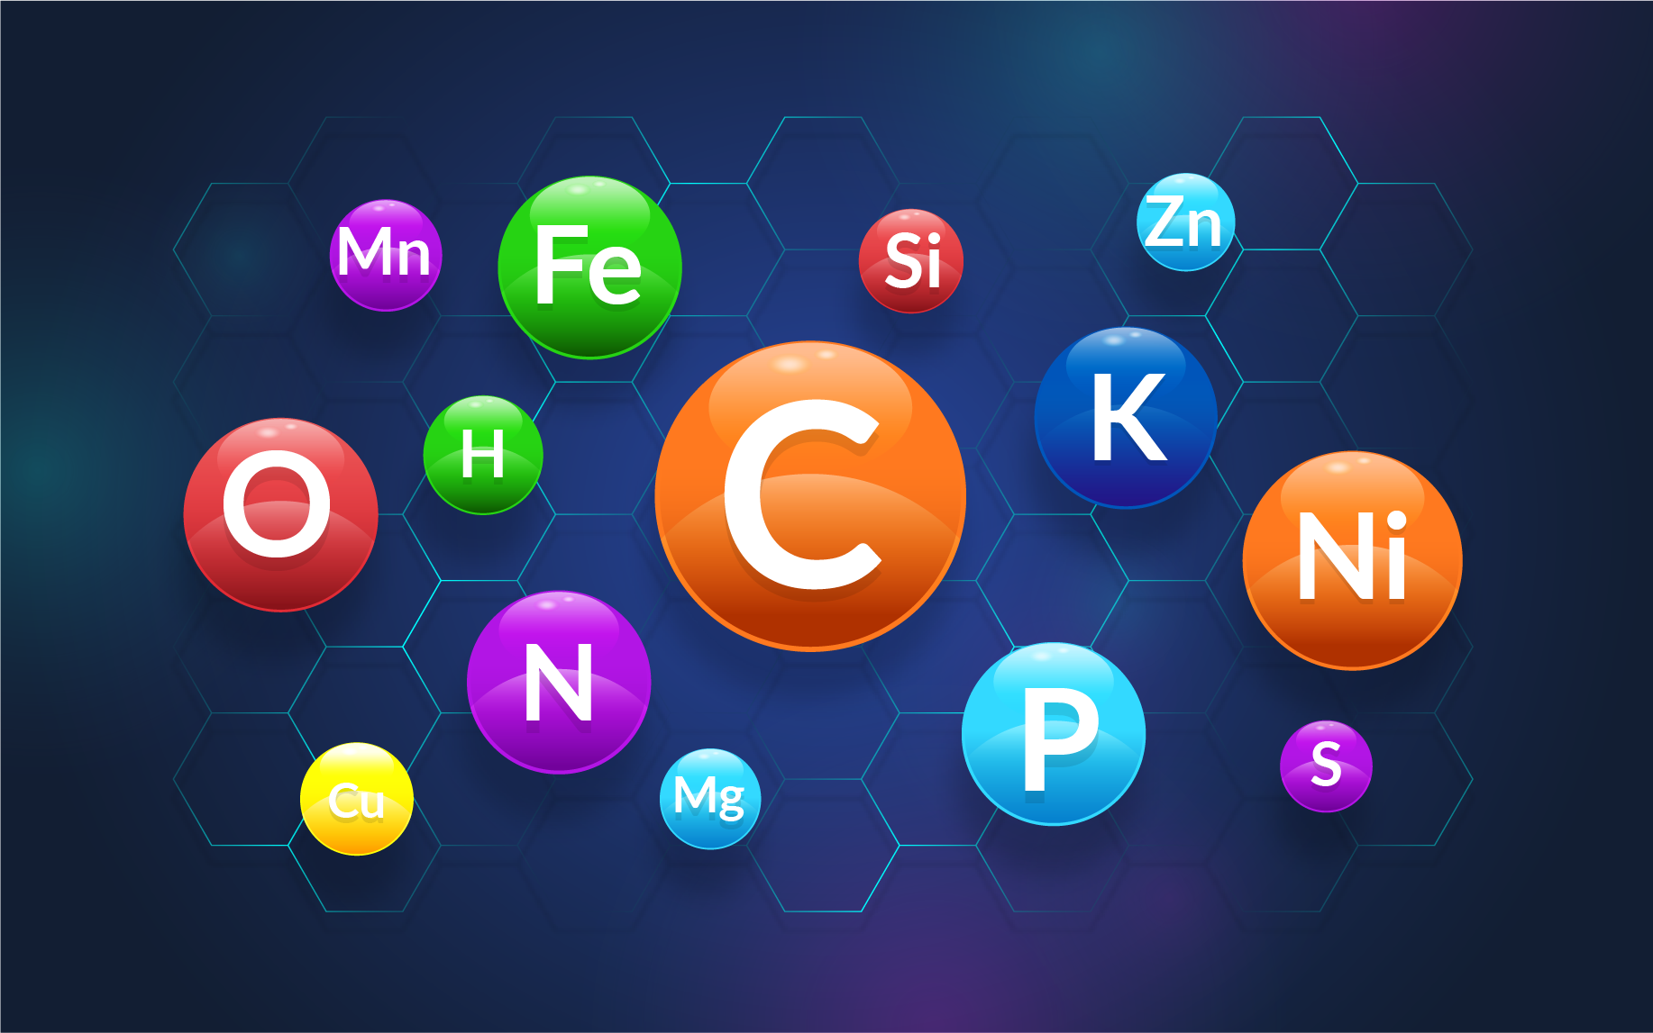
The process of absorption, translocation and assimilation of nutrients by plants is known as Mineral nutrition.

Slide 3
Criteria of essentiality
This concept was propounded by Arnon and Stout (1939).
For an element be regarded as an essential nutrient, it must satisfy the following criteria;
A deficiency of an essential nutrient element makes it impossible for the plant to complete the vegetative or reproductive stage of its life cycle.
The deficiency of an element is very specific to the element in question and deficiency can be corrected /prevented only by supplying that particular element.
The element must directly be involved in the nutrition and metabolism of the plant and have a direct influence on plant apart from its possible effects in correcting some micro-biological or chemical conditions of the soil or other culture medium.
N.B. – Statement-2 can not be accepted as Mo may be substituted by V. Cl by Br, K by Rb, Ca by Sr.

Slide 4
Role of mineral nutrients in plant’s metabolism:
1. Mineral nutrients perform several functions.
2. They participate in various metabolic processes in the plant cells such as
Permeability of cell membrane
Maintenance of osmotic concentration of cell sap
Electron transport systems
Buffering action
Enzymatic activity
Act as major constituents of macromolecules and co-enzymes.

Slide 5
Essential elements and their classification
The elements which the plants require to complete their life cycle are known as essential elements of plants.
Plants require 17 essential elements for growth.
The essential elements are further classified into two categories :
Macroelements (Major elements) : These elements are required by the plant in larger quantities. These are Carbon, Hydrogen, Oxygen, Nitrogen, Phosphorus, Potassium, Magnesium, Calcium, Sulphur.
Microelements (Minor elements or Trace elements) : These are required by the plant in low quantities (often less than 1 ppm.). Boron, Zinc, Manganese, Copper, Molybdenum, Chlorine, Iron, Nickel.

Slide 6
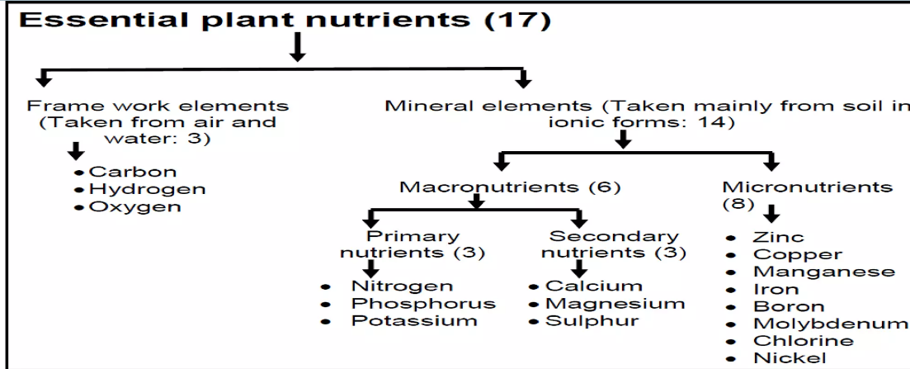
Fig. Classification of essential plant nutrients

Slide 7
Beneficial elements
Beneficial elements are the mineral elements which stimulate the growth and have beneficial effects even at very low concentration. They are not essential or essential only for certain plant species under specific conditions. They are also known as ‘potential micro-nutrients’.
These elements have been found to affect the uptake, translocation and utilization of other essential elements, help in production of essential metabolite by activating enzymatic system/action and also counteract the toxic effects of some other elements or anti metabolites.
E.g.: Silicon (Si) for rice, Sodium (Na), Aluminum (Al), Cobalt (Co), Selenium (Se), Iodine (I), Gallium (Ga) and Vanadium (Va).

Slide 8
THANK YOU

