Slide 1
Nutrient Elements and Their Importance
Lecture 24: Factors influencing the nutrients availability;
Critical levels of nutrients.

Slide 2
Factors affecting availability of nutrients
Availability of mineral nutrients is affected by both endogenous and exogenous factors.
External factors include; | Internal factors include;
Soil Soil hydrogen ion concentration (pH) Type of the soil and Cation exchange capacity Light Temperature Interaction of elements Excess Minerals in the Soil | Growth and morphophysiological status Aging Mycorrhiza Root system

Slide 3
External factors
Soil
Soil is a complex substrate- physically, chemically and biologically.
The size of soil particles and the cation exchange capacity of soil provides a reservoir for water and nutrients.
Hydrogen ion concentration (pH)
pH of the soil solution affects the availability of nutrients to plants.
pH values across physiological range may damage the plant tissues and inhibit salt absorption.

Slide 4
Cation exchange capacity:
Mineral cations such as NH4 + and K+ are adsorbed to the negative surfaces of soil.
This cation adsorbed is an important factor in soil fertility as these are not easily leached when soil is in filtered by water and thus provide a nutrient reserve available to plant roots.
The degree to which a soil can adsorb and exchange ions is termed its cation exchange capacity and is highly dependent on soil type.
Temperature:
In general, an increase in temperature results increase in the absorption of salts up to a certain optimum level.
At very high temperature the absorption is considerably inhibited.
The change in temperature also affects the process of diffusion.

Slide 5
Light:
It has no direct affect but indirectly by photosynthesis and transpiration, influences salt absorption.
Interaction of nutrients with each other:
The absorption of one ion is affected by the presence of other ions in the medium.
Bromide and iodide compete with chloride and vice-versa.
Small quantity of calcium inhibits excessive entry of potassium.
Excess minerals in the soil:
When excess minerals are present in the soil, the soil is said to be saline, and plant growth may be restricted if these mineral ions reach levels that limit water availability or exceed the adequate zone for a particular nutrient.

Slide 6
II. Internal factors
Growth:
Active cell division, elongation and developmental processes promote the absorption of mineral salts.
The size of soil particles and the cation exchange capacity of soil provides a reservoir for water and nutrients.
Aging:
As the root matures it increases the surface area which is favorable for salt absorption, but due to heavy suberization the mineral salt uptake is greatly reduced.

Slide 7
Mycorrhiza
There are two major classes of mycorrhizal fungi:
Ectotrophic mycorrhizal fungi typically show a thick sheath, or “mantle,” of fungal mycelium around the roots, and some of the mycelium penetrates between the cortical cells.
The cortical cells themselves are not penetrated by the fungal hyphae but instead are surrounded by a network of hyphae called the Hartig net.
Vesicular arbuscular mycorrhizal fungi do not produce a compact mantle of fungal mycelium around the root.
Instead, the hyphae grow in a less dense arrangement, both within the root itself and extending outward from the root into the surrounding soil.
Arbuscular mycorrhizas increase uptake of mineral nutrients particularly phosphorus that are relatively immobile in the soil
Ectomycorrhizas play significant role in obtaining N from organic sources

Slide 8
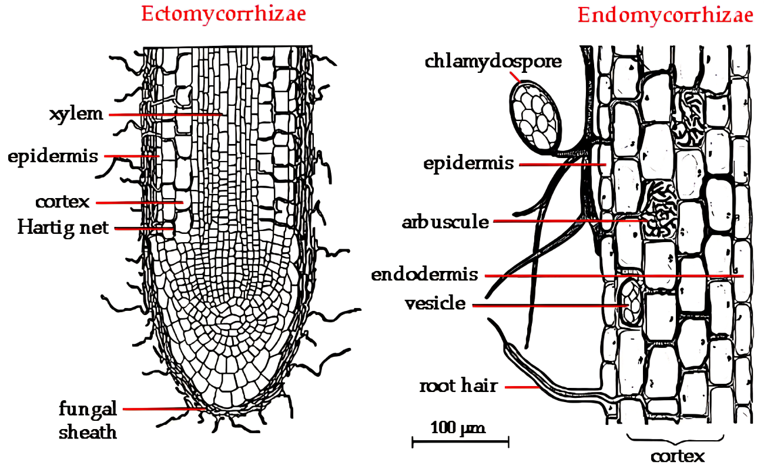

Slide 9
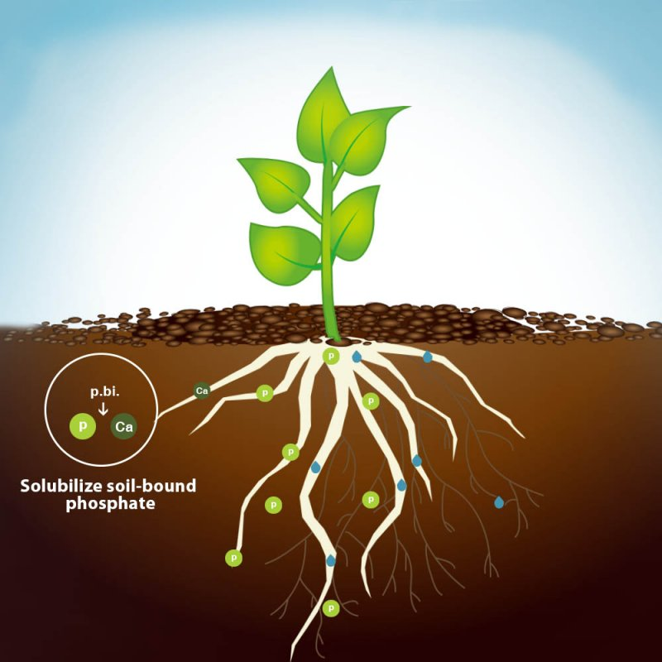
Root system:
The ability of plants to obtain both water and mineral nutrients from the soil is related to their capacity to develop an extensive root system.
If the rhizosphere is poor in nutrients or too dry, root growth is slow. As rhizosphere conditions improve, root growth increases.

Slide 10
Critical levels of nutrients

Slide 11
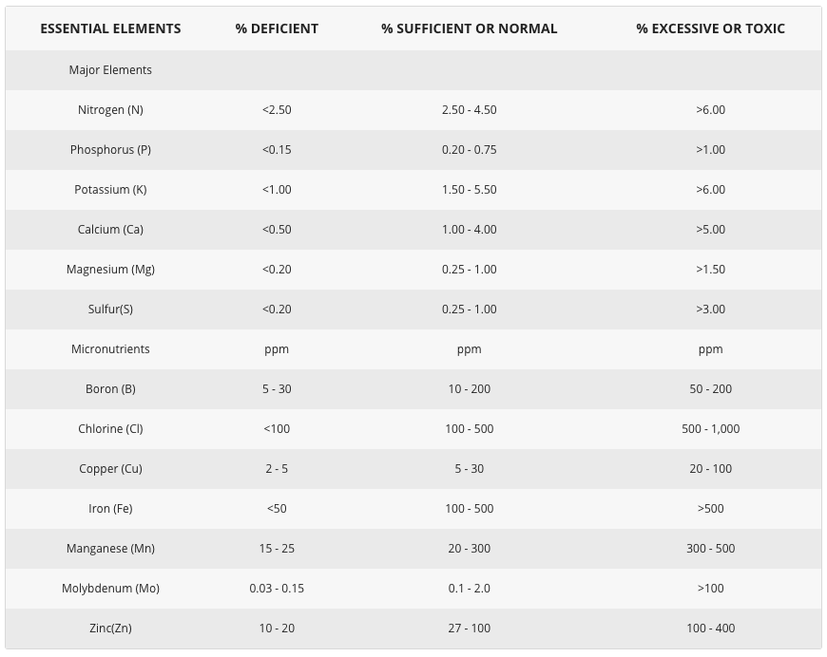

Slide 12
THANK YOU

