Slide 1
Nutrient Elements and Their Importance
Lecture 25: Deficiency and toxicity symptoms in plants

Slide 2
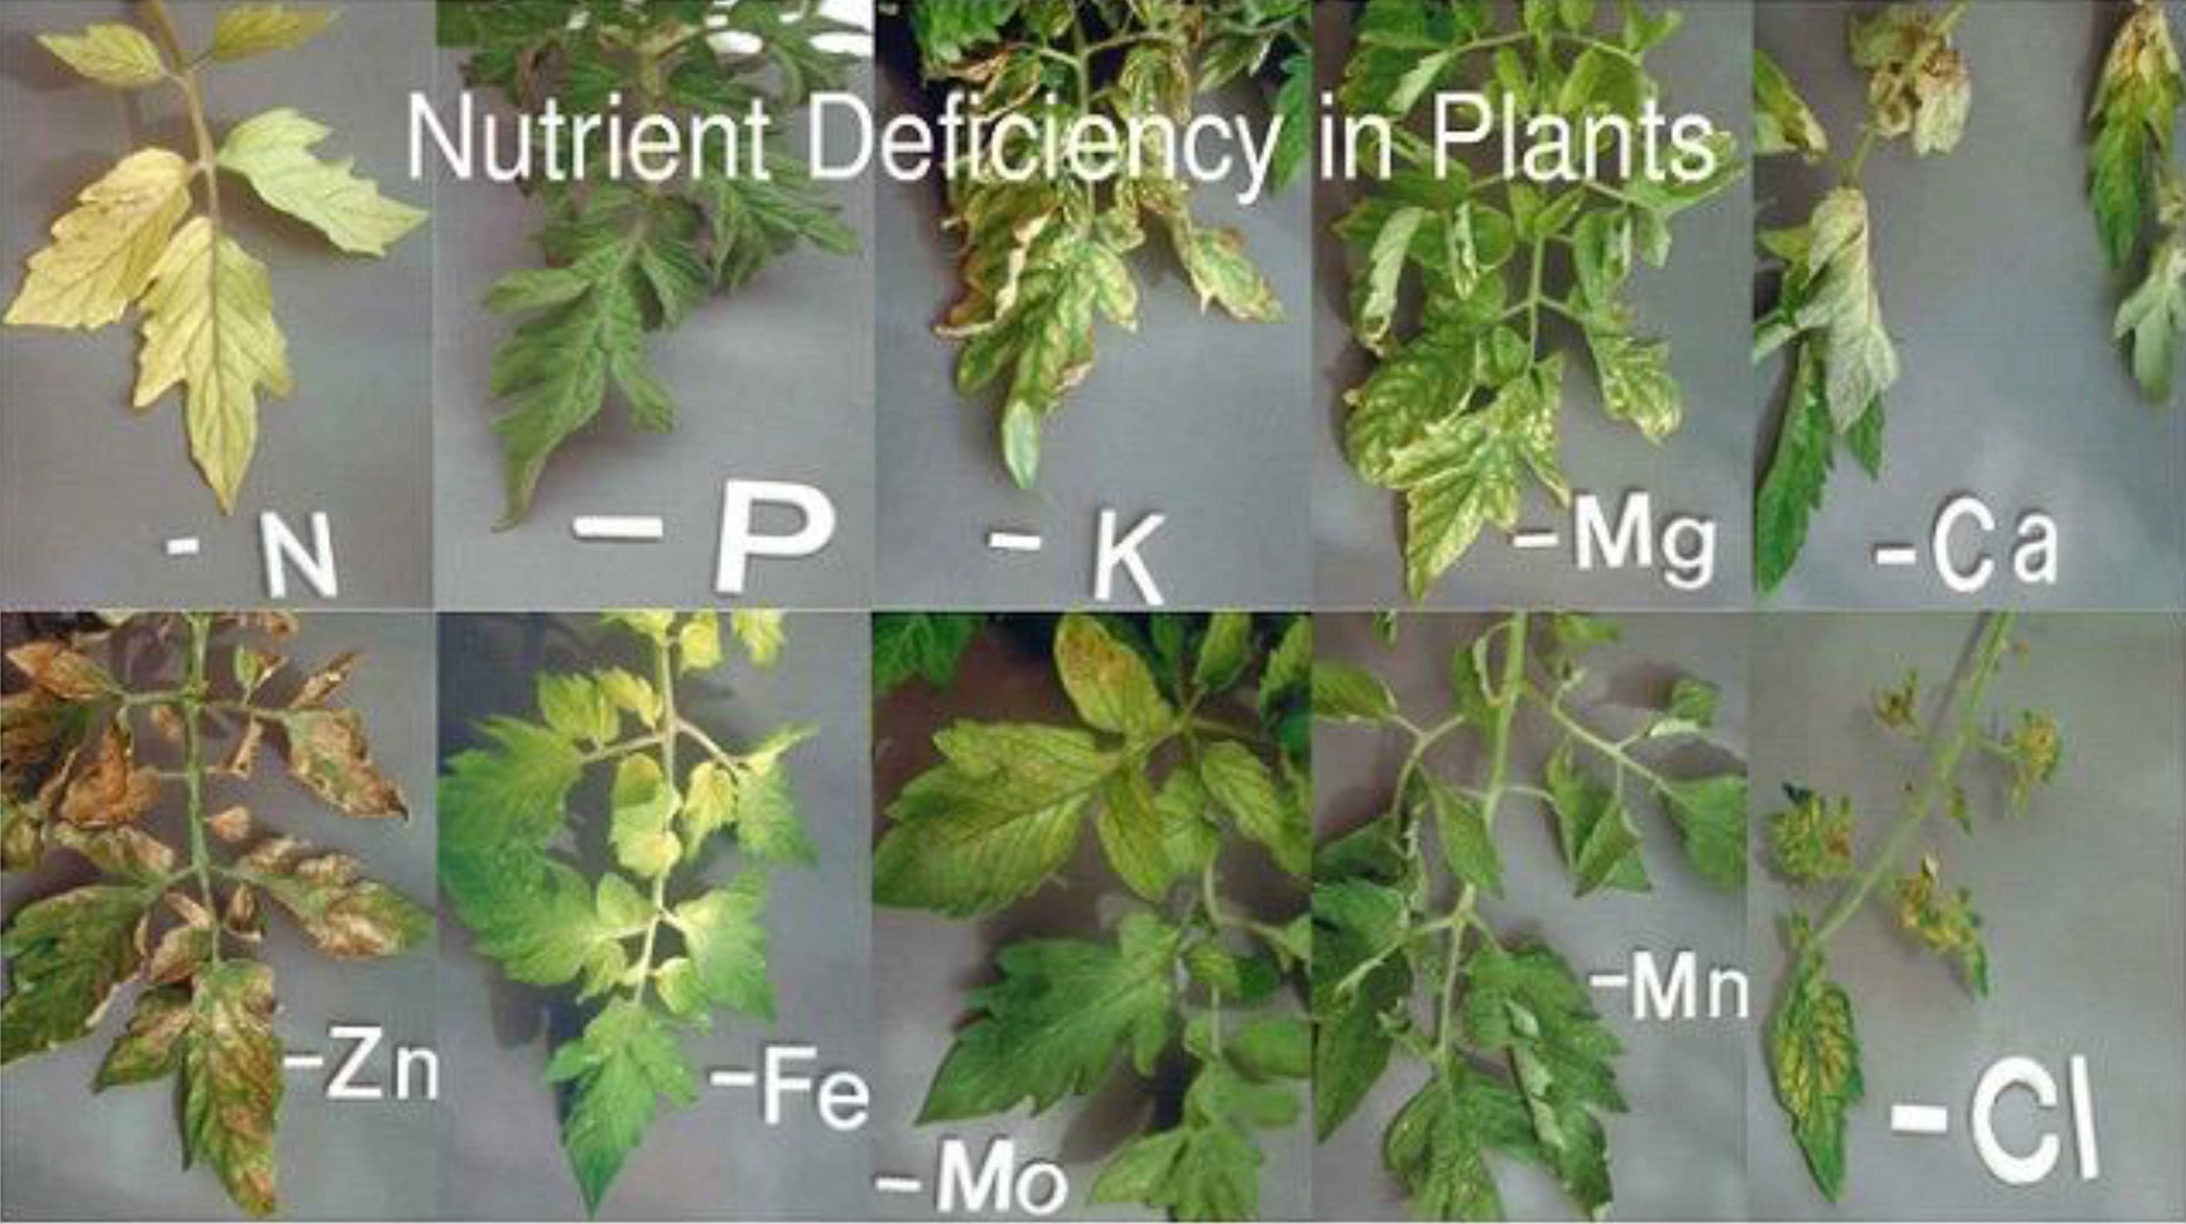
Whenever the supply of an essential element becomes limited, plant growth is retarded.
The concentration of the essential element below which plant growth is retarded is termed as “The element is said to be deficient when present below the critical concentration”.

Slide 3
Nutrients | Visual deficiency symptoms
N | Light green to yellow appearance of leaves, especially older leaves, stunted growth, poor fruit development
P | Leaves may develop purple coloration, stunted plant growth and delay in plant development
K | Marginal burning of leaves, irregular fruit development
Ca | Reduced growth or death of growing tips, poor fruit development and appearance
Mg | Initial yellowing of older leaves between leaf veins spreading to younger leaves, poor fruit development and production
S | Initial yellowing of young leaves spreading to whole plant, similar symptoms to N deficiency but occurs on new growth

Slide 4
Fe | Initial distinct yellow or white areas between veins of young leaves leading to spots of dead leaf tissue
Mn | Interveinal yellowing or mottling of young leaves
Zn | Interveinal yellowing on young leaves, reduce leaf size, short internodes, brown leaf spot on paddy
Cu | Stunted growth, terminal leaf buds die, leaf tips become white and leaves are narrowed and twisted.
B | Terminal buds die, breakdown of internal tissues in root crops, internal cork of apple, impairment of flowering and fruit development
Mo | Resemble N deficiency symptoms, whiptail diseases of qualiflower, leaves show scorching and whithering
Cl | Chlorotic leaves, some leaf necrosis

Slide 5
Deficiency of Nutrient | Corrective measures
N | Use of nitrogen fertilizer in the soil. (2) Foliar spray of urea.
P | Application of phosphatic fertilizer in the soil e.g., DAP, super phosphate
K | Use of potassic fertilizer in the soil e.g., muriate of potash.
Ca | Use of calcium carbonate or calcium hydroxide in the soil.
Mg | Soil or foliar application of magnesium sulphate.
S | Soil or foliar application of sulphur or sulphate.
Fe | Soil or foliar spray of ferrous sulphate.
Mn | Soil or foliar spray of manganese sulphate.
Zn | Soil or foliar application of zinc sulphate
B | Soil or foliar spray of boric acid or borax
Cu | Soil or foliar spray of copper sulphate
Mo | Soil or foliar application of sodium molybdate or ammonium molybdate.

Slide 6
Nutrient toxicity and management
The requirement of micronutrients is always in low amounts while their moderate increase causes toxicity.
Any mineral ion concentration in tissues that reduces the dry weight of tissues by about 10 per cent is considered toxic.
The toxicity symptoms are difficult to identify. Toxicity levels for any element also vary for different plants.
Many a times, excess of an element may inhibit the uptake of another element.
Nutrient toxicities in crops are more frequent for manganese (Mn) and boron (B) than for other nutrients.

Slide 7
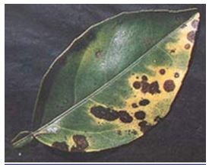
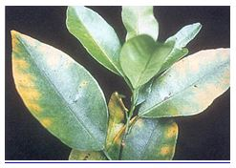
Manganese toxicity is found on acid soils. It is important to know that manganese competes with iron and magnesium for uptake and with magnesium for binding with enzymes. Manganese also inhibits calcium translocation in shoot apex. Therefore, excess of manganese may, induce deficiencies of iron, magnesium and calcium.
Boron toxicities occur in irrigated regions where the well or irrigation waters are exceptionally high in B.
Generally, the symptoms of toxicity in crops occur as burning, Chlorosis and yellowing of leaves. Toxicities can result in decreased yield and/or impaired crop quality.

Slide 8
Prevention of toxicity
With the exception of Mo, toxicity of other nutrients can be reduced by liming.
Following recommended rates of fertilizers and the safe and controlled use of waste materials, such as sewage sludge and coal fly ash, should reduce metal loading and nutrient toxicity in crops.
Provided sufficient drainage because availability of nutrients like Fe and Mn is increases up to toxicity level under water logged condition.
Ground water must be monitored regularly, if content of B and Cl is too high stop to applied water or applied with dilution.

Slide 9
THANK YOU

