Slide 1
Nutrient Acquisition
Lecture 27: Mechanism of mineral uptake and translocation;
Ion transporters;
Genes encoding for ion transporters;
Localization of transporters;

Slide 2
Mineral nutrients are found either as soluble fractions of soil solution or as adsorbed ions on the surface of colloidal particles.
Various theories proposed to explain the mechanism of mineral salt absorption can be placed in two broad categories:
i)Passive Absorption
ii) Active Absorption

Slide 3
Passive transport: Movement of ions and other atomic or molecular substances across cell membranes without need of energy input.
1.Simple diffusion: It occurs with small, non-polar molecules (O2, CO2, NH3) appear to traverse membranes by simple diffusion through the lipid bilayer.
2.Facilitated diffusion: Specific Transport proteins facilitate the diffusion of solutes, especially charged solutes or ions, into the cell by effectively overcoming the solubility problem.
The term facilitated diffusion was coined to describe this rapid, assisted diffusion of solutes across the membrane

Slide 4
Active transport:
The movement of substances against the electrochemical gradient
Large or more charged molecules have great difficulty in moving across plasma membrane requiring active transport mechanism.
Active transport across a selectively permeable membrane occurs through ATP powered pumps that transport ions against their concentration gradient.
This mechanism utilises energy released by hydrolysis of ATP

Slide 5
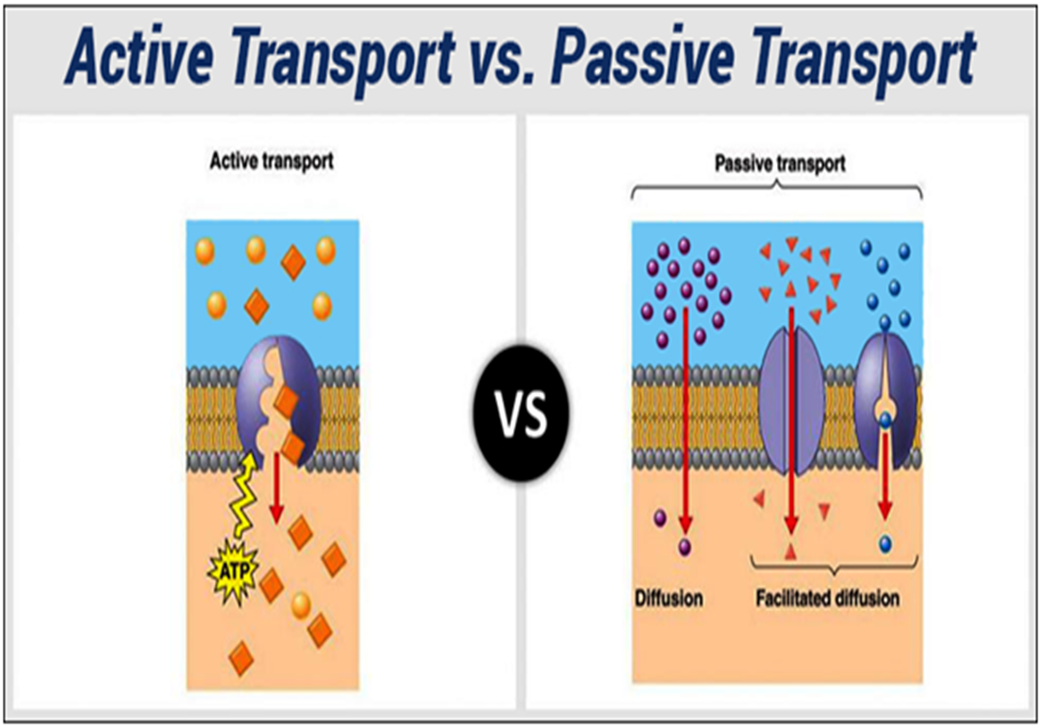

Slide 6
Carrier proteins/ Transporters : Bind only one or a few substrate molecule at time. After binding a molecule or ion, the carrier protein undergoes a structural change specific to specific ion or molecule which delivers the solute to the other side of the membrane.
Release of the solute at the other surface of the membrane completes the transport and the protein then reverts to its original conformation, ready to pick up another solute

Slide 7
Types:
Uniporter: Transport only one molecule at a time down a concentration gradient.
Antiporter: An antiporter is a integral membrane protein involved in secondary active transport of two or more different molecules or ions across the plasma membrane in opposite directions.
Symporter : A symporter is an integral membrane protein that is involved in the transport of many differing types of molecules across the cell membrane. The symporter works in the plasma membrane and molecules are transported across the cell membrane at the same direction.

Slide 8
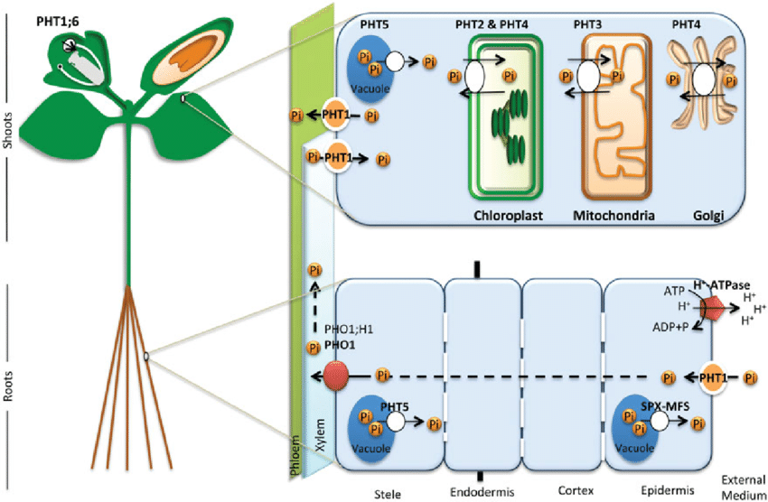
Fig. Localization of transporters

Slide 9
THANK YOU

